Slide 1
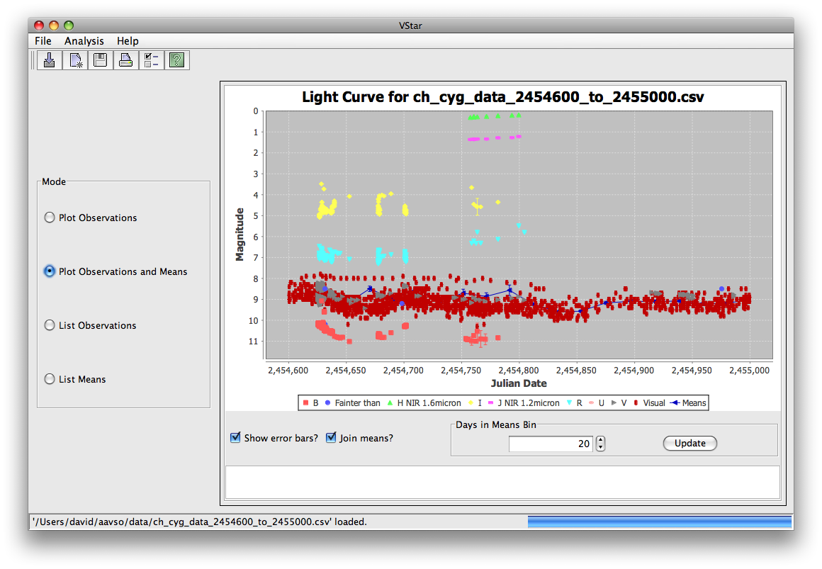
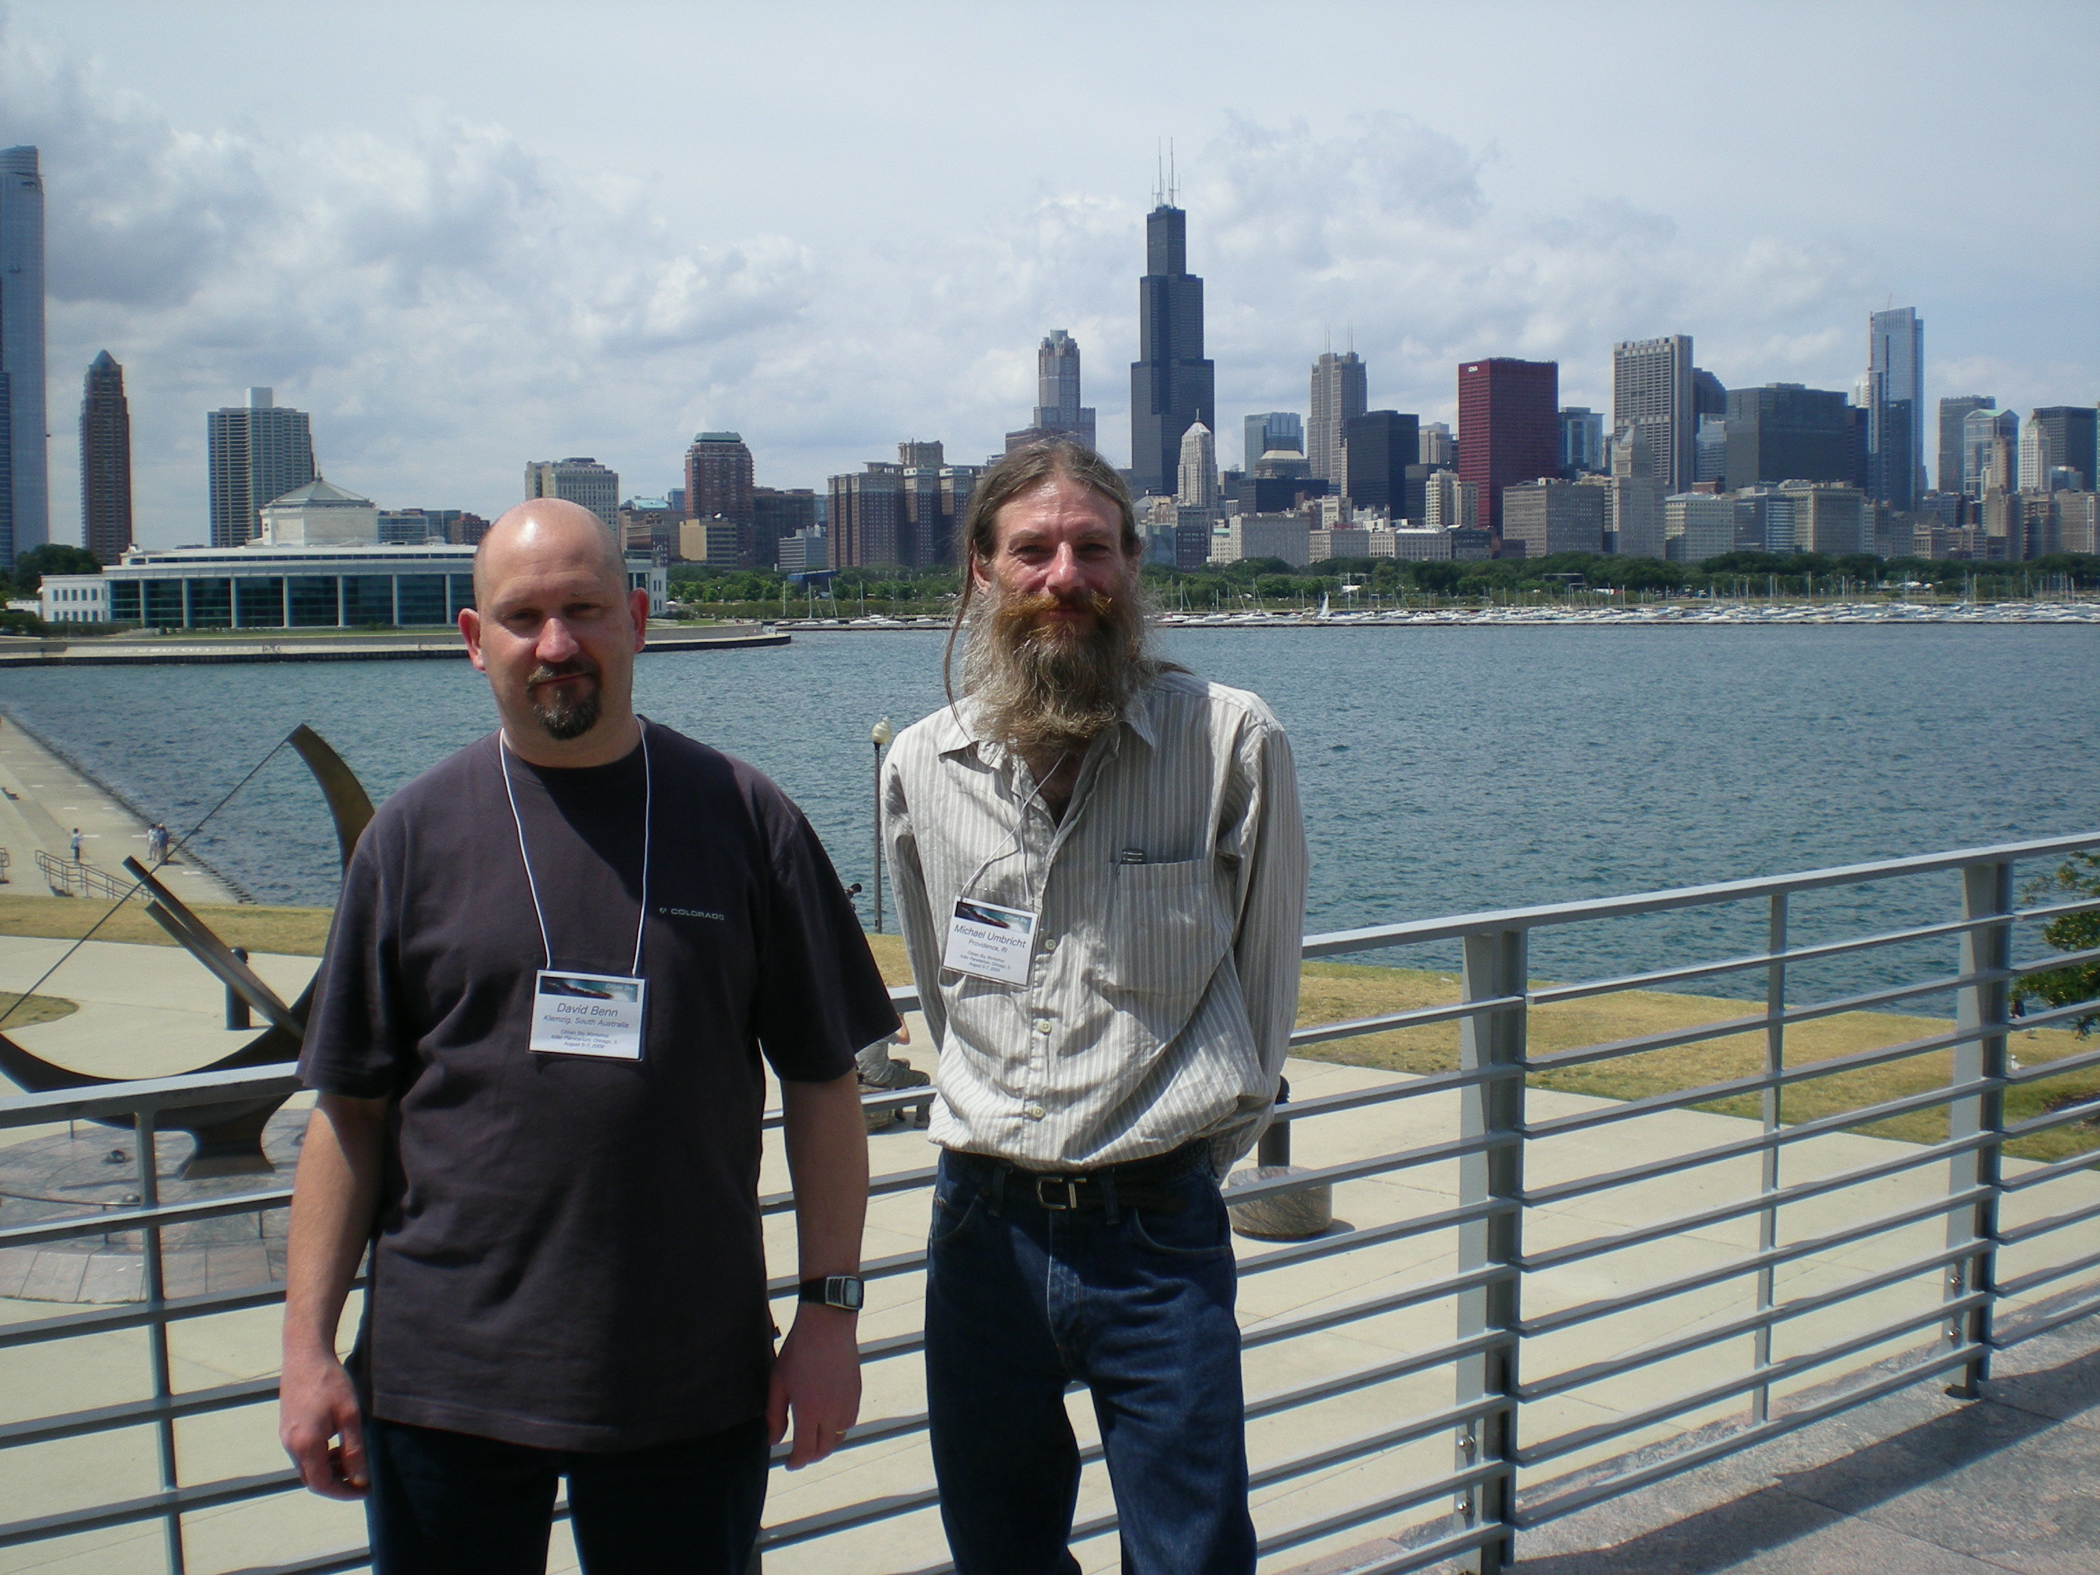

VStar Begins

Slide 2
I am…
an amateur/volunteer astronomer;
a software engineer (aka Code Monkey) ;
passionate about contributing to Science in my spare time;
NOT a statistician or mathematician;
keen to make VStar what its intended audience(s) want it to be.

Slide 3
VStar is…
intended to be an easy-to-use variable star data visualization and analysis tool;
a SourceForge project;
still in progress;
being implemented in multiple phases;
in need of more testers (the more the merrier, especially with respect to platforms);
downloadble as a tarball (please do); but no formal releases yet.

Slide 4
Key Features
Now
Light curve with error bars
Mean plot plus light curve with error bars
Data related to each of these plot in tables
Series visibility change, with effect upon mean plot
Inspection of individual observations
Saving, printing
Next
Phase plots
Period analysis algorithm implementations

Slide 5
Links
http://sourceforge.net/projects/vstar/

