Slide 1
Bluestock MF Capstone
Mutual Fund Analytics, Dashboard, and Final Deliverables

Slide 2
Problem & Objective
Understand mutual fund performance, investor SIP behavior, and portfolio concentration.
Deliver a clean analytics pipeline, advanced risk insights, and intuitive dashboards.

Slide 3
Data Sources
NAV history, scheme performance, investor transactions, holdings, and benchmark indices.
Derived analytics use cleaned tables and a SQLite-loaded star schema.

Slide 4
Architecture
Raw source files → cleaning → SQLite warehouse → EDA and advanced analytics → dashboard export.
Final outputs include PDF report, PPTX presentation, and dashboard visuals.

Slide 5
EDA Highlight 1
SIP inflows show strong monthly growth and category-level variation.
AUM concentration remains highest among top large-cap fund houses.

Slide 6
EDA Highlight 2
Investor cohorts reveal higher ticket sizes in newer SIP cohorts.
State and age analytics highlight regional and demographic investment patterns.

Slide 7
Performance Metric 1
Top funds ranked using a composite score with Sharpe, alpha, expense ratio, and drawdown.
VaR and CVaR quantify downside risk across all 40 schemes.

Slide 8
Performance Metric 2
Rolling 90-day Sharpe highlights changing risk-adjusted returns for key funds.
Sector HHI distinguishes concentrated vs diversified equity portfolios.

Slide 9
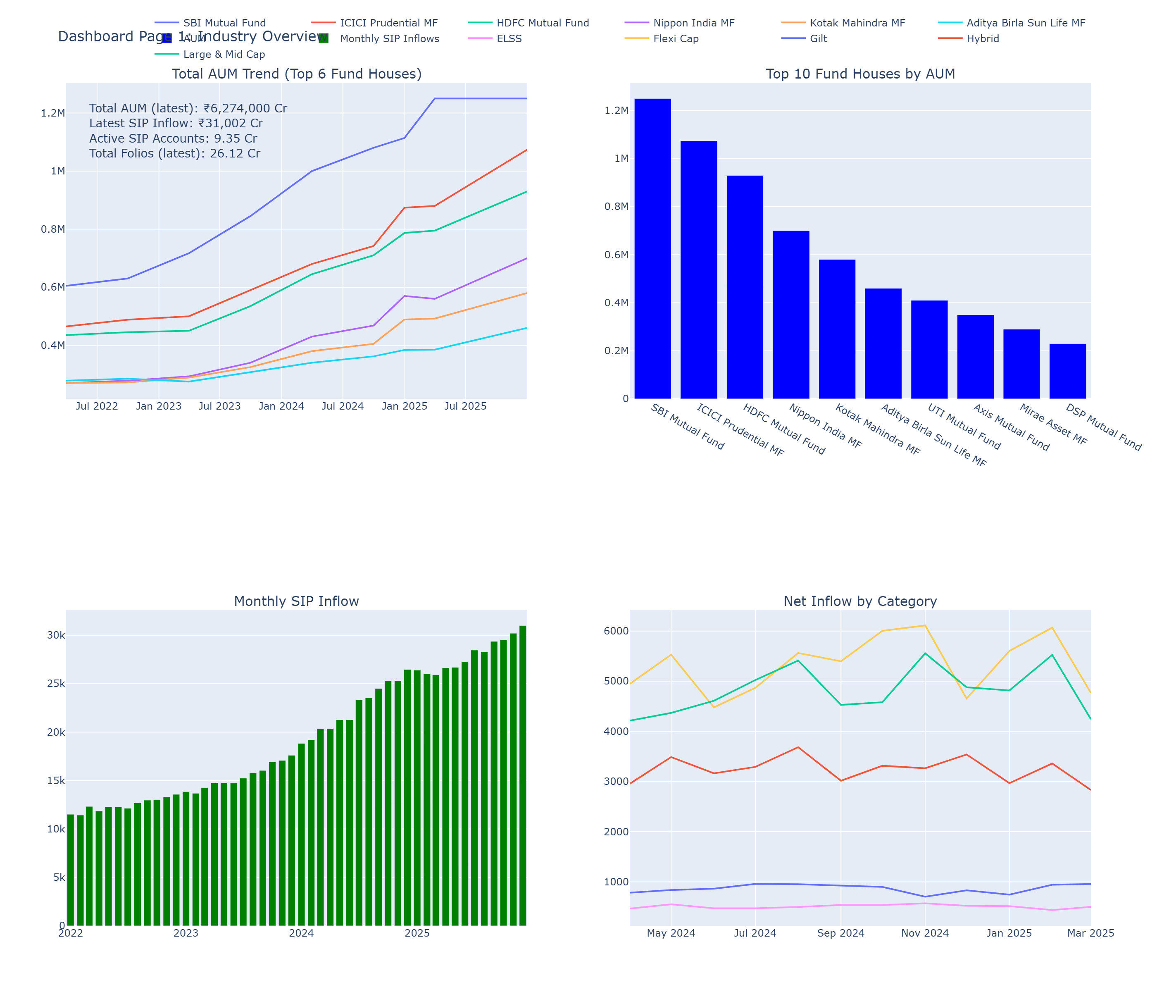
Dashboard Snapshot 1

Slide 10
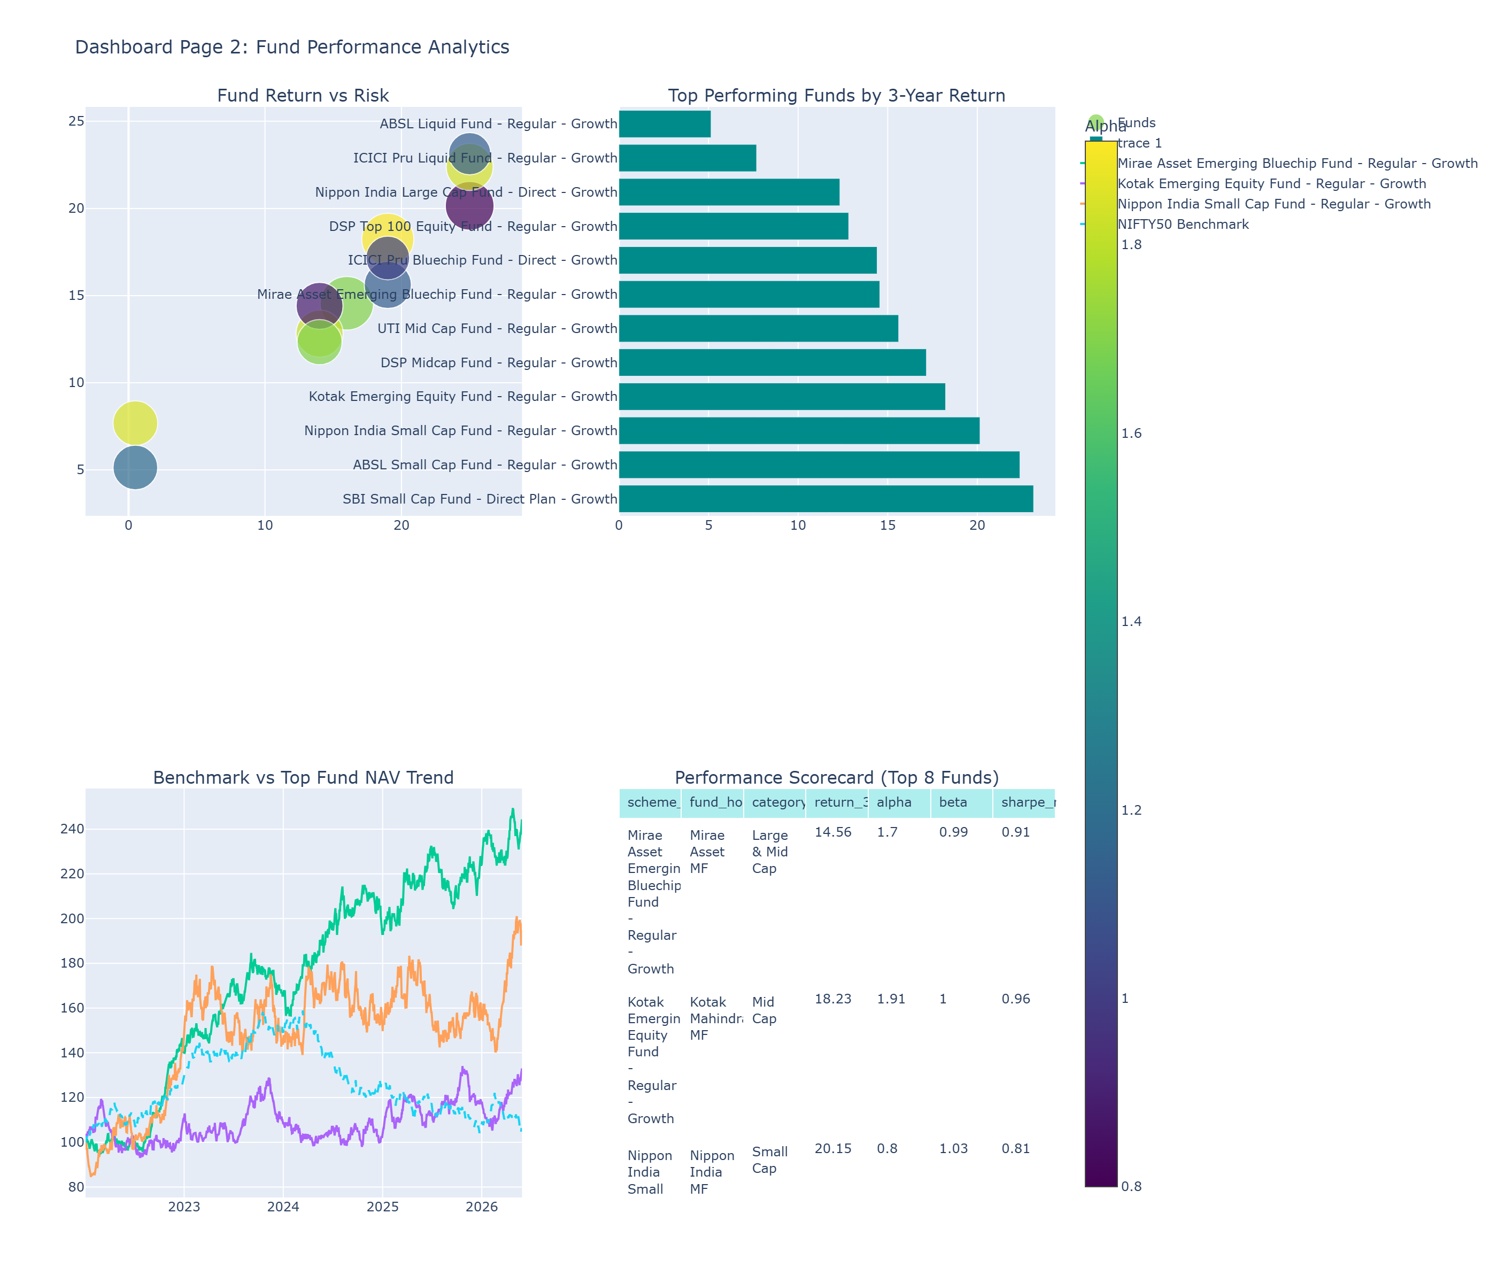
Dashboard Snapshot 2

Slide 11
Key Findings
Value-at-risk and CVaR highlight downside vulnerability for fund selection.
SIP continuity analysis identifies investors at risk due to large gaps.
Concentration analysis spots funds with higher single-stock exposure.

Slide 12
Thank You
End of presentation.
Questions and next steps welcome.

