Slide 1
Laboratory work 2. Model Sensitivity and Uncertainty Analysis
Course: Discrete Mathematical Modeling

Slide 2
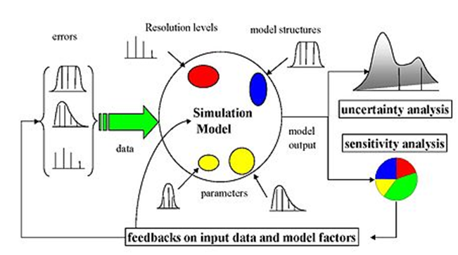
Sources of model errors
Errors in the source data (measurement errors)
Parameter estimation procedure errors
Errors in the structure of the model
Roughness Errors (Resolution)
For dynamic models, the error progresses over time!!

Slide 3
Sensitivity analysis
Sensitivity analysis is the study of how the uncertainty in the output of a mathematical model or system can be correlated with various sources of uncertainty in its input and / or parameters.
The technique for conducting a sensitivity analysis is to change the selected parameters within certain limits, provided that the remaining parameters remain unchanged.

Slide 4
General sensitivity estimation algorithm
Assess the uncertainty of each input parameter (e.g. ranges, probability distributions). Note that it can be difficult, and there are a lot of methods for identifying uncertainty distributions.
Determine the model and its output (result) that should be analyzed (the goal of interest should ideally be directly related to the problem considered by the model).
Run the model several times, using some experimental plan dictated by the selection method and input uncertainty.
Using the obtained model results, calculate the sensitivity indicators of interest.

Slide 5
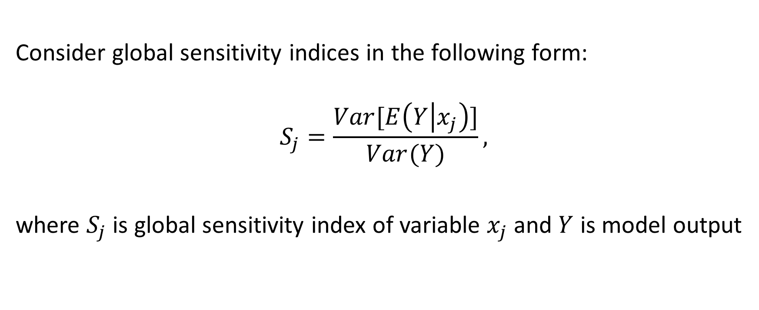
Total-effect index (Sobol index)
Consider global sensitivity indices in the following form:
$$S_{j}=\frac{Var[E\left(Y | x_{j}\right)]}{Var(Y)},$$
where $S_{j}$ is global sensitivity index of variable $x_{j}$ and $Y$ is model output

Slide 6
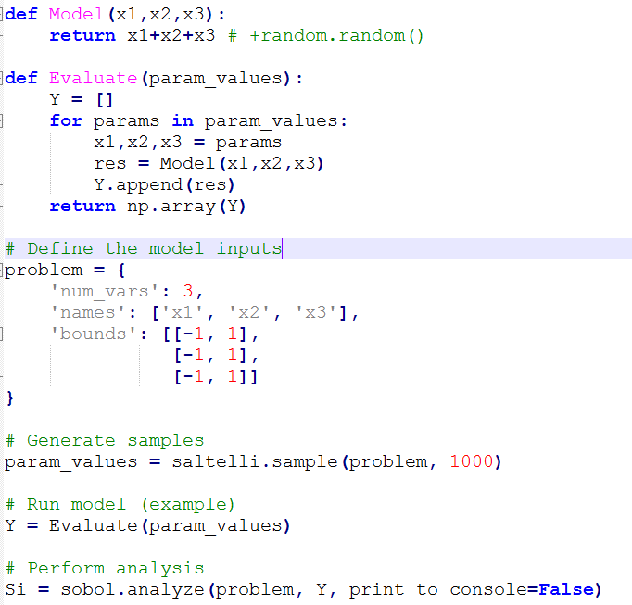
Calculation example (library SALib)
The main steps:
Set the Model
Describe the function of generating output data from a set of parameters
Set model parameters
Generate sample of random parameters
Calculate sensitivity indexes

Slide 7
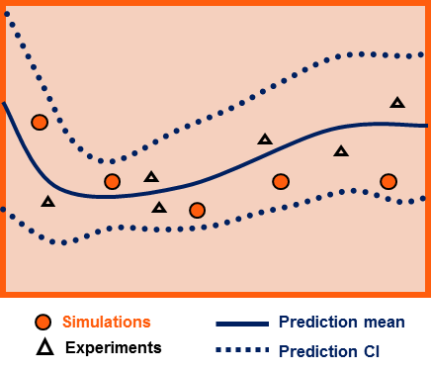
Uncertainty analysis
Uncertainty analysis – is a field of science that quantifies and reduces uncertainties in both computational and real-world applications.
This type of analysis attempts to determine how likely certain results are if certain aspects of the system are not precisely known.

Slide 8
Task
Perform a sensitivity analysis for a demographic model with respect to a set of parameters: fertility rate, boys/girls ratio, «survival» rate for different age groups (not all can be taken). Model output: number of inhabitants for a given year. Test on the final forecast values ​​for 10, 20, 50, 100 years.
Define ranges of model parameter values ​​from data for previous periods (1950-2000)
Based on all ranges of parameter values, perform an uncertainty analysis in the form of a graph with confidence intervals of the results. The values ​​between the boundaries can be considered evenly distributed.

