Slide 1



IBM Cloud
Cluster
ISTIO
Local PC

Slide 2
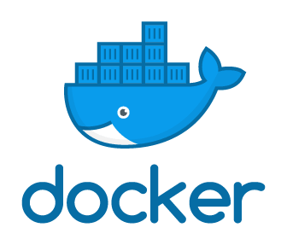




IBM Cloud
Cluster
Build and
store the container images
ISTIO
deploy
Pod
Pod
Pod
articles micro-service
authors micro-service
web-app
micro-service
Local PC
Node.JS microservice container
Java microservice container articles

