Slide 1
September 4th 2018
IBM Cloud Architecture Center
Virtual Private Cloud Diagram Template
Using the Diagram Template
This template is for use in creating a visual representation of Virtual Private Cloud
You may add numbers (which are provided on page 3) to the diagram to correspond to the runtime flow steps in your architecture.
See instructions on how to gray out icons and lines on Page 5

Slide 2








PUBLIC
NETWORK
CLOUD
NETWORK
ENTERPRISE
NETWORK
US-SOUTH
VPN
US-SOUTH-1
US-SOUTH-2
ACL1
LB
ACL1
CLOUD
USER
SG1
ENTERPRISE
USER
FIP
VM1
VM2
VM5
VM6
DIRECT
LINK
USER
DIRECTORY
SUBNET 10.10.10.0/24
SUBNET 10.10.40.0/24
ACL1
ACL1
APPS
SG2
INTERNET
VM3
VM4
VM7
VM8
PUBLIC
GATEWAY
DATA
SUBNET 10.10.20.0/24
SUBNET 10.10.30.0/24
SERVICES
OS IMAGES
USER KEYS

Slide 3
IBM Cloud Architecture Center
Runtime numbers
1
2
3
4
5
6
7
8
9
10
11
12
13
14
15
16
17
18
19
20

Slide 4

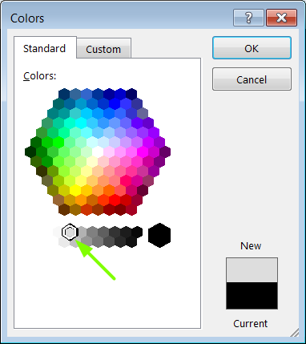
IBM Cloud Architecture Center
Gray Icons and Arrows for Background
OFFLINE
CAPABILITIES
Copy an icon.
Select it and ungroup.
Select the icon background and change the fill color to R221, G221, B221. This is a standard color. See the picture.
Change the text to the same color.
Regroup the icon.
Change background arrows to the same color.

