Slide 1
September 7th 2018
IBM Cloud Architecture Center
Virtual Private Cloud Diagram Template
Using the Diagram Template
This template is for use in creating a visual representation of Virtual Private Cloud
You may add numbers (which are provided on page 3) to the diagram to correspond to the runtime flow steps in your architecture.
See instructions on how to gray out icons and lines on Page 5

Slide 2






PUBLIC
NETWORK
CLOUD
NETWORK
ENTERPRISE
NETWORK
ENTERPRISE
USER
DIRECTORY
US-SOUTH
LOAD
BALANCER
US-SOUTH-1
US-SOUTH-2
CLOUD
USER
ACL
ACL
ENTERPRISE
USER
SECURITY
GROUP
VPN
FIP
VM1
VM2
VM5
VM6
SUBNET 10.10.10.0/24
SUBNET 10.10.40.0/24
ACL
ACL
SECURITY
GROUP
DIRECT
LINK
INTERNET
ENTERPRISE
APPLICATIONS
VM3
VM4
VM7
VM8
PUBLIC
GATEWAY
SUBNET 10.10.20.0/24
SUBNET 10.10.30.0/24
ENTERPRISE
DATA

Slide 3
IBM Cloud Architecture Center
Runtime numbers
1
2
3
4
5
6
7
8
9
10
11
12
13
14
15
16
17
18
19
20

Slide 4

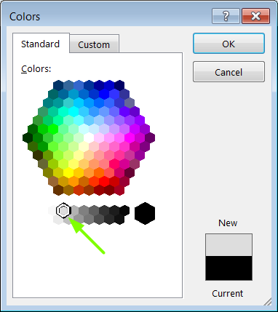
IBM Cloud Architecture Center
Gray Icons and Arrows for Background
OFFLINE
CAPABILITIES
Copy an icon.
Select it and ungroup.
Select the icon background and change the fill color to R221, G221, B221. This is a standard color. See the picture.
Change the text to the same color.
Regroup the icon.
Change background arrows to the same color.

