Slide 1
August 16th 2018
IBM Cloud Architecture Center
Virtual Private Cloud Diagram Templates
Using the Diagram Templates
These templates are for use in creating a visual representation of Virtual Private Cloud
You may add numbers (which are provided on page 3) to the diagrams to correspond to the runtime flow steps in your architecture.
See instructions on how to gray out icons and lines on Page 5

Slide 2


VIRTUAL PRIVATE CLOUD
US-SOUTH
MARKETPLACE
US-SOUTH-1
US-SOUTH-2
LOAD BALANCER
ACL1
ACL1
SECURITY GROUP1
FLOATING IP
VPN
VM1
VM2
VM5
VM6
SUBNET 10.10.10.0/24
SUBNET 10.10.40.0/24
INTERNET
ACL1
ACL1
SECURITY GROUP2
PUBLIC
GATEWAY
DIRECT
LINK
VM3
VM4
VM7
VM8
SUBNET 10.10.20.0/24
SUBNET 10.10.30.0/24
ON PREMISE

Slide 3







CLOUD UNIVERSE
PUBLIC NETWORK
IBM CLOUD
ENTERPRISE
NETWORK
CLOUD
USER
VIRTUAL PRIVATE CLOUD
VPN
US-SOUTH
ENTERPRISE
USER
US-SOUTH-1
US-SOUTH-2
LB
ACL1
ACL1
DIRECT
LINK
USER
DIRECTORY
FIP
SG1
VM1
VM2
VM3
VM4
APPS
10.10.10.0/24
10.10.20.0/24
INTERNET
PUBLIC
GATEWAY
SERVICES
DATA
OS IMAGES
USER KEYS
ACL1 RULES
SG1 RULES

Slide 4
IBM Cloud Architecture Center
Runtime numbers
1
2
3
4
5
6
7
8
9
10
11
12
13
14
15
16
17
18
19
20

Slide 5

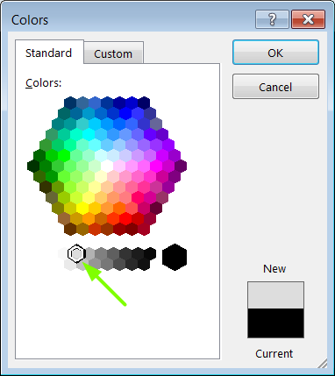
IBM Cloud Architecture Center
Gray Icons and Arrows for Background
OFFLINE
CAPABILITIES
Copy an icon.
Select it and ungroup.
Select the icon background and change the fill color to R221, G221, B221. This is a standard color. See the picture.
Change the text to the same color.
Regroup the icon.
Change background arrows to the same color.

