Slide 1
October 2nd 2019
IBM Cloud Architecture Center
Virtual Private Cloud Diagram Template
Using the Diagram Template
This template is for use in creating a visual representation of Virtual Private Cloud
You may add numbers (which are provided on page 3) to the diagram to correspond to the runtime flow steps in your architecture.
See instructions on how to gray out icons and lines on Page 4

Slide 2














Public
Network
IBM Cloud
Enterprise
Network
Region A
VPC 1
Classic
Infrastructure
Zone 1
10.10.0.0/18
Zone 2
10.20.0.0/18
Classic
DC
User
Public
LB
10.10.30.0/24
ACL 1
10.10.10.0/24
ACL 1
Subnet
ACL
10.20.30.0/24
Gateway Appliance
Enterprise
User Directory
Internet
Public Gateway
RG 1
SG 1
RG 1
FIP
VSI
Classic VSI
VSI
Bare Metal
Enterprise User
VPN Connection
VPN
Gateway
10.10.20.0/24
ACL 2
Private
LB
10.20.40.0/24
ACL 2
Direct
Link
Enterprise Applications
RG 2
SG 2
RG 3
VSI
VSI
VSI
VSI
Implicit Router
Enterprise Data
Notes:
Shows primary interface for VSIs in subnet and security group shown, and VPC enabled for Classic Access.
Each VSI has one or more interfaces in same or other subnet and each interface can be in multiple security groups.

Slide 3
IBM Cloud Architecture Center
Runtime numbers
1
2
3
4
5
6
7
8
9
10
11
12
13
14
15
16
17
18
19
20

Slide 4

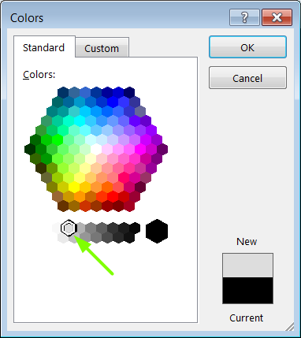
IBM Cloud Architecture Center
Gray Icons and Arrows for Background
OFFLINE
CAPABILITIES
Copy an icon.
Select it and ungroup.
Select the icon background and change the fill color to R221, G221, B221. This is a standard color. See the picture.
Change the text to the same color.
Regroup the icon.
Change background arrows to the same color.

