Slide 1
September 10th 2018
IBM Cloud Architecture Center
Virtual Private Cloud Diagram Template
Using the Diagram Template
This template is for use in creating a visual representation of Virtual Private Cloud
You may add numbers (which are provided on page 3) to the diagram to correspond to the runtime flow steps in your architecture.
See instructions on how to gray out icons and lines on Page 5

Slide 2








PUBLIC
NETWORK
IBM CLOUD
ENTERPRISE
NETWORK
CLOUD
USER
US SOUTH
VIRTUAL PRIVATE CLOUD
ZONE 1
LOAD
BAL
ZONE 2
PUBLIC SUBNET
PUBLIC SUBNET
USER DIRECTORY
INTERNET
SG
FIP
PUBLIC
GATEWAY
VSI
VSI
VSI
VSI
10.10.10.0/24
10.10.30.0/24
USER
PRIVATE SUBNET
PRIVATE SUBNET
VPN
GATEWAY
VPN
CONNECT
APPLICATIONS
VSI
VSI
SG
VSI
VSI
10.10.20.0/24
10.10.40.0/24
DIRECT
LINK
DATA

Slide 3
IBM Cloud Architecture Center
Runtime numbers
1
2
3
4
5
6
7
8
9
10
11
12
13
14
15
16
17
18
19
20

Slide 4

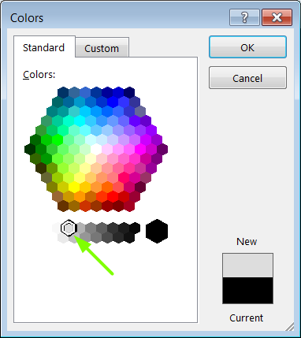
IBM Cloud Architecture Center
Gray Icons and Arrows for Background
OFFLINE
CAPABILITIES
Copy an icon.
Select it and ungroup.
Select the icon background and change the fill color to R221, G221, B221. This is a standard color. See the picture.
Change the text to the same color.
Regroup the icon.
Change background arrows to the same color.

