Slide 1
22nd May 2017
IBM Cloud Architecture Center
API Management Diagram Icons
Using the Diagram Template
This template is for use in creating a visual representation of API Management
You may add numbers (which are provided on page 3) to the diagram to correspond to the runtime flow steps in your architecture.
See instructions on how to gray out icons and lines on Page 4

Slide 2









PUBLIC NETWORK
CLOUD NETWORK
ENTERPRISE NETWORK
1
1
API DEVELOPER TOOLKIT
ENTERPRISE
DATA
API
DEVELOPER
6
6
API ANALYTICS VISUALIZATION
2
2
API
RUNTIME
TRANSFORMATION &
CONNECTIVITY
API
OWNER
EDGE
SERVICES
3
API
MANAGEMENT
7
3
ENTERPRISE
APPLICATIONS
APPLICATION
DEVELOPER
4
DEVELOPER
PORTAL
EDGE
SERVICES
IT
OPERATIONS
5
END
USER
DEVICE
APPLICATION
API GATEWAY
LEGEND
Application
Infrastructure
Data Store
Management
Security
SECURITY
Users
Scalable

Slide 3
IBM Cloud Architecture Center
Runtime numbers
1
2
3
4
5
6
7
8
9
10
11
12
13
14
15
16
17
18
19
20

Slide 4

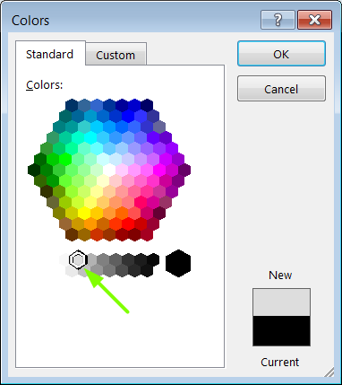
IBM Cloud Architecture Center
Gray Icons and Arrows for Background
OFFLINE
CAPABILITIES
Select icon and ungroup.
Select the icon background and change the fill color to R221, G221, B221. This is a standard color. See the picture.
Change the text to the same color.
Regroup the icon.
Change background arrows to the same color.

