Slide 1
May 22nd 2017
IBM Cloud Architecture Center
Blockchain Diagram Template
Using the Diagram Template
This template is for use in creating a visual representation of BLOCKCHAIN overview.
You may add numbers (which are provided on page 3) to the diagram to correspond to the runtime flow steps in your architecture.
See instructions on how to gray out icons and lines on Page 4

Slide 2



















PUBLIC NETWORK
CLOUD NETWORK
ENTERPRISE NETWORK
DEVELOPER USER
END USER
SECURITY
GATEWAY
PROVIDER CLOUD
PORTAL SERVICE
ENTERPRISE
USER DIRECTORY
BLOCKCHAIN
USER
EDGE
SERVICES
SERVER
RUNTIMES
TRANSFORMATION &
CONNECTIVITY
ENTERPRISE
APPLICATIONS
PEER
CLOUD
API MANAGEMENT
ENTERPRISE DATA
BLOCKCHAIN
USER
APPLICATION
MOBILE
WALLET
WEB
CLI
BLOCKCHAIN
Admin &
Ops Services
MEMBERSHIP
CONSENSUS
LEDGER
SMART
CONTRACT
SYSTEM
INTEGRATION
LEGEND
EVENTS
User
Application
Infrastructure
Data Store
Management
Scalable
GOVERNANCE
INFRASTRUCTURE
SECURITY
SECURITY MONITORING
& INTELLIGENCE
Security
BLOCKCHAIN

Slide 3
IBM Cloud Architecture Center
Runtime numbers
1
2
3
4
5
6
7
8
9
10
11
12
13
14
15
16
17
18
19
20

Slide 4

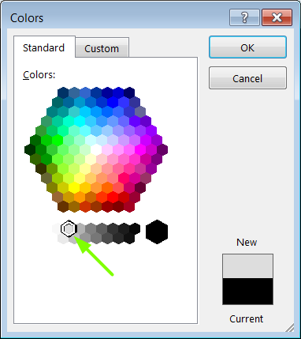
IBM Cloud Architecture Center
Gray Icons and Arrows for Background
OFFLINE
CAPABILITIES
Select icon and ungroup.
Select the icon background and change the fill color to R221, G221, B221. This is a standard color. See the picture.
Change the text to the same color.
Regroup the icon.
Change background arrows to the same color.

