Slide 1
10th July 2017
IBM Cloud Architecture Center
Cognitive Diagram Template
Using the Diagram Template
This template is for use in creating a visual representation of Cognitive
You may add numbers (which are provided on page 3) to the diagram to correspond to the runtime flow steps in your architecture.
Page 4 will walk you through the steps of graying out unused components in the architecture.

Slide 2












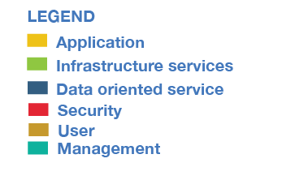


PUBLIC NETWORK
CLOUD NETWORK
ENTERPRISE NETWORK
USER
USER
CONVERSATION
CONVERSATION
ENDPOINTS
CONVERSATION
ENDPOINTS
TRANSFORMATION &
CONNECTIVITY
PUBLIC APIs
BUSINESS
PROCESS
EDGE SERVICES
APPLICATION
LOGIC
DISCOVERY
SERVICE
3rd PARTY APIs
ENTERPRISE APIs
SERVICES
EXTEND
(Cognitive API’s)
EXTERNAL DATA
SOURCES
ENTERPRISE DATA
INGESTION
APPLICATION
TRANSFORMATION &
CONNECTIVITY
INFORMATION
GOVERNANCE
SECURITY

Slide 3
IBM Cloud Architecture Center
Runtime numbers
1
2
3
4
5
6
7
8
9
10
11
12
13
14
15
16
17
18
19
20

Slide 4

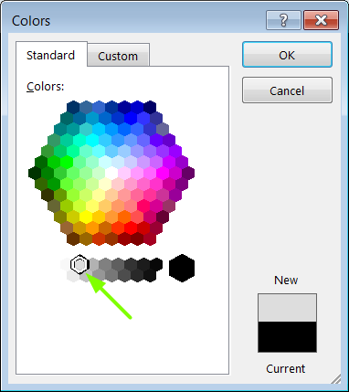
IBM Cloud Architecture Center
Gray Icons and Arrows for Background
OFFLINE
CAPABILITIES
Select icon and ungroup.
Select the icon background and change the fill color to R221, G221, B221. This is a standard color. See the picture.
Change the text to the same color.
Regroup the icon.
Change background arrows to the same color.

