Slide 1
May 22nd, 2017
IBM Cloud Architecture Center
Commerce Diagram Template
Using the Diagram Template
This template is for use in creating a visual representation of Commerce Domain Overview.
You may add numbers (which are provided on page 3) to the diagram to correspond to the runtime flow steps in your architecture.
See instructions on how to gray out icons and lines on Page 4

Slide 2






















PUBLIC NETWORK
PROVIDER CLOUD
ENTERPRISE NETWORK
1
GATEWAY
5
7
9
BUSINESS
USER
e-COMMERCE
USER
e-COMMERCE
APPLICATIONS
PAYMENT
SUPPLY CHAIN
& LOGISTICS
MANAGEMENT
DATA
SERVICE
2
6
3
INTERNAL
CHANNEL
EDGE SERVICES
TRANSFORMATION &
CONNECTIVITY
11
CHANNEL
DIGITAL
EXPERIENCE
DISTRIBUTED
ORDER
MANAGEMENT
BUSINESS
PERFORMANCE
8
MERCHANDISING
USER DIRECTORY
10
CUSTOMER
CARE
WAREHOUSE
MANAGEMENT
COMMERCE
ANALYTICS
ENTERPRISE
APPLICATION
LEGEND
Application
4
Infrastructure
MARKETING
Data Store
Management
ENTERPRISE DATA
Security
Analytics
Users
Scalable
SECURITY

Slide 3
IBM Cloud Architecture Center
Runtime numbers
1
2
3
4
5
6
7
8
9
10
11
12
13
14
15
16
17
18
19
20

Slide 4

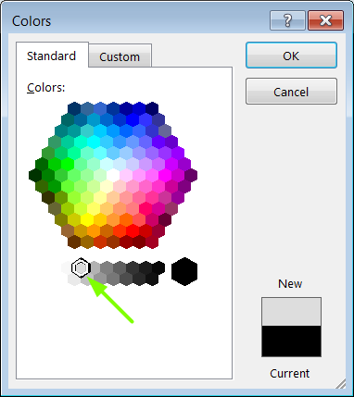
IBM Cloud Architecture Center
Gray Icons and Arrows for Background
OFFLINE
CAPABILITIES
Copy an icon.
Select it and ungroup.
Select the icon background and change the fill color to R221, G221, B221. This is a standard color. See the picture.
Change the text to the same color.
Regroup the icon.
Change background arrows to the same color.

