Slide 1
22nd May 2017
IBM Cloud Architecture Center
Big Data Analytics Diagram Template
Using the Diagram Template
This template is for use in creating a visual representation of Big Data Analytics
You may add numbers (which are provided on page 3) to the diagram to correspond to the runtime flow steps in your architecture.
Page 4 will walk you through the steps of graying out unused components in the architecture.

Slide 2
















PUBLIC CLOUD
PROVIDER CLOUD
ENTERPRISE NETWORK
CLOUD
USER
API MANAGEMENT
KNOWLEDGE
ENGINEER
EDGE
SERVICES
TRANSFORMATION &
CONNECTIVITY
SAAS
APPLICATIONS
ENTERPRISE
APPLICATIONS
SAAS
APPLICATIONS
COGNITIVEANALYTICS
DISCOVERY & EXPLORATION
DATA
REPOSITORIES
COGNITIVE
ACTIONABLE
INSIGHTS
DATA
SOURCES
STREAMING
COMPUTING
ENTERPRISE
DATA
COGNITIVE ASSISTED
DATA INTEGRATION
LEGEND
Application
Infrastructure
ENTERPRISE
USER DIRECTORY
Data Store
Management
Security
INFORMATION
GOVERNANCE
SYSTEM
MANAGEMENT
Capabilities
SECURITY
User

Slide 3
IBM Cloud Architecture Center
Runtime numbers
1
2
3
4
5
6
7
8
9
10
11
12
13
14
15
16
17
18
19
20

Slide 4

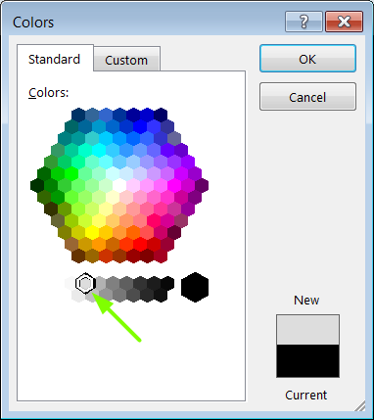
IBM Cloud Architecture Center
Gray Icons and Arrows for Background
OFFLINE
CAPABILITIES
Select icon and ungroup.
Select the icon background and change the fill color to R221, G221, B221. This is a standard color. See the picture.
Change the text to the same color.
Regroup the icon.
Change background arrows to the same color.

