Slide 1
May 22nd 2017
IBM Cloud Architecture Center
DEVOPS Diagram Template
Using the Diagram Template
This template is for use in creating a visual representation of DevOps
You may add numbers (which are provided on page 3) to the diagram to correspond to the runtime flow steps in your architecture.
See instructions on how to gray out icons and lines on Page 4

Slide 2

































PUBLIC NETWORK
PROVIDER CLOUD
ENTERPRISE NETWORK
2
4
15
3
SOURCE
CONTROL
USAGE
ANALYTICS
CODE
EDITOR
14
5
TRANSFORMATION &
CONNECTIVITY
1
16
IT SERVICE MANAGEMENT
BUILD, TEST, &
CONTINOUS INTEGRATION
17
COLLABORATIVE
DEVELOPMENT
USER
13
10
7
6
ENTERPRISE
USER DIRECTORY
ALERT
NOTIFICATION
SECURITY
9
RELEASE
MANAGEMENT
ARTIFACT
MANAGEMENT
12
8
APPLICATION
LEGEND
MONITORING &
METRICS
11
DEPLOYMENT
ORCHESTRATION
Application
RUNTIME & CONTAINERS
Infrastructure
Data store
Management
Security
Analytics
Users
Dev Ops

Slide 3
IBM Cloud Architecture Center
Runtime numbers
1
2
3
4
5
6
7
8
9
10
11
12
13
14
15
16
17
18
19
20

Slide 4

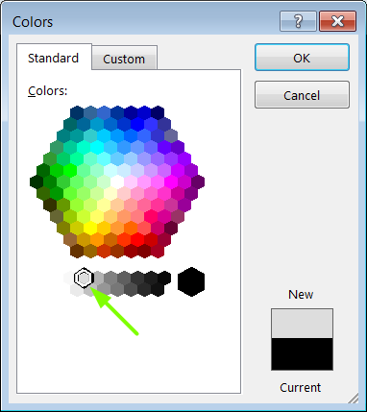
IBM Cloud Architecture Center
Gray Icons and Arrows for Background
OFFLINE
CAPABILITIES
Copy an icon.
Select it and ungroup.
Select the icon background and change the fill color to R221, G221, B221. This is a standard color. See the picture.
Change the text to the same color.
Regroup the icon.
Change background arrows to the same color.

