Slide 1
22nd May 2017
IBM Cloud Architecture Center
Microservices Diagram Template
Using the Diagram Template
This template is for use in creating a visual representation of Microservices
You may add numbers (which are provided on page 3) to the diagram to correspond to the runtime flow steps in your architecture.
See instructions on how to gray out icons and lines on Page 4

Slide 2




















OMNICHANNEL
CLIENTS & PUBLIC
NETWORK
CLOUD NETWORK
ENTERPRISE NETWORK
PUSH
NOTIFICATIONS
DEVICE
ANALYTICS
DEVICE SECURITY
MANAGEMENT
SERVICE DISCOVERY
& CONFIGURATION
MOBILE PROVIDER
NETWORK
ENTERPRISE
USER DIRECTORY
MOBILE BACKEND
FOR FRONTEND
PROXY
REUSABLE
MICROSERVICES
DEVICE
EDGE
SERVICES
MOBILE BACKEND
FOR FRONTEND
PROXY
REUSABLE
MICROSERVICES
TRANSFORMATION &
CONNECTIVITY
ENTERPRISE
APPLICATIONS
API
GATEWAY
MOBILE BACKEND
FOR FRONTEND
DATA STORE
ENTERPRISE
DATA
BROWSER
MOBILE BACKEND
FOR FRONTEND
CACHES
LEGEND
Application
Infrastructure services
MOBILE BACKEND
FOR FRONTEND
FILE REPOSITORY
Data Store
Management
Security
Capabilities
User
CONTENT MANAGEMENT

Slide 3
IBM Cloud Architecture Center
Runtime numbers
1
2
3
4
5
6
7
8
9
10
11
12
13
14
15
16
17
18
19
20

Slide 4

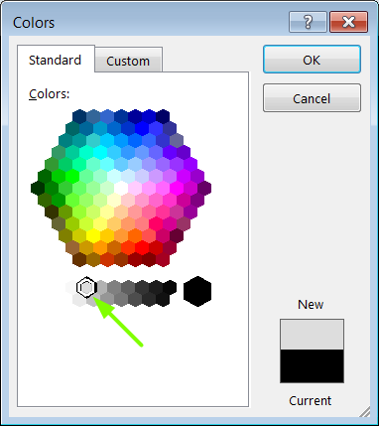
IBM Cloud Architecture Center
Gray Icons and Arrows for Background
OFFLINE
CAPABILITIES
Select icon and ungroup.
Select the icon background and change the fill color to R221, G221, B221. This is a standard color. See the picture.
Change the text to the same color.
Regroup the icon.
Change background arrows to the same color.

