Slide 1
November 22nd 2016
IBM Cloud Architecture Center
MOBILE Diagram Template
Using the Diagram Template
This template is for use in creating a visual representation of Mobile
You may add numbers (which are provided on page 3) to the diagram to correspond to the runtime flow steps in your architecture.
See instructions on how to gray out icons and lines on Page 4

Slide 2













MOBILE DEVICE
PUBLIC NETWORK
PROVIDER CLOUD
ENTERPRISE NETWORK
API MANAGEMENT
SECURITY
SERVICES
MOBILE
APPLICATION
ENTERPRISE
USER DIRECTORY
DATA SERVICES
EDGE SERVICES
MOBILE
GATEWAY
MOBILE
BACKEND
TRANSFORMATION &
CONNECTIVITY
ENTERPRISE DATA
MANAGEMENT
AGENT
MOBILE DEVICE
AGENT
MOBILE BUSINESS
APPLICATIONS
ENTERPRISE
APPLICATION
LEGEND
MOBILE PROVIDER
NETWORK
Application
Infrastructure
Data Store
Management
Security
OFFLINE
CAPABILITIES
Capabilities

Slide 3
IBM Cloud Architecture Center
Runtime numbers
1
2
3
4
5
6
7
8
9
10
11
12
13
14
15
16
17
18
19
20

Slide 4

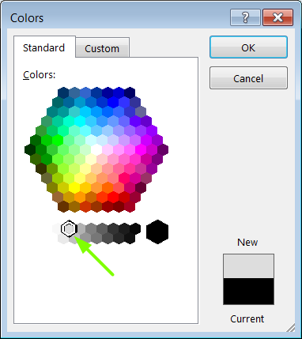
IBM Cloud Architecture Center
Gray Icons and Arrows for Background
OFFLINE
CAPABILITIES
Copy an icon.
Select it and ungroup.
Select the icon background and change the fill color to R221, G221, B221. This is a standard color. See the picture.
Change the text to the same color.
Regroup the icon.
Change background arrows to the same color.

