Slide 1
November 2nd 2016
IBM Cloud Architecture Center
Security Diagram Template
Using the Diagram Template
This template is for use in creating a visual representation of SECURITY Domain Overview.
You may add numbers (which are provided on page 3) to the diagram to correspond to the runtime flow steps in your architecture.
See instructions on how to gray out icons and lines on Page 4

Slide 2


















PUBLIC NETWORK
CLOUD NETWORK
ENTERPRISE NETWORK
SECURED CLOUD RESOURCES & SERVICES
APPLICATION
USER
APPLICATION
SECURITY
CLOUD
APPLICATION
DATA
SERVICES
DATA
SECURITY
ENTERPRISE
USER DIRECTORY
CLOUD
ADMIN
TRANSFORMATION &
CONNECTIVITY
ENTERPRISE
APPLICATIONS
EDGE SERVICES
RUNTIME
SERVICES
CLOUD
DEVELOPER
ENTERPRISE
DATA
INFRASTRUCTURE
SECURITY
INFRASTRUCTURE
SERVICES
SECURE
DEVOPS
SECURITY SERVICES
APPLICATION
LEGEND
IDENTITY &
ACCESS
MANAGEMENT
PHYSICAL
SECURITY
SECURITY MONITORING
& INTELLIGENCE
User
GOVERNANCE RISK &
COMPLIANCE
Application
Infrastructure
Data Store
DEVICE
Management
Scalable
Security

Slide 3
IBM Cloud Architecture Center
Runtime numbers
1
2
3
4
5
6
7
8
9
10
11
12
13
14
15
16
17
18
19
20

Slide 4

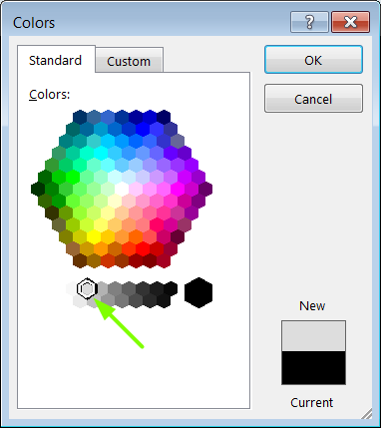
IBM Cloud Architecture Center
Gray Icons and Arrows for Background
OFFLINE
CAPABILITIES
Select icon and ungroup.
Select the icon background and change the fill color to R221, G221, B221. This is a standard color. See the picture.
Change the text to the same color.
Regroup the icon.
Change background arrows to the same color.

