Slide 1
8th June 2017
IBM Cloud Architecture Center
Service Management Diagram Template
Using the Diagram Template
This template is for use in creating a visual representation of Service Management
You may add numbers (which are provided on page 3) to the diagram to correspond to the runtime flow steps in your architecture.
See instructions on how to gray out icons and lines on Page 4
17 May 2016

Slide 2
















PUBLIC NETWORK
& CONSUMERS
PROVIDER CLOUD
ENTERPRISE
APPLICATION
OWNER
REQUEST
FULFILLMENT
INCIDENT
MANAGEMENT
PROBLEM
MANAGEMENT
ENTERPRISE
USER DIRECTORY
DEVOPS
APPLICATION
EDGE
SERVICES
TRANSFORMATION &
CONNECTIVITY
OPERATIONS
SITE RELIABILITY
ENGINEER
ENTERPRISE DATA
CONFIGURATION
MANAGEMENT
CHANGE
MANAGEMENT
LEGEND
Application
Infrastructure
Data Store
MANAGED
SOLUTION
SECURITY
SERVICES
GOVERNANCE
Management
Security
Capabilities

Slide 3
IBM Cloud Architecture Center
Runtime numbers
1
2
3
4
5
6
7
8
9
10
11
12
13
14
15
16
17
18
19
20

Slide 4

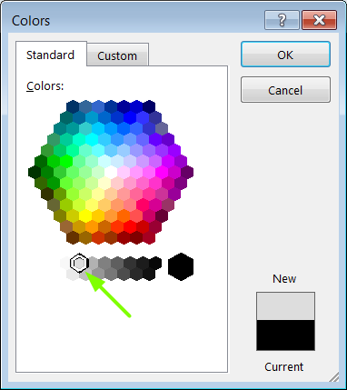
IBM Cloud Architecture Center
Gray Icons and Arrows for Background
OFFLINE
CAPABILITIES
Select icon and ungroup.
Select the icon background and change the fill color to R221, G221, B221. This is a standard color. See the picture.
Change the text to the same color.
Regroup the icon.
Change background arrows to the same color.

