Slide 1
September 10th 2018
IBM Cloud Architecture Center
Virtual Private Cloud Diagram Template
Using the Diagram Template
This template is for use in creating a visual representation of Virtual Private Cloud
You may add numbers (which are provided on page 3) to the diagram to correspond to the runtime flow steps in your architecture.
See instructions on how to gray out icons and lines on Page 4

Slide 2










IBM Cloud
Public
Network
Region A
Enterprise
Network
VPC 1
Classic
Infrastructure
Public
LB
Zone 1
10.10.0.0/16
Zone 2
10.20.0.0/16
DCnn
User
Public Gateway
Public
Subnet
Public
Subnet
Enterprise User Directory
ACL
ACL
Gateway Appliance
Internet
SG 1
FIP
Classic LB
VSI
VSI
VPN Connection
Enterprise User
VPN
Gateway
10.10.10.0/24
10.20.30.0/24
Classic VSI
Private
LB
Private
Subnet
Private
Subnet
ACL
ACL
Bare Metal
Direct
Link
Enterprise Applications
SG 2
VSI
VSI
VSI
VSI
10.10.20.0/24
10.20.40.0/24
Implicit Router
Enterprise Data
Notes:
Diagram shows VPC enabled for Classic Access.
Diagram shows primary interface for each VSI in the subnet and security group shown.
Each VSI has one or more interfaces in same or other subnet and each interface is in one or more security groups.

Slide 3
IBM Cloud Architecture Center
Runtime numbers
1
2
3
4
5
6
7
8
9
10
11
12
13
14
15
16
17
18
19
20

Slide 4

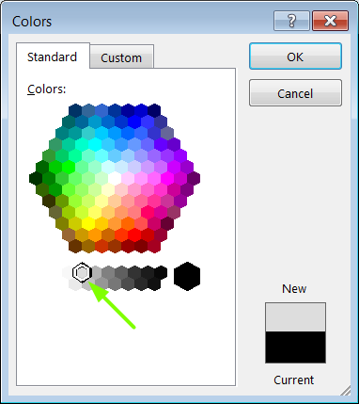
IBM Cloud Architecture Center
Gray Icons and Arrows for Background
OFFLINE
CAPABILITIES
Copy an icon.
Select it and ungroup.
Select the icon background and change the fill color to R221, G221, B221. This is a standard color. See the picture.
Change the text to the same color.
Regroup the icon.
Change background arrows to the same color.

