Slide 1
Event Driven Architecture
Point of View
Notes:
This should be my unique deck

Slide 2
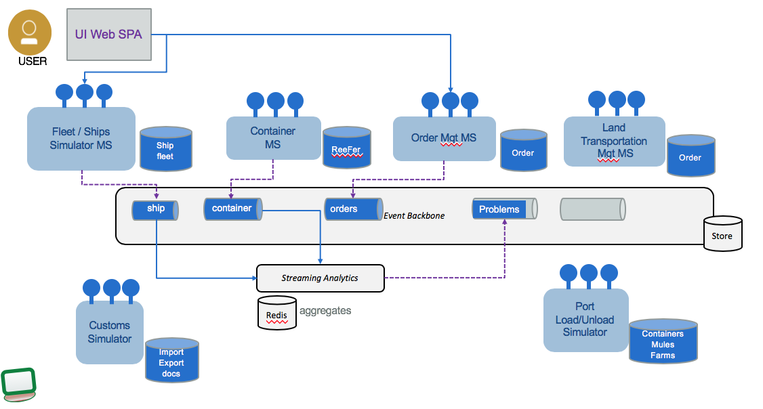
Reference Implementation
Shows solution design process with Event and Insight Storming.
Shows event driven microservices implementing Event Sourcing and CQRS application patterns.
Demonstrate streaming analytics and intelligent apps pattern with machine learning
https://ibm-cloud-architecture.github.io/refarch-kc

Slide 3
Fleet Simulator

Slide 4


Container Microservice - KStreams
Manage Container Inventory, APIs to access the inventory and consumer of ContainerEvent.
Kstreams implementation (Java – Open Liberty – JAXRS)
Container microservice as KStreams
KStream - KTable
OpenLiberty
Containers
0
1
2
3
4
5
6
7

Slide 5
Container Microservice - KStreams
Assign container to orders
Containers
0
1
2
3
4
5
6
7
Container microservice as KStreams
KStream - KTable
containers
City-containers
Orders
Kstreams - orders
0
1
2
3
4
5
OpenLiberty

Slide 6


Container Microservice – Springboot - Postgresql
Kafka data source, web, kafka template.
Containers
0
1
2
3
4
5
6
7
Container microservice Springboot
containers
Consumer - containers
City-containers
Orders
Consumer - orders
0
1
2
3
4
5
Tomcat

Slide 7
Container Microservice – Springboot - Postgresql
4
3
Producer
Consumer
2
psql
Containers
0
1
2
3
4
5
6
7
1
Container microservice Springboot
containers
Consumer - containers
Producer
Producer
6
City-containers
Orders
Consumer - orders
Producer
0
1
2
3
4
5
6
Tomcat
Consumer
5

Slide 8

Container Microservice - Python
Manage Container Inventory, APIs to access the inventory and consumer of ContainerEvent.
Python Flask, Kafka python API
Container microservice
Kafka Consumer
Python Flask
Containers
0
1
2
3
4
5
6
7

