Slide 2
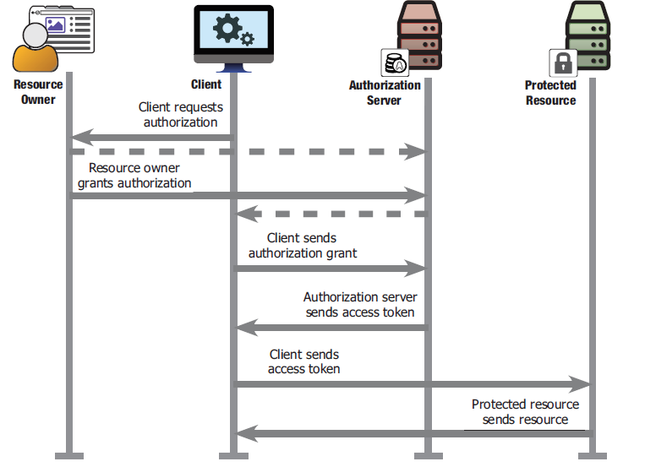
The OAuth process, at a high level

