Slide 1
Scripting with Knime
Development Notes
Notes:
Fight against paradigm, by creating solutions for dm which everyone is able to use.

Slide 2
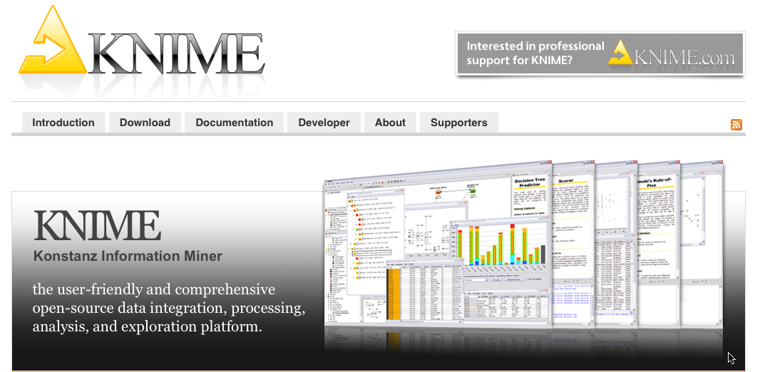
What is KNIME?
modular data exploration platform that enables the user to visually create data flows (often referred to as pipelines), selectively execute some or all analysis steps, and later investigate the results through interactive views on data and models.
100+ processing nodes for data I/O, preprocessing and cleansing, modeling, analysis and data mining as well as various interactive views
Notes:
Short demo: ldchem: example: add cv for cells and add barbplot for it
Make clear the difference to excel

Slide 3
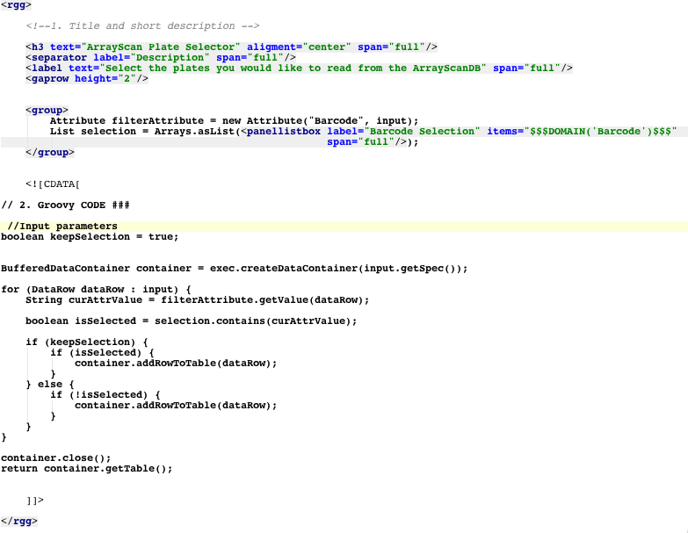
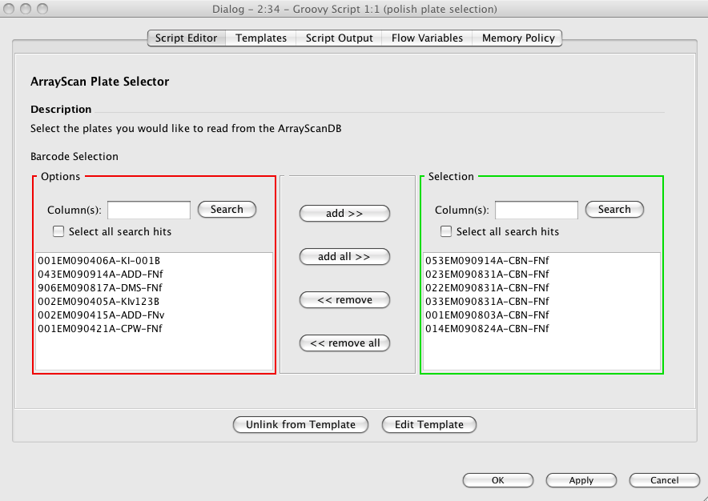
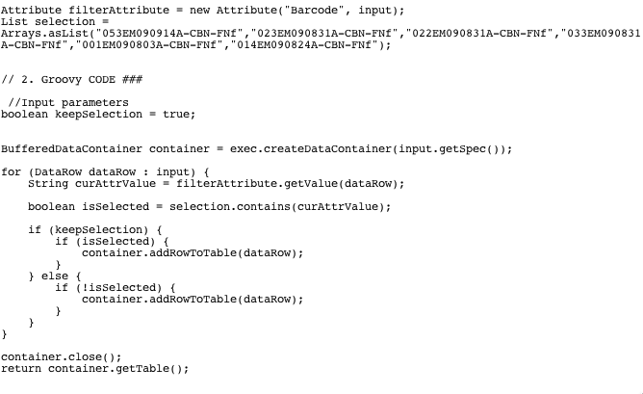
New script templates system
Visne et al., RGG: A general GUI Framework for R scripts, 2009, Bioinformatics, doi:10.1186/1471-2105-10-74

Slide 4

New script templates system
Internal
Internal
user
Notes:
DEMO
Make two plots and show how the scripting embeds into a flow (use alnylam-project as an example → boxplot)

Slide 5
Scripting node state diagram
Empty Script
Scripting
Create Node
Execute
Script
on execute
Reattach/
Convert to template
Not
rgg
Unlink
Template
Create
UI
Configure
Discards all script customizations
Rebuild
UI
Edit Template
Notes:
Pareto-principle 80 :20 examples: 80 ui is sufficient (given a well-designed set of templates), but for 20% of problems → custom solution necessary

Slide 6
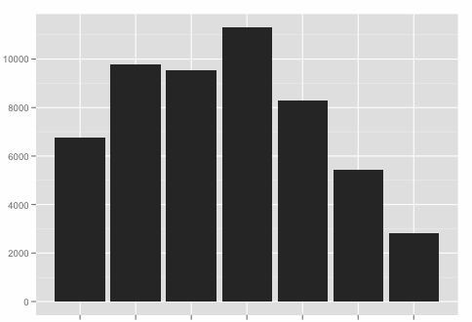
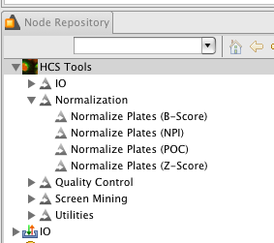
Difference between scripting-nodes and ‘real’ Knime-nodes?
Less meaningful node-name for scripting nodes
‘Real’ nodes are likely to be much faster
‘Real’ nodes scale better/work with huge data-sets
‘Real’ nodes can be updated by updating Knime
‘Real’ node-development requires 10x more resources
Convert to ‘real’ Knime-nodes
Usage count
T1 T2 T3 T4 T5 T6 T7
Templates

Slide 7
New Scripting System: Summary
Generic: Available for all supported scripting languages (Matlab, R, Groovy)
Facilitate knowledge propagation within the group
Applicable to different levels of expertise
Template library to preserve found solutions
Notes:
Explain the chart starting with the users
Why not python → Jepp integration, but not mature enough

Slide 8

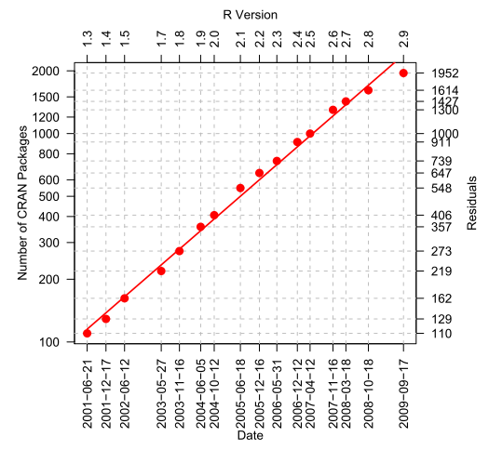
R Integration
Why R?
Free
Exponential growth
Lingua franca for statistical modeling
3 Nodes
R-plot: Use the power of R for visualization
R-Snippet: Data transformation
Open in R: Rapid prototyping
Notes:
There is a basic R-integration but R seems so central that we’ve created a much more powerful one

Slide 9
Scripting integration revisited
Goals
Faster table conversion (rm284)
Generic R/Scripting
Typed inputs and outputs
Ability to deploy scripting nodes into Knime’s node repository
Option to use fixed or updatable template

Slide 10
Generic R
Does not make sense for groovy
Matlab not in use enough
GenericR will be used for special tasks as it completely diminishes Knime to become a user interface
Idea: don’t pass just data-frames between nodes but arbitrary objects
This would also allow for function definitions to be passed between nodes
Similar attempts: Galaxy, RevoDeployR, RapidMiner

Slide 11
How to persist generic R-objects?
Not easily (Java) serializable because REXP instance might have links to R
Save the output R object using R’s persistence mechanism → transfer to Knime save as node data → send to R when required as input
Pro/Con: Java serialization seems cleaner, but R persistence is likely to be faster (because it does not require 2 additional Java-R conversion steps

Slide 12
Required nodes
Explicit cast nodes give more cluttered workflows but should be cleaner from a conceptual point
"Cast to R" given a table as input
”Coerce to table" (given a generic R object)
"R snippet" (generic R in an out)
"R-Plot" Plot a generic R input
The processing node should have one or two optional inputs
The plotting node should share as much as possible with the non-generic "R-Plot" node. Just the snippet node and the plotting node need an own Rtifactory.
Notes:
Cf optional inputsL: (which should be the second one to give a cleaner workflow picture)

Slide 13
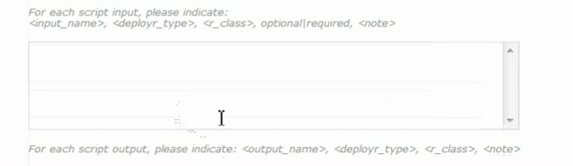
Typed input/outputs
Assign types to persistent data objects
Could be inferred from data itself → R ‘class’ attribute
Could be defined in the template (as done for RevoDeployR, or galaxy)
Priority:Low

Slide 14
ToDos
Generic port
Persistence mechanism
OpenInR Generic
Cast nodes
Plot node
Deploy some templates as Knime-nodes
Speed up Knime→R Conversion

Slide 15
Further requirements
The current scripting system should support nodes with Knime-native UI and some generic mechanism to push the config to R
Why: To allow conditional attributes, and to allow the reuse of existing UI elements in Knime
Required for generic barplot & Alexis

Slide 16
Template sensitive table conversion
Instead of pushing the complete table just the columns according to the config should be transferred to R and back
Entry point: pass list of required columns to Rutils.convertInputs and skip columns Rutils.convert2RList
Needs to be optional
In place replacements should work without by simply overriding existing columns
Complete table transformations (irrespective of the template config) would not work any longer
Results of script should be attached to existing data-frame

Slide 17
Proper support for configure for natively deployed templates
Needs to be defined for each template individually
Could be eased by utility methods like
appendSuffix(List<String>)
newTable(List<String>
Etc.
Evidentially, just a few lines should give a proper configure support for each template

Slide 18
Hardwired vs. softwired template nodes
HW:
Nodes will pick up the latest version of the node-template from the jar on restart
The edit template button is disabled
The node will use the hardwired version just if being linked to the template. If being unlinked the user still can change the script as desired.
Softwired
The template is just loaded initially from the jar-rgg definition and is then decoupled from its source

Slide 19
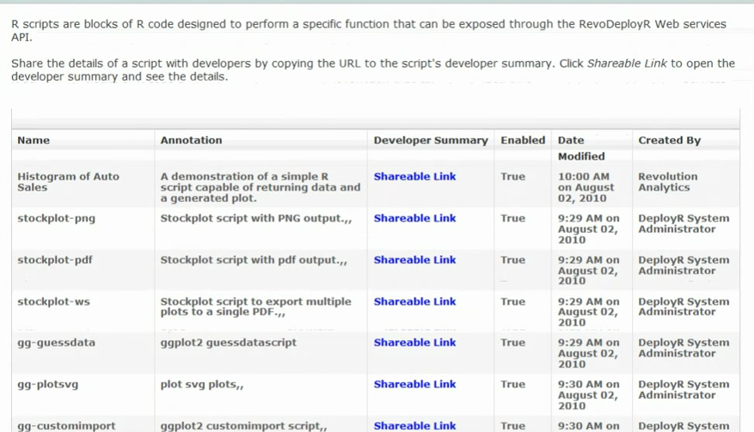
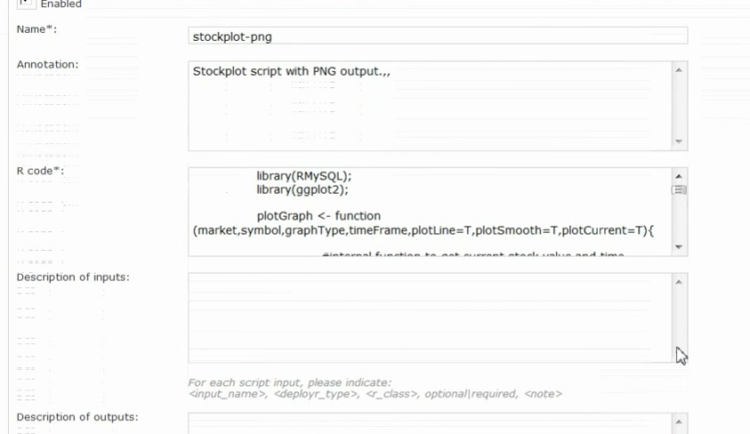
Overview: RevoDeployR
More focused on webapps, but also excel addin
Webservice framework

Slide 20
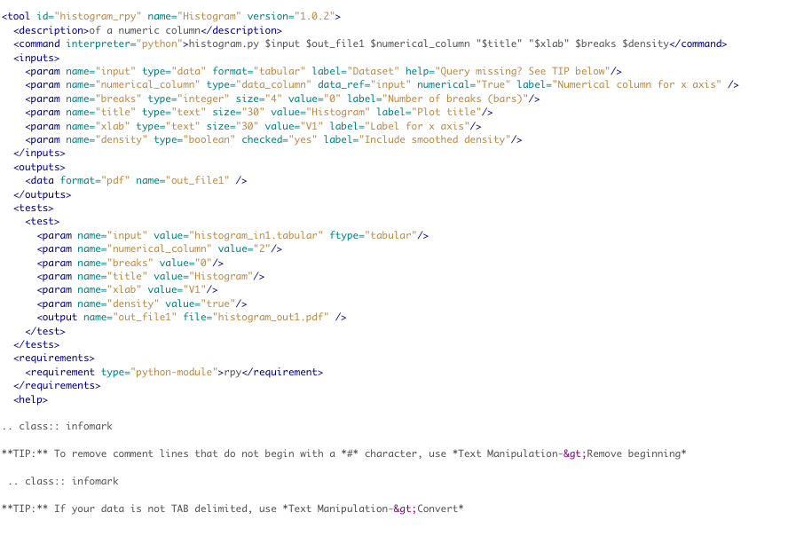
Overview Galaxy?
Tools.xml → refers to all scripts to be integrated
Xml desc for each operator

