Slide 1


Slide 2

Digital Library Management System

Slide 3
Group Members Introduction
My name is Muhammad Ahsan. I have opted this project as a single member and I’m the only person who have worked and developed it. My VU ID: MC190200251

Slide 4

INTRODUCTION OF PROJECT
This project Digital Library Management System is a web application. It is developed in html, css, JavaScript and php. There are three users in this system Admin, Librarian and Student/User. Admin can register a librarian. A registered librarian will be performing all the basic operations related to a library like add new book, delete book, issue book, fine collection, add new student, delete student, search, return book. This system will make the job of librarian easy and automated. All the information of this system will be stored in a database which is helpful to keep available books record, borrowed books and members. This software is easy to use and error free.

Slide 5
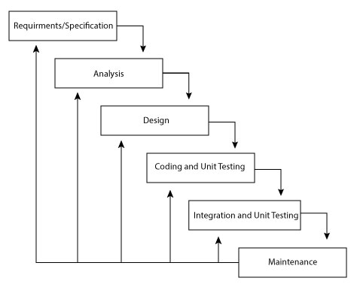
Process Model

Slide 6
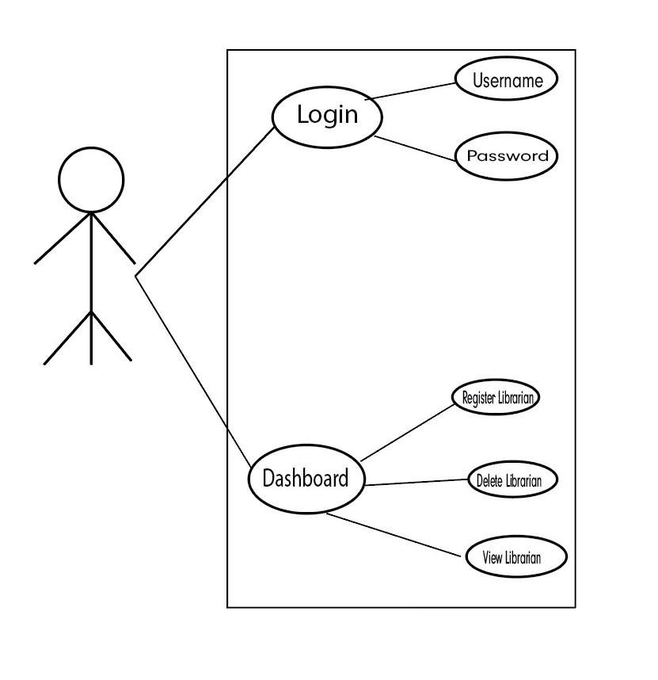
Use Case Diagram
Use case Diagram for Admin:

Slide 7
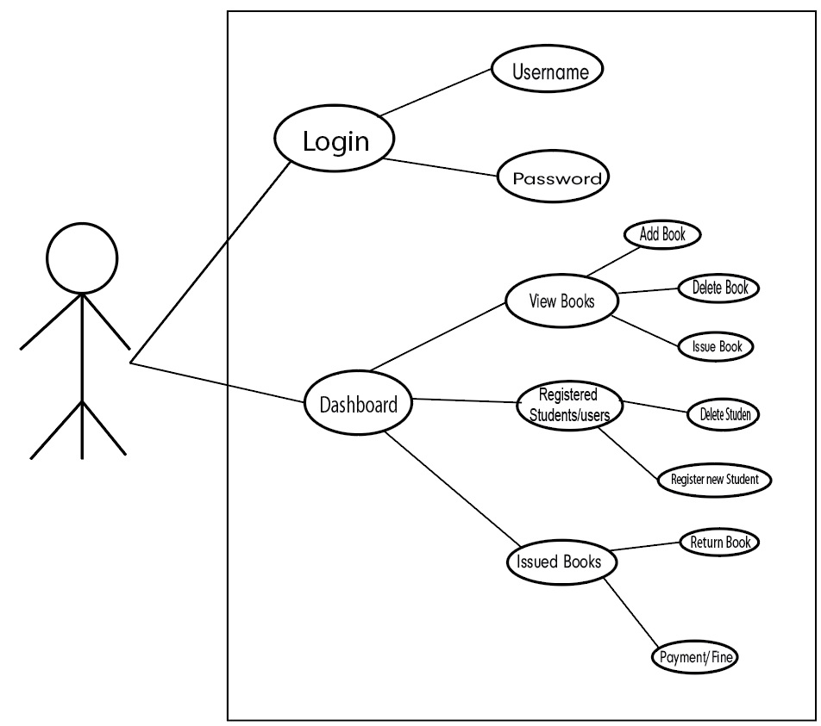
Use case Diagram for Librarian:

Slide 8
Functional Requirements :
Admin will be able to login into system using by default username and id.
Admin will be able to register, view already registered and delete a librarian.
Librarian will be registering a user/student using his/her name, college roll number, email and class.
Librarian will be able to search a book or already registered user/student through search option.
Librarian will be able to view, add, issue a book.
Librarian will be able to update or delete an existing book.
The system will be calculating fine in case of late return of book after due date by the user/student.

Slide 9
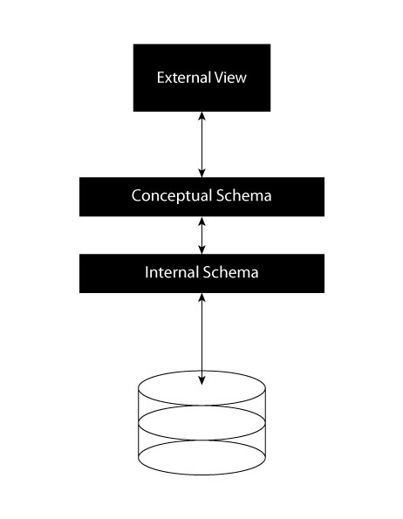
Architectural Design

Slide 10
Team Structure
I’m Muhammad Ahsan and I’m the only person who has worked and developed this whole project.

Slide 11
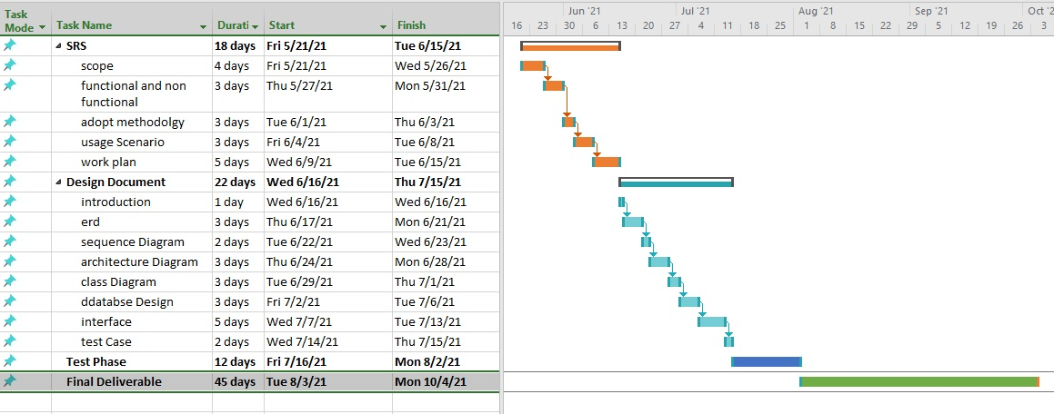
Project Schedule

Slide 12
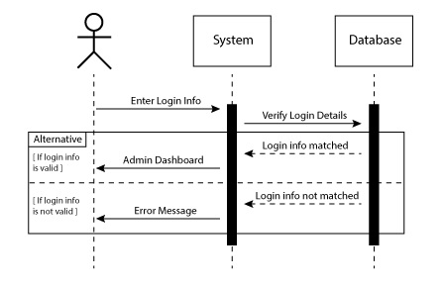
Sequence Diagrams
Admin Login

Slide 13
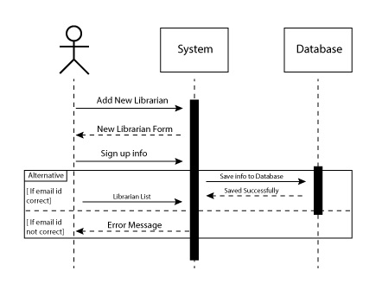
Librarian Registration

Slide 14
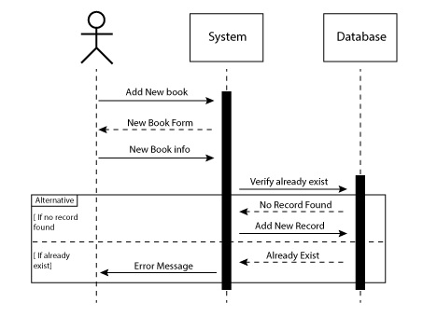
Add New Book

Slide 15
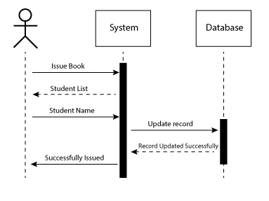
Issue Book

Slide 16
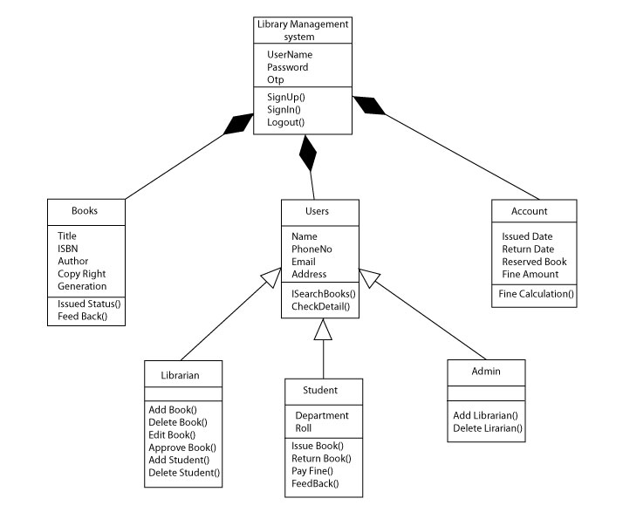
Logical Model/Class Diagram

Slide 17
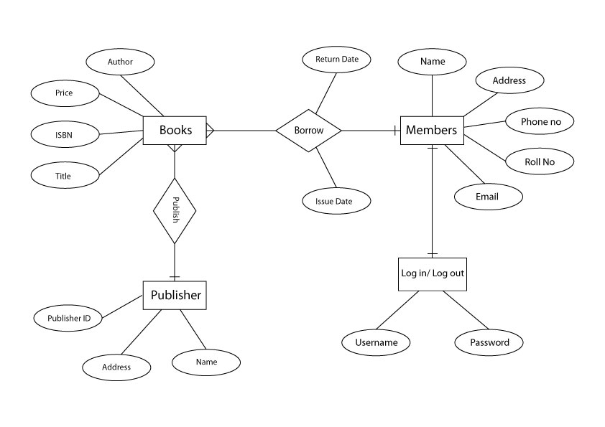
Entity-Relationship Diagram

Slide 18
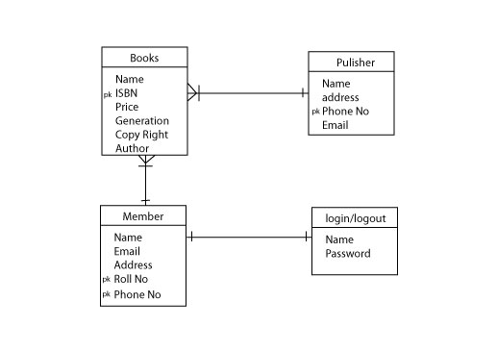
Database Diagram

Slide 19
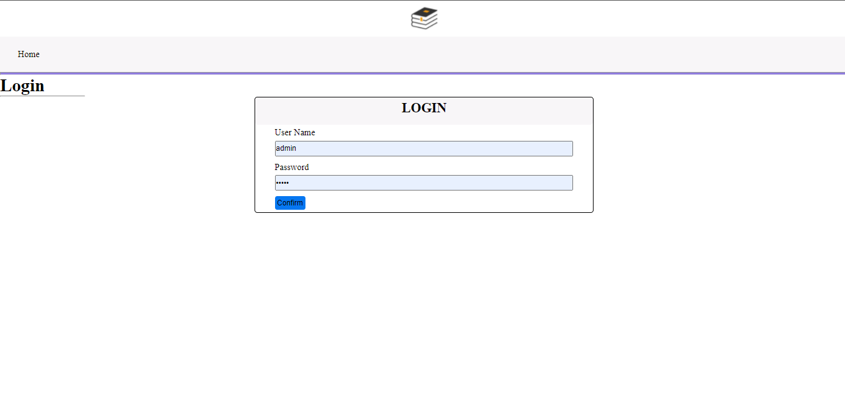
User Interfaces

Slide 20
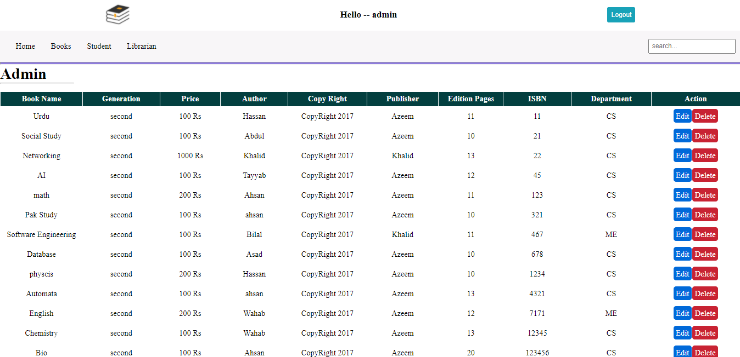

Slide 21
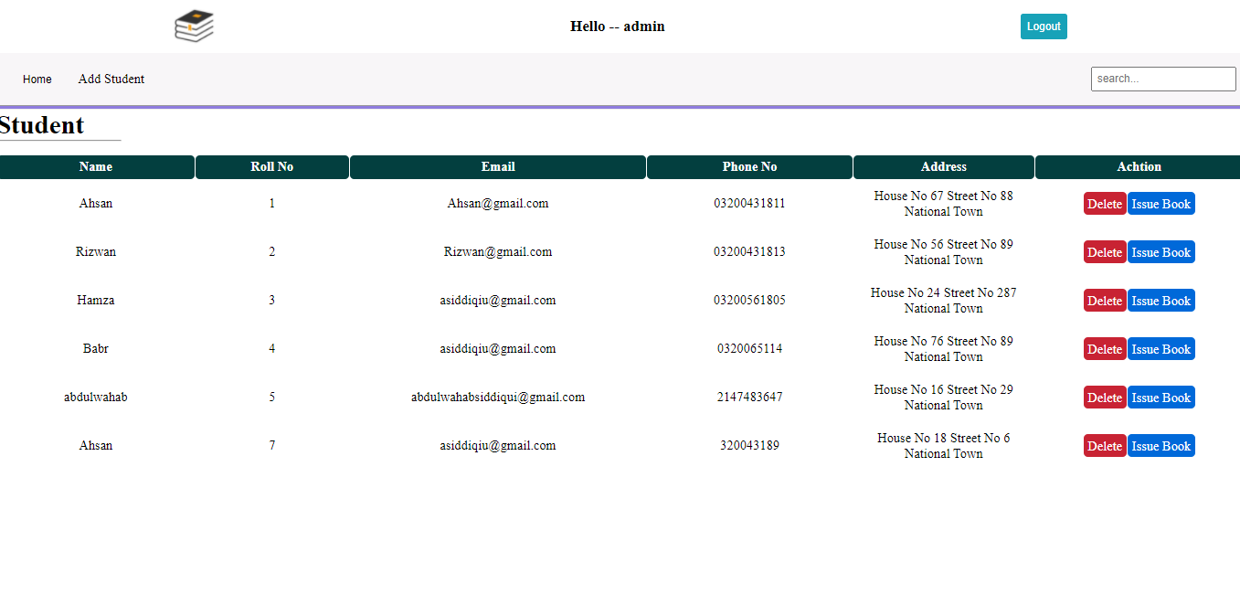

Slide 22
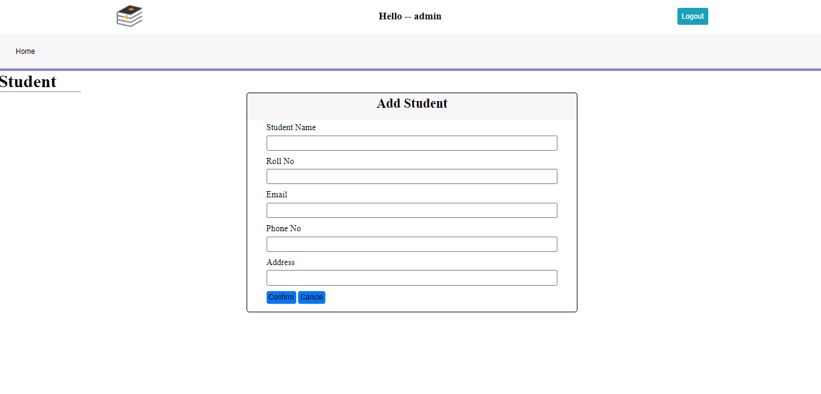

Slide 23
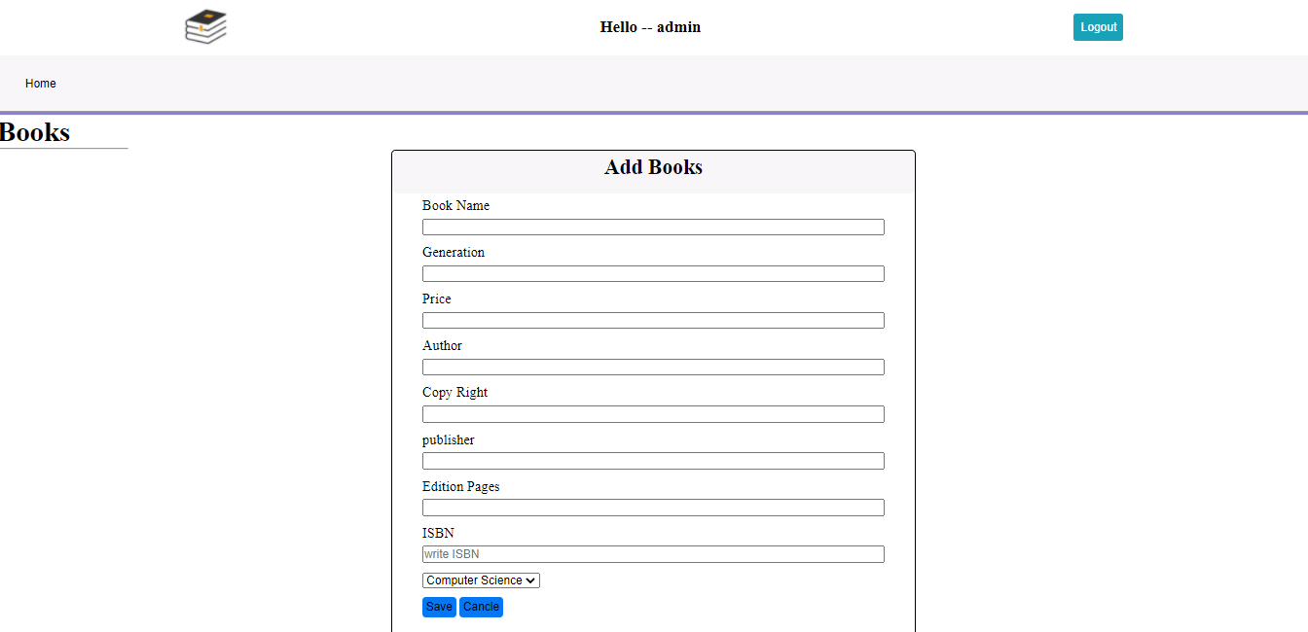

Slide 24
Tools
This application Digital Library Management System is developed in VS Code IDE and mysql.

