Slide 1
Resource Description Framework
By: Amina Aiache
Master Degree in Information Systems’ Technologies
https://github.com/Aaiache/WebRDF

Slide 2
What is Semantic Web?
“The Semantic Web is a web of data, in some ways like a global database” (https://www.w3.org)
“First step is putting data on the Web in a form that machines can naturally understand, or converting it to that form, this creates what I call a Semantic Web : a web of data that can be processed directly or indirectly by machines” (Tim Berners-Lee, Weaving the web. Harper, San Fransisco. 1999)

Slide 3
The problem
Web pages are written in HTML.
Machines are not able to understand the meaning behind information.
They cannot help us find what we are interested in!

Slide 4
Solution
A Web where all is about things …
RDF is A standard of the World Wide Web Consortium (W3C) for describing resources in the Web.
It uses triples to describe things :
Subject – Predicate – Object
(Thing) – (Property) – (Value)

Slide 5
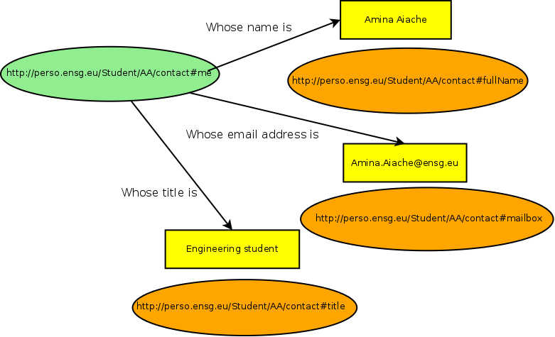
Example:RDF description of a person named Amina Aiache

Slide 6
Thank you!

