Slide 1
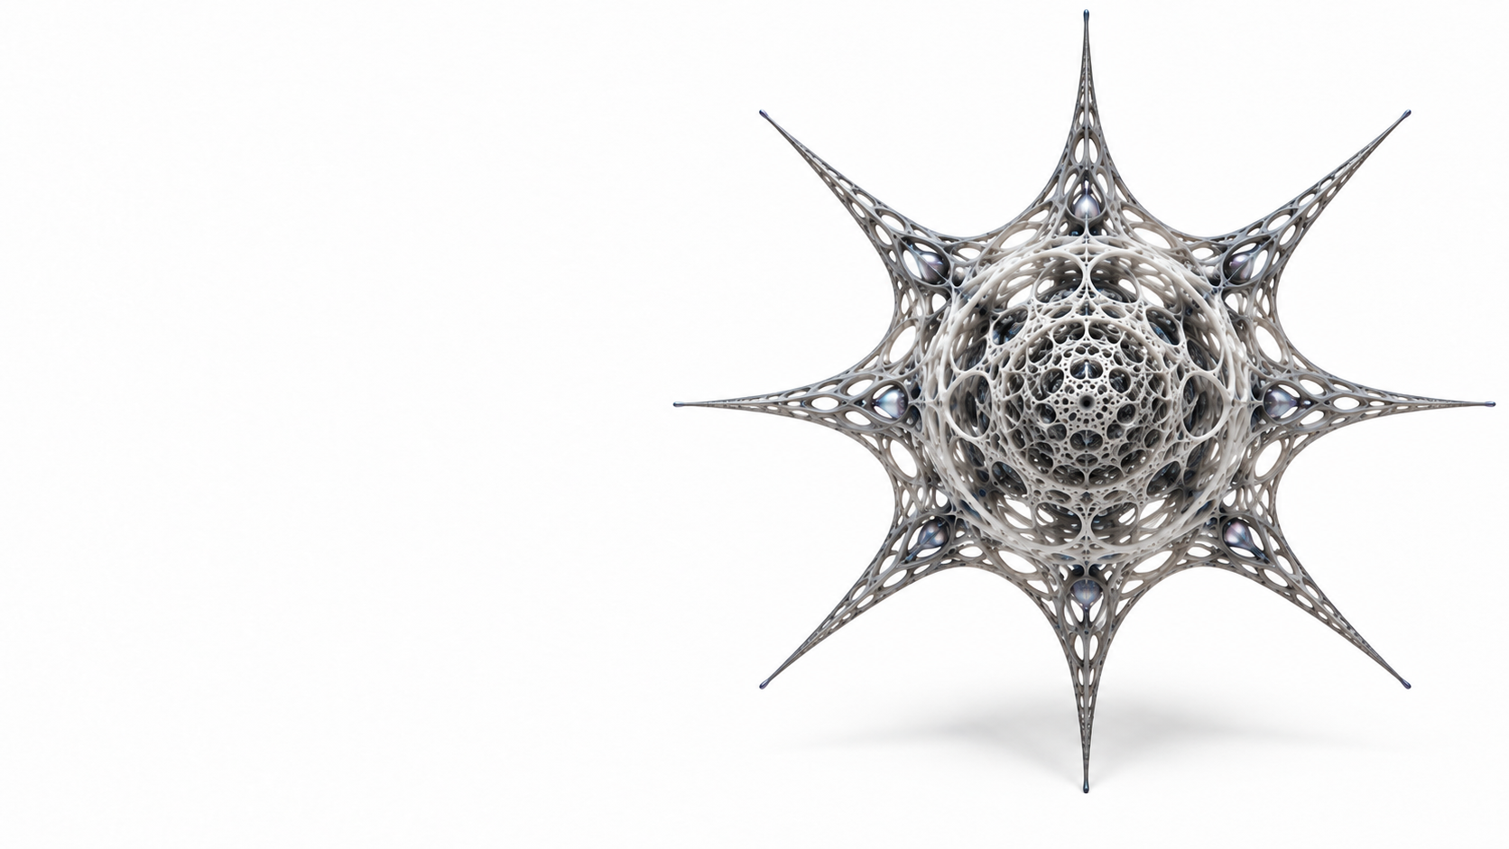
RADIOLARIA OS / EDITORIAL PILOT
Computing, assembled around intent
Three football sessions.
Natural grass. A EUR 70 limit.
Compute an offer.
Check it with another owner.
Book only with separate consent.
Approved conceptual artwork, not evidence.
An application execution kernel for models, code and services.
Recorded reference code. Mock effects. No new runtime campaign.
CL01-CL03 / Useful activity; bounded recorded example
01 / 05
Notes:
{
"title": "Computing, assembled around intent",
"classification": "CL01-CL03 / Useful activity; bounded recorded example",
"source": "presentation/slides.json",
"local_route": "../README.md",
"technical_basis": "2e965ecb18e545e428380eb8e9aa5a7037a388be",
"claim_ids": [],
"entity_ids": [],
"technical_sources": [],
"figure_id": null,
"artwork": "Original bytes, conceptual/prototype scope preserved. See assets/provenance.json."
}

Slide 2
RADIOLARIA OS / EDITORIAL PILOT
Independent owners, useful work
A user or event supplies an intention; semantic proposals are not permission.
VenueRoot
ActivePlanetRoot
Bounded code computes availability
Local Work consumes checked evidence
DATA
Local Root reviews the result
Its own Root decides locally
PERMISSION: current packet -> Firewall
Foreign approval is not permission
EXECUTION: separately authorized effect
No write access to venue registry
Time and local memory inform each decision; neither retains action authority.
Typed Work can compose child Work. Runtime owns topology, not final authority.
ATLAS_A / CONCEPTUAL / CL01 / No SuperRoot
02 / 05
Notes:
{
"title": "Independent owners, useful work",
"classification": "ATLAS_A / CONCEPTUAL / CL01 / No SuperRoot",
"source": "presentation/slides.json",
"local_route": "../atlas/README.md#atlas_a",
"technical_basis": "2e965ecb18e545e428380eb8e9aa5a7037a388be",
"claim_ids": [
"CL01"
],
"entity_ids": [
"INTENT",
"MODEL",
"VENUE",
"REQUESTER",
"WORK",
"ROOT",
"MEMORY",
"FIREWALL"
],
"technical_sources": [
"specs/current_architecture_lock_v01.md"
],
"figure_id": "ATLAS_A",
"artwork": "Original bytes, conceptual/prototype scope preserved. See assets/provenance.json."
}

Slide 3
RADIOLARIA OS / EDITORIAL PILOT
A result crosses; permission does not
E: computed offer
DERIVATION
B: source body
DATA
C: local Work input
VenueRoot native Work
Offer + Work/review refs
ActivePlanetRoot consumes
Three natural-grass slots
Address locates material
Body + current ACTIVE status
6300 / 7000 minor EUR
Release binds delivery
Local result review
EUR 63 / EUR 70
No booking permission
SHIFT: zero effects
REVOKED -> status_not_active -> Root BLOCKED_FAIL_CLOSED
Native reason: hard_identity_violation. No successful consumer in that branch.
BOOK is separate: explicit consent -> VenueRoot -> one mock effect + receipt.
ATLAS_B / RECORDED_EXECUTION / CL02-CL03 / G54D1 main + revoked_source
03 / 05
Notes:
{
"title": "A result crosses; permission does not",
"classification": "ATLAS_B / RECORDED_EXECUTION / CL02-CL03 / G54D1 main + revoked_source",
"source": "presentation/slides.json",
"local_route": "../episode/FOOTBALL.md",
"technical_basis": "2e965ecb18e545e428380eb8e9aa5a7037a388be",
"claim_ids": [
"CL02",
"CL03"
],
"entity_ids": [
"VENUE",
"E",
"B",
"POINTER",
"STATUS",
"C",
"REQUESTER"
],
"technical_sources": [
"main_pub_shift_venue_work",
"main_pub_shift_offer_body",
"main_req_shift_requester_work",
"negative_shift_status"
],
"figure_id": "ATLAS_B",
"artwork": "Original bytes, conceptual/prototype scope preserved. See assets/provenance.json."
}

Slide 4
RADIOLARIA OS / EDITORIAL PILOT
Authorship is not runtime permission
DESIGN TIME
DOCUMENT_REFERENCE
DATA
PROPOSAL
HOW + WHAT
Candidate
Independent exam
Admission
Public interfaces and task
Authored program
Own inputs and oracle
Reviewed source
G54D1 continued an existing lineage with authorized correction 4.
G54B1 and G54D remain INCOMPLETE. This was not one-shot authorship.
RUNTIME
New request -> current sources -> bounded Work -> local Root -> scoped effect
The audit Reader explains evidence; it is not the Authoring Kit or hidden oracle.
ATLAS_C / CONCEPTUAL / CL04 / Historical admission remains source-bound
04 / 05
Notes:
{
"title": "Authorship is not runtime permission",
"classification": "ATLAS_C / CONCEPTUAL / CL04 / Historical admission remains source-bound",
"source": "presentation/slides.json",
"local_route": "../CONTRIBUTIONS.md",
"technical_basis": "2e965ecb18e545e428380eb8e9aa5a7037a388be",
"claim_ids": [
"CL04"
],
"entity_ids": [
"KIT",
"WHAT",
"CANDIDATE",
"EXAMINER",
"SOURCE_ADMISSION",
"READER"
],
"technical_sources": [
"docs/gate5_authoring_kit_v01/START_HERE.md",
"docs/showcase/gate5_reference_v01/dossiers/A.md"
],
"figure_id": "ATLAS_C",
"artwork": "Original bytes, conceptual/prototype scope preserved. See assets/provenance.json."
}

Slide 5

RADIOLARIA OS / EDITORIAL PILOT
A visible fingerprint, not authority
Evidence object -> digest -> picture
Existing SVG and noncanonical PNG
Source files and output hashes inspected
No fresh repeatability or camera test
No image-to-hash recovery or ECC
No permission, signature or uniqueness proof
B1R3 NONCANONICAL PREVIEW
Lookup needs an explicit interface. A picture does not restore evidence or authority.
VISUAL_SEAL / PROTOTYPE / Existing sibling outputs; not a fresh generation
05 / 05
Notes:
{
"title": "A visible fingerprint, not authority",
"classification": "VISUAL_SEAL / PROTOTYPE / Existing sibling outputs; not a fresh generation",
"source": "presentation/slides.json",
"local_route": "../VISUAL_SEAL.md",
"technical_basis": "2e965ecb18e545e428380eb8e9aa5a7037a388be",
"claim_ids": [],
"entity_ids": [],
"technical_sources": [],
"figure_id": null,
"artwork": "Original bytes, conceptual/prototype scope preserved. See assets/provenance.json."
}

