Slide 1
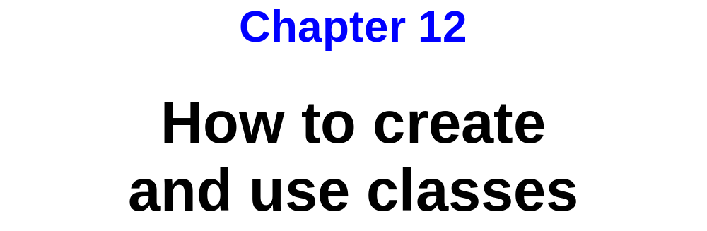
Murach’s C# 2010, C12
© 2010, Mike Murach & Associates, Inc.
Slide <number>

Slide 2
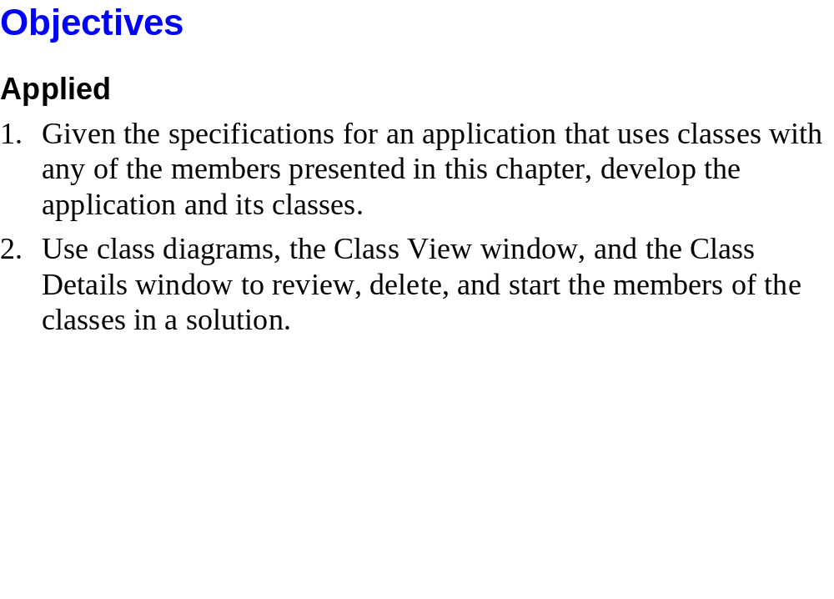
Murach’s C# 2010, C12
© 2010, Mike Murach & Associates, Inc.
Slide <number>

Slide 3
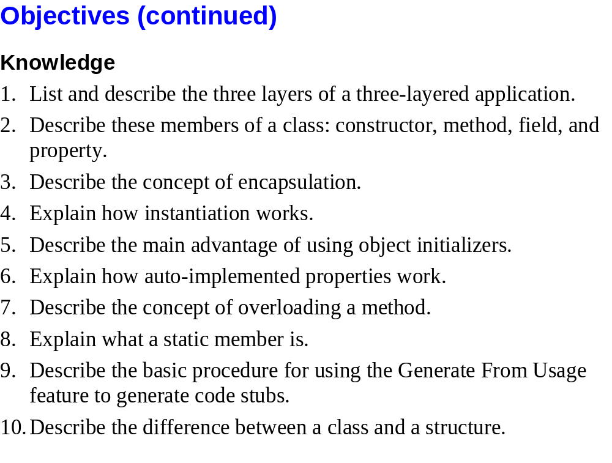
Murach’s C# 2010, C12
© 2010, Mike Murach & Associates, Inc.
Slide <number>

Slide 4
Programming Paradigms
Procedural programming or structured programming
  Focuses on the “processes” involved in solving a particular problem and how the data involved in those processes will be shared
  We used this approach in 133C# (and in 102)
    We talked about WHAT SHOULD HAPPEN when the user pressed this button or loaded this form
    We wrote algorithms to describe the details of each of our event handlers
    Sometimes, when an algorithm was complex, we broke it up into smaller pieces called methods
    We identified parameters and returns values from methods and talked about how we might use instance variables to store data that needed to persist between event handlers
    We focused on VERBS

Slide 5
Programming Paradigms
Object oriented programming
  Focuses on the “things” involved in a system.
  We’ll use this approach in 233C#
    We’ll identify the “things” or entities in each problem space. We’ll focus on NOUNS rather than verbs.
    We’ll build software components or classes that model each of the things we identify.
      Each class will have attributes or characteristics that it knows about itself
      Each class will have behaviors or methods that it knows how to do
      We’ll teach each class “what it means to be” that kind of thing.
      Object oriented programming is the “zen” approach to programming.
    We’ll build applications by “dropping” our classes into an application and letting them “do their stuff”.
    We’ll still have algorithms and control structures and parameters and return values

Slide 6
Designing a Class
Let’s think about playing card games and design a Card class that simulates a card in the real world
  I’ll create a class diagram on the board as we design the class together
  I’ll show you the class diagram that I developed in preparation for class as well as the C# code that implements the class
Remember that we’ll be “teaching” our Card “what it means to be a card.”
  What’s the name of our class?
  What attributes or characteristics does it have? What “things does it need to know about itself” to differentiate it from another Card?
  What behaviors or actions does it need to know how to do in order to behave like a Card?

Slide 7
Designing a Class
The next 2 slides illustrate the class I designed in preparation for class today. Both were generated in Visual Studio.
  The first shows a “standard” UML model.
    The top is the class name
    The middle sections list the attributes
    The bottom section lists the methods including “special methods” called constructors that are used to create an object, getters or accessors that allow programmers to retrieve attribute values and setters or mutators that allow programmers to change attribute values.

Slide 8
Designing a Class
  The second shows a model that is includes properties rather than getters and setters
    A property is a .NET construct that allow you to work with attributes.
    You did this a lot in 133 when you were working with GUI objects.
    Some properties are read/write – getter and setter
    Others are just read – just a getter
    Rarely will you have a write only property – just a setter

Slide 9
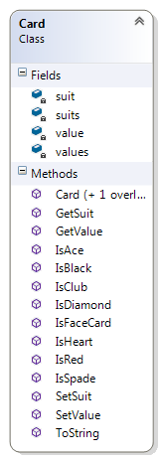
Designing a Class

Slide 10
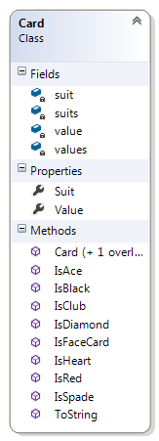
Designing a Class

Slide 11
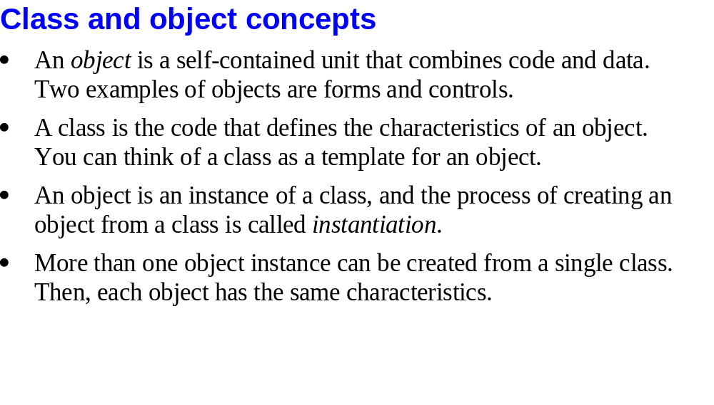
Murach’s C# 2010, C3
© 2010, Mike Murach & Associates, Inc.
Slide <number>

Slide 12
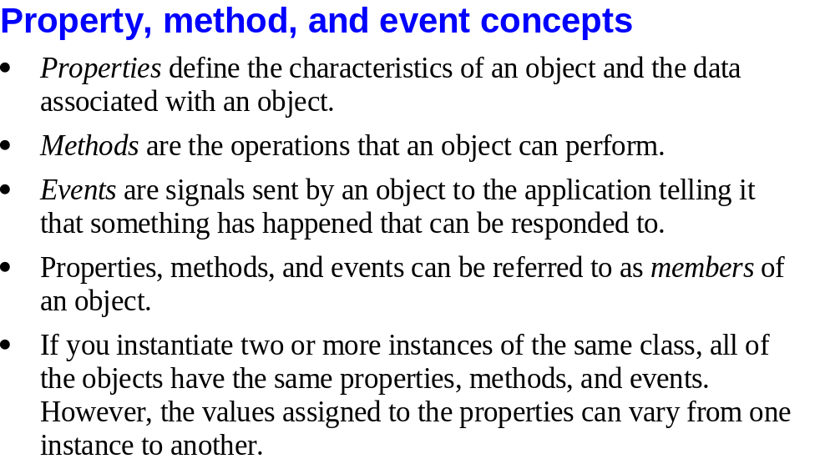
Murach’s C# 2010, C3
© 2010, Mike Murach & Associates, Inc.
Slide <number>

Slide 13
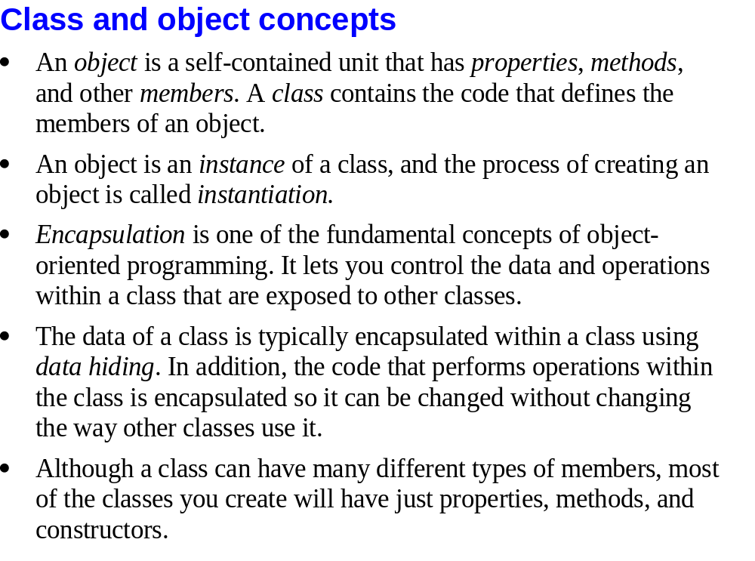
Murach’s C# 2010, C12
© 2010, Mike Murach & Associates, Inc.
Slide <number>

Slide 14
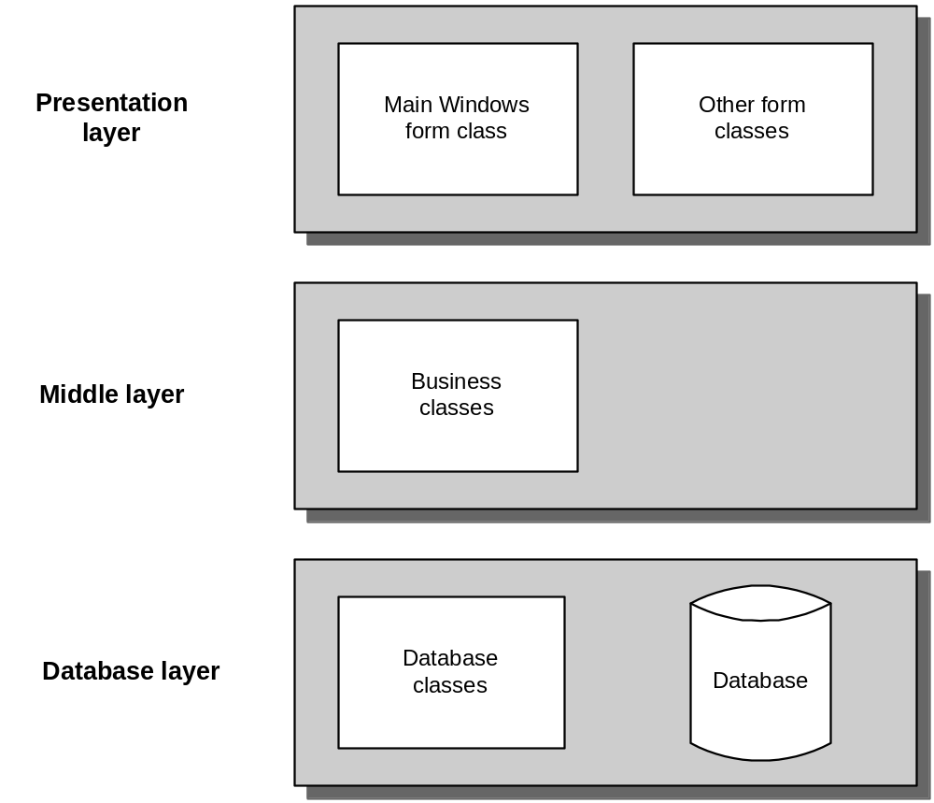
Murach’s C# 2010, C12
© 2010, Mike Murach & Associates, Inc.
Slide <number>

Slide 15
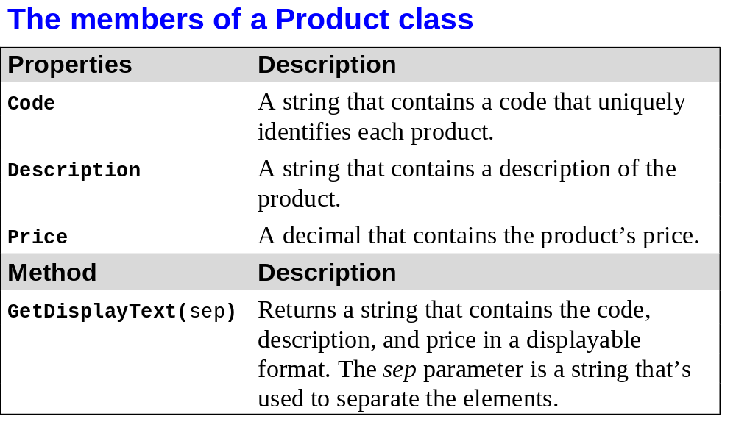
Murach’s C# 2010, C12
© 2010, Mike Murach & Associates, Inc.
Slide <number>

Slide 16
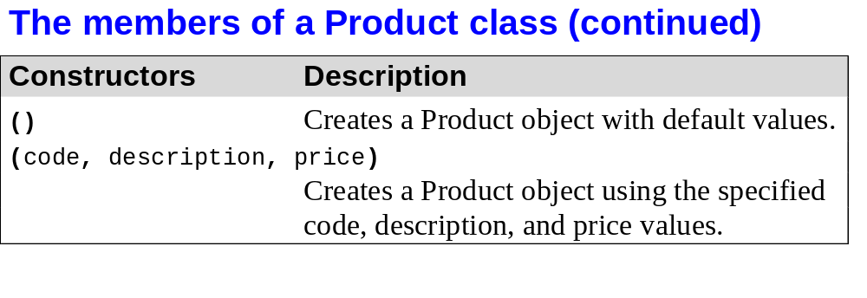
Murach’s C# 2010, C12
© 2010, Mike Murach & Associates, Inc.
Slide <number>

Slide 17
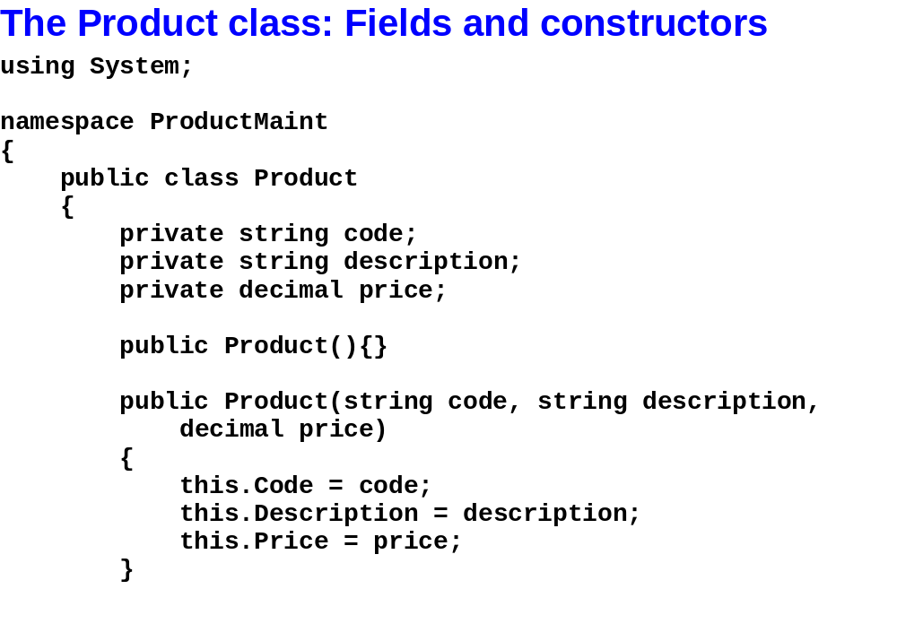
Murach’s C# 2010, C12
© 2010, Mike Murach & Associates, Inc.
Slide <number>

Slide 18
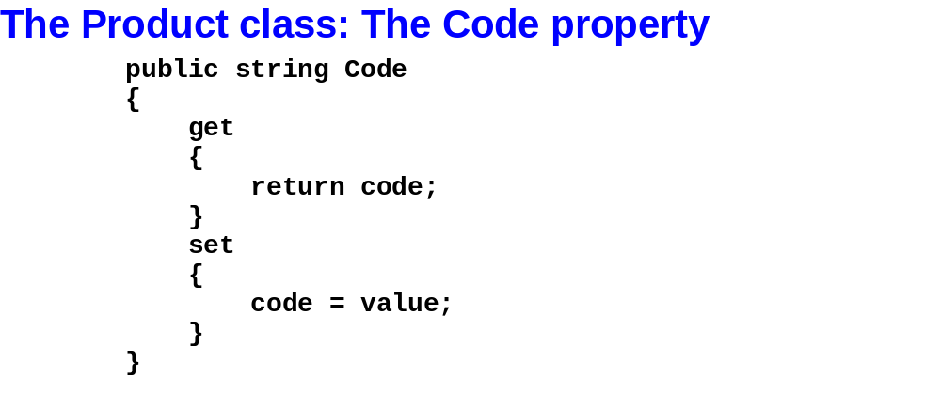
Murach’s C# 2010, C12
© 2010, Mike Murach & Associates, Inc.
Slide <number>

Slide 19
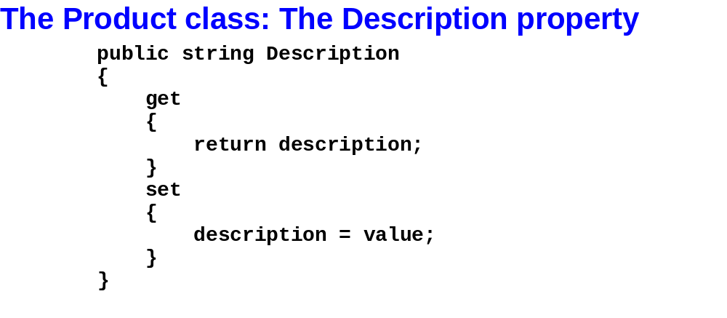
Murach’s C# 2010, C12
© 2010, Mike Murach & Associates, Inc.
Slide <number>

Slide 20
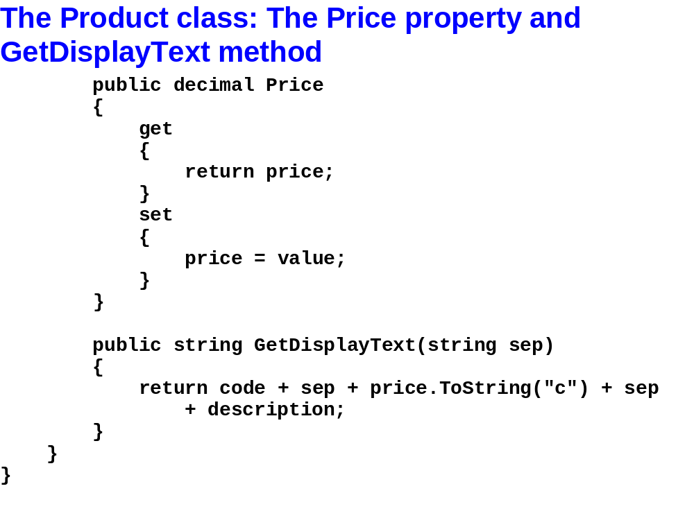
Murach’s C# 2010, C12
© 2010, Mike Murach & Associates, Inc.
Slide <number>

Slide 21
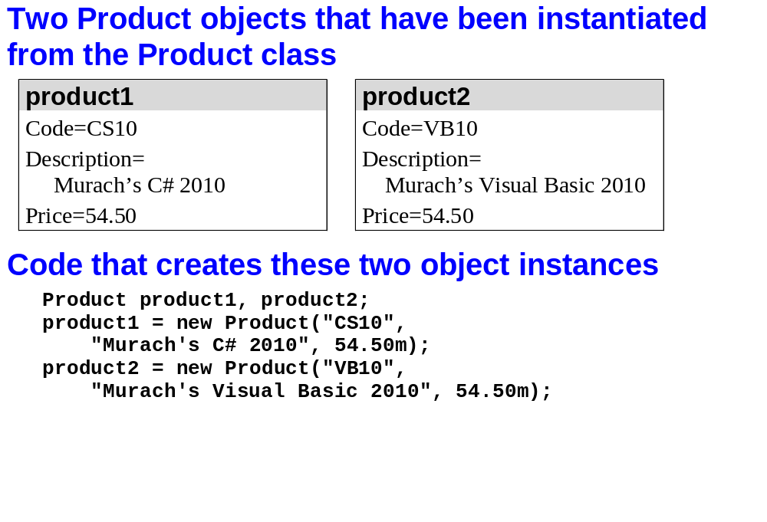
Murach’s C# 2010, C12
© 2010, Mike Murach & Associates, Inc.
Slide <number>

Slide 22
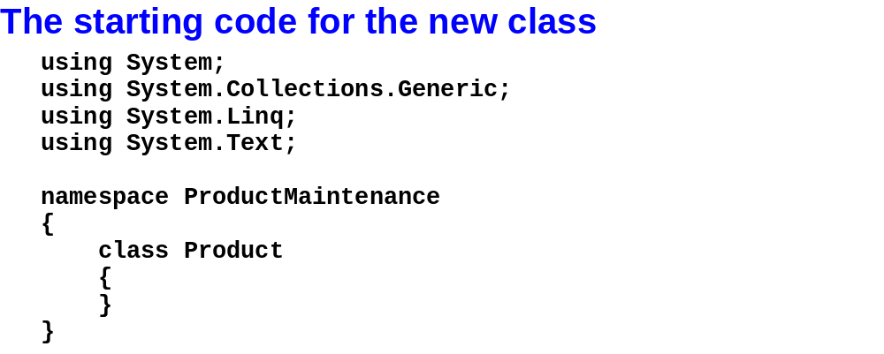
Murach’s C# 2010, C12
© 2010, Mike Murach & Associates, Inc.
Slide <number>

Slide 23
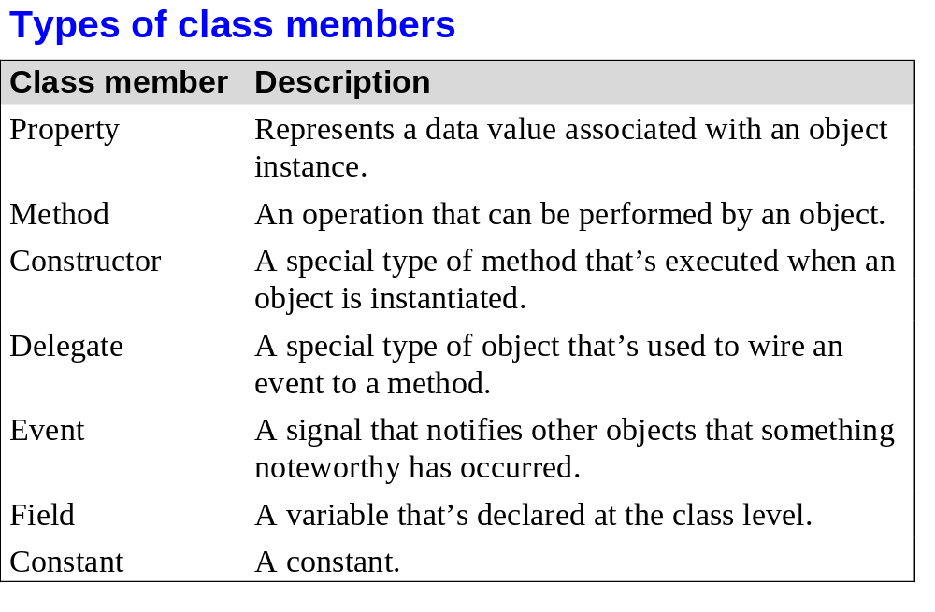
Murach’s C# 2010, C12
© 2010, Mike Murach & Associates, Inc.
Slide <number>

Slide 24
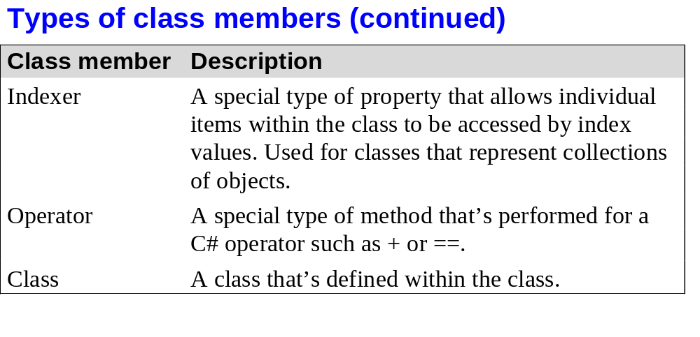
Murach’s C# 2010, C12
© 2010, Mike Murach & Associates, Inc.
Slide <number>

Slide 25
Lab 4
There’s lot of additional information in the chapter that tells you all of the different ways that you can do all of what you just saw in the product class but you know enough at this point to write a class of your own
BUT before we do that, let’s look at the Product Maintenance solutions (there are 2) in Visual Studio
  Version 1 – looks like the code that’s in the book. It has one project that includes the UI and the classes.
  Version 2 – has 3 separate projects and is a more typical project configuration.
    UI
    Classes – generally there would be several of these class library projects, one for business classes and one for database classes, for example.
    Test code
  Let’s focus just on the Product class first
  Then I’ll show you how I tested it. The textbook doesn’t do that, which is a very bad idea. Why?

Slide 26
Lab 4
The first part of lab 4 asks you to write a Customer class as described in Exercise 12 – 1 on page 393 in the text.
  Do steps 1 – 4 now.
  Write a comprehensive set of tests.
  You’ll use the classes in the UI in lab 5.
The second part of lab 4 asks you to write a Card class.
  Use the class diagram that we developed in class together to determine the specifications. Write a comprehensive set of tests. You’ll use the class in Concentration in lab 5.
    Make a copy of your solution to lab 3. Even if you’re not done …
    Add a class library project
    Rename the class to Card.
    Add a console app project. Make this the start up project. Add a reference to the class library and a using statement to the top of the console app program.cs.
    Implement one or two methods and test each one as you go.

Slide 27
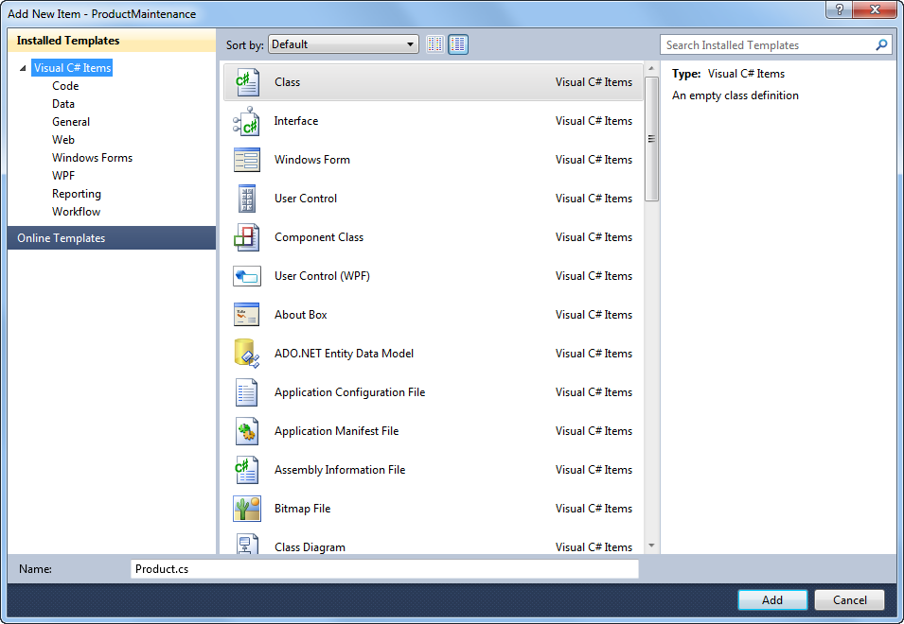
Murach’s C# 2010, C12
© 2010, Mike Murach & Associates, Inc.
Slide <number>

Slide 28
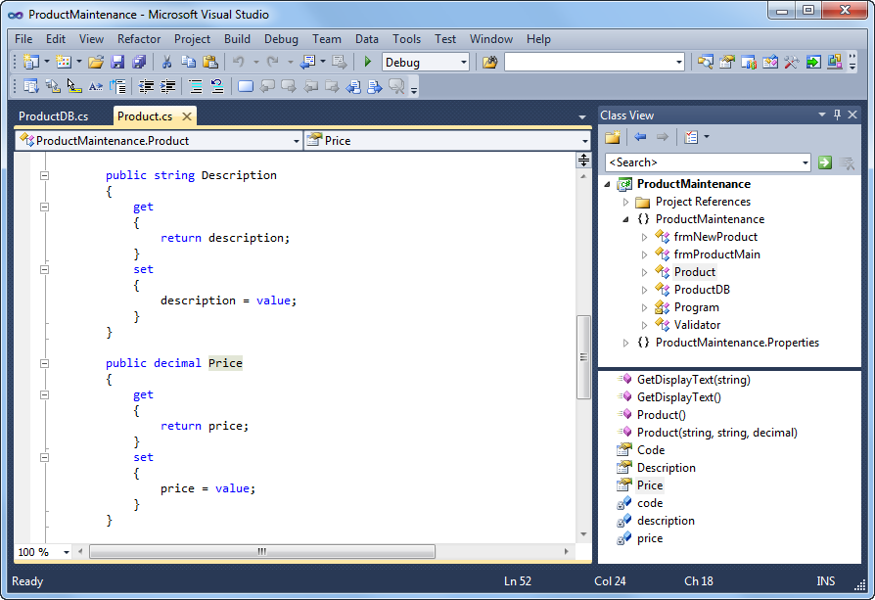
Murach’s C# 2010, C12
© 2010, Mike Murach & Associates, Inc.
Slide <number>

Slide 29
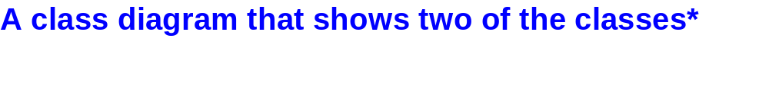
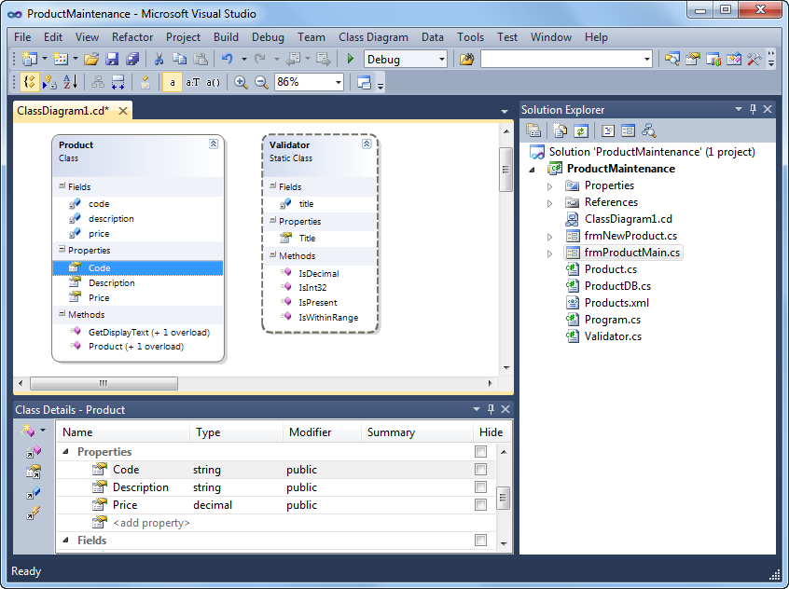
Murach’s C# 2010, C12
© 2010, Mike Murach & Associates, Inc.
Slide <number>

Slide 30
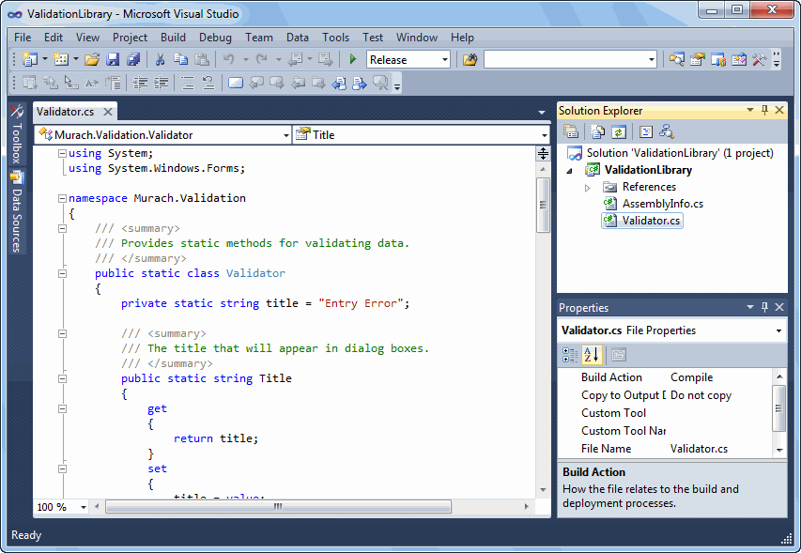
Murach’s C# 2010, C16
© 2010, Mike Murach & Associates, Inc.
Slide <number>

Slide 31

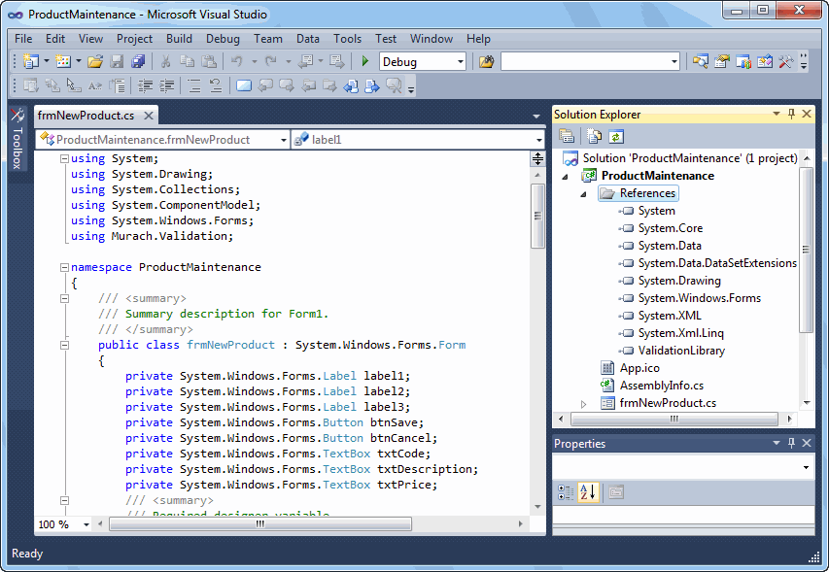
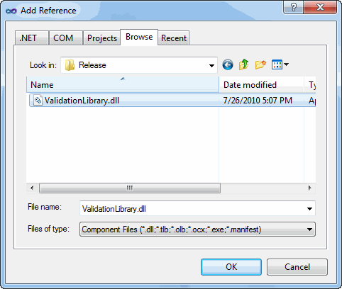
Murach’s C# 2010, C16
© 2010, Mike Murach & Associates, Inc.
Slide <number>

Slide 32
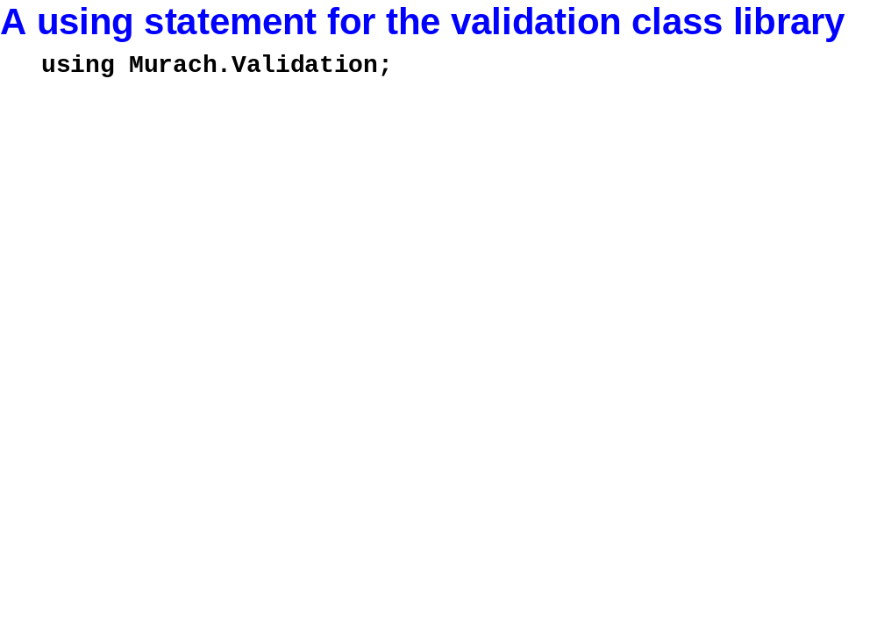
Murach’s C# 2010, C16
© 2010, Mike Murach & Associates, Inc.
Slide <number>

Slide 33
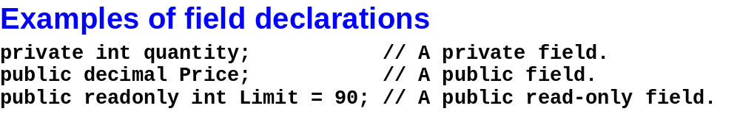
Murach’s C# 2010, C12
© 2010, Mike Murach & Associates, Inc.
Slide <number>

Slide 34
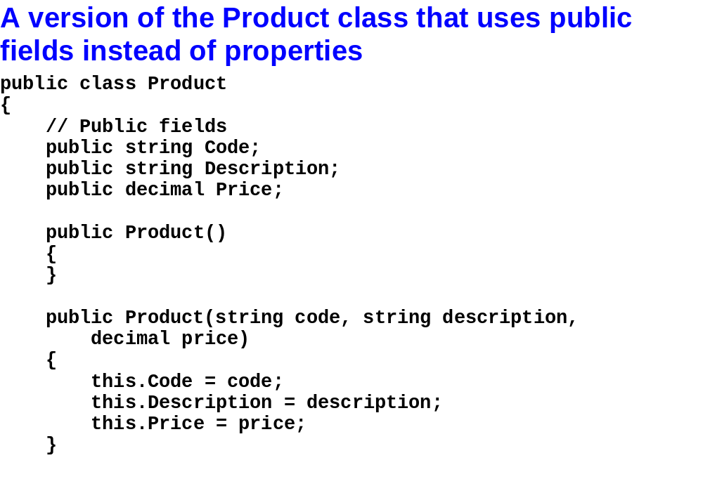
Murach’s C# 2010, C12
© 2010, Mike Murach & Associates, Inc.
Slide <number>

Slide 35
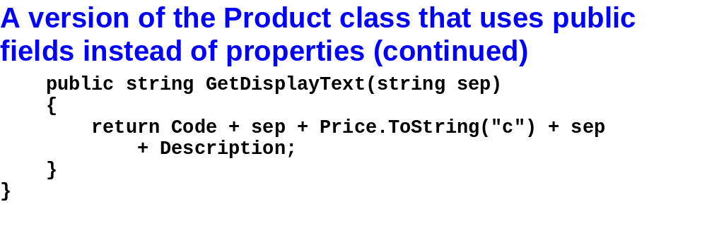
Murach’s C# 2010, C12
© 2010, Mike Murach & Associates, Inc.
Slide <number>

Slide 36
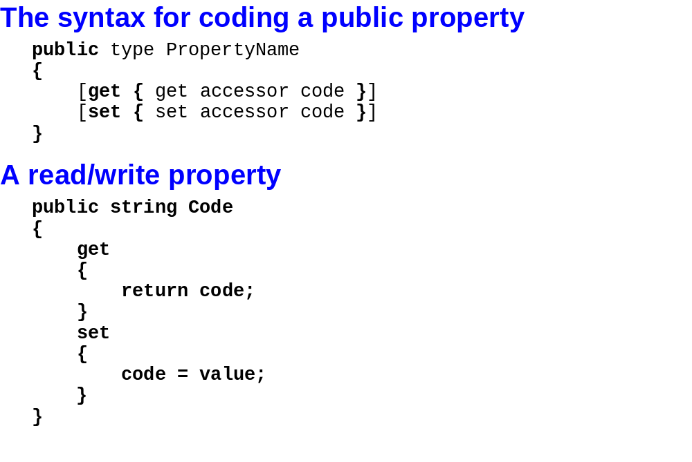
Murach’s C# 2010, C12
© 2010, Mike Murach & Associates, Inc.
Slide <number>

Slide 37
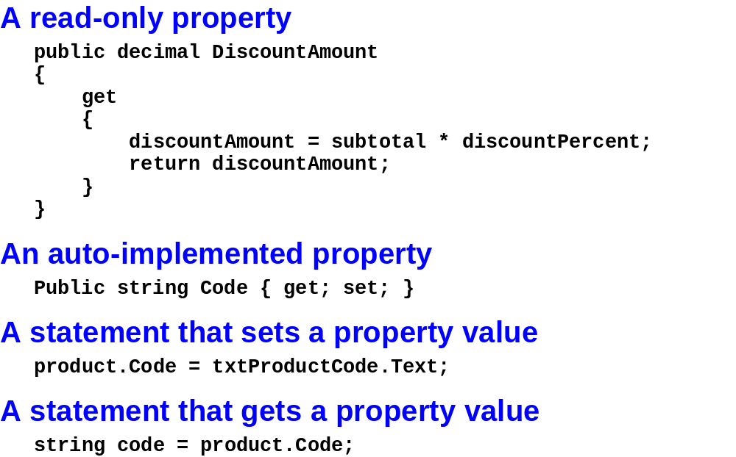
Murach’s C# 2010, C12
© 2010, Mike Murach & Associates, Inc.
Slide <number>

Slide 38
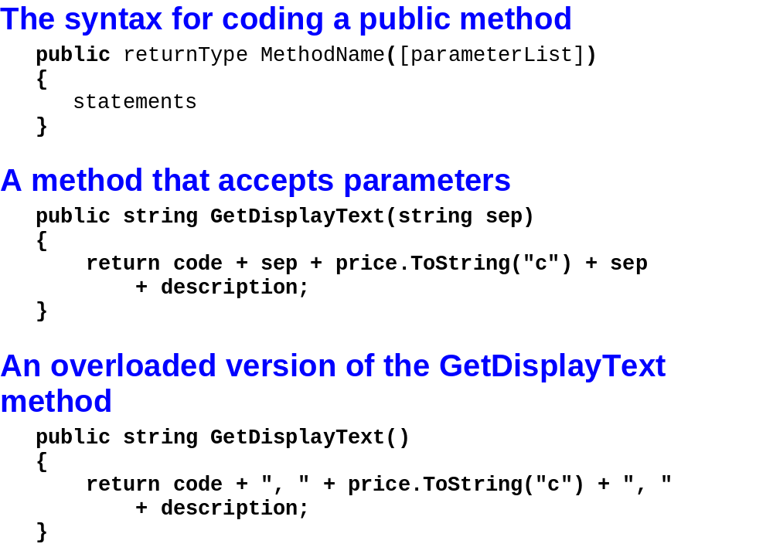
Murach’s C# 2010, C12
© 2010, Mike Murach & Associates, Inc.
Slide <number>

Slide 39
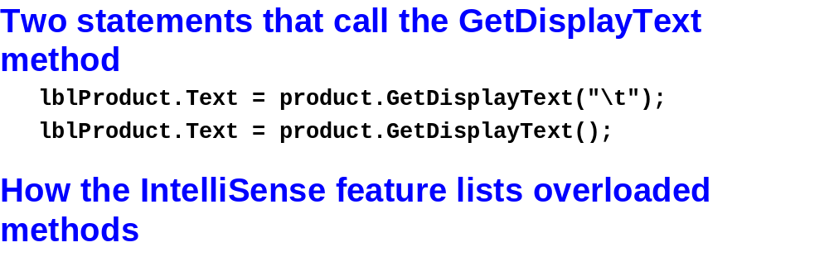

Murach’s C# 2010, C12
© 2010, Mike Murach & Associates, Inc.
Slide <number>

Slide 40
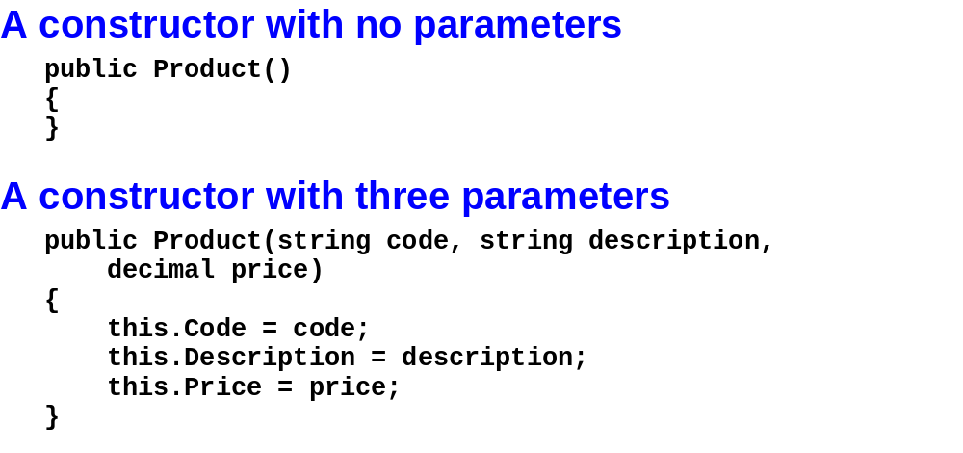
Murach’s C# 2010, C12
© 2010, Mike Murach & Associates, Inc.
Slide <number>

Slide 41
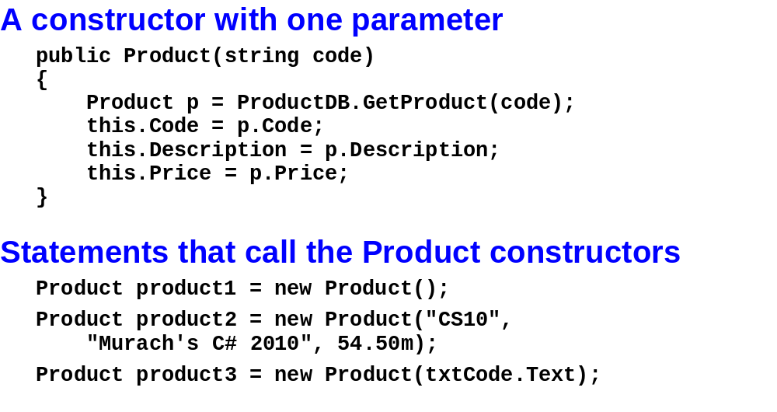
Murach’s C# 2010, C12
© 2010, Mike Murach & Associates, Inc.
Slide <number>

Slide 42
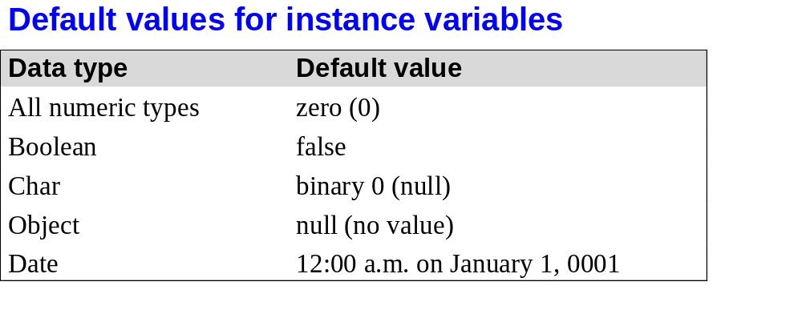
Murach’s C# 2010, C12
© 2010, Mike Murach & Associates, Inc.
Slide <number>

Slide 43
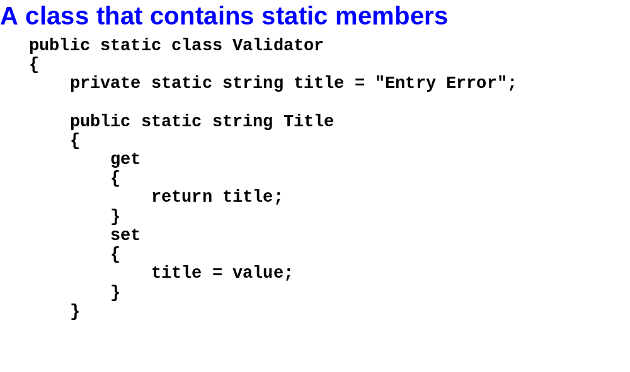
Murach’s C# 2010, C12
© 2010, Mike Murach & Associates, Inc.
Slide <number>

Slide 44
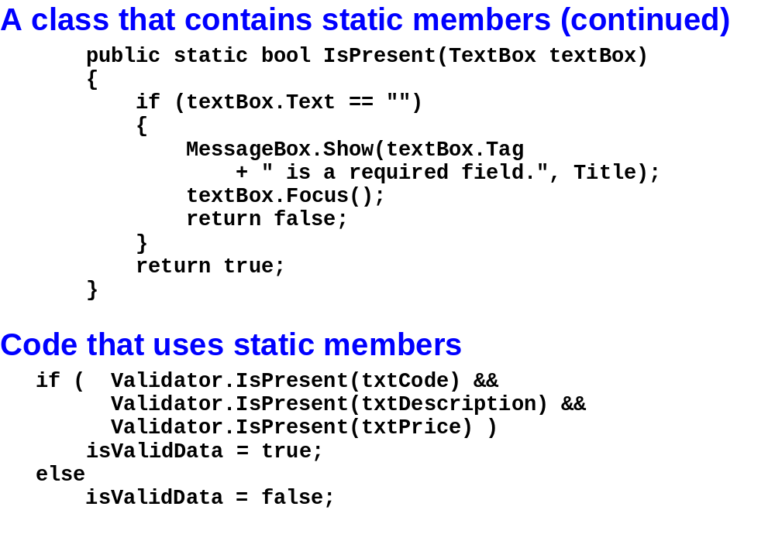
Murach’s C# 2010, C12
© 2010, Mike Murach & Associates, Inc.
Slide <number>

Slide 45
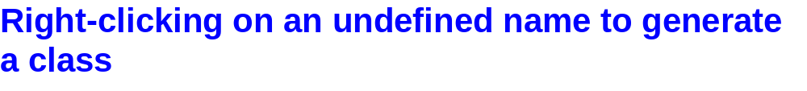
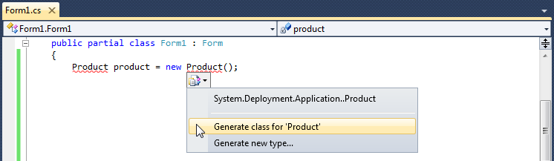
Murach’s C# 2010, C12
© 2010, Mike Murach & Associates, Inc.
Slide <number>

Slide 46
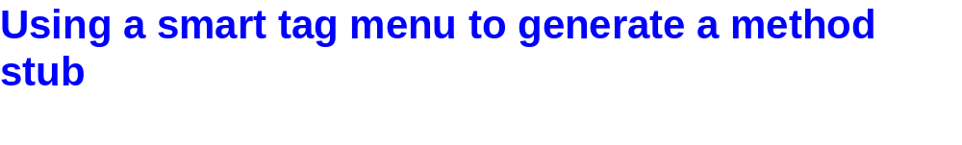
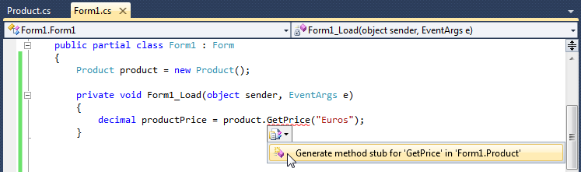
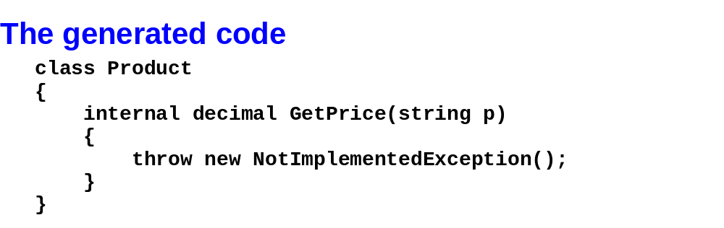
Murach’s C# 2010, C12
© 2010, Mike Murach & Associates, Inc.
Slide <number>

Slide 47
Lab 5
The first part of lab 5 asks you to use the Customer class in a windows forms application.
  Before you do that, let’s look at the Product Maintenance Application.
    Let’s run it first and then look at code.
  Pay attention to
    The reference to the class library
    The using statement at the top of both forms.
    The main form
      The typed list of products declared as an instance variable on the main form
      The way that the event handlers use the business object and the db object.
      The way that the main form interacts with the add product form
    The add product form
      The instance variable for the product
      The use of the Validator class
      Where the product is instantiated
      The way that the add product form exposes the new product to the main form

Slide 48
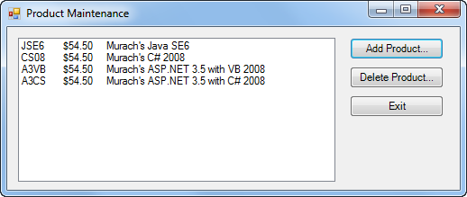
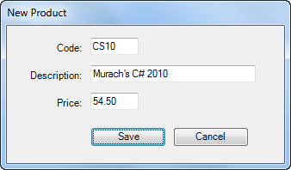
Murach’s C# 2010, C12
© 2010, Mike Murach & Associates, Inc.
Slide <number>

Slide 49
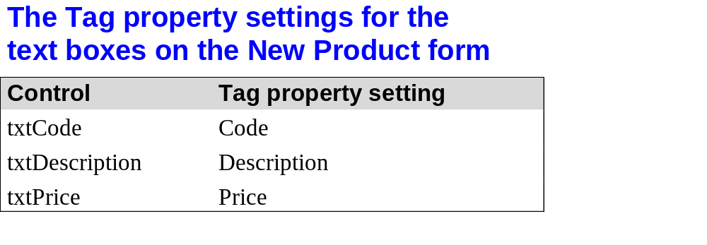
Murach’s C# 2010, C12
© 2010, Mike Murach & Associates, Inc.
Slide <number>

Slide 50
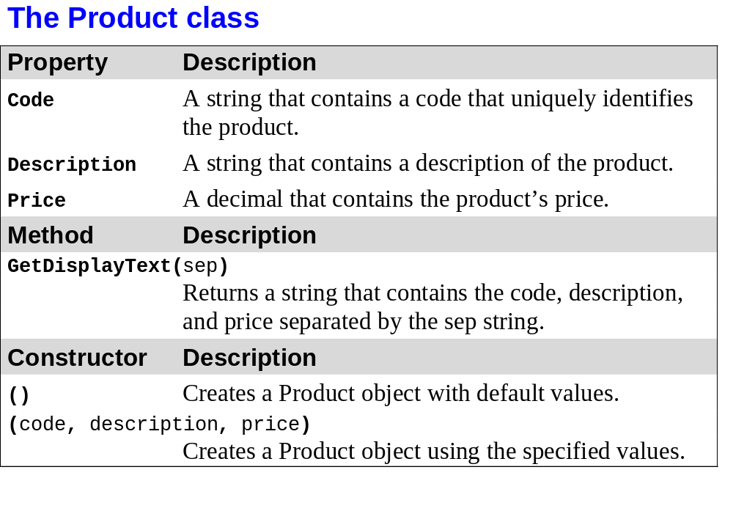
Murach’s C# 2010, C12
© 2010, Mike Murach & Associates, Inc.
Slide <number>

Slide 51
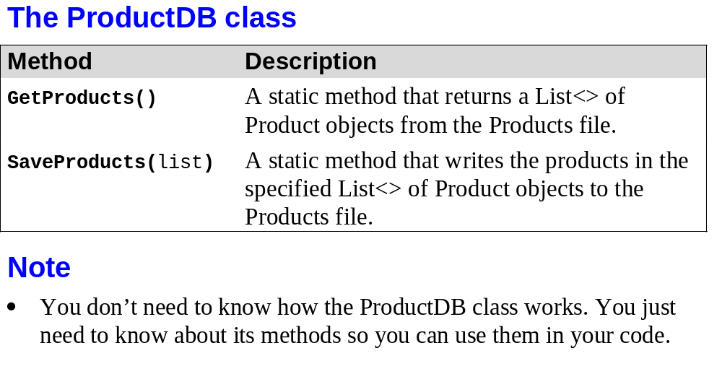
Murach’s C# 2010, C12
© 2010, Mike Murach & Associates, Inc.
Slide <number>

Slide 52
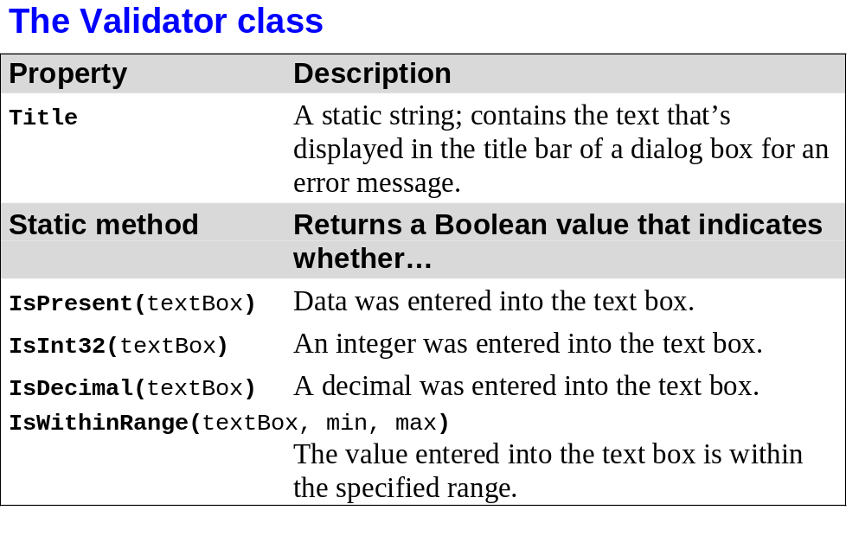
Murach’s C# 2010, C12
© 2010, Mike Murach & Associates, Inc.
Slide <number>

Slide 53

Murach’s C# 2010, C12
© 2010, Mike Murach & Associates, Inc.
Slide <number>

Slide 54

Murach’s C# 2010, C12
© 2010, Mike Murach & Associates, Inc.
Slide <number>

Slide 55

Murach’s C# 2010, C12
© 2010, Mike Murach & Associates, Inc.
Slide <number>

Slide 56

Murach’s C# 2010, C12
© 2010, Mike Murach & Associates, Inc.
Slide <number>

Slide 57

Murach’s C# 2010, C12
© 2010, Mike Murach & Associates, Inc.
Slide <number>

Slide 58

Murach’s C# 2010, C12
© 2010, Mike Murach & Associates, Inc.
Slide <number>

Slide 59

Murach’s C# 2010, C12
© 2010, Mike Murach & Associates, Inc.
Slide <number>

Slide 60

Murach’s C# 2010, C12
© 2010, Mike Murach & Associates, Inc.
Slide <number>

Slide 61

Murach’s C# 2010, C12
© 2010, Mike Murach & Associates, Inc.
Slide <number>

Slide 62

Murach’s C# 2010, C12
© 2010, Mike Murach & Associates, Inc.
Slide <number>

Slide 63
Lab 5
The first part of lab 5 asks you to use the Customer class in a windows forms application.
  Now do EXACTLY the same thing for the Customer Maintenance application. This is the rest of Exercise 12 – 1 on page 393 – 394. You did 1 – 4 already. Now do 5 – 14.
The last part of lab 5 asks you to re-write the Concentration game from lab 3 using your class.
  You should have a solution with the Card class and a test program from lab 4.
    Make a copy of the folder with your concentation game from lab 4 and paste it into the solution folder for this part of lab 4.
    In visual studio, add an existing project to the solution and add the project you just copied. Add a reference in the concentration project to your class library. Add a using statement at the top of the form for the concentration game.
  I’ll show you my Card class as well as my concentration game. Ask tons of questions. You’ll have time to work on it in class so I can help.

Slide 64

Murach’s C# 2010, C12
© 2010, Mike Murach & Associates, Inc.
Slide <number>

Slide 65

Murach’s C# 2010, C12
© 2010, Mike Murach & Associates, Inc.
Slide <number>

Slide 66

Murach’s C# 2010, C12
© 2010, Mike Murach & Associates, Inc.
Slide <number>

Slide 67
What’s Next
Chapter 13 – Classes that contain arrays or lists and all kinds of related stuff

