Slide 1

Murach’s C# 2010, C8
© 2010, Mike Murach & Associates, Inc.
Slide <number>

Slide 2
Topics
Syntax and semantics of character and string processing
Several examples
  Tutorial 8-1 – password validation
  Tutorial 8-2 – format a phone number
  Tutorial 8-4 – parsing a csv file
Lab 2
  Pig Latin
  Shift Cypher
  Substitution Cypher
Copyright © 2014 Pearson Education, Inc.

Slide 3
8.2 String/Character Processing
Text is a commonly used form of data to be processed by programs
  You frequently need to manipulate strings at a detailed level
C# and the .NET Framework provide tools to work with:
  individual characters (char)
  sets of characters (string)
Copyright © 2014 Pearson Education, Inc.

Slide 4
The char Data Type
C# data type is used to store individual characters
A char variable can hold only one character at a time
  To declare a char variable, use:
    char letter;
  This statement declares a char variable named letter
Character literals are enclosed in single quotation marks (‘)
    letter = ‘g’;
  This statement assigns the character g to the letter variable
char and string are two incomputable data types
  The following attempts to assign a string to a char variable. It will not compile.
    letter = “g”;
  Use ToString method to convert a char literal to string literal
    MessageBox.Show(letter.ToString());
Copyright © 2014 Pearson Education, Inc.

Slide 5
Retrieve One Character in a String
C# allows you to access the individual characters in a string using subscript notation
  Treat a string as an array of characters
    string name = “Jacob”;
    char letter;
    for (int index = 0; index < name.Length; index++)
    {
    letter = name[index];
    MessageBox.Show(letter.ToString());
    }
  Elements in the string array are read-only. You cannot change their values. For example, the following will compile:
    name[0]=‘T’; // assign a new value
// use foreach loop
foreach (char letter in name)
{
letter = name[index];
MessageBox.Show(letter.ToString());
}
Copyright © 2014 Pearson Education, Inc.

Slide 6
Character Testing Methods
Methods for testing the value of a character are:
  char.IsDigit(ch): checks if ch is a digit (0 through 9)
  char.IsDigit(str, index): checks if index of str is a digit
  char.IsLetter(ch): checks if ch is an alphabet (a through z or A through Z)
  char.IsLetter(str, index): checks if index of str is an alphabet
  char.IsLetterOrDigit(ch): checks if ch is a digit or alphabet
  char.IsLetterOrDigit(str, index): checks if index of str is a digit or alphabet
where ch is a character; str is a string; and index is the position of a character within str
string str = “12345”;
if (char.IsDigit(str[0]))
{
MessageBox.Show(“True”);
}
string str = “12345”;
if (char.IsDigit(str, 0))
{
MessageBox.Show(“True”);
}
string str = “Hello”;
if (char.IsLetter(str[0]))
{
MessageBox.Show(“True”);
}
Copyright © 2014 Pearson Education, Inc.

Slide 7
Character Testing Methods
More methods for testing the value of a character are:
  char.IsPunctuation(ch): checks if ch is a punctuation mark
  char.IsPunctuation(str, index): checks if index of str is a punctuation mark
  char.IsWhiteSpace(ch): checks if ch is a white-space
  char.IsWhiteSpace(str, index): checks if index of str is a white-space
where ch is a character; str is a string; and index is the position of a character within str
string str = “Hello!”;
if (char.IsPunctuation(str[5]))
{
MessageBox.Show(“True”);
}
string str = “Hello!”;
if (char.IsPunctuation(str, 5))
{
MessageBox.Show(“True”);
}
string str = “Hello World!”;
if (char.IsWhiteSpace(str[6]))
{
MessageBox.Show(“True”);
}
Copyright © 2014 Pearson Education, Inc.

Slide 8
Character Testing Methods
Methods that check the letter’s case are:
  char.IsLower(ch): checks if ch is a lowercase letter
  char.IsLower(str, index): checks if index of str is a lowercase letter
  char.IsUpper(ch): checks if ch is a uppercase letter
  char.IsUpper(str, index): checks if index of str is a uppercase letter
where ch is a character; str is a string; and index is the position of a character within str
string str = “hello!”;
if (char.IsLower(str[0]))
{
MessageBox.Show(“True”);
}
string str = “Hello!”;
if (char.IsUpper(str, 0))
{
MessageBox.Show(“True”);
}
Copyright © 2014 Pearson Education, Inc.

Slide 9
Character Case Conversion
The char data type provides two methods to convert between the case of a character:
  char.ToLower(ch): return lowercase equivalent of ch
  char.ToUpper(ch): return uppercase equivalent of ch
For example:
  string str1 = “abc”;
  string str2 = “XYZ”;
  char letter.ToUpper(str1[0]);
  char letter.ToLower(str2[0]);
Copyright © 2014 Pearson Education, Inc.

Slide 10
Searching for Substrings
Some tasks require you to search for a specific string of characters within a string. Some of the substring searching methods are:
  stringVar.Contains(substring): checks if stringVar contains substring
  stringVar.Contains(ch): checks if stringVar contains ch
  stringVar.StartsWith(substring): checks if stringVar starts with substring
  stringVar.EndsWith(substring): checks if stringVar ends with substring
where stringVar is the name of a string variable; substring the string to be found; ch is a character
string str = “Eat ice cream!”;
if (str.Contains(“ice”))
{
MessageBox.Show(“True”);
}
string str = “Eat ice cream!”;
if (str.Contains(‘i’))
{
MessageBox.Show(“True”);
}
string str = “Eat ice cream!”;
if (str.EndsWith(“eam”))
{
MessageBox.Show(“True”);
}
Copyright © 2014 Pearson Education, Inc.

Slide 11
Finding Position of Substrings
Sometimes you need to know the position of the substring. You can use the IndexOf methods.
  It returns the integer position of substring’s first occurrence, and returns -1 if not found. Common usages to find substrings are:
    stringVar.IndexOf(substring):
    stringVar.IndexOf(substring, start):
    stringVar.IndexOf(substring, start, count):
  It can also find characters. It returns the integer position of ch’s first occurrence, and returns -1 if not found. Common usages are:
    stringVar.IndexOf(ch):
    stringVar.IndexOf(ch, start):
    stringVar.IndexOf(ch, start, count):
  where start is an integer indicating the starting position for searching; count is an integer specifying the number of character positions to examine
Copyright © 2014 Pearson Education, Inc.

Slide 12
Sample Code (substring)
// The following code display “10”
string str = “chocolate ice cream”;
int position = str.IndexOf(“ice”);
if (position != -1)
{
MessageBox.Show(position.ToString());
}
// The following code display “2”
string str = “cocoa beans”;
int position = str.IndexOf(“co”, 2);
if (position != -1)
{
MessageBox.Show(position.ToString());
}
// The following code display “6”
string str = “xx oo xx oo xx”;
int position = str.IndexOf(“xx”, 3, 8);
if (position != -1)
{
MessageBox.Show(position.ToString());
}
Copyright © 2014 Pearson Education, Inc.

Slide 13
Sample Code (Ch)
// The following code display “2”
string str = “chocolate ice cream”;
int position = str.IndexOf(‘o’);
if (position != -1)
{
MessageBox.Show(position.ToString());
}
// The following code display “4”
string str = “chocolate ice cream”;
int position = str.IndexOf(‘o’, 3);
if (position != -1)
{
MessageBox.Show(position.ToString());
}
// The following code display “12”
string str = “chocolate ice cream”;
int position = str.IndexOf(‘e’, 10, 4);
if (position != -1)
{
MessageBox.Show(position.ToString());
}
Copyright © 2014 Pearson Education, Inc.

Slide 14
Finding Position of Substrings
When you need to search backwards to find the LAST occurrence, you can use the LastIndexOf methods
  It returns the index position of the last occurrence of a specified character or substring within this instance. Common usages to find substrings are:
    stringVar.LastIndexOf(substring):
    stringVar.LastIndexOf(substring, start):
    stringVar.LastIndexOf(substring, start, count):
  It can also find characters. It returns the integer position of ch’s first occurrence, and returns -1 if not found. Common usages are:
    stringVar.LastIndexOf(ch):
    stringVar.LastIndexOf(ch, start):
    stringVar.LastIndexOf(ch, start, count):
  where start is an integer indicating the starting position for searching; count is an integer specifying the number of character positions to examine
Copyright © 2014 Pearson Education, Inc.

Slide 15
Sample Code (substring)
// The following code display “11”
string str = “blue green blue”;
int position = str.LastIndexOf(“blue”);
if (position != -1)
{
MessageBox.Show(position.ToString());
}
// The following code display “6”
string str = “xx oo xx oo xx”;
int position = str.LastIndexOf(“xx”, 10);
if (position != -1)
{
MessageBox.Show(position.ToString());
}
// The following code display “6”
string str = “xx oo xx oo xx”;
int position = str.LastIndexOf(“xx”, 10, 8);
if (position != -1)
{
MessageBox.Show(position.ToString());
}
Copyright © 2014 Pearson Education, Inc.

Slide 16
Sample Code (Ch)
// The following code display “14”
string str = “chocolate ice cream”;
int position = str.LastIndexOf(‘c’);
if (position != -1)
{
MessageBox.Show(position.ToString());
}
// The following code display “12”
string str = “chocolate ice cream”;
int position = str.LastIndexOf(‘e’, 14);
if (position != -1)
{
MessageBox.Show(position.ToString());
}
// The following code display “12”
string str = “chocolate ice cream”;
int position = str.LastIndexOf(‘e’, 14, 8);
if (position != -1)
{
MessageBox.Show(position.ToString());
}
Copyright © 2014 Pearson Education, Inc.

Slide 17
The Substring Method
Sometimes you need to retrieve a specific set of characters from a string. You can use the Substring method.
  stringVar.Substring(start): return a string containing the characters beginning at start, continuing to the end of stringVar
  stringVar.Substring(start, count): return a string containing the characters beginning at start, continuing for count characters
  where start is an integer indicating the starting position for searching; count is an integer specifying the number of character positions to examine
  Examples:
// The following code displays “beans”
String str = “cocoa beans”;
MessageBox.Show(str.Substring(6));
// The following code displays “cocoa”
String str = “cocoa beans”;
MessageBox.Show(str.Substring(0, 5));
Copyright © 2014 Pearson Education, Inc.

Slide 18
Methods for Modifying a String
When you need to modify the contents of a string, you can use:
  The Insert method to insert a string into another
  The Remove method to remove specified characters from a string
  The Trim method to remove all leading and trailing spaces from a string
    Leading spaces are spaces before the string: “ Hello”
    Trailing spaces are spaces after the string: “Hello “
  The TrimStart method to remove all leading spaces
  The TrimEnd method to remove all trailing spaces
  To convert cases of a string use either ToLower or ToUpper methods
Copyright © 2014 Pearson Education, Inc.

Slide 19
Methods for Modifying a String
Syntaxes:
  stringVar.Insert(start, strItem)
    For example,
    string str1 = “New City”;
    string str2 = str1.Insert(4, “York”);
    MessageBox.Show(str2); // display “New York City”
  stringVar.Remove(start)
  stringVar.Remove(start, count)
    For example,
    string str1 = “blueberry”;
    string str2 = str1.Remove(4); // outcome is “blue”
  where start specifies a position in stringVar; strItem is the string to be inserted; count specifies a number of characters
// str2 will be “jelly doughnuts”
string str1 = “jelly filled doughnuts”;
string str2 = str1.Remove(6, 7);
Copyright © 2014 Pearson Education, Inc.

Slide 20
Methods for Modifying a String
The syntax of Trim methods are:
  stringVar.Trim()
  stringVar.TrimStart()
  stringVar.TrimEnd()
where stringVar is the name of a string variable:
// The output is “>Hello<“
string str1 = “ Hello “;
string str2 = str1.Trim();
MessageBox.Show(“>” + str2 + “<“);
// The output is “>Hello<“
string str1 = “ Hello“;
string str2 = str1.TrimStart();
MessageBox.Show(“>” + str2 + “<“);
// The output is “>Hello<“
string str1 = “Hello “;
string str2 = str1.TrimEnd();
MessageBox.Show(“>” + str2 + “<“);
Copyright © 2014 Pearson Education, Inc.

Slide 21
Tokenizing Strings
When a string contains a series of words or other items of data
separated by spaces or other characters
  “apple:orange:banana”
The string can be thought to contain four items of data: apple, orange, and banana
  Each item is known as a token
  The character that separates tokens is known as a delimiter
  The process of breaking a string into tokens is known as tokenizing
In C#, the Split method is used to tokenize strings
  It extracts tokens from a string and returns them as an array of strings
  You can pass null as an argument indicating white-spaces are delimiters
  You can pass a character or a char array as arguments to specify a list of delimiters
// using null (white space)
string str = “one two three four”;
string[] tokens = str.Split(null);
// using ; as delimiter
string str = “one;two;three;four”;
string[] tokens = str.Split(‘;’);
// using char array
string str = “joe@gaddisbooks.com”;
char[] delim = { ‘@’, ‘.’ }
string[] tokens = str.Split(deliml);
Copyright © 2014 Pearson Education, Inc.

Slide 22
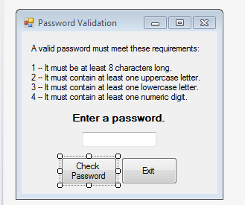
Lab 2
In the first part of the lab, you’ll modify the password validation app. (Tutorial 8-1)
  The app allows the user to enter a password, checks to see that the password has at least 8 characters, one uppercase, one lowercase and one digit.
  Let’s look at the code.
  Let’s write the methods.
  Let’s write the event
    Handler.
Murach’s C# 2010, C8
© 2010, Mike Murach & Associates, Inc.
Slide <number>

Slide 23
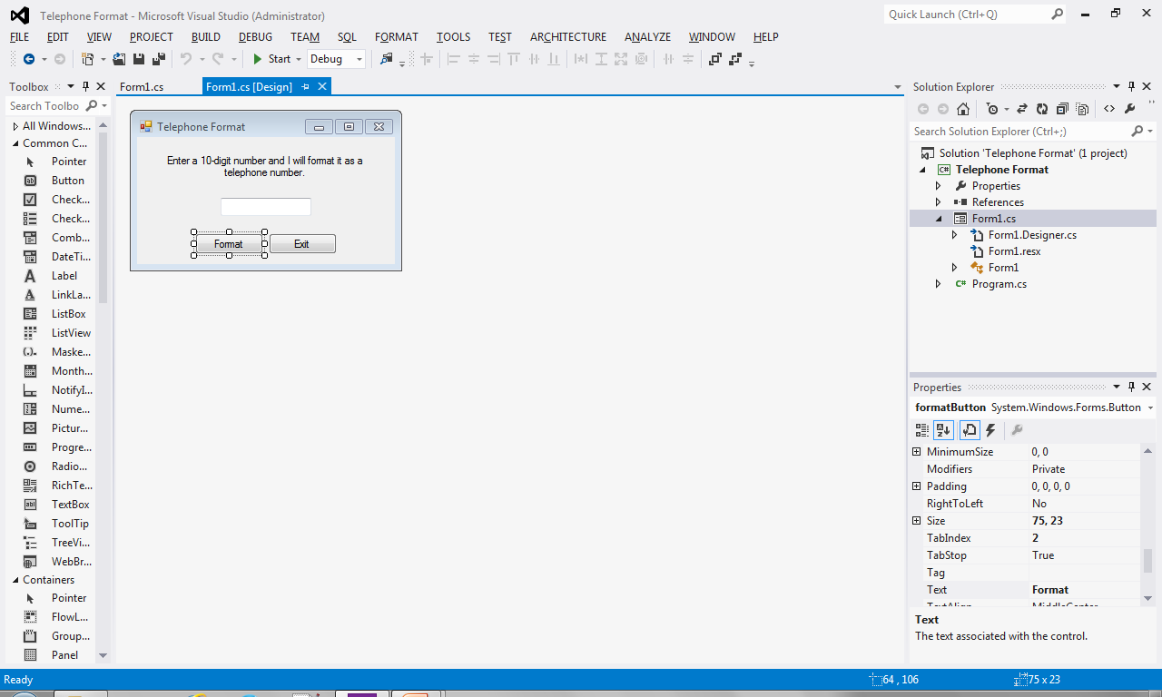
Lab 2
In the second part of the lab, you’ll modify the phone number app. (Tutorial 8-2)
  The app allows the user to enter a phone number, checks to see that the phone number contains exactly 10 digits, and then formats the phone number ###-###-####
  Let’s look at the code.
  Let’s write the methods.
  Let’s write the event
    Handler.
Murach’s C# 2010, C8
© 2010, Mike Murach & Associates, Inc.
Slide <number>

Slide 24
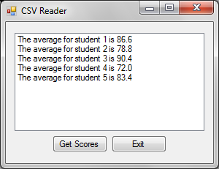
Lab 2
In the third part of the lab, you’ll modify the csv reading app (Tutorial 8-4)
  The app reads a text file that contains a set of test scores for 5 students, calculates the average for each student and displays the average in a list box.
  Let’s look at the file.
  All of the work happens in the
  Event handler. Let’s write it.
  For extra credit:
Store the data in a 2d array rather than processing it as you read it from the file
Write some methods
Murach’s C# 2010, C8
© 2010, Mike Murach & Associates, Inc.
Slide <number>

Slide 25
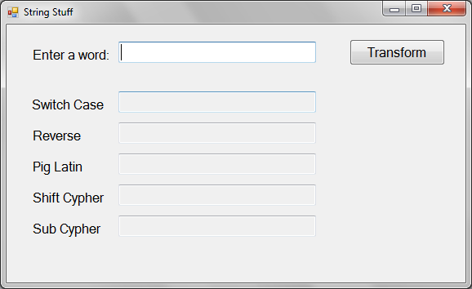
Lab 2
The LAST part of the lab is String Stuff.
The app allows the user to enter a word and then does all kinds of things to that word that involve string manipulation practice.
Let’s look at what I’ve given you.
What should each method do? Can you do an example?
Write each of the methods and call them in the event handler.
EXTRA CREDIT: deal with multiple words in the last 3.
© 2010, Mike Murach & Associates, Inc.
Slide <number>
Murach’s C# 2010, C8
Slide <number>

Slide 26
What’s Next
Reading Quiz 3 covers chapter 9
Lab 3 – Memory or Concentration will give you one more chance to practice writing a more complicated “object based” program
Quiz 1
Murach’s C# 2010, C8
© 2010, Mike Murach & Associates, Inc.
Slide <number>

