Slide 1
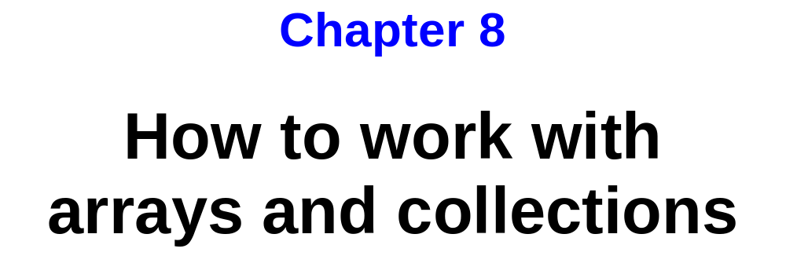
Murach’s C# 2010, C8
© 2010, Mike Murach & Associates, Inc.
Slide <number>

Slide 2
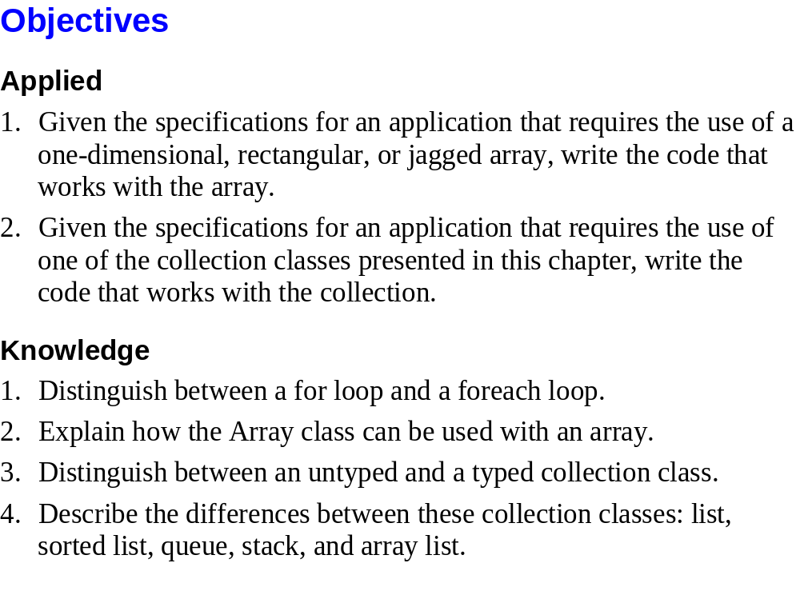
Murach’s C# 2010, C8
© 2010, Mike Murach & Associates, Inc.
Slide <number>

Slide 3
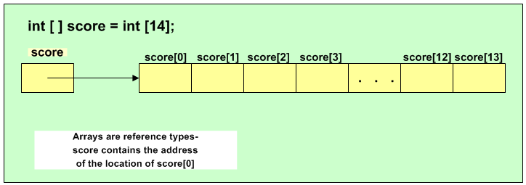
One Dimensional Arrays
An array is used to store a set of elements.
  Elements are stored in a contiguous block in memory.
  Each element must be the same data type.
  Individual elements are accessed using the array name and an index, position or subscript.

Slide 4
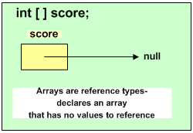
One Dimensional Arrays

Slide 5
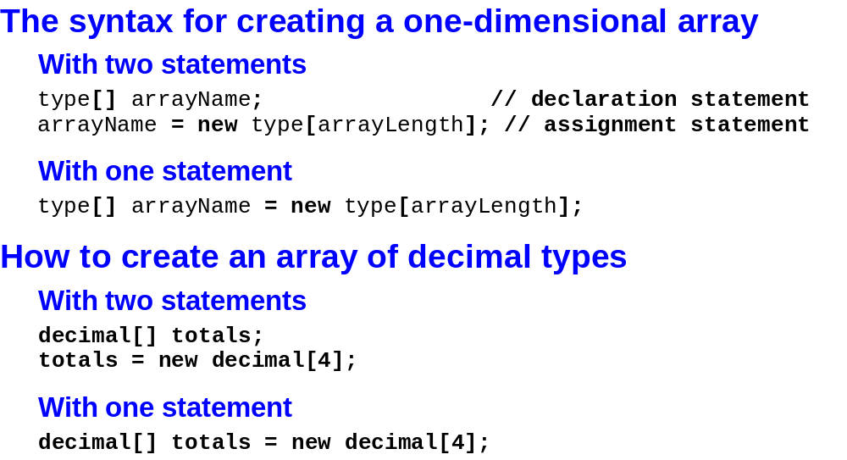
Murach’s C# 2010, C8
© 2010, Mike Murach & Associates, Inc.
Slide <number>

Slide 6
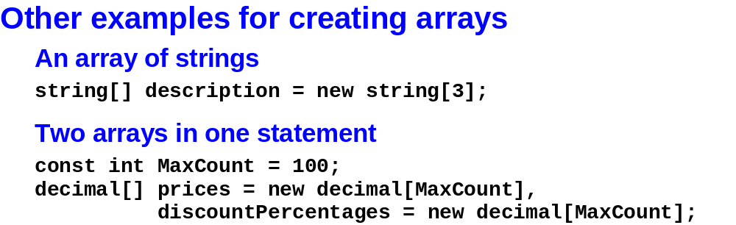
Murach’s C# 2010, C8
© 2010, Mike Murach & Associates, Inc.
Slide <number>

Slide 7
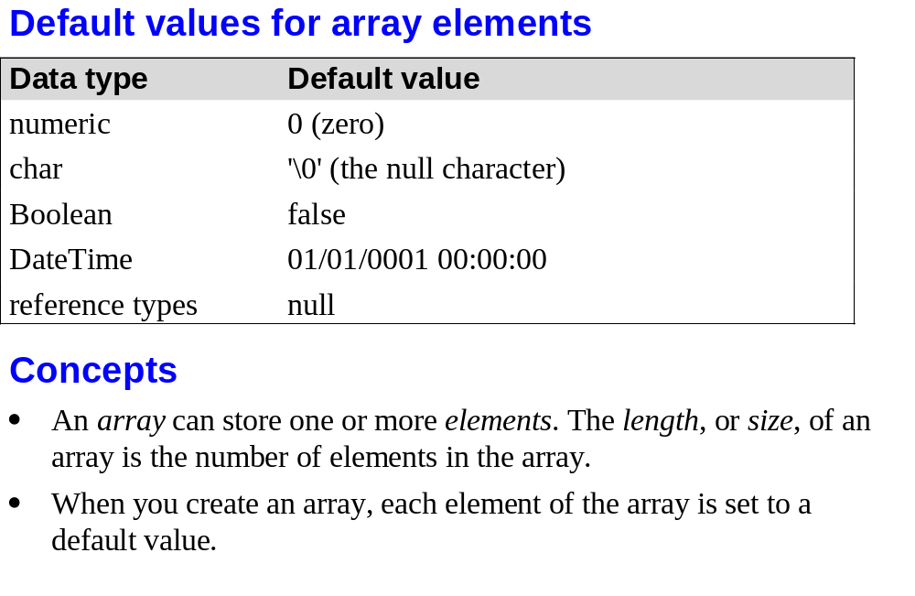
Murach’s C# 2010, C8
© 2010, Mike Murach & Associates, Inc.
Slide <number>

Slide 8
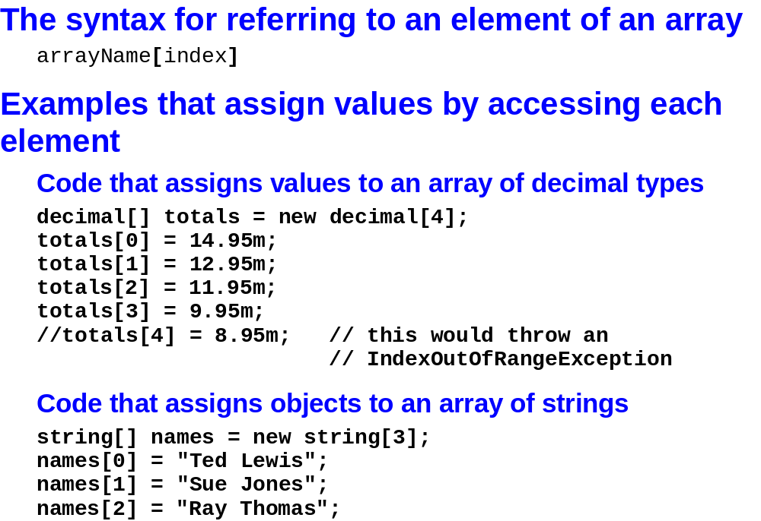
Murach’s C# 2010, C8
© 2010, Mike Murach & Associates, Inc.
Slide <number>

Slide 9
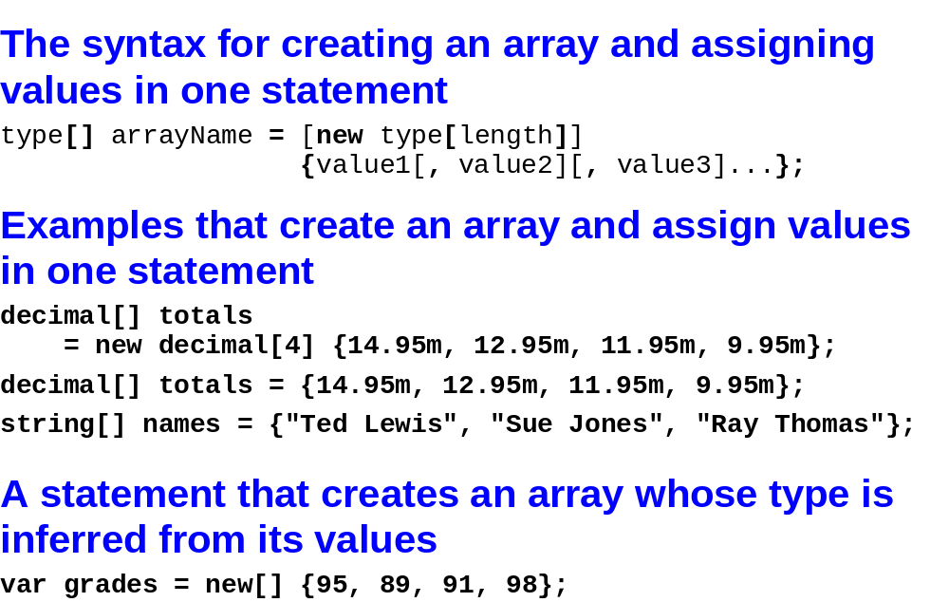
Murach’s C# 2010, C8
© 2010, Mike Murach & Associates, Inc.
Slide <number>

Slide 10
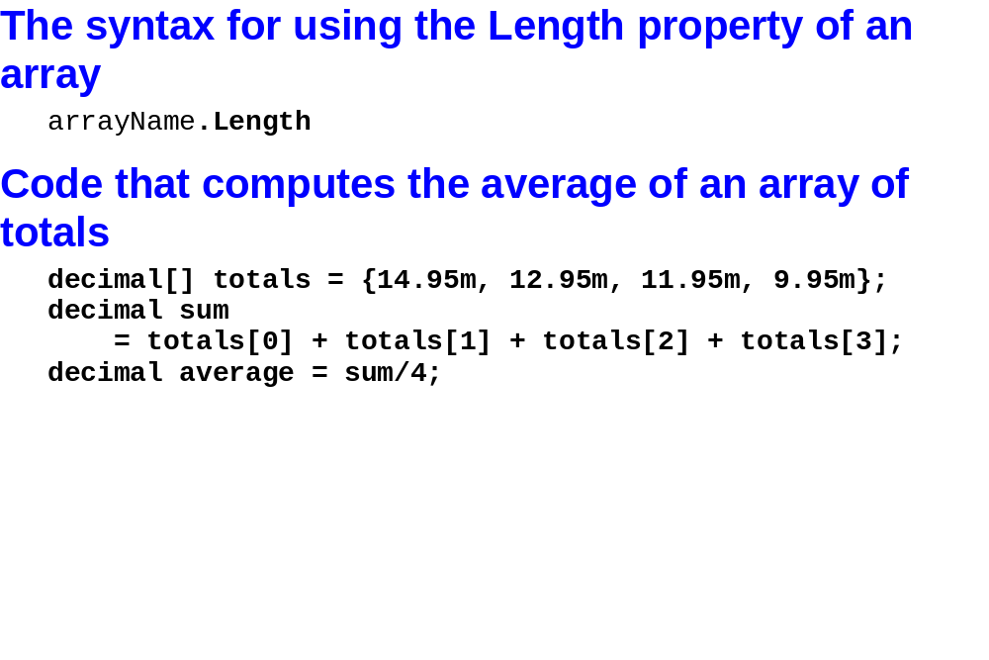
Murach’s C# 2010, C8
© 2010, Mike Murach & Associates, Inc.
Slide <number>

Slide 11
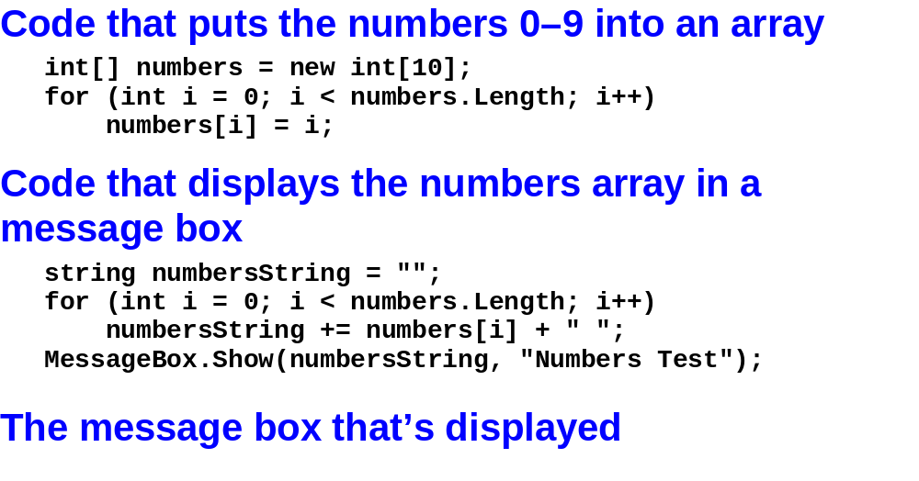
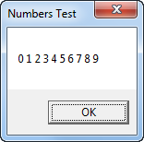
Murach’s C# 2010, C8
© 2010, Mike Murach & Associates, Inc.
Slide <number>

Slide 12
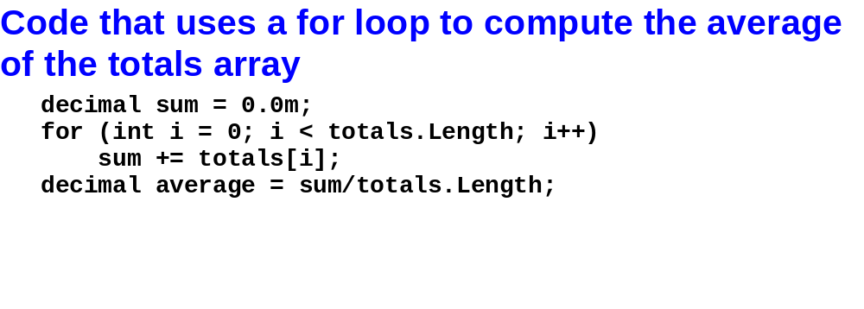
Murach’s C# 2010, C8
© 2010, Mike Murach & Associates, Inc.
Slide <number>

Slide 13
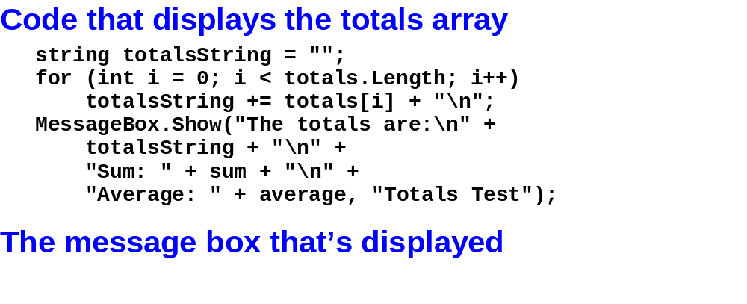
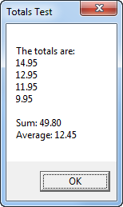
Murach’s C# 2010, C8
© 2010, Mike Murach & Associates, Inc.
Slide <number>

Slide 14
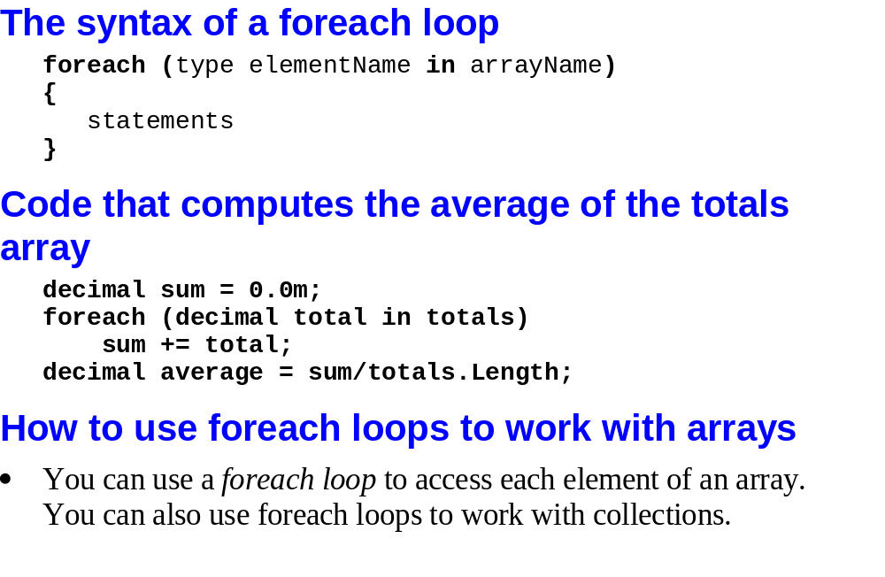
Murach’s C# 2010, C8
© 2010, Mike Murach & Associates, Inc.
Slide <number>

Slide 15
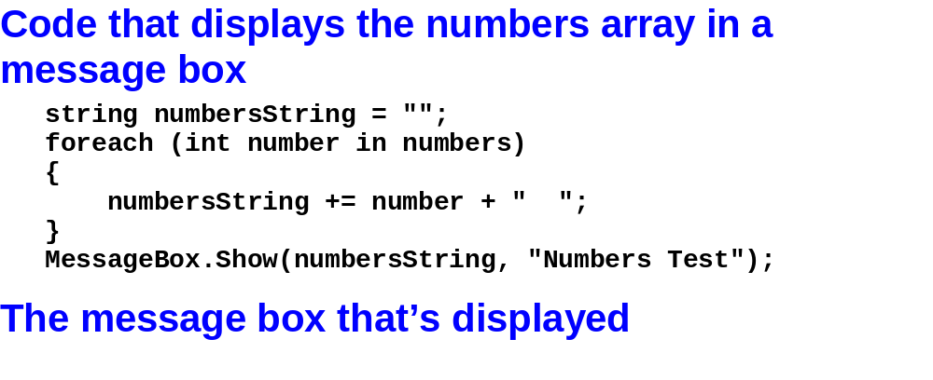
Murach’s C# 2010, C8
© 2010, Mike Murach & Associates, Inc.
Slide <number>

Slide 16
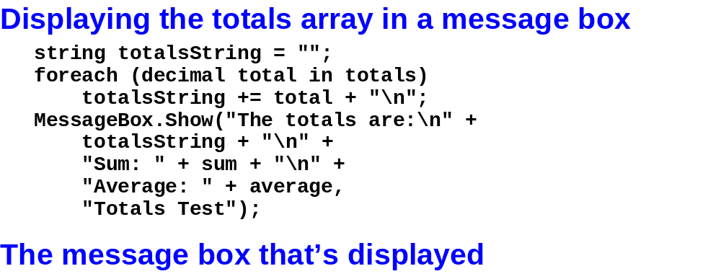
Murach’s C# 2010, C8
© 2010, Mike Murach & Associates, Inc.
Slide <number>

Slide 17
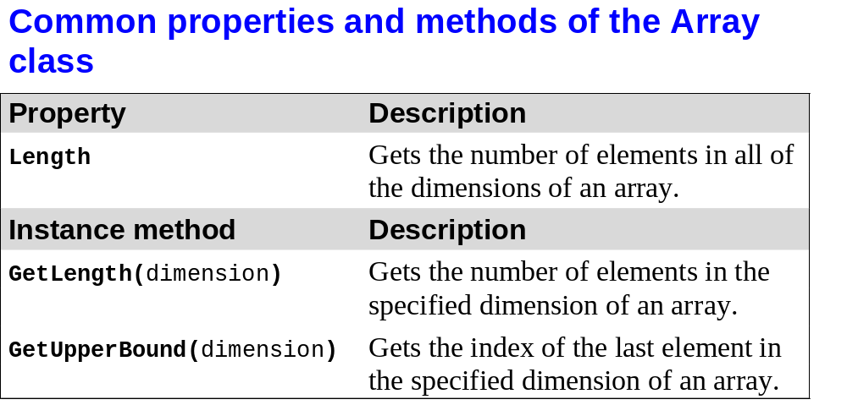
Murach’s C# 2010, C8
© 2010, Mike Murach & Associates, Inc.
Slide <number>

Slide 18
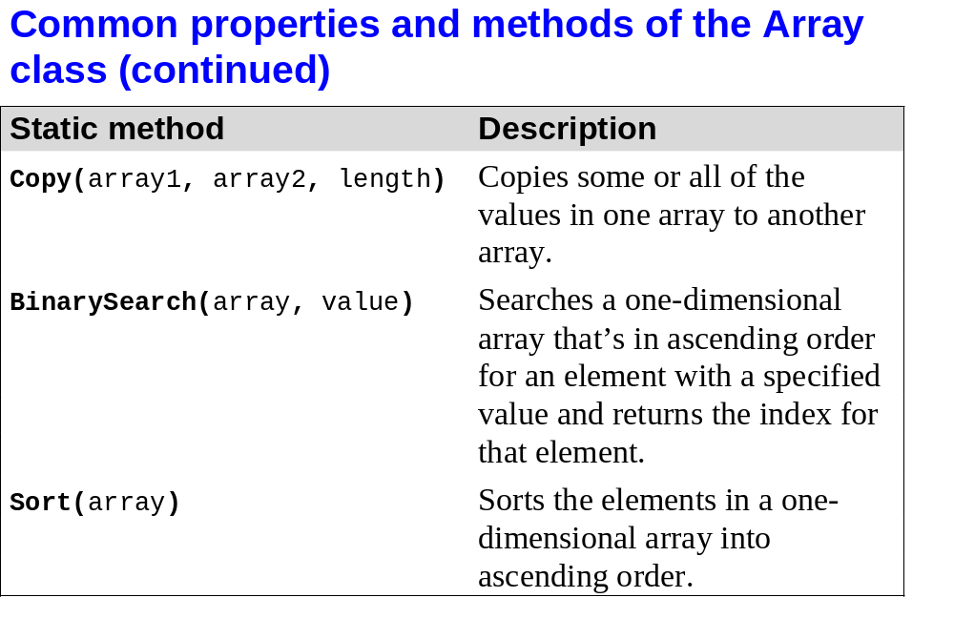
Murach’s C# 2010, C8
© 2010, Mike Murach & Associates, Inc.
Slide <number>

Slide 19
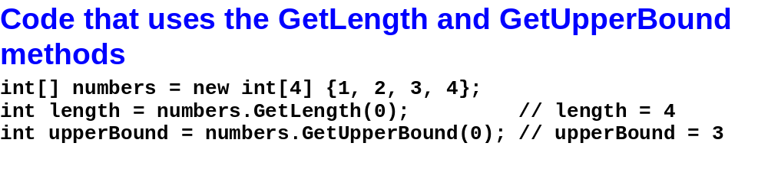
Murach’s C# 2010, C8
© 2010, Mike Murach & Associates, Inc.
Slide <number>

Slide 20
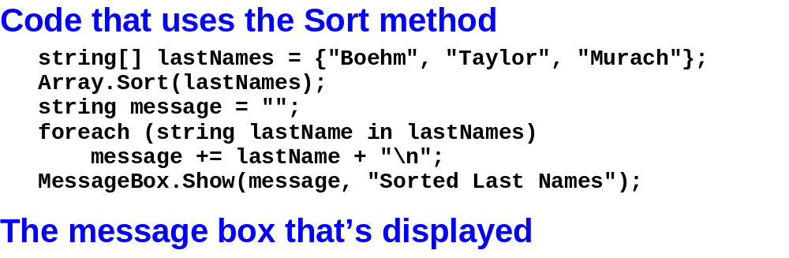
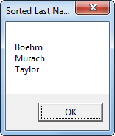
Murach’s C# 2010, C8
© 2010, Mike Murach & Associates, Inc.
Slide <number>

Slide 21
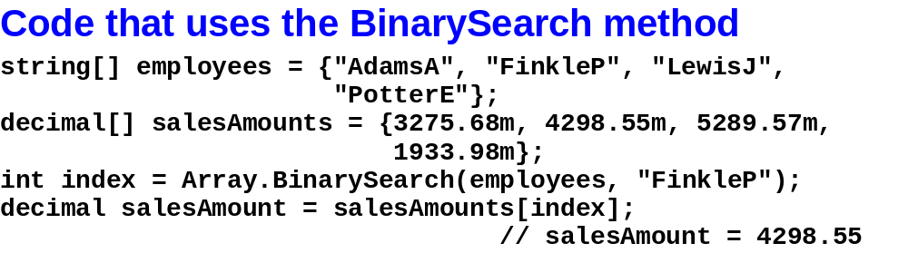
Murach’s C# 2010, C8
© 2010, Mike Murach & Associates, Inc.
Slide <number>

Slide 22
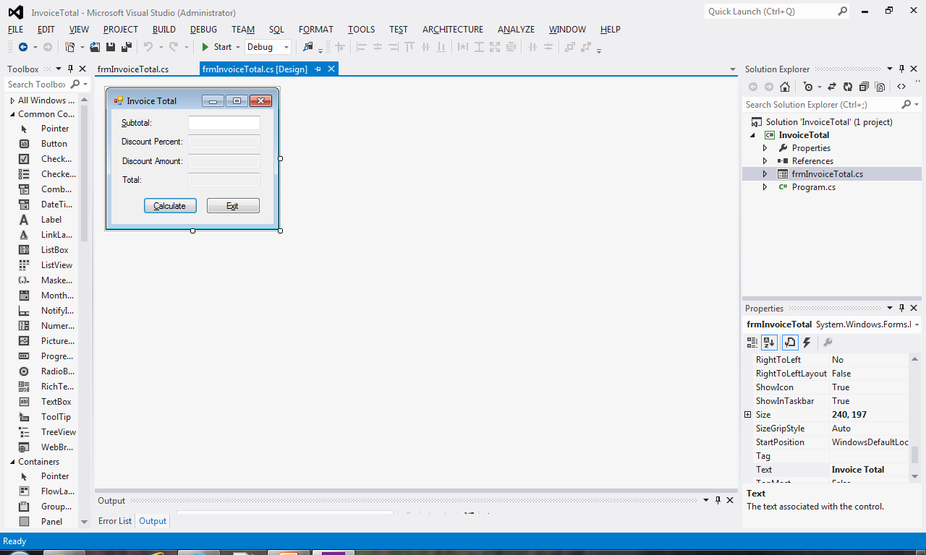
Lab 1
In the first part of the lab, you’ll modify the Invoice Total application from the textbook
  See page 251 of the text.
    Do just 1 – 8. 9 and 10 are extra credit.
  Let’s run the application and see what it does.
  Let’s look at the code.
  Pay particular attention
    to the catch block in the
    calculate event handler
Murach’s C# 2010, C8
© 2010, Mike Murach & Associates, Inc.
Slide <number>

Slide 23
Lab 1
In the first part of the lab, you’ll modify the Invoice Total application from the textbook
  See page 251 of the text. Do just 1 – 8. 9 and 10 are extra credit.
  Let’s add
    the instance variables in #2. Why are these instance variables?
    The total to the array at the end of the calculate event handler. # 3
    You try 4, 5 and 6.
Murach’s C# 2010, C8
© 2010, Mike Murach & Associates, Inc.
Slide <number>

Slide 24
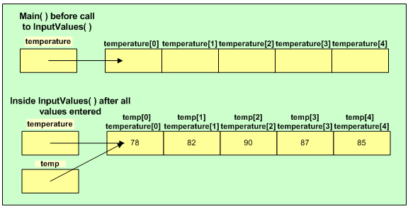
Arrays as Parameters
An array name is a reference. Passing an array to a method does NOT make a copy of the array.
Assume public static void InputValues(int[] temp) { …}
And a call InputValues(temperature)

Slide 25
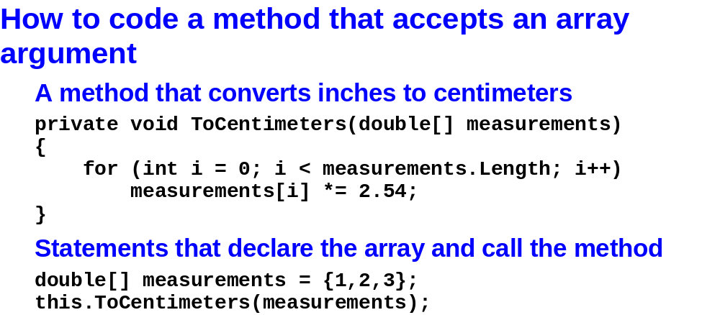
Murach’s C# 2010, C8
© 2010, Mike Murach & Associates, Inc.
Slide <number>

Slide 26
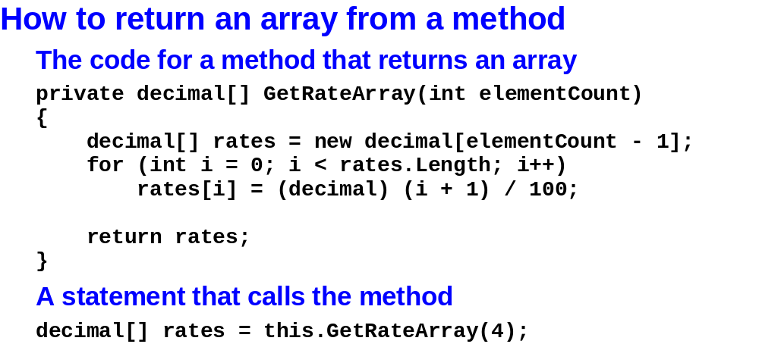
Murach’s C# 2010, C8
© 2010, Mike Murach & Associates, Inc.
Slide <number>

Slide 27
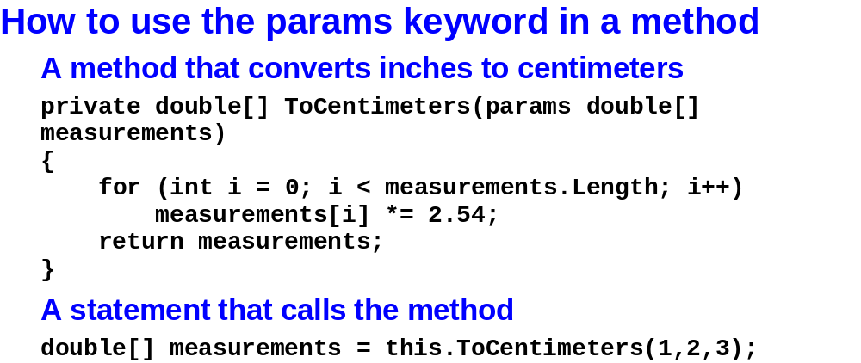
Murach’s C# 2010, C8
© 2010, Mike Murach & Associates, Inc.
Slide <number>

Slide 28
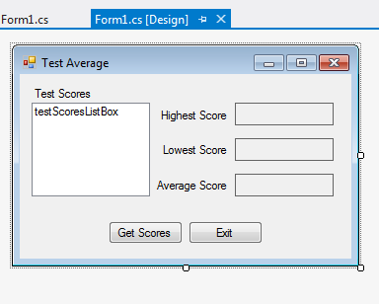
Lab 1
The next problem from the lab that I want to do with you in tutorial 7-2 out of the 133 text (page 424)
  The program reads 5 integers from a file, stores them in an array and in a list box on the form. The program also calculates the highest, lowest and average of the scores.
  Open the solution
  I didn’t give you a text file.
    What should it look like?
    Where should it be?
  Look at the code for the event
    handler. I’ve added comments that
    will help us write code.
Murach’s C# 2010, C8
© 2010, Mike Murach & Associates, Inc.
Slide <number>

Slide 29
Lab 1
The next problem from the lab that I want to do with you in tutorial 7-2 out of the 133 text (page 424)
  Look at the method Average. Pay attention to the array as a parameter as well as how the array is used.
  Call the method in the event handler.
  Finish writing the other 2 methods and calling them in the event handler.
Murach’s C# 2010, C8
© 2010, Mike Murach & Associates, Inc.
Slide <number>

Slide 30

Stop here on day 1?
Murach’s C# 2010, C8
© 2010, Mike Murach & Associates, Inc.
Slide <number>

Slide 31
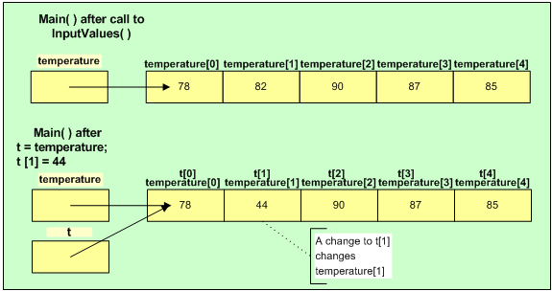
Arrays and Assignment
Assigning an array to another array doesn’t make a copy of the array.
Assume temperature has been initialized and
  int[] t;
  t = temperature;
  t[1] = 44;

Slide 32
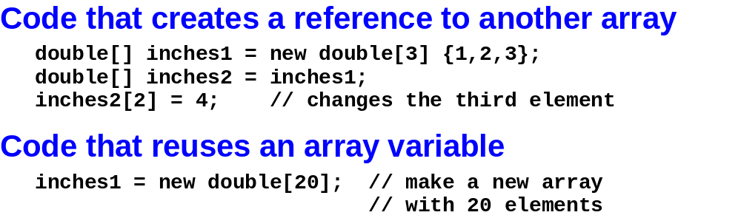
Murach’s C# 2010, C8
© 2010, Mike Murach & Associates, Inc.
Slide <number>

Slide 33
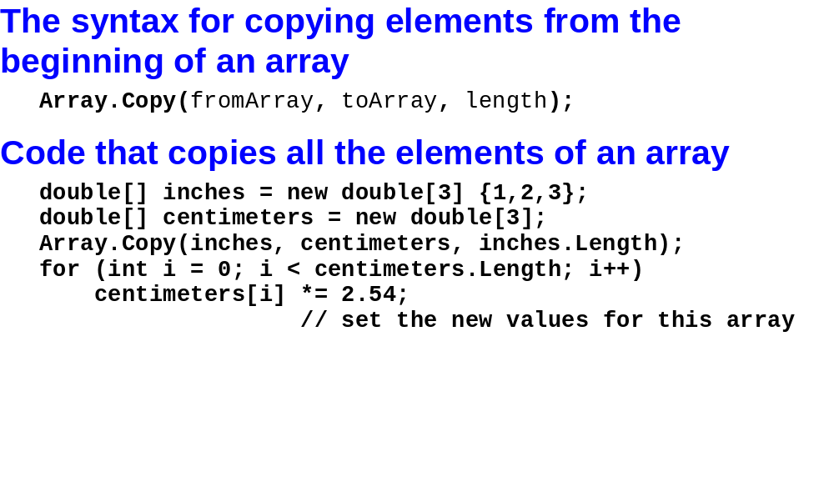
Murach’s C# 2010, C8
© 2010, Mike Murach & Associates, Inc.
Slide <number>

Slide 34
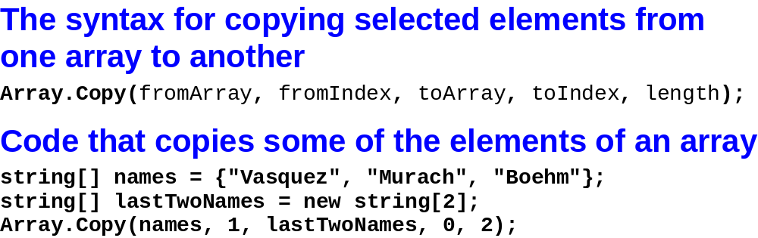
Murach’s C# 2010, C8
© 2010, Mike Murach & Associates, Inc.
Slide <number>

Slide 35
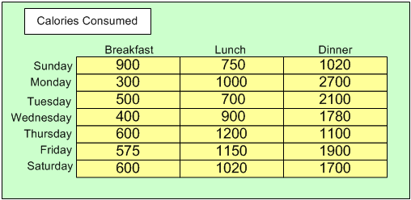
Two Dimensional Arrays
Assume that you want to create a calorie counting application.
  Each row represents the calories consumed for 3 meals
  Each column represents the calories consumed for one meal on all 7 days.

Slide 36
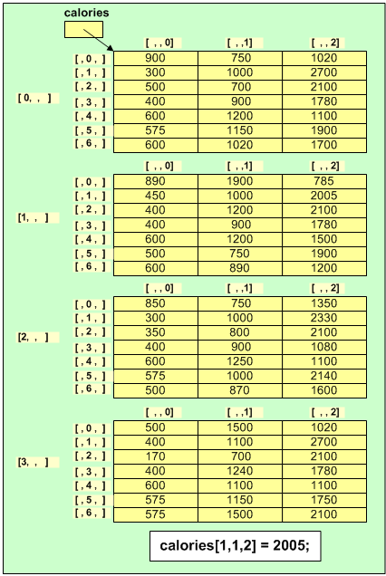
N-D Arrays
If we wanted to collect calorie information for several weeks we could create a 3 dimensional array
  Notice the number of indices
  Notice the number of loops to iterate throughout the data structure

Slide 37
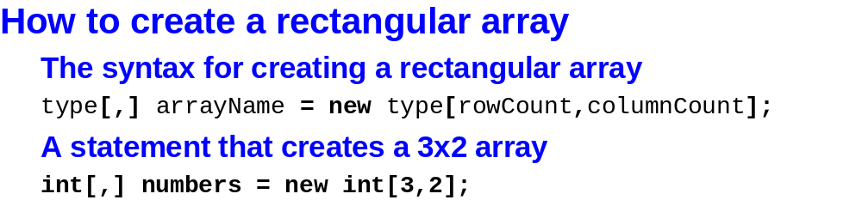
Murach’s C# 2010, C8
© 2010, Mike Murach & Associates, Inc.
Slide <number>

Slide 38
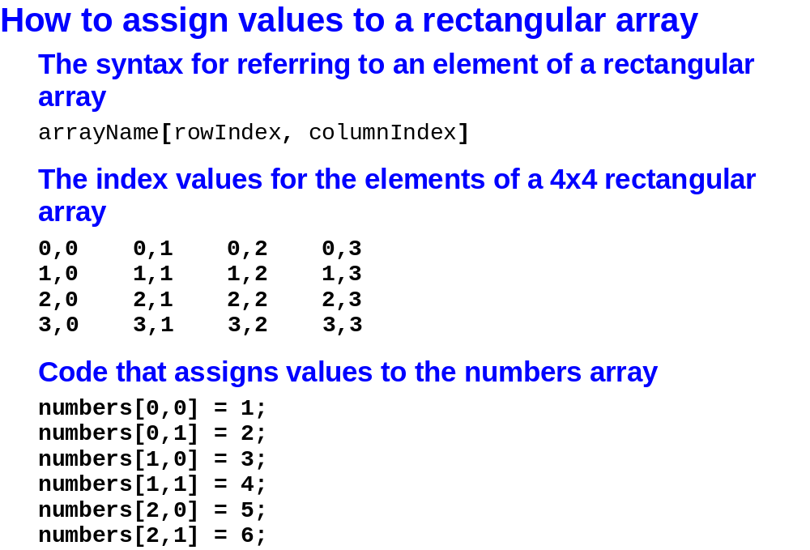
Murach’s C# 2010, C8
© 2010, Mike Murach & Associates, Inc.
Slide <number>

Slide 39
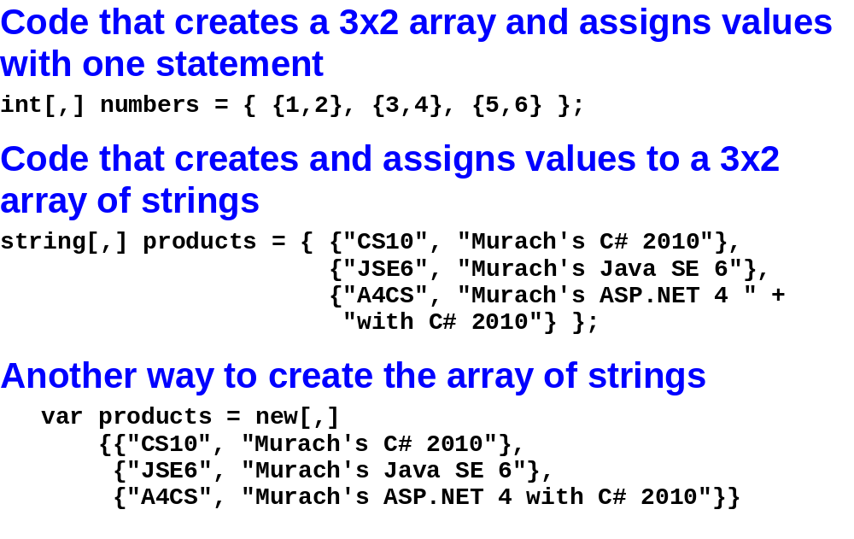
Murach’s C# 2010, C8
© 2010, Mike Murach & Associates, Inc.
Slide <number>

Slide 40
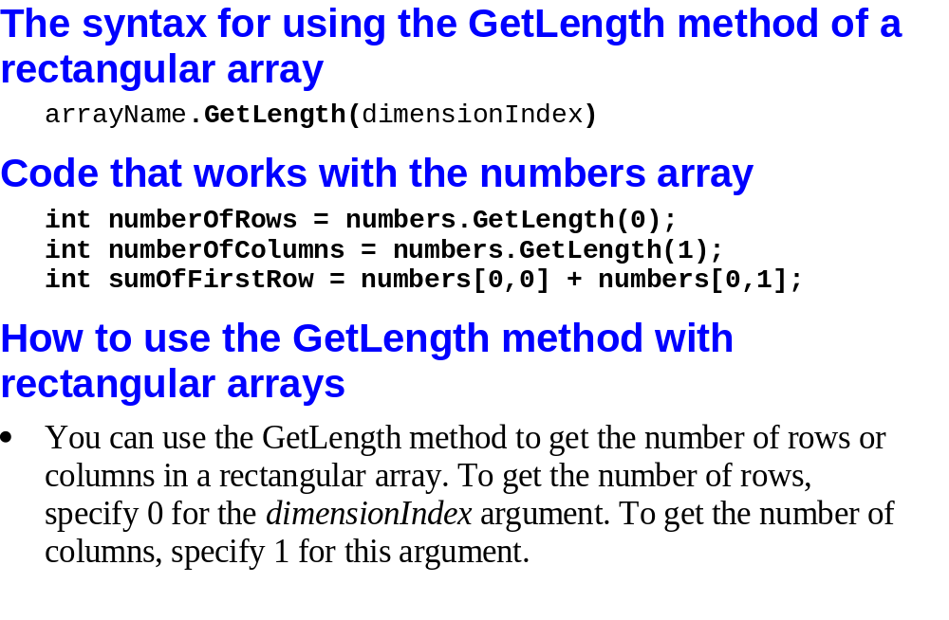
Murach’s C# 2010, C8
© 2010, Mike Murach & Associates, Inc.
Slide <number>

Slide 41
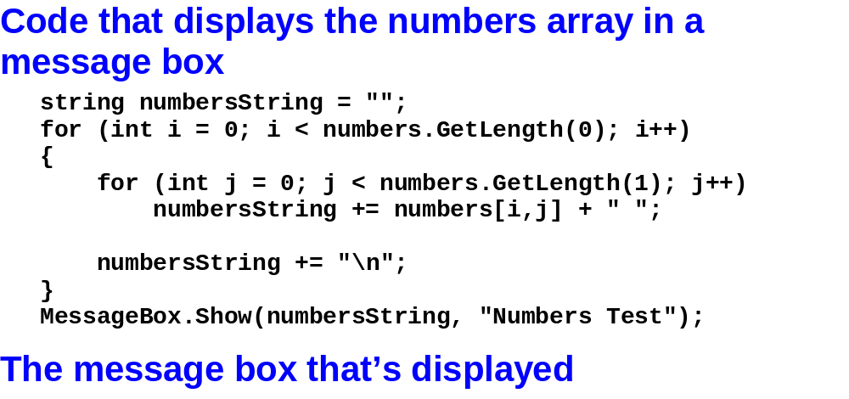
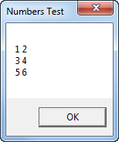
Murach’s C# 2010, C8
© 2010, Mike Murach & Associates, Inc.
Slide <number>

Slide 42
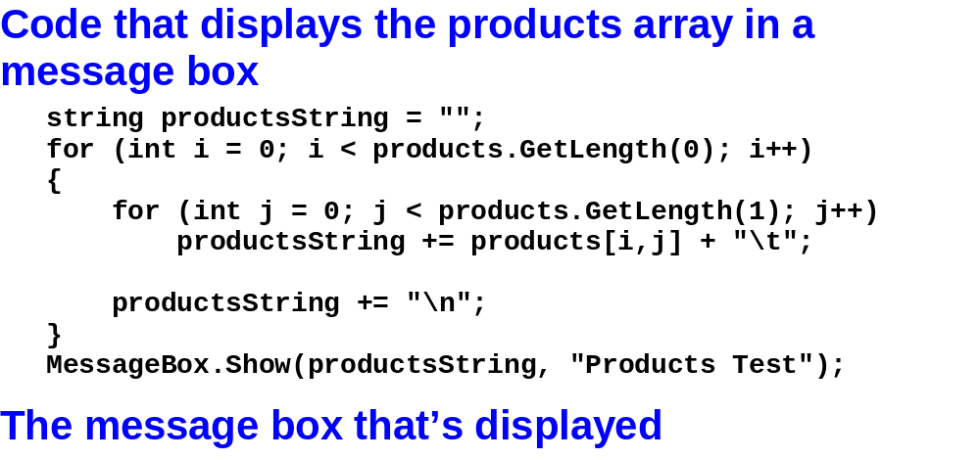
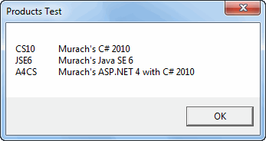
Murach’s C# 2010, C8
© 2010, Mike Murach & Associates, Inc.
Slide <number>

Slide 43
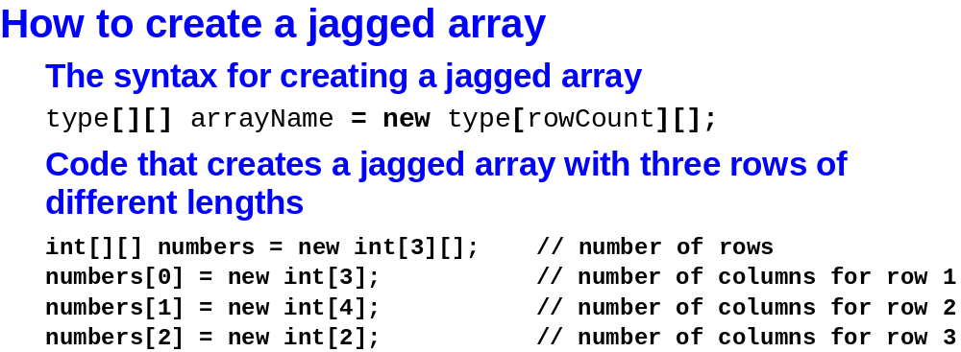
Murach’s C# 2010, C8
© 2010, Mike Murach & Associates, Inc.
Slide <number>

Slide 44
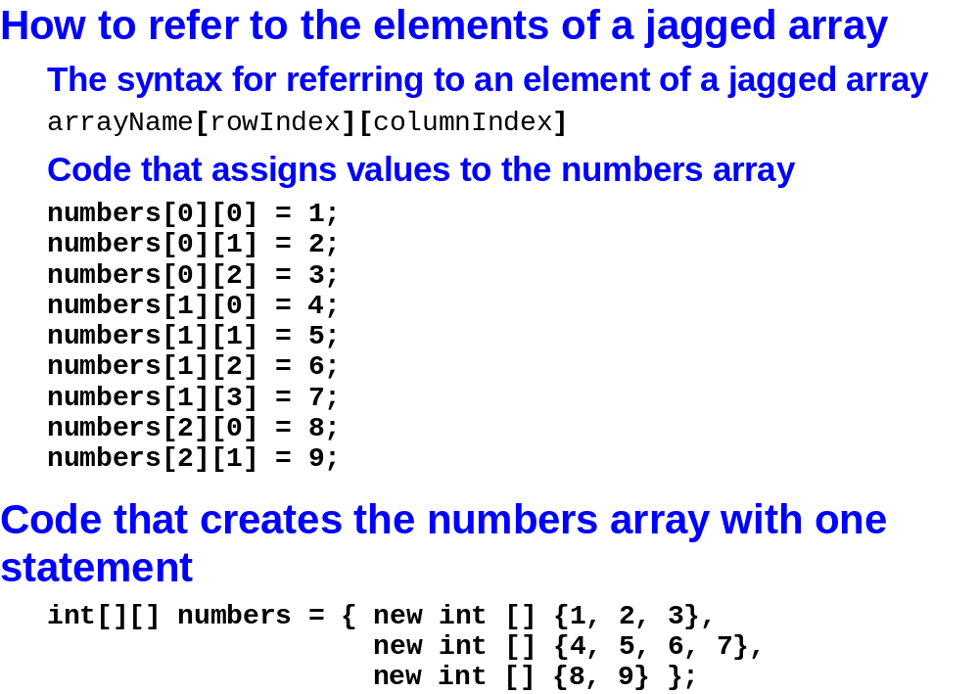
Murach’s C# 2010, C8
© 2010, Mike Murach & Associates, Inc.
Slide <number>

Slide 45
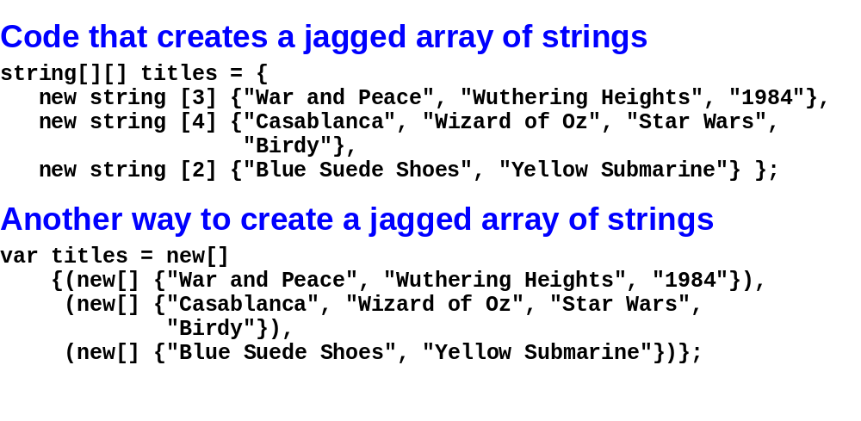
Murach’s C# 2010, C8
© 2010, Mike Murach & Associates, Inc.
Slide <number>

Slide 46
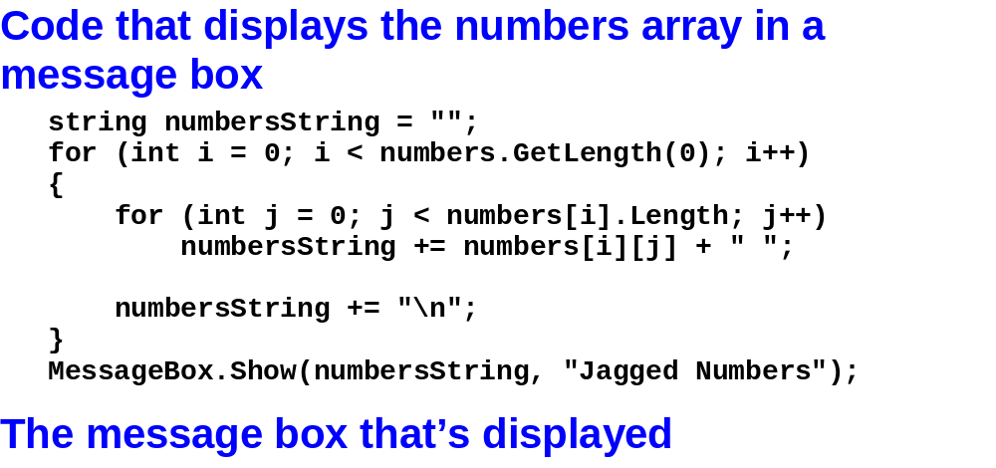
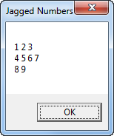
Murach’s C# 2010, C8
© 2010, Mike Murach & Associates, Inc.
Slide <number>

Slide 47
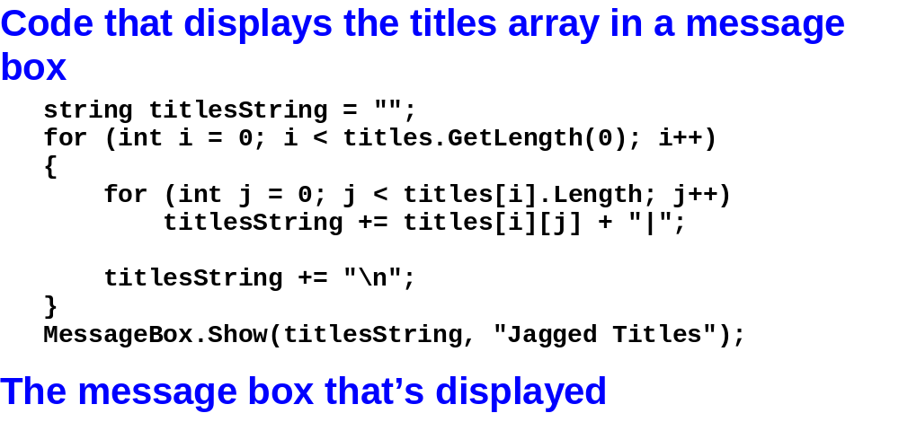

Murach’s C# 2010, C8
© 2010, Mike Murach & Associates, Inc.
Slide <number>

Slide 48
Lab 1
The next part of the lab asks you to modify the Future Value application from the textbook
  See page 252 of the text. Let’s run the application and see what it does.
  Let’s look at the code. Pay particular attention to all of the methods for validating the data.
  Let’s add
    the instance variables in #2. Why are these instance variables?
    The field values to the 2d array at the end of the calculate event handler.
    You try 4 and 5
Murach’s C# 2010, C8
© 2010, Mike Murach & Associates, Inc.
Slide <number>

Slide 49

Lab 1
The next part of the lab asks you to complete tutorial 7-3 from the 133 text (page 439)
You enter the seat you want, a row and a column. The app reports the price of the seat. The seat prices are stored in a 2 dimensional array.
Look at the code. I added comments.
  Create the array to store the prices
  Retrieve the value out of the array based on the row and column and display it on the form.
Murach’s C# 2010, C8
© 2010, Mike Murach & Associates, Inc.
Slide <number>

Slide 50

Lab 1
The LAST part of the lab is Tic Tac Toe.
Find your solution to this problem from 133 … or start from scratch with the solution I gave you.
What data structure will you use for the “board”? Why? What’s the scope of that variable?
Conceptually, which code will have to change now that we’re not storing the “data” for our application in the UI?
  Event handlers?
  Methods that check for winner?
© 2010, Mike Murach & Associates, Inc.
Slide <number>
Murach’s C# 2010, C8
Slide <number>

Slide 51
Lab 1
The LAST part of the lab is Tic Tac Toe.
Let’s talk about MakeComputerMove specifically.
  Should we pass a parameter or use the instance variable? Why?
  Which lines of code have to change? Can you write them?
Re-write other methods like
  IsFull?
  IsRowWinner?
  IsAnyRowWinner?
© 2010, Mike Murach & Associates, Inc.
Slide <number>
Murach’s C# 2010, C8
Slide <number>

Slide 52


Murach’s C# 2010, C8
© 2010, Mike Murach & Associates, Inc.
Slide <number>

Slide 53

Murach’s C# 2010, C8
© 2010, Mike Murach & Associates, Inc.
Slide <number>

Slide 54

Murach’s C# 2010, C8
© 2010, Mike Murach & Associates, Inc.
Slide <number>

Slide 55

Queue

Slide 56

Stack

Slide 57

Murach’s C# 2010, C8
© 2010, Mike Murach & Associates, Inc.
Slide <number>

Slide 58

Murach’s C# 2010, C8
© 2010, Mike Murach & Associates, Inc.
Slide <number>

Slide 59

Murach’s C# 2010, C8
© 2010, Mike Murach & Associates, Inc.
Slide <number>

Slide 60

Murach’s C# 2010, C8
© 2010, Mike Murach & Associates, Inc.
Slide <number>

Slide 61

Murach’s C# 2010, C8
© 2010, Mike Murach & Associates, Inc.
Slide <number>

Slide 62

Murach’s C# 2010, C8
© 2010, Mike Murach & Associates, Inc.
Slide <number>

Slide 63

Murach’s C# 2010, C8
© 2010, Mike Murach & Associates, Inc.
Slide <number>

Slide 64


Murach’s C# 2010, C8
© 2010, Mike Murach & Associates, Inc.
Slide <number>

Slide 65


Murach’s C# 2010, C8
© 2010, Mike Murach & Associates, Inc.
Slide <number>

Slide 66

Murach’s C# 2010, C8
© 2010, Mike Murach & Associates, Inc.
Slide <number>

Slide 67

Murach’s C# 2010, C8
© 2010, Mike Murach & Associates, Inc.
Slide <number>

Slide 68

Murach’s C# 2010, C8
© 2010, Mike Murach & Associates, Inc.
Slide <number>

Slide 69

Murach’s C# 2010, C8
© 2010, Mike Murach & Associates, Inc.
Slide <number>

Slide 70

Murach’s C# 2010, C8
© 2010, Mike Murach & Associates, Inc.
Slide <number>

Slide 71


Murach’s C# 2010, C8
© 2010, Mike Murach & Associates, Inc.
Slide <number>

Slide 72

Murach’s C# 2010, C8
© 2010, Mike Murach & Associates, Inc.
Slide <number>

Slide 73


Murach’s C# 2010, C8
© 2010, Mike Murach & Associates, Inc.
Slide <number>

Slide 74

Murach’s C# 2010, C8
© 2010, Mike Murach & Associates, Inc.
Slide <number>

Slide 75

Murach’s C# 2010, C8
© 2010, Mike Murach & Associates, Inc.
Slide <number>

Slide 76


Murach’s C# 2010, C8
© 2010, Mike Murach & Associates, Inc.
Slide <number>

Slide 77

Murach’s C# 2010, C8
© 2010, Mike Murach & Associates, Inc.
Slide <number>

Slide 78
Lab 1
The next part of the lab asks you to complete tutorial 7-4 in the 133 text. (page 452)
  Re-write the test score application using a list instead of an array. I’ve added comments.
    Write each of the methods.
    Write the event handler
      Create the list variable
      Call each of the methods.
Murach’s C# 2010, C8
© 2010, Mike Murach & Associates, Inc.
Slide <number>

Slide 79
What’s Next
Reading Quiz 2 covers chapter 8
Chapter 9 - Strings
  Reading Quiz 3
  Lab 2
Lab 3 – Memory or Concentration will give you one more chance to practice writing a more complicated “object based” program
Quiz 1
Murach’s C# 2010, C8
© 2010, Mike Murach & Associates, Inc.
Slide <number>

