Slide 2
Topics
Relational database concepts
my_guitar_shop database(s) as an example of concepts
MySQL
Using phpMyAdmin
Using MySQL Work Bench
Designing a database (ch 16)
Next week – Intro to SQL (ch 18)

Slide 3
Relational Databases
Lots of you took CIS 125 D
125D – gave you experience with using a database product that was designed for “small” applications and end users – Access. It also gave you an intuitive understanding about the structure of databases.
275 –will give you experience with a formal process for creating normalized databases, reinforce your understanding of database concepts, perfect your ability to write SQL statements and exposed you to a database product that was designed for “large scale” applications – ORACLE.
276 – will build on 275 and gives you more database administration knowledge and skills as well

Slide 4
Relational Databases
Those of you who didn’t take either one or both of those courses will get the database concepts by example
I’ll show you a couple of databases, explain some key concepts, help you design databases for labs and help you write the sql scripts you need for most labs.
You’ll pick up the stuff you need to know through working with the examples and exercises.
I won’t expect any of you to have lots of database expertise and will help you with or just plain give you the database specific information you need for the labs.

Slide 5
Relational Databases
Store data in a set of 2-dimensional tables
Each table
Describes an entity or a thing - customer or a book or an order
Consists of a set of characteristics or attributes or fields related to that thing – customerid, name, address, city might be fields in the customer table
Contains one field that uniquely identifies each row or record in the table. That field is called the primary key.

Slide 6
Relational Databases
A table is related to other tables
A customer places at least one but maybe lots of orders.
You physically create the relationship between the by putting the primary key from one table into another table.
In this example, the customer id would be included in the order to table. Why wouldn’t you put the orderid in the customer table to create the relationship?
A pkey used in another table to create a relationship is called a foreign key.
The relationship between tables has a “cardinality”.
One to many is most typical. There’s a 1 to m relationship between customer and order.
One to one are sometimes used but often indicates that the 2 tables can be combined into 1 table.
Many to many relationships often indicate the need for a 3rd table between the 2 tables. A book is purchased on 1 to many orders and an order can contain 1 or more books. The relationship between book and order is many to many. Creating an order items table that lists the books in a specific order resolves the many to many relationship.

Slide 7
Relational Databases
Lots of books describe formal rules for creating database structure. I’ll use a couple rules of thumb to keep instead …
Avoid Redundant data
Wastes storage space
Creates possibility for inconsistency
Requires extra work when updating
Avoid “repeating groups” of data
Order table that contained fields like book1, book2, book3 would be an example. Why is that problematic?
Make sure field values are atomic. Why?
Use natural fields for the pkey. Why?
Avoid empty attributes.
Book table with a large text field for the book review that might be blank for lots of books would be example. Why is that problematic?

Slide 8
Guitar Shop Example
Your text uses 2 versions of a database for a fictitional guitar shop, my_guitar_shop1 and my_guitar_shop2.
In my_guitar_shop1
categories (categoryId, categoryName)
products (productId, categoryId, productCode, productName, listPrice
orders (orderId, customerId, orderDate)
Can you identify key concepts like: table, field, primary key, foreign key?

Slide 9
Guitar Shop Example
In my_guitar_shop2
categories (categoryID, categoryName)
products (productID, categoryID, productCode, productName, listPrice, discountPercent, dateAdded)
orders (orderID, customerId, orderDate, shipAmount, taxAmount, shipDate, shipAddressID, cardType, cardNumber, cardExpires, billingAddressID)
orderItems ( itemID, orderID, productID, itemPrice, discountAmount, quantity)
customers (customerID, emailAddress, password, firstName, lastName, shipAddressID, billingAddressID)
addresses ( addressID, customerID, line1, line2, city, state, zipCode, phone, disabled)
administrators ( adminID, emailAddress, password, firstName, lastName)
Can you identify key concepts like: table, field, primary key, foreign key?
Potential problems with or questions about the structure?

Slide 10
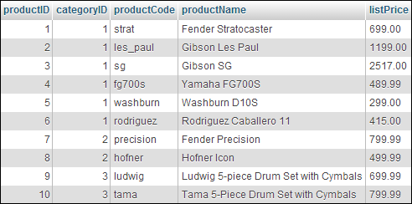
Primary key
Columns
Rows

Slide 11
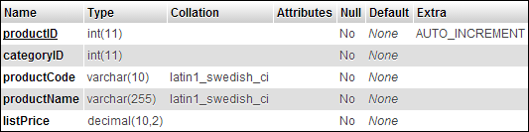

Slide 12

Primary key
Foreign key

Slide 15
MySQL
Is the database that’s most often used with php apps because
The community edition is free. Oracle now owns MySQL and is committed to continuing the free version but other versions are available for a fee.
It’s open source. Upgrades. Standards.
It’s relatively easy to install, administer and use if you don’t have a lot of db experience.
It doesn’t require lots of hardware resources.
It runs on any OS platform.
The MyISAM engine is very fast.
The newer engines like InnoDB provide support for important and necessary database features like enforcing referential integrity at the database backend.
Lots of programming languages provide support for working specifically with MySQL. And MySQL conforms to ODBC standards so you can use it with any language that knows how to work with ODBC.

Slide 16
MySQL
Is an immature database product when compared with ORACLE or MS SQL Server.
Until version 5, it didn’t provide support for views, stored procedures or triggers, transactions or enforcing referential integrity
Most php/mysql applications don’t use these features and instead rely on programmers to do the right thing in applications.
That is NOT database application development “best practice”
It makes programming more complicated.
It’s also very naïve about how databases get used over time… rarely is a database used just by the application for which it was originally designed.
It requires that an application developer re-do the same work in every application that accesses the database.

Slide 17
MySQL Tools
Lots of software exists to help you work with MySQL
MySQL Monitor is a command line tool. It’s installed when you install MySQL. It requires that you know SQL. It provides access to newer features of MySQL that phpMyAdmin doesn’t support.
phpMyAdmin is a web based application. It’s nice because it has a GUI and can be used on a remote machine - we’ll use to work with MySQL on citstudent.
MySQL Workbench – is a java application much like Oracle SQL Developer that many of you used (or will use) in 275. http://dev.mysql.com/downloads/workbench/

Slide 18
MySQL Tools
Lots of software exists to help you work with MySQL
http://www.databasejournal.com/features/mysql/slideshows/top-10-mysql-gui-tools.html is an “article” that briefly describes 10 most popular tools for MySQL.

Slide 19
MySQL Tools
Before we look at MySQL client tools
Make sure mysql is installed and running on your machine
C:\wamp\bin\mysql\
Control panel services tool – wampmysqld - start/stop/automatically start on startup
This will be different for those of you who installed mysql manually or who are using xampp or some other #amp server products

Slide 20
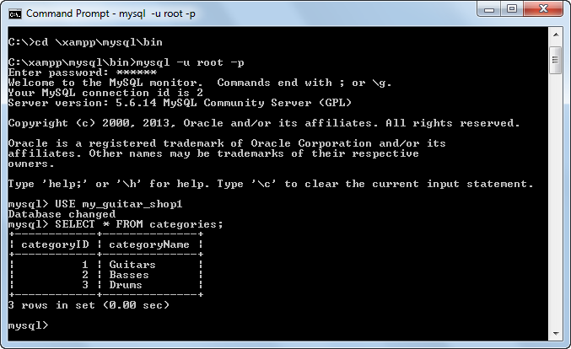
MySQL Tools
MySQL Monitor – is mentioned in your text briefly in chapter 3. Most MySQL developers use another tool so we won’t spend a lot of time on it

Slide 21
MySQL Tools
phpMyAdmin – is described more thoroughly in chapter 3. We’ll use it now to create and “poke around” my_guitar_shop databases.
Start phpMyAdmin by opening your browser and navigating to http://localhost/phpMyAdmin
Some of you may also be able to launch it from the phpMyAdmin menu item on the wampServer icon on your taskbar.
Generally, the only user that is created when you install is the root user and the password is not set. That creates a HUGE security risk but we’ll leave it that way right now. DO NOT change the password for the root user on our machines.
AND make sure you use the same machine all of the time in class. You are about to create databases on your machine and you don’t want to have to re-create them every time you come to class!

Slide 22
Creating the MGS Databases
Find the create_db.sql file in the starting files for this week in moodle.
Let’s look at the file in notepad before we run it in phpMyAdmin.
By the way, I expect you to be able to read sql scripts that create database objects but not to be able to write them. We’re skipping chapter 17 in the text which is the chapter that explains all of this in detail. Those of you who took 275 should definitely look at that chapter.
What’s the name of the database we’re creating?
What’s the first table you see? What are the fields for this table? What’s the data type for each field? What are some other attributes for a field? What do you think each means? What’s the primary key for the table?
Will the table have any data in it? How many rows?

Slide 23
Creating the MGS Databases
Find the second version of the database in the file. Find anything else that’s interesting? Does anyone see any foreign key constraints being created?
Use the Import tab in phpMyAdmin (in your browser) to run the sql script from the file that we just looked at. You should get a message when the import is complete.
“Poke around” with phpMyAdmin. Make sure you
Find each database
Identify the tables in each database
Identify the structure of each table
Browse the data in each table.
Insert and edit data in each table.
Try to delete a record that should violate referential integrity. Can you?
Recreate the databases from the script again when you’re done

Slide 24
MySQL Tools
MySQL Workbench – is described briefly in chapter 16. If you haven’t already installed it on you machine, do that now.
Open the application and “poke around” the 2 MGS databases using this tool.
Do you find it easier or harder to use than phpMyAdmin?
When doing your work for this class, you can use any MySQL client tool that you like. For those of you who have some database experience, I’d encourage you to get proficient using both.
Can anyone figure out how to add foreign key constraints using the GUI?
Chapter 16 talks about using MySQL Workbench to create database diagrams and forward engineer a database script from the diagram. It’s also possible to generate a diagram from a script or a database. We’ll talk more about this next time.

Slide 25
Database Design
Chapter 16 talks about the process of designing a database for a real world problem
The first half of the chapter outlines a process and identifies some “errors” to look out for. I did this same kind of thing with you at the beginning of our db discussion.
The second half of the chapter describes a more formal process called “normalization”. Those of you who took 275 know all about that process and all of the normal forms. The rest of you should read the chapter so that you’ve seen the words but are NOT responsible for the formalized process.
I’d like to do one database design problem with you as a group.

Slide 26
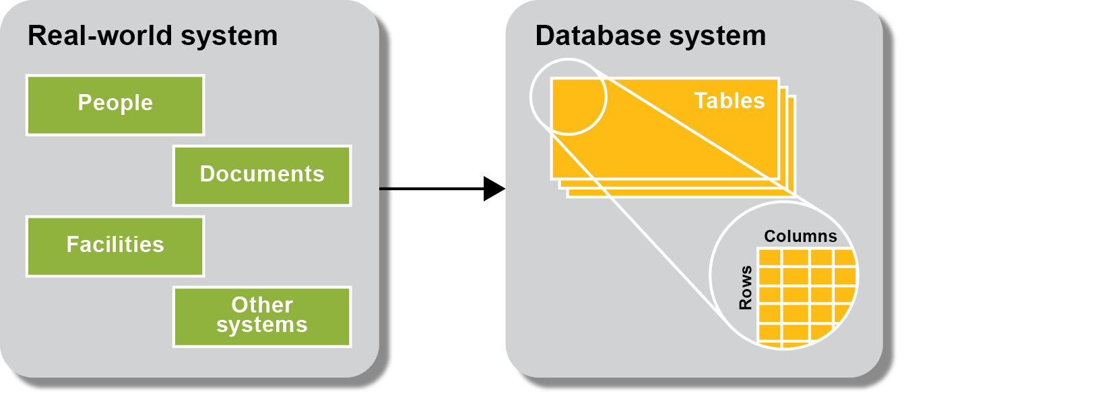

Slide 28
Database Design
Assume that you’ve been asked to create a database that supports the process of doing course evaluations at LCC.
Let me tell you what I know about the process and what I’d like the to be able to do with the data when evaluations are complete.
In groups of 3 or 4, create a first draft of the design on paper. Use the first 4 or 5 steps in the previous slide.
We’ll compare and contrast your designs as a group when you’re done.
Then we’ll create at least PART of the design using a MySQL Workbench diagram and then will create a version of the database from the diagram.

Slide 29
Lab 4
Is essentially finished. Write me a note in moodle when you have
Created both MGS databases in at least one instance of MySQL (the one you use in class and the one you use (at home) to do your labs)
Worked with phpMyAdmin and/or MySQL Workbench enough to feel comfortable.
Have created the CourseEvaluation database with either a SQL script or a database diagram in MySQL Workbench or the GUI in phpMyAdmin or MySQL Workbench.

Slide 30
Next Time
Introduction to SQL
Chapter 18
Reading Quiz 7
Lab 7
php and MySQL together
Chapter 4
Reading Quiz 8
Lab 8
Quiz 2

Slide 33
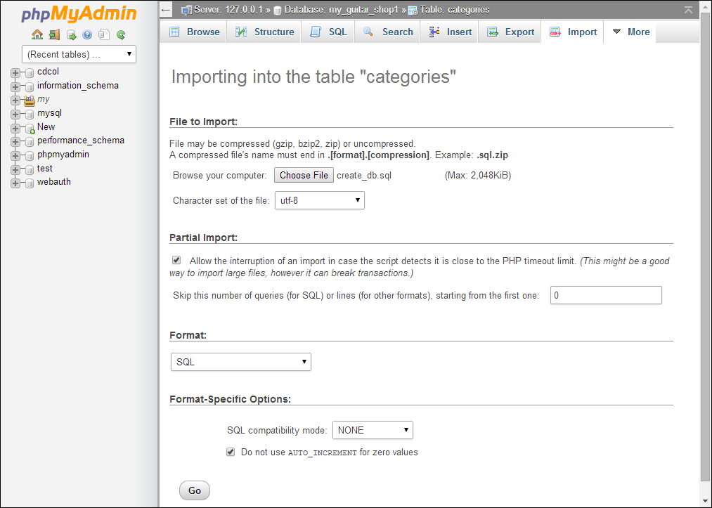

Slide 34
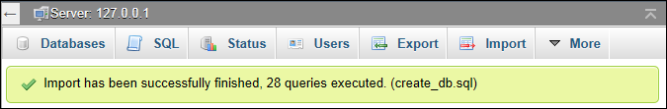

Slide 36
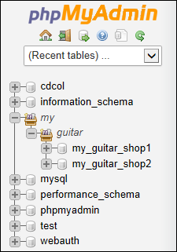
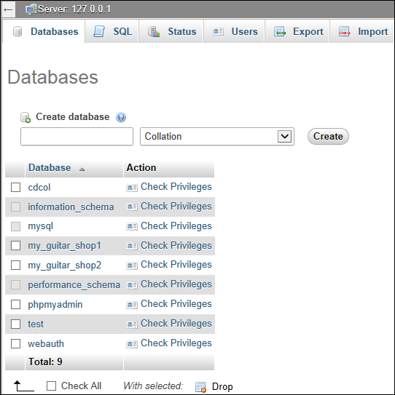

Slide 37
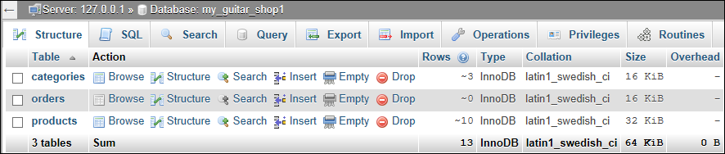

Slide 38
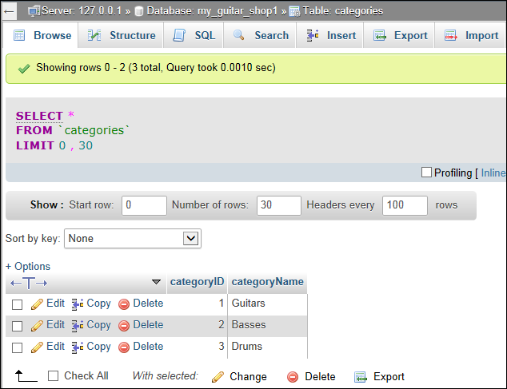

Slide 39


Slide 40
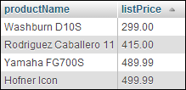

Slide 42


Slide 44
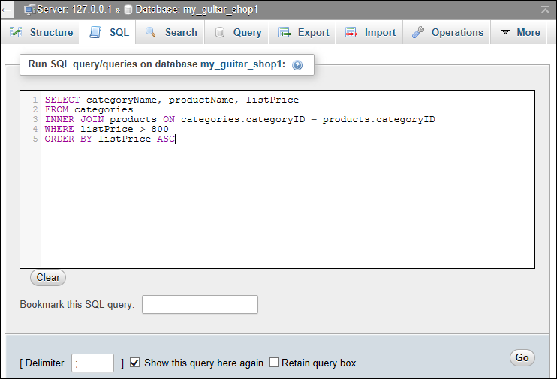

Slide 45
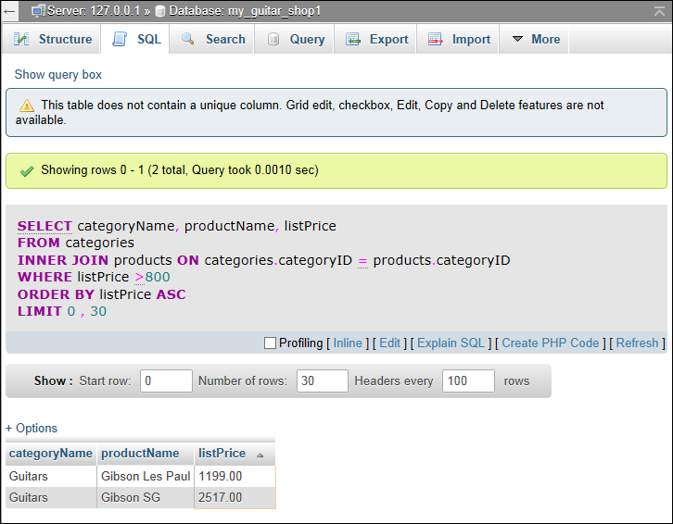

Slide 49
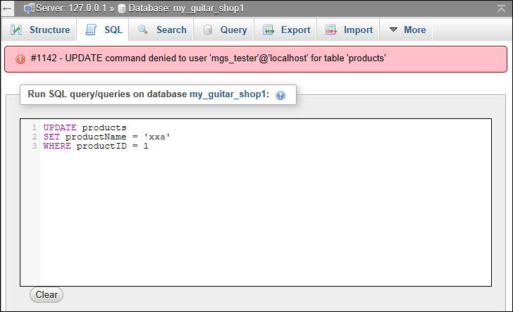

Slide 53
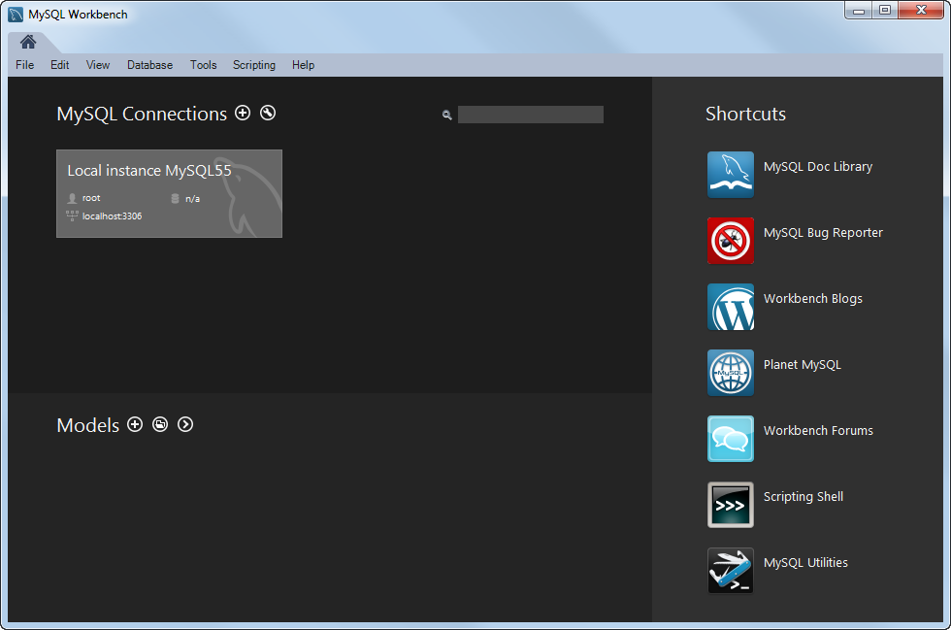

Slide 54
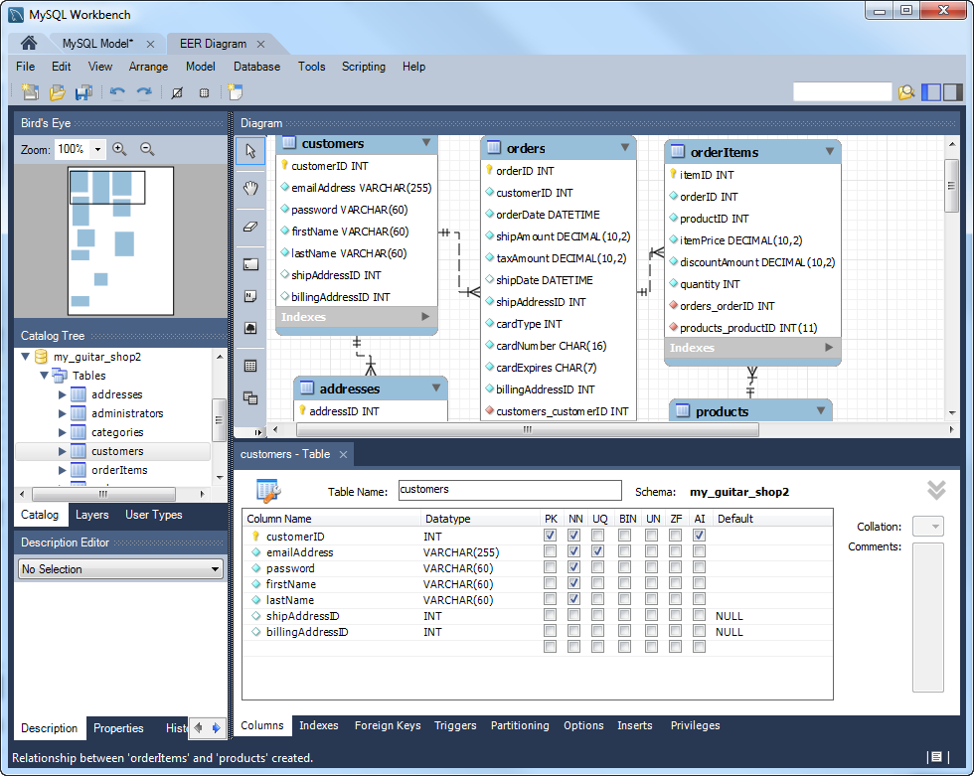

Slide 57
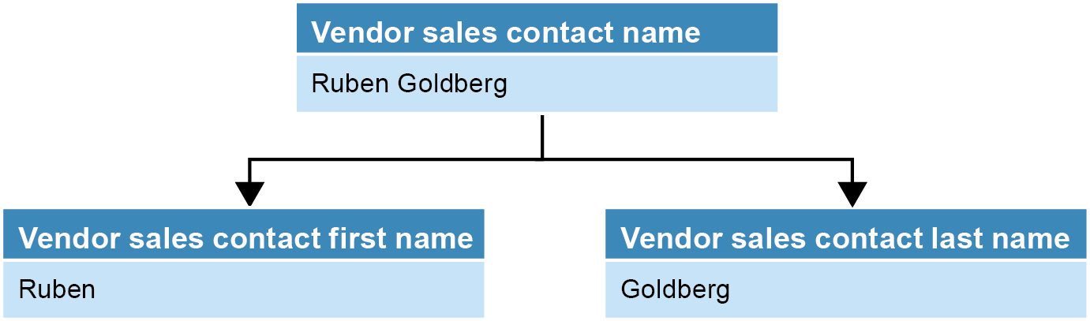

Slide 58
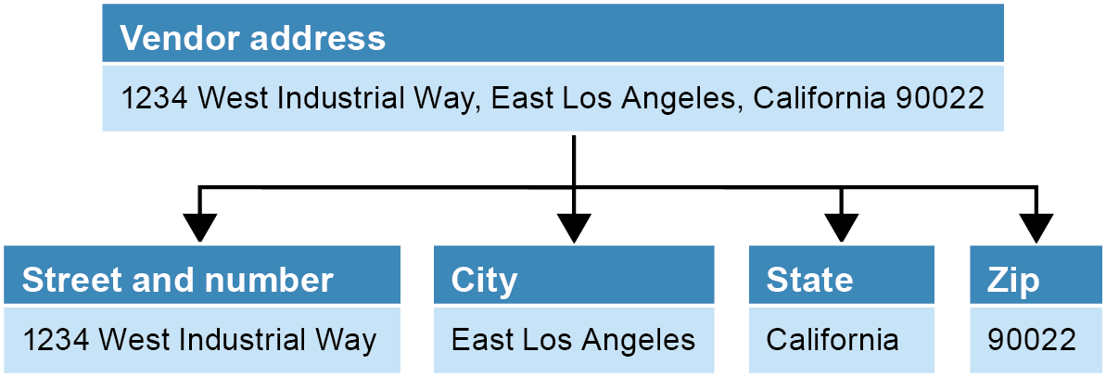

Slide 61
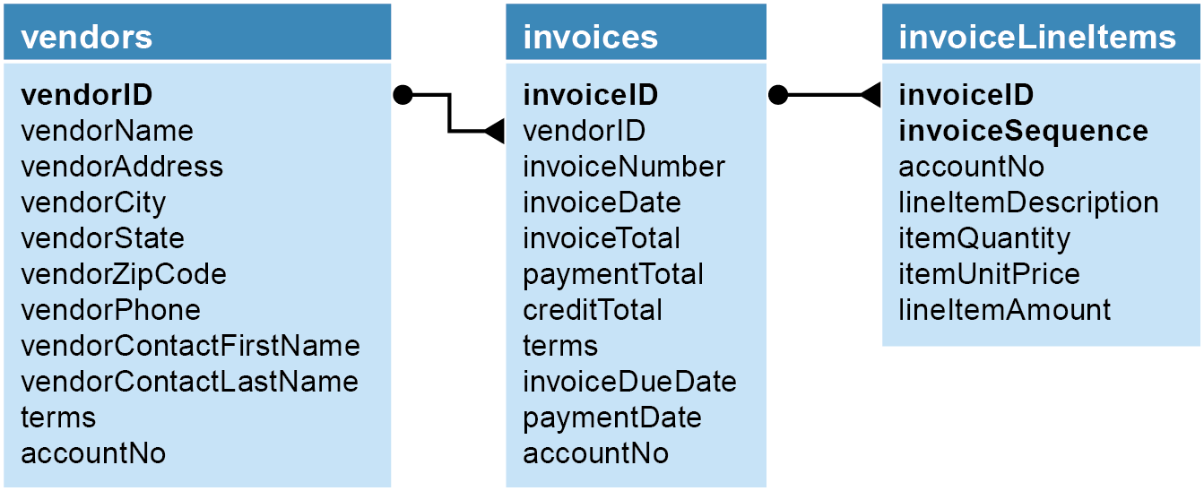

Slide 62
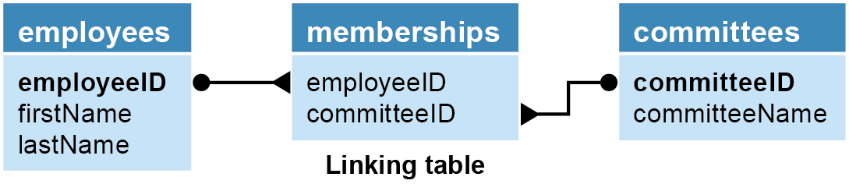
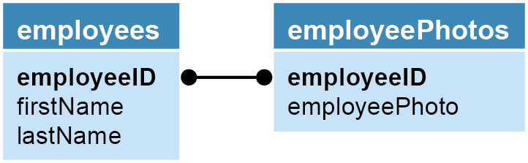

Slide 64

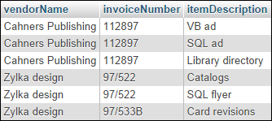

Slide 65
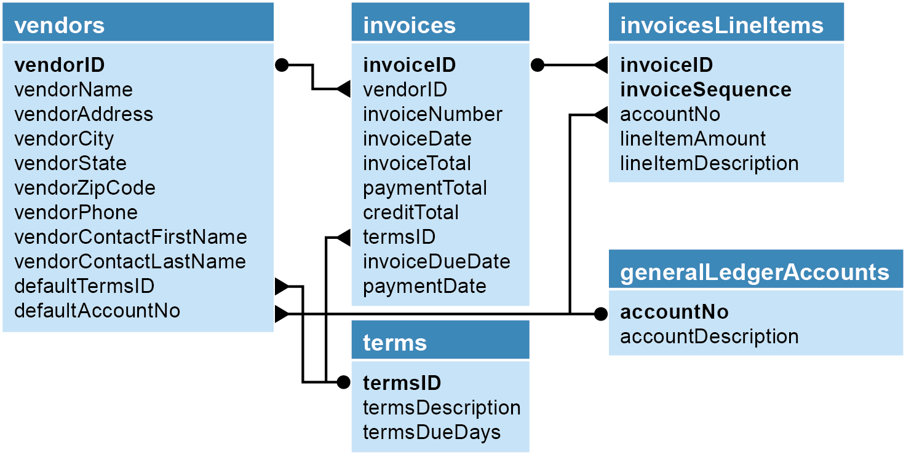

Slide 69



Slide 70


Slide 71
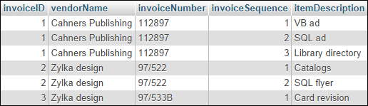

Slide 72

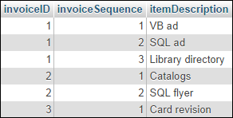

Slide 73
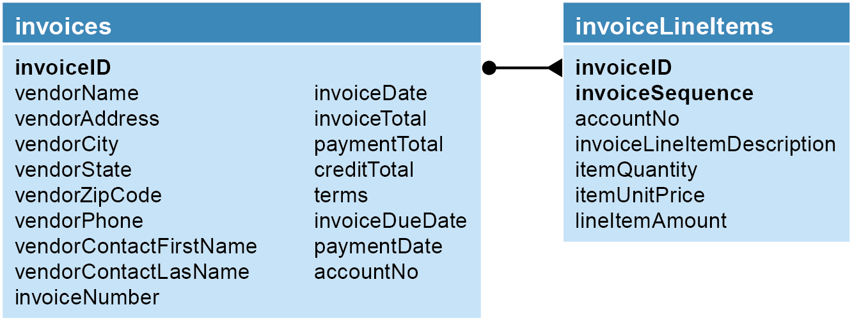

Slide 74


Slide 75
