Slide 2
Topics
Intro to SQL data manipulation statements
Select – skip the part on subqueries
Insert
Update
Delete

Slide 4
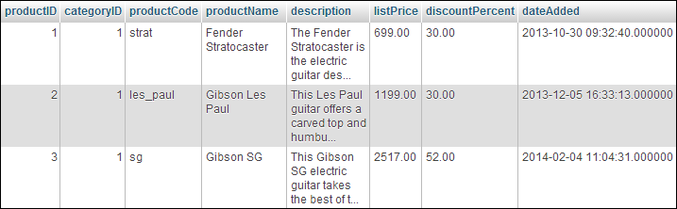

Slide 5
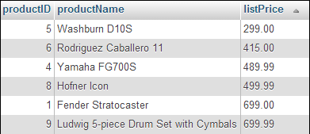

Slide 6


Slide 7


Slide 8


Slide 9


Slide 10


Slide 11


Slide 16
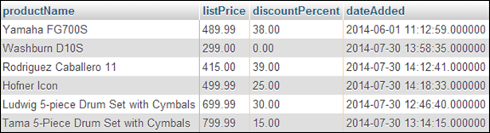

Slide 17


Slide 18


Slide 19


Slide 20


Slide 23
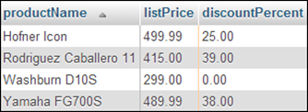

Slide 24
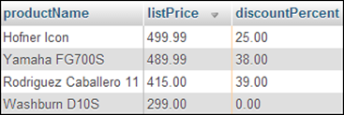

Slide 25
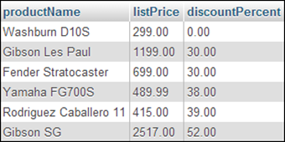

Slide 26
Lab 7
In addition to some exercises out of the book. I’d like you to write some sql select statements on your own
Get me a list of all of the products
Get me a list of all of the products in category 1
Get me a list of all of the products in category 1, sorted from most to least expensive
Get me a list of all of the orders that are being shipped to an address that is different than the billing address, sorted by order id
Get me a list of the of the items ordered on orders 1 and 3, sorted by the order and then the product

Slide 28


Slide 29


Slide 30
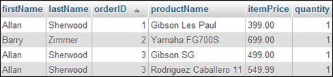

Slide 31
Lab 7
In addition to some exercises out of the book. I’d like you to write some sql select statements on your own
Add the CategoryName to #3.
Add the billing address to #4.
Add the shipping address to #7
Add the product information to # 5.
Add the order information to # 9.
Add the customer information to # 10.

Slide 32


Slide 33


Slide 34


Slide 35


Slide 36


Slide 37


Slide 38
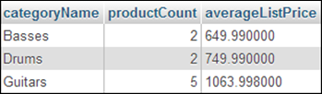

Slide 39
Lab 7
In addition to some exercises out of the book. I’d like you to write some sql select statements on your own
How many orders have been placed?
How many items products where ordered on each order?
What's the total value of the products ordered on each order?
How many products are we offering at a 30% discount?
How many orders have been placed by each customer?

Slide 46
Lab 7
Starts with exercise 18-1 in your text on page 611 and 612
We finished 1-3 as part of lab 4
4 and 5 ask you to enter some of the sql statements out of the text as examples. We’ve already done that.
7 and 8 ask you to write sql select statements yourself. DO these in addition to the 16 statements described in lab 5 in moodle, many of which we did together in class.
10 – 12 as you to write insert, update and delete statements yourself. DO these.
As you go, add your sql statements to a text file. Submit this text file in moodle when you’re done.

Slide 47
Next Time
php and MySQL together
Chapter 4
Reading Quiz 8
Lab 8
Quiz 2 – Is an optional exercise

