Slide 2
Topics
Syntax for creating classes and working with them in php
An example
OO Product Viewer and Product Manager application

Slide 3
Object Oriented Programming
Because all of you have programmed in at least one other object oriented programming language, we’ll focus largely on syntax as we talk about this chapter.
You’ll be pleased to know that the most recent version of php has good support for all of the features of oop that you’d expect.
Encapsulation and information hiding
Inheritance
Polymorphism

Slide 49
Product Manager Application
The text illustrates all of this syntax using part of the MGS application that we’ve been looking at all term
The UI hasn’t changed much but the code is VERY different!
Get to run on your machine
Then let’s talk about the code

Slide 50
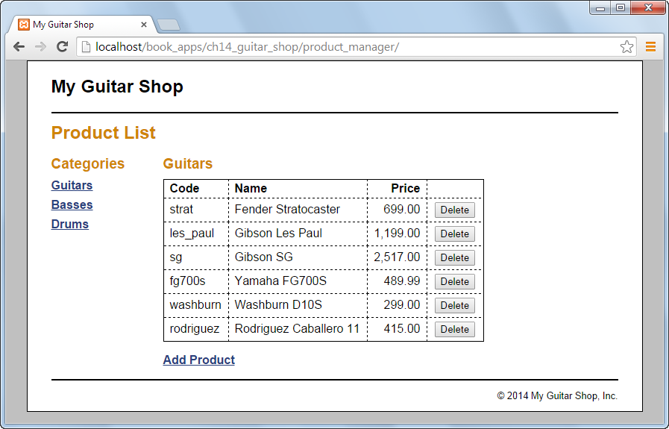

Slide 51
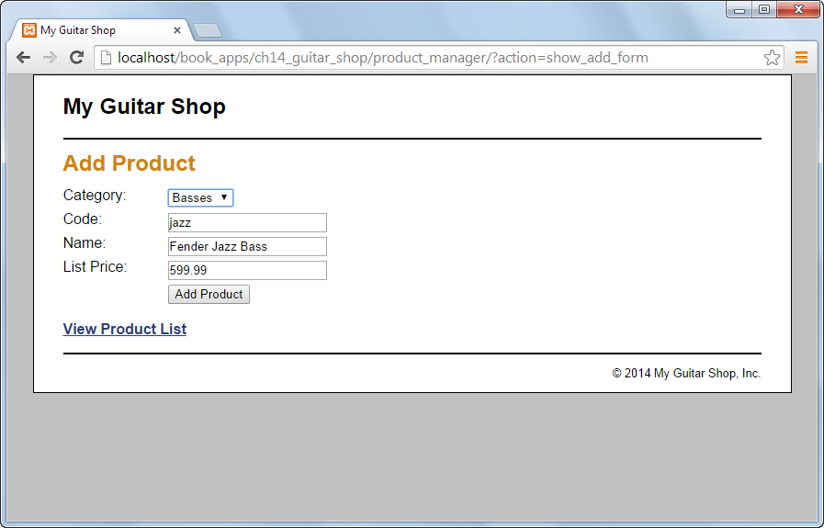

Slide 65
Lab 6
Convert lab 5 to an object oriented application
Start with your solution to lab 5
Add the files from the model in chapter 14, Product and Catalog, to the model folder from lab 5
Replace the contents of the model files that access the database in lab 5 with classes that access the database. You’ll copy and paste the ProductDB class from chapter 14. The CategoryDB class from chapter 14 in missing the method that adds a category as well as the method that deletes a category. You’ll have to add those but you have lots of this code written in the version from lab 5.
Rewrite the controller and the views from lab 5 so that they use your classes.

Slide 66
Next Time
We’re done with new content. The rest of the term we’ll spend building the Lab Management Application.

