Slide 2
Topics
Using php to
Connect to a database
Run a sql statement that returns a record set
Fetch a record from the record set
Run a sql statement that doesn’t return a record set
Handling exceptions with try / catch
Several Examples
Product Viewer and Product Manager (Ch 4)
My Guitar Shop web site (Ch 5)
My Guitar Shop web site (Ch 20)

Slide 3
MySQL Extensions to PHP
There are several libraries in php designed specifically to work with MySQL
mysql – old, procedural approach
mysqli – new approach introduced with php 5 works with mysql 4.1.3 and above – functions are largely the same as mysql functions – includes a mysqli class that allows you to use an object oriented approach – see chapter 19
database abstraction layers – are designed to allow you to connect to lots of different database backends in addition to mysql without having to change your php code. All of them are object oriented.
pdo is the one that the text introduces in chapter 4 and uses throughout the book. That’s the db access extension that I want you to use.

Slide 4
Database Processing
Whenever you interact with a database from a programming language you have to
Connect to the database
Issue a sql command
If it’s a sql select command, you’ll have to “loop through” the set of records that is returned
Disconnect from the database
The next couple of slides show you the syntax for doing that with PDO

Slide 16
Database Processing
All kinds of things can go wrong in the process of working with a database
Can’t get a connection because user id or password is incorrect
Can’t issue a sql statement because you don’t have permissions
Can’t issue a sql statement because there’s an error in the statement
Generally, you should use try / catch blocks to deal with errors / exceptions

Slide 19
Product Viewer Application
The text illustrates all of this syntax using an application that allows a user to “browse products by category” in MSG
Let’s look at the UI first
Then the code
Then get it to run on your machine

Slide 20
What? No Functions?
The textbook author improves on this application in a variety of ways in chapter 5 (and again in chapter 20).
One of the notable improvements in chapter 5 is the use of functions.
I might have written some additional functions, but we’ll talk about that after we’ve looked at the example in chapter 5.
The other way in which the text improves on this example is the use of the MVC design pattern.
For right now, just notice the way in which the example works with the database.

Slide 21
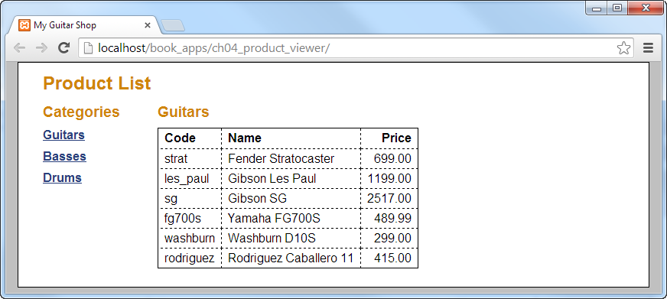

Slide 22
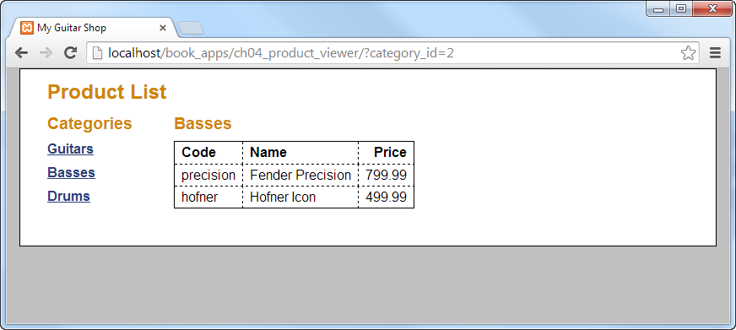

Slide 30
Product Manager Application
The second example in the text allows an “administrator” to maintain the data that’s used by the app we just looked at
Let’s look at the UI first
Then the code
Then get it to run on your machine

Slide 31
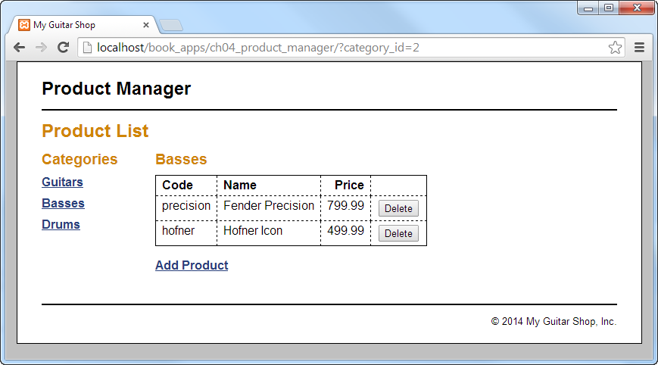

Slide 32
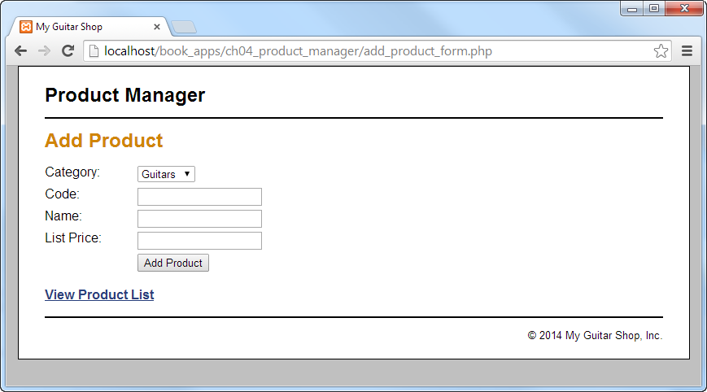

Slide 45
Product Manager App
Chapter 5 gives you an updated version of the app we just looked at
Let’s get it to run on your machine.
Notice that the functionality and the UI are the same as the previous version

Slide 46
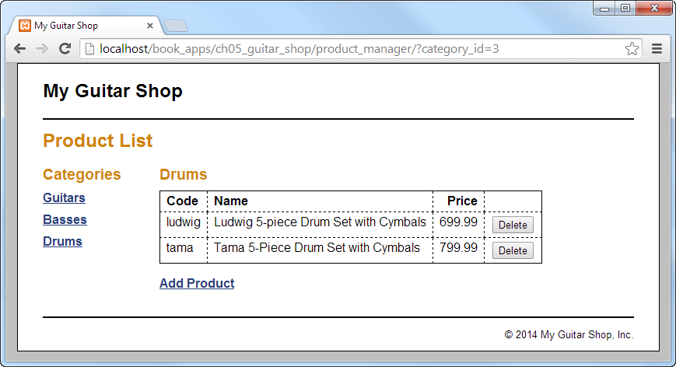

Slide 47
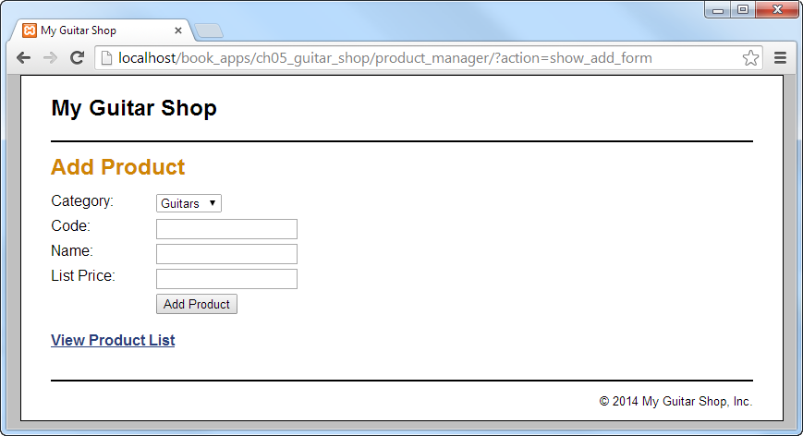

Slide 48
Product Manager App
Chapter 5 gives you an updated version of the app we just looked at
Let’s look at the code and focus on what’s different in the new version
Model folder contains a set of functions that are responsible for getting the data (from the database).

Slide 52
Product Manager App
Chapter 5 gives you an updated version of the app we just looked at
Let’s look at the code and focus on what’s different in the new version
Model folder contains a set of functions that are responsible for getting the data (from the database).
Controller handles all of the actions. It calls the functions to get the data and then includes the appropriate view.

Slide 56
Product Manager App
Chapter 5 gives you an updated version of the app we just looked at
Let’s look at the code and focus on what’s different in the new version
Model folder contains a set of functions that are responsible for getting the data (from the database).
Controller handles all of the actions. It calls the functions to get the data and then includes the appropriate view.
Each view displays a UI for the user to interact with. Each has access to the model data provided by the controller.

Slide 64
Product Catalog App
Chapter 5 gives you an updated version of the Product Viewer as well
Let’s get it to run on your machine.
Notice that the functionality and the UI are similar to the previous version.
The product list contains just a list of products without the details for each
The product page contains the details for a product, including an image.

Slide 65
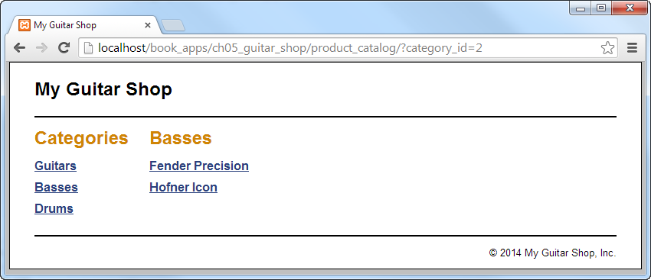

Slide 66
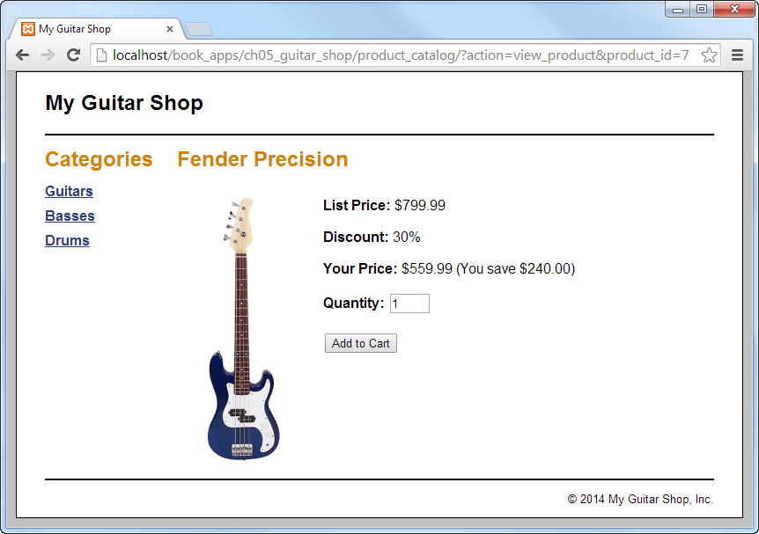

Slide 67
Product Catalog App
Chapter 5 gives you an updated version of the Product Viewer as well
Let’s look at the code and focus on what’s different in the new version
This app has the same model related functions as the previous app. After all, the data is the same in both cases.
Controller handles all of the actions. It calls the functions to get the data and then includes the appropriate view. It’s not the same controller as in the product manager app but it’s structure is the same.

Slide 72
Product Catalog App
Chapter 5 gives you an updated version of the Product Viewer as well
Let’s look at the code and focus on what’s different in the new version
Each view displays a UI for the user to interact with. Each has access to the model data provided by the controller.

Slide 78
Lab 5
The first part of the lab asks you to add functionality to the page that allows an administrator to manage the list of categories.
This is exercise 5 – 1 parts 5 – 13 on pages 189 and 190 in the text.
The second part of the lab asks you “refactor” some things in the Product Catalog application.
This is exercise 5 -1 parts 14 – 16.
I’d also like you to look for opportunities to divide complex parts of the code into functions.

Slide 79
Lab 5
A couple of hints when working on Category List part of the lab.
Copy, paste and modify code from the product related model and view as you’re working on similar parts of the category list page. The book is asking you to do something similar to what they did in every instance.
Test after you complete each piece of the work.
#6. Test the functions before you put them in the page.

Slide 80
Lab 5
A couple of hints when working on Category List part of the lab.
#7 – 13
Test showing the empty page.
Write the code that gets the categories from the db and the code that displays the list of categories. Test that.
Write the code that deletes a category. Test that. NOTICE THAT YOU CAN DELETE A CATEGORY THAT HAS PRODUCTS. You would fix that by enforcing referential integrity. Don’t worry about that now.
Write the code that displays the add category form and the code that adds a category. Test that.

Slide 81
Lab 5
A couple of hints when working on Category List part of the lab.
#14 – 16 are pretty straight forward

Slide 82
Chapter 19
Gives you the details about all of the things that were introduced in chapters 4 and 5.
It talks about 3 different ways to access a MySQL database from php. You’re responsible for knowing the details about just pdo right now.
It talks about sql injection and encourages you to use prepared statements rather than concatenating input from the user into a sql statement.
It talks about the pdo error mode. It’s “best practice” to use structured exception handling to deal with errors. That requires that you set the error mode in your php code.
It improves the model from chapter 5 by including these things.

Slide 104
Lab 5
I disagree with your textbook author about where exceptions should be handled. The text handles the exceptions in each function. I’d prefer to handle them in the controller.
The last part of lab 5 asks you to change the error mode for pdo and to add structured exception handling to your version of the app from chapter 5.

Slide 105
Lab 5
Set the attribute to throw exceptions when you create the connection to the db
Add try / catch block to the controller
Introduce some errors and see if we can deal with them in a reasonable way
Change the database connection password
Add a syntax error in a sql statement
Hard code a category id that doesn’t exist in the call to delete.
Check the return value for execute and rowCount. Throw a PDOException
Anything else you can think of?

Slide 106
Next Time
Chapter 20
One last version of the My Guitar Shop applications
Chapter 12
Object Oriented Programming
Lab 6
Creating the “Lab Management” app
Labs 7/8/9

