Slide 2
Topics
Review of SQL data manipulation statements
Select
Insert
Update
Delete

Slide 4
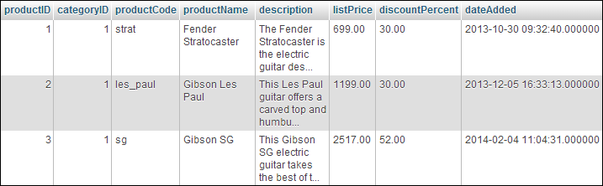
Notes:
* All of the fields in the “products” table

Slide 5
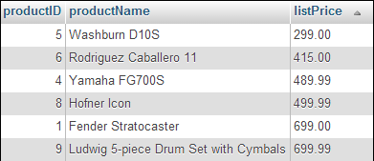

Slide 6


Slide 7


Slide 8


Slide 9


Slide 10


Slide 11


Slide 16
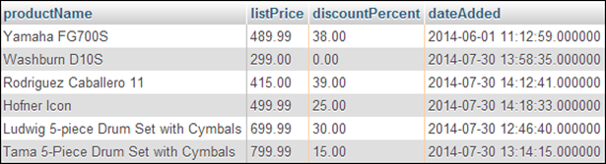

Slide 17


Slide 18


Slide 19


Slide 20


Slide 23
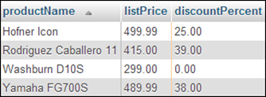

Slide 24
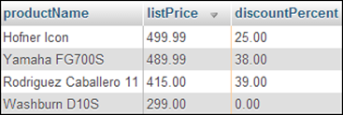

Slide 25
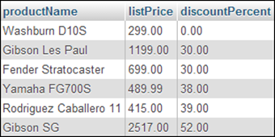

Slide 26
Lab 4
Because many of you did the exercises in the book last term, the starting files for lab 4 create a new database that we’ll use to practice our SQL
Download and unzip the file
Open it in Mysql Workbench or phpMyAdmin
Review the contents of the file.
What’s the name of the db?
What’s the name of the first table?
What are the fields in that table? Datatypes? Attributes?
What is it’s primary key?
Answer the same questions for the second table?
How is the second table related to the first?
Other questions?
Create the database on your machine
Notes:
W

Slide 27
Lab 4
Asks you to write a bunch of SQL statements to get the data described in English. Ask questions if you don’t know what I’m asking you for.
At this point you should be able to do questions 1 – 4 and question 16
Notes:
W

Slide 29


Slide 30


Slide 31
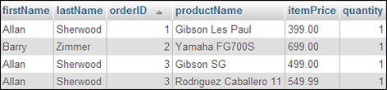

Slide 32
Lab 4
At this point you should be able to do 7 - 12

Slide 33


Slide 34


Slide 35


Slide 36


Slide 37


Slide 38


Slide 39
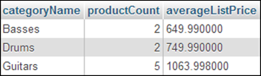

Slide 40
Lab 4
At this point you should be able to do 13 - 15

Slide 47
Lab 4
The second part of lab 4 asks you to begin to design and implement the database for lab 7/8/9. Let’s work on that together now …

Slide 48
Next Time
php and MySQL together
Chapter 4, 19 and 20
Reading Quiz 5
Lab 5
Object Oriented PHP
Chapter 14
Reading Quiz 6
Lab 6
Lab 7/8/9

