Slide 1
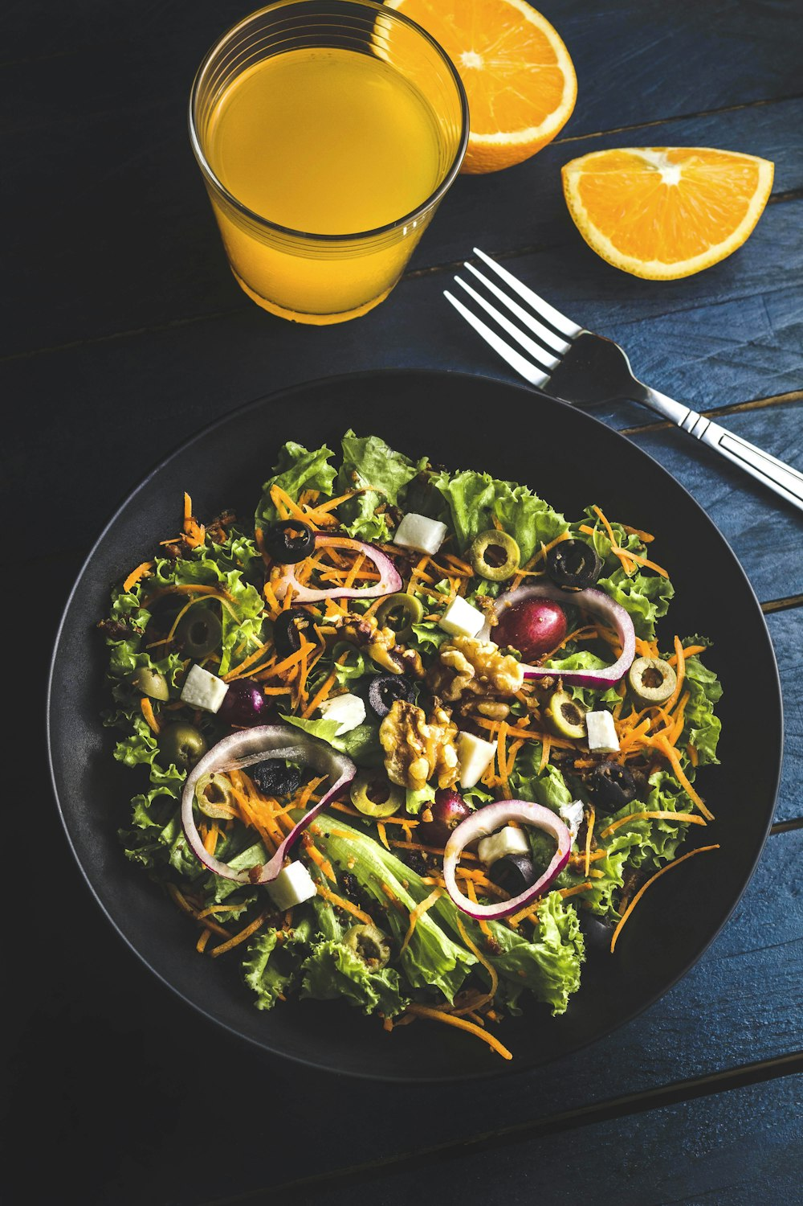
Recipe website for lower-income families
By Abdulhafeed, Prateek, Patryk and Joesph

Slide 2
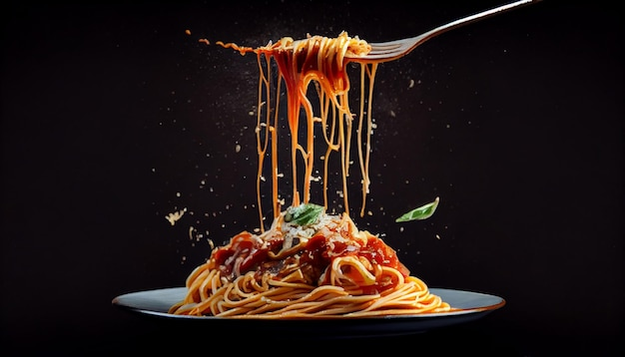
Objectives
Provide cheap recipes for lower-income individuals and families.
Improve the health of lower-income individuals by promoting healthier options.
Provide lower-income individuals with the locations of the closest local food bank.
Notes:
Ingredients grabbed from the internet and sorted from cheapest.

Slide 3
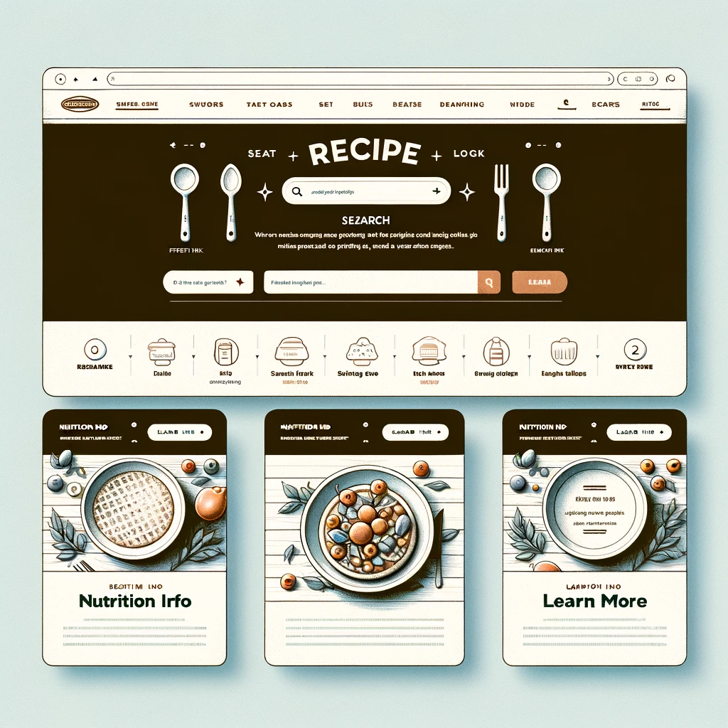
The prototype end goal

Slide 4
Accessibility features implemented
Dark/Light mode
Colour blind mode
Dyslexia mode (Font change)
Notes:
For dark mode we implemented a toggle button which updated the pages view.
For colour blind mode we alse implemented a toggle button.

Slide 5
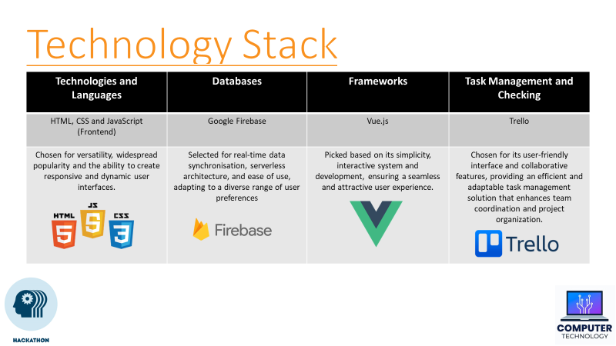

Slide 6
Project Management
Collaborators were assigned to appropriate tasks.
We adopted sprints into our project development.
We focused on achieving a functional prototype.
We incorporate regular feedback from team members.

Slide 7
How it makes money. ☺
Ads
Sponsors
Donations
NO membership
NO subscription
Notes:
Make it accessible to all. Sponsors could be organisations that help the under privileged.

Slide 8

DEMO TIME
Presented by: Patryk and Prateek

Slide 9
What to add in the future.
Implement the cheapest ingredients grabbed from local grocery websites.
Implements emergency food bank contact.
Notes:
Emergency contact includes a map to the food bank location depending on the user’s location.

Slide 10
Thank you
Presented by: Abdulhafeed,
Prateek,
Joesph and
Patryk

