Slide 1
OCEANIC INDEXES ON GLOBAL COFFEE PRICES AND PRODUCTION
Aaron Albers
Hilari Waters
Manuel Sosa

Slide 2
What Countries are Producing Coffee?

Slide 3
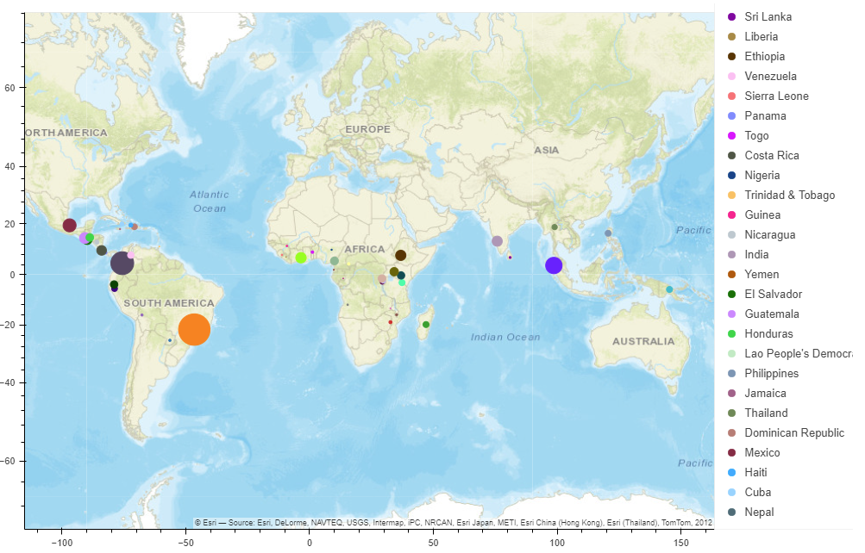
Coffee Production Quantities by Country
Notes:
Here we can see the location of production plants - the size of the dot represents the size in production. Something to note is the proximity to the equator for all production.

Slide 4
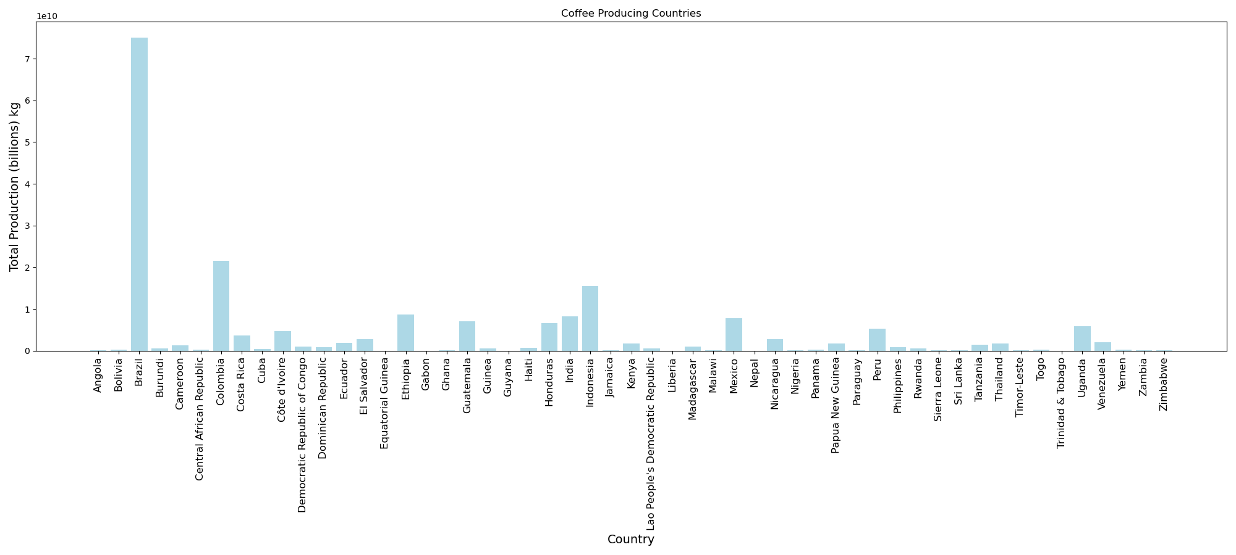
From 1990-2017, there were 53 countries observed producing a total of 180,320,340,000 Billion kgs of Arabica and Robusta coffee with a median of 595,080,000 Million kgs.
Notes:
From 1990-2017:
53 countries producing coffee
Total of 180 Billion kgs of coffee with a median of 595 Million kgs
Brazil being the outlier skewing the dataset

Slide 5
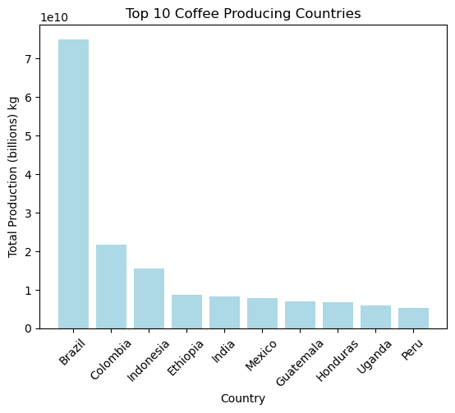
From 1990-2017, Brazil accounts for almost 50% of coffee production with a total production of 67,682,460,000 Billion kgs.
Notes:
Brazil accounts for almost 50% of coffee production
Total production of 67,682,460,000 Billion kgs.

Slide 6
PRIMARY COFFEE SPECIES AND THEIR ENDEMIC REGIONS
Two major species used in coffee production:
Coffea arabica (Arabica), native to Latin America
Coffea canephora (Robusta), native to Africa
Notes:
There are many different varieties and cultivars of the beans above, which have been bred to create hardier genes so that the plants can withstand harsher climates, allowing the cultivation of coffee beans worldwide.

Slide 7
GROWING REQUIREMENTS
Key factors in growing coffee plants is temperature, rainfall, and elevation
Arabica
Temp: 73°F – 82°F; does not tolerate heat, does not thrive if temps vary much outside of given range
Rainfall: 60-80 inches per year, with a dry period of 2-3 months
Elevation: 2000-6500 ft
Very temperamental if weather varies outside of the given ranges
Robusta
Temp: 75.2°F-86°F; is heat tolerant
Rainfall: 60-80 inches per year, with a dry period of 2-3 months
Elevation: sea level to 600-1970 ft
Tougher, hardier plant overall – much more forgiving when weather is outside of the given parameters
Notes:
Arabica is more temperamental when it comes to weather - when the weather is outside of the normal parameters, the plant will stop growing beans, making them no longer viable.
Robusta can handle a wider range in temperature due to breeding, making it a hardier plant. It can withstand colder/hotter temperatures without stunting bean growth.

Slide 8
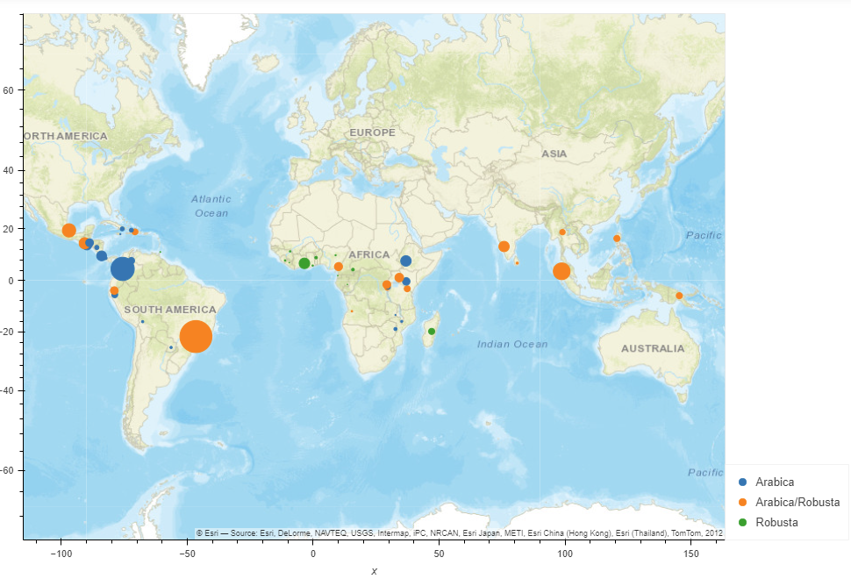
Coffee type cities map
Coffee Species Location by Country
Notes:
This map shows where each species of coffee bean is grown - the size of each dot is relative to the size in production across the countries. We can conclude that Arabica beans are more widely produced versus Robusta. Coffee farms are located closer to the equator due to their stringent growth requirements.

Slide 9

Global Prices of Arabica and Robusta Coffee Beans
How have these prices changed over time?

Slide 10
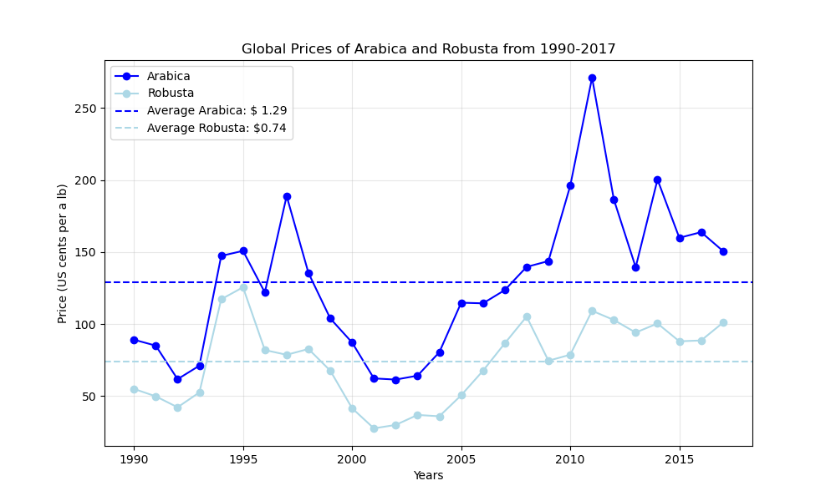
Arabica vs Robusta Prices (in US cents per pound)

Slide 11


What is El Nino & La Nina?
The El Nino – Southern Oscillation (ENSO) is a recurring climate pattern involving changes in the temperature of waters in the central and eastern tropical Pacific Ocean.
El Nino - condition occur when abnormally warm waters accumulate in tropical latitudes of the central and eastern Tropical Pacific Ocean.
La Nina - conditions occur when cooler-than-average waters accumulate in the central and eastern tropical Pacific.

Slide 12
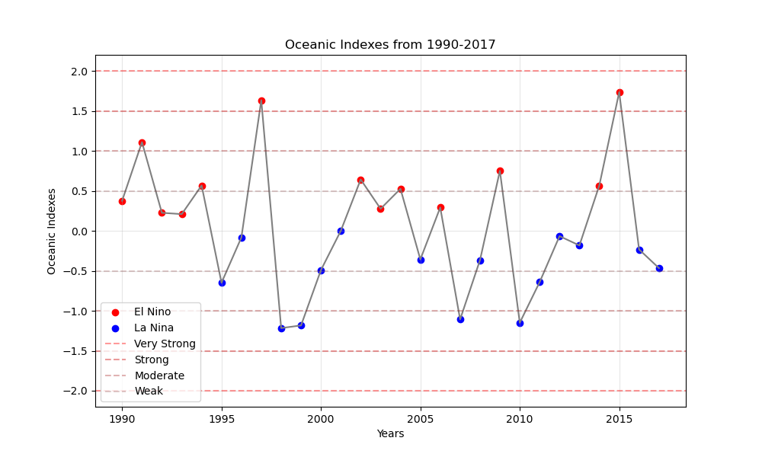
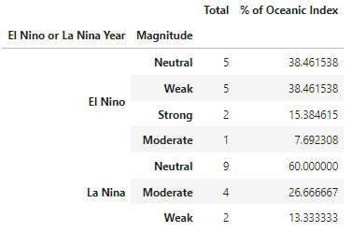
Interpreting El Nino & La Nina
Total and Distribution of Oceanic Indexes
From 1990-2017, El Nino and La Nina was on average relatively Neutral. El Nino was more likely to be Weak with a total of 5 magnitude readings; however, there were to large spikes in 1997 and 2015. While La Nina majority magnitude readings were Neutral with Moderate spikes in 1998-1999, 2007 and 2010.
Notes:
Talk about how magnitudes are assigned
+ or - 0.5 = Neutral
+ or - 0.5 to 0.9 = Weak
+ or - 1.0 to 1.4 = Moderate
+ or - 1.5 to 1.9 = Strong
+ or - >= 2 = Very Strong
1990-2017 relatively Neutral.
El Nino more likely to be Weak with Strong spikes in 1997 and 2015
La Nina more likely to be Neutral with Moderate spikes in 1998-1999, 2007 and 2010.

Slide 13
How has El Nino & La Nina Impacted Coffee Prices?
Notes:
We have to account for latency! The coffee plants’ growing cycle takes 3-4 years to mature, and afterwards, beans can be harvested twice a year for the next 20 years. Because the growing cycle is so long, environmental impacts heavily impact the success of the plant overall. However, it is critical that environmental factors are within the standard growing requirements when the plant is ready to produce the bean. Within this year, if the growing requirements are not met and are outside the norm, the bean will stop growing and not be viable for harvest.
How to make inferences using latency with these graphs:
The Oceanic Indexes (El Nino/La Nina) have to be read as one year AHEAD of coffee prices. For instance, we see that there is a spike in price from 2008-2011. If we look at the graph on the left, we are going to look at the years 2007-2010 to see what was going on. In 2007, there was a significant drop between warm, rainy weather (caused by El Nino) and cool, dry weather (La Nina). Due to this drastic change, plus seeing that La Nina was prevalent for the next three years, this caused a notable drop in supply of beans, causing the uprise in prices over the next 3 years. Similarly, we can see that prices were at an all-time low from 2001-2003. Looking at the indexes from 2000-2002, we can see the indexes are closer to 0°C, meaning that the weather was more stable. Due to this stability, farms were not greatly impacted, allowing for greater yields in crop. Greater yields means that there was plenty of beans to go around, decreasing the price from the previous years.

Slide 14
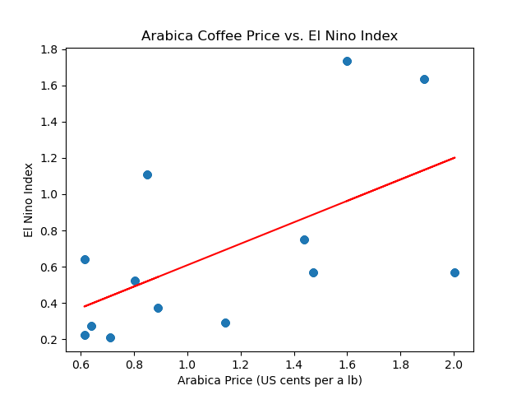
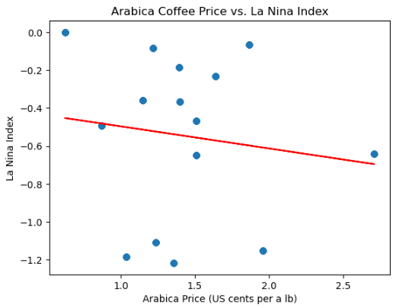
Relationships Between Oceanic Indexes and Arabica Coffee Prices
With an r-value of 0.33, there is a weak positive relationship for as Oceanic waters warm Arabica Prices increase. When Oceanic waters are Neutral Arabica Prices decrease.
With an r-value of 0.018, there is a very weak negative relationship for as Oceanic waters cool Arabica Prices increase.

Slide 15
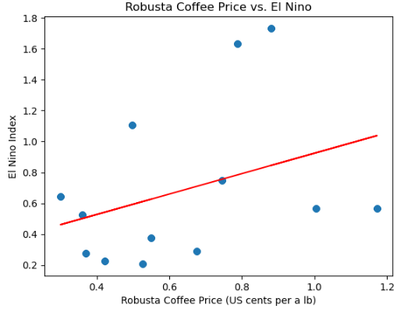
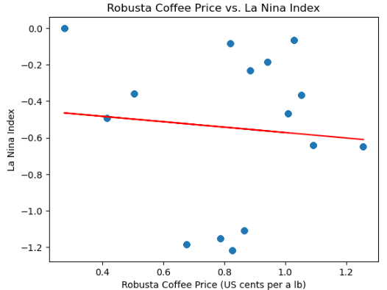
Relationships Between Oceanic Indexes and Robusta Coffee Prices
With an r-value of 0.12, there is a weak positive relationship for as Oceanic waters warm Robusta Prices increase. When Oceanic waters are Neutral Robusta Prices decrease.
With an r-value of 0.008, there is a very weak negative relationship for as Oceanic waters cool Robusta Prices increase.

Slide 16
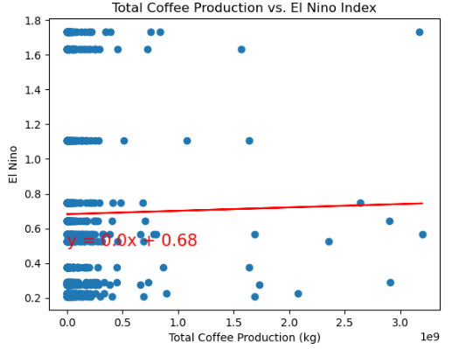
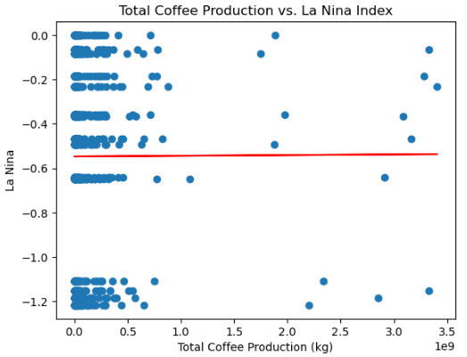
Relationships Between Oceanic Indexes and Total Production
With an r-value of 0.00017, there is a negligible linear relationship for as Oceanic waters warm Total Production increase.
With an r-value of 7.95, there is a negligible linear relationship for as Oceanic waters cool Total Production decrease.

Slide 17
Conclusions
While the insights gained from these analyses are invaluable for understanding the complex dynamics of the global coffee market and the interplay between environmental factors and agricultural production, the correlation between Arabica coffee prices, Robusta coffee prices, Total Production and the Oceanic Index (El Nino and La Nina) suggests that while meteorological conditions may have some impact, they are likely not the sole influencing factor. More analysis will be needed with extraneous variables.

Slide 18
Questions?

