Slide 1
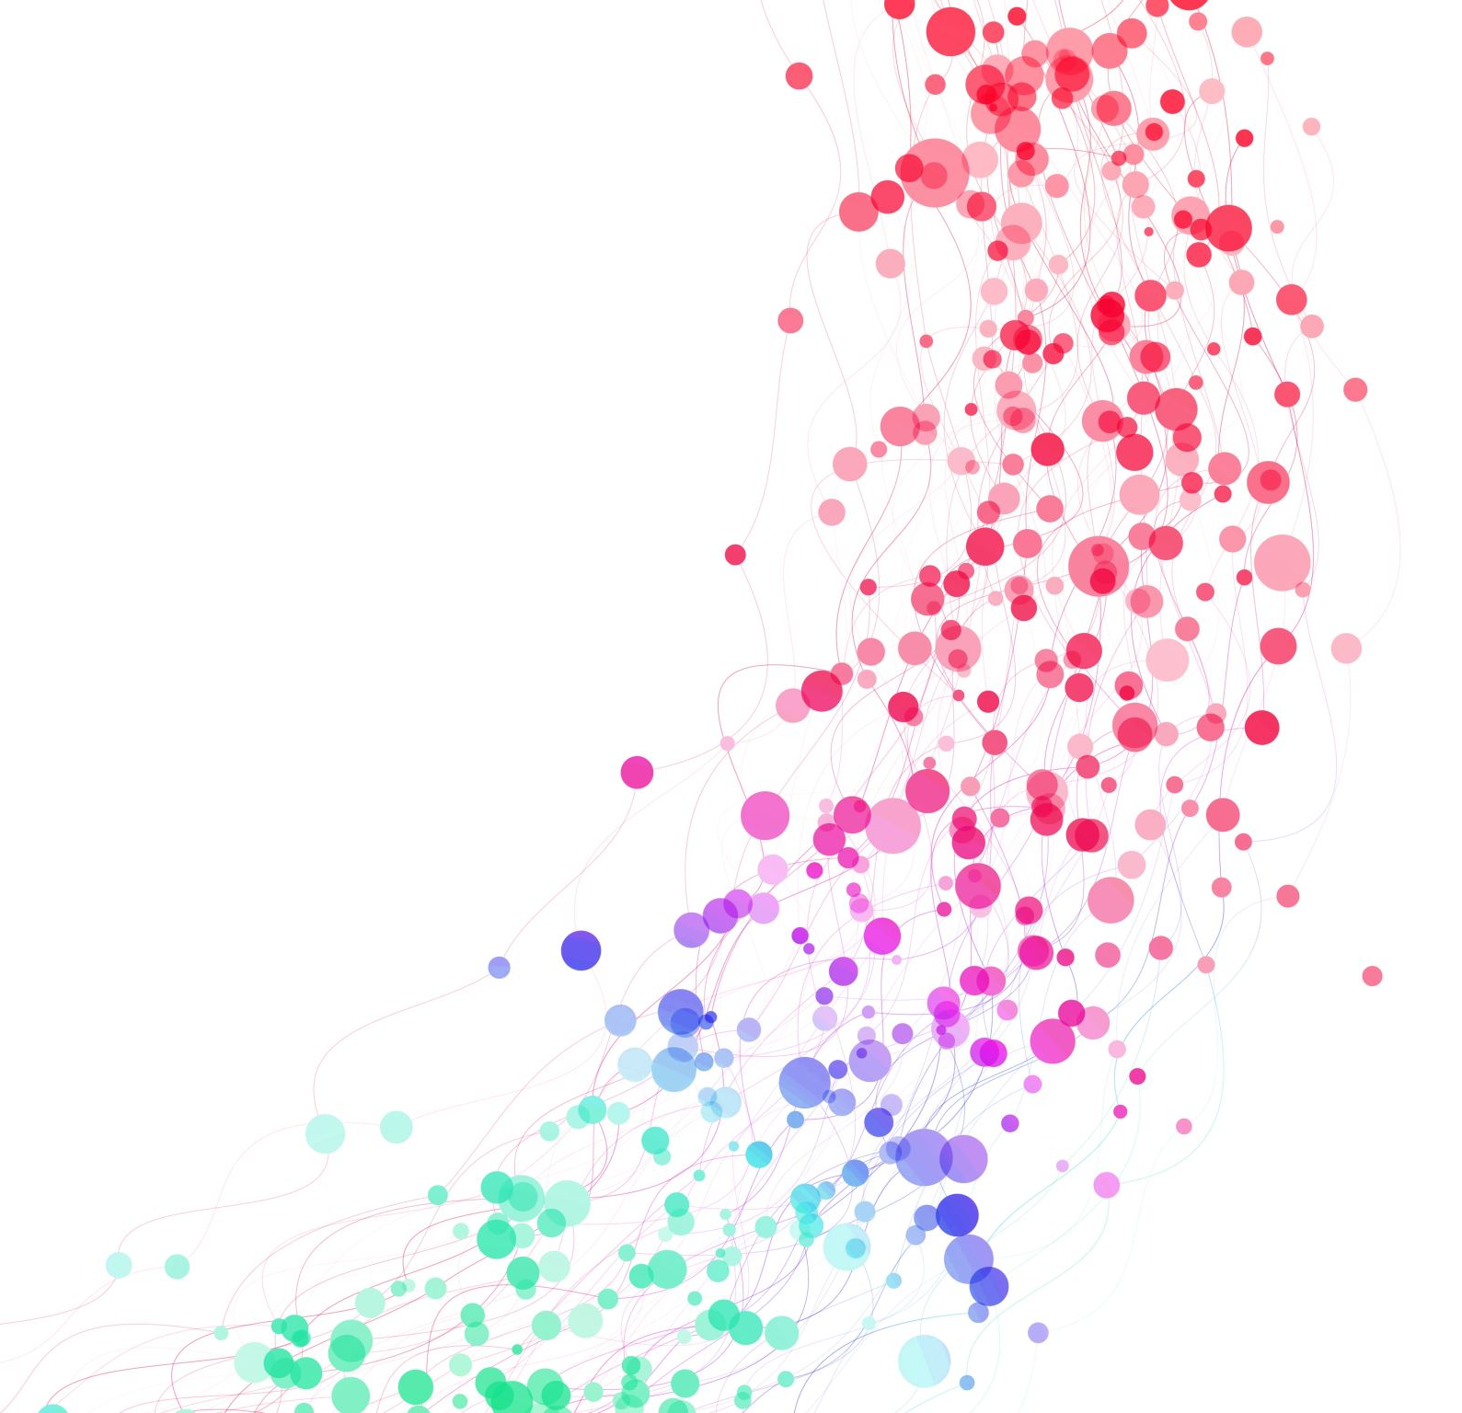
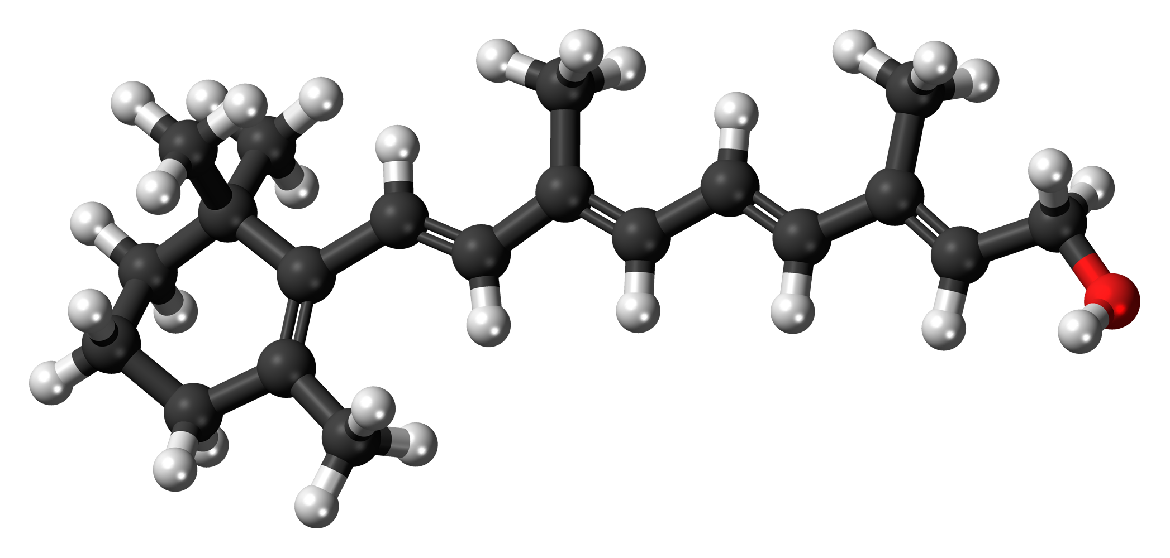
Defining Gene Families Involved in Retinol Metabolism Across the Tree of Life

Slide 2
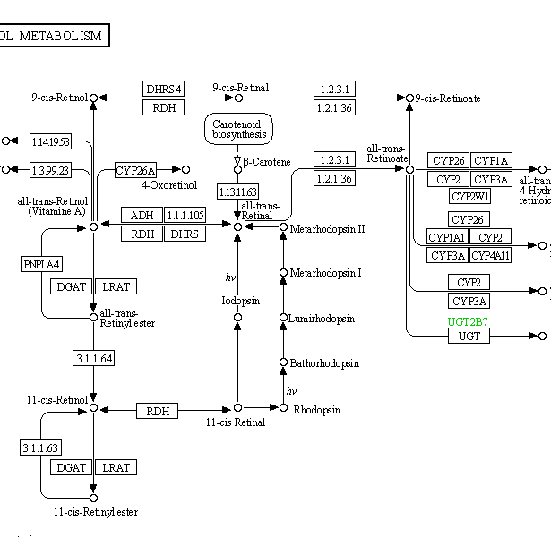
Background
Retinol pathway only characterised for few species
Many genes involved
Aim: Study evolution in a broad group of organisms

Slide 3
Why Broccoli and Orthofinder?
First challenge: to define orthogroups in large range of organisms
Approach: use programmes such as Broccoli and Orthofinder
Since we didn’t know which programme worked best, had to compare outputs of both

Slide 4
Broccoli Runs
Ran Broccoli for 101 species spanning tree of life
Three different runs with sp_overlap set at 0.7-0.9
sp_overlap = how strict orthogroup clustering is
Selected most appropriate run with least OGs
Closest to expected gene families

Slide 5
Annotation with Eggnog
Next challenge: identify corresponding gene families to orthogroups
For this annotation of the orthogroups, we used Eggnog
Enabled identification of likely gene groups corresponding to each orthogroup

Slide 6
Preliminary analysis: presence/absence
Now that we have all the groups, useful to see in which species they are present.
Used Morpheus to visualise which orthogroups were present for which species

Slide 7
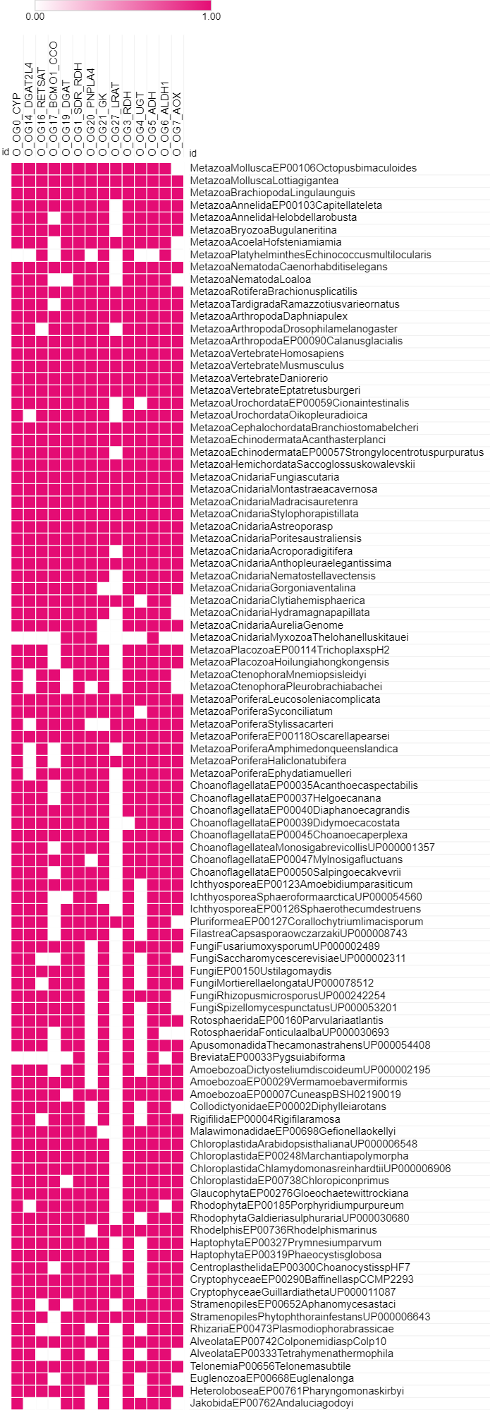
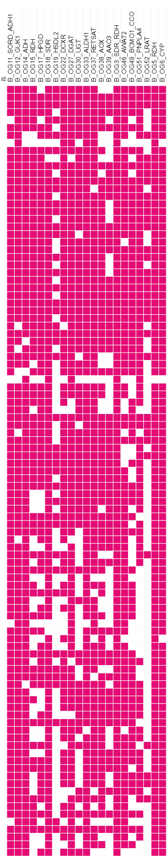
Orthofinder Orthogroups
Broccoli Orthogroups
Bilateria
Bilateria
Non-Bilateria
Non-Bilateria
Other Holozoa
Other Holozoa
Other Eukaryotes
Other Eukaryotes

Slide 8
Orthofinder Orthogroups
Broccoli Orthogroups
Results:
LRAT mainly in metazoan – annotation error in other groups??
CYP almost present in all groups
Overall: retinol pathway genes ancient
Bilateria
Bilateria
Non-Bilateria
Non-Bilateria
Other Holozoa
Other Holozoa
Other Eukaryotes
Other Eukaryotes

Slide 9
Comparing Broccoli and Orthofinder
Next challenge: comparing Broccoli and Orthofinder
To compare this data set, Cytoscape used
Created a network
Nodes = orthogroups
Edges = number of connections
Allowed for visual comparison of orthogroups

Slide 10
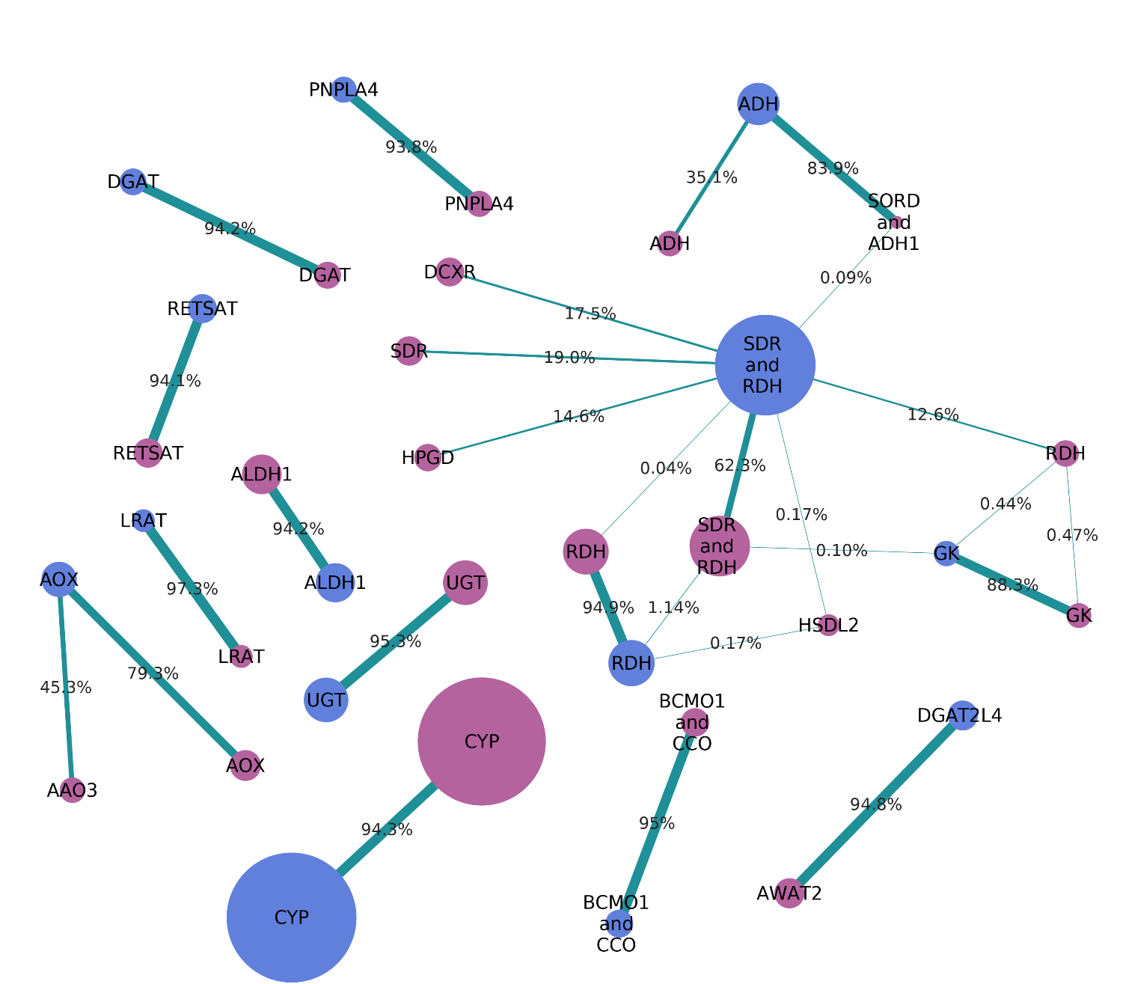


Slide 11
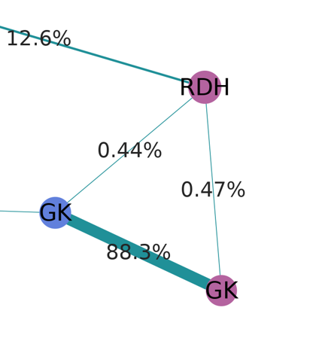
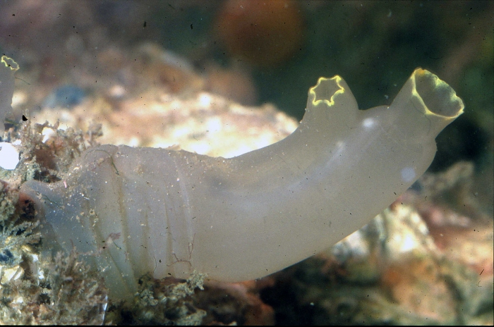
Troubleshooting:
Connection between two Broccoli orthogroups
Upon inspection, revealed to be caused by a chimeric protein
Gene fusion??
Assembly error??

Slide 12
NEXT STEP… IQTREE for gene families
Next step: identify phylogenetic relationships for each gene family
Can be done using IQTREE
Allows us to study patterns of evolution within each family
IQTREE currently running for the RETSAT gene group…

