Slide 1
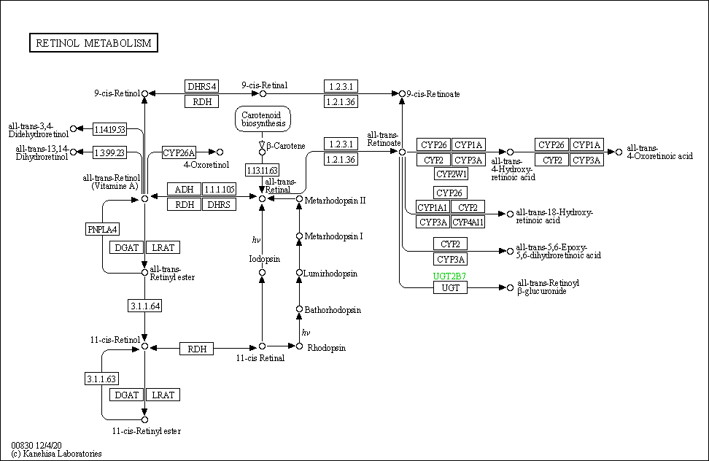
Retinol metabolism - Reference pathway (KEGG map00830)
38 elements. How many gene families? (Based on nomenclature/literature: ~13?)

Slide 2
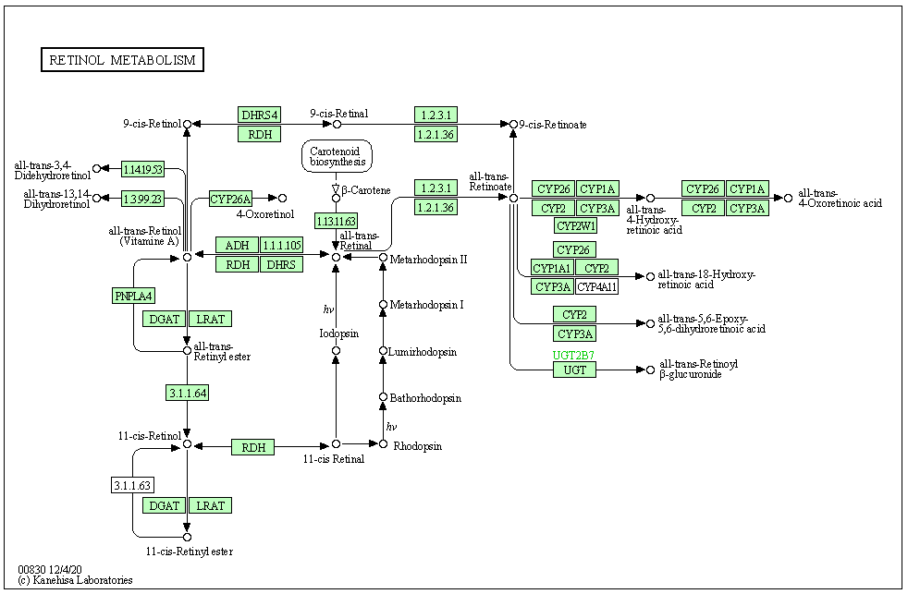
Retinol metabolism - Reference pathway (KEGG map00830)
Homo sapiens (mammal): 37/38 elements.

Slide 3
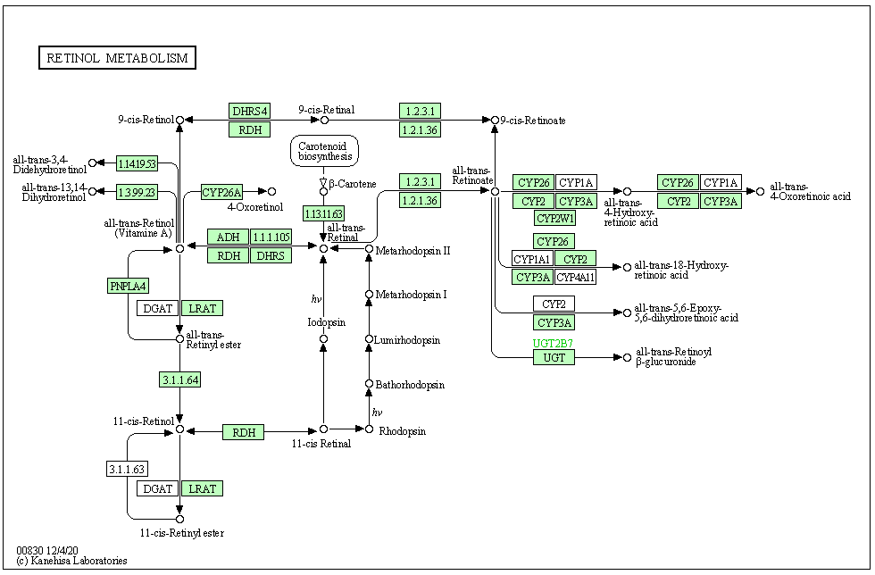
Retinol metabolism - Reference pathway (KEGG map00830)
Gallus gallus (bird): 31/38 elements.

Slide 4
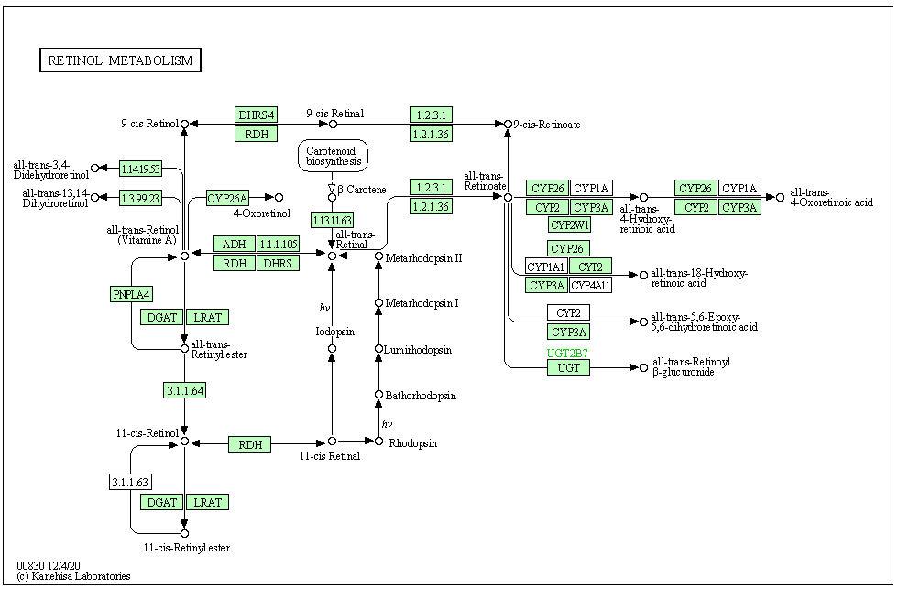
Retinol metabolism - Reference pathway (KEGG map00830)
Anolis carolinensis (reptile): 33/38 elements.

Slide 5

Retinol metabolism - Reference pathway (KEGG map00830)
Xenopus laevis (amphibian): 32/38 elements.

Slide 6
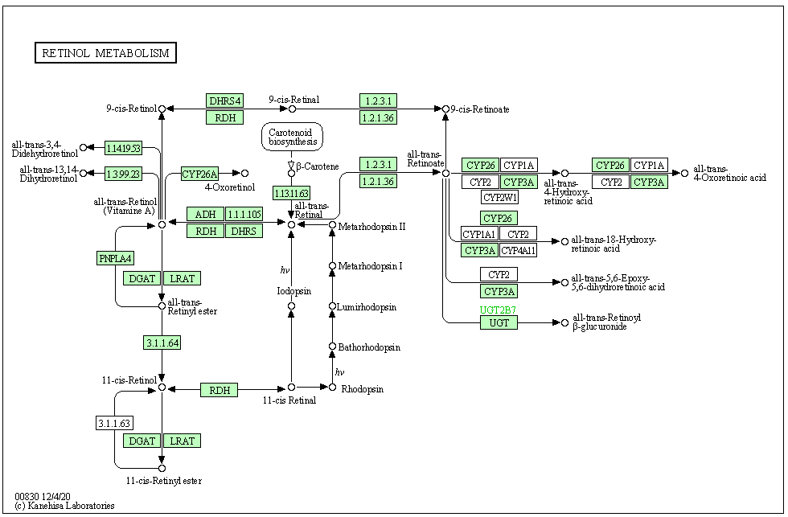
Retinol metabolism - Reference pathway (KEGG map00830)
Danio rerio (bony fish): 29/38 elements.

Slide 7
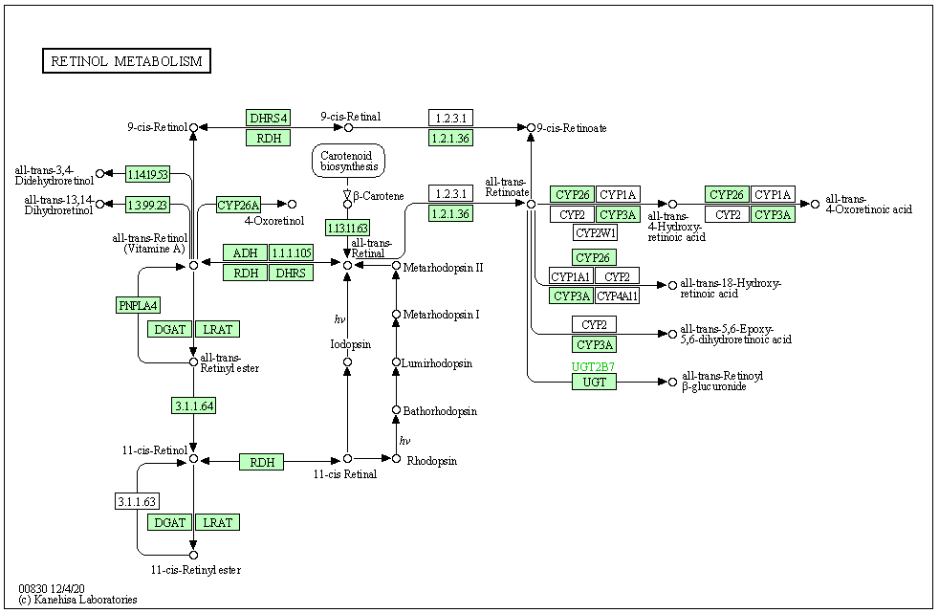
Retinol metabolism - Reference pathway (KEGG map00830)
Callorhinchus milii (cartilaginous fish): 27/38 elements.

Slide 8
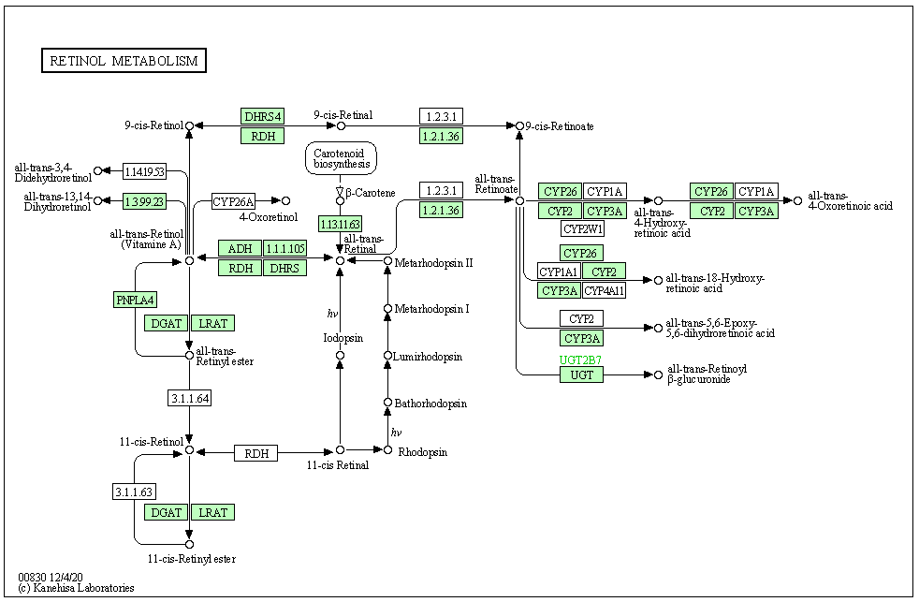
Retinol metabolism - Reference pathway (KEGG map00830)
Branchiostoma floridae (cephalochordate): 26/38 elements.

Slide 9
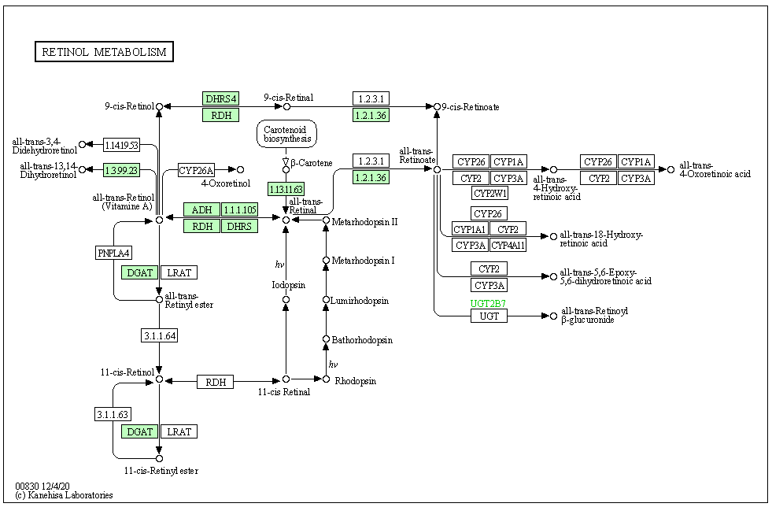
Retinol metabolism - Reference pathway (KEGG map00830)
Ciona intestinalis (urochordate): 12/38 elements.

Slide 10
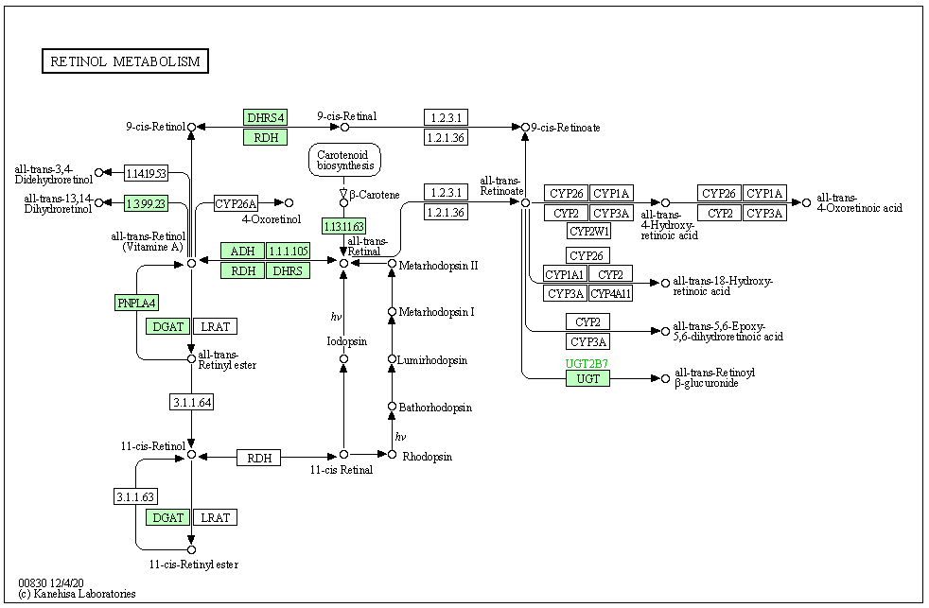
Retinol metabolism - Reference pathway (KEGG map00830)
Strongylocentrotus purpuratus (echinoderm): 12/38 elements.

Slide 11

Retinol metabolism - Reference pathway (KEGG map00830)
Saccoglossus kowalevskii (hemichordate): 13/38 elements.

Slide 12
Retinol metabolism - Reference pathway (KEGG map00830) (EDIT)
38 elements. How many gene families? (~13?)
DHRS4
AOX
RDH
ALDH1A
CYP27C1
RETSAT
CYP26A
AOX
CYP26
CYP1A
CYP26
CYP1A
BCMO1
ALDH1A
CYP2
CYP3A
CYP2
CYP3A
CYP2W1
ADH
SDR16C
CYP26
RDH
DHRS
CYP1A1
CYP2
PNPLA4
CYP3A
CYP4A11
DGAT
LRAT
CYP2
CYP3A
UGT
RPE65
RDH
RPH
DGAT
LRAT

Slide 13
Retinol metabolism - Reference pathway (KEGG map00830) (Orthofinder Orthogroups)
OG0_CYP
OG1_SDR and RDH
OG3_RDH
OG4_UGT
DHRS4
AOX
OG5_ADH
RDH
ALDH1A
OG6_ALDH1
CYP27C1
OG7_AOX
RETSAT
CYP26A
AOX
CYP26
CYP1A
CYP26
CYP1A
OG14_DGAT2L4
BCMO1
ALDH1A
CYP2
CYP3A
CYP2
CYP3A
OG16_RETSAT
CYP2W1
ADH
SDR16C
CYP26
OG17_BCMO1_and_CCO
RDH
DHRS
CYP1A1
CYP2
OG19_DGAT
PNPLA4
CYP3A
CYP4A11
OG20_PNPLA4
DGAT
LRAT
CYP2
OG27_LRAT
CYP3A
N/A (RPH)
UGT
RPE65
RDH
RPH
DGAT
LRAT

