Slide 1

Few-shot Anomaly Detection
In Time Series Data
1.Abdul Alim
2.Farea Mahdea
3.Anik Barua
-

Slide 2

Introduction to Few-Shot Anomaly Detection
The Anomaly Detection Few-Shot in Time Series Data project is about finding unusual patterns in data that is collected over time, like stock prices, sensor readings, or website traffic. "Few-shot" means the system doesn't need a lot of examples to learn what's normal; it can identify unusual events even with just a few examples of normal behavior.
Here's what the project does:
Anomaly Detection: It helps spot when something unusual happens in data that usually behaves in a predictable way. For example, if you're tracking the temperature of a machine, an anomaly could be a sudden rise or fall in temperature.
Few-Shot Learning: Instead of needing tons of data, the system can learn from just a few examples of what normal data looks like and still detect when something is wrong.
Time Series Data: This is data collected over time, like stock prices, heart rate readings, or daily website visits.

Slide 3
Introduction to Few-Shot Anomaly Detection
Why it's important:
Detecting Problems Early: Anomalies could indicate problems like equipment failure, fraud, or security breaches. Identifying these problems early can save time, money, and prevent larger issues.
Limited Data: In many real-world situations, you may not have a lot of data to work with, especially for rare problems (like a rare machine breakdown). Few-shot learning helps address this by detecting anomalies without needing large amounts of data.
Automation: This can help automate monitoring systems, making them smarter and faster at identifying issues without needing constant human supervision.
Why it's needed:
Efficiency: Monitoring systems that can detect issues without a lot of training data can save resources, time, and effort.
Adaptability: Many industries deal with unpredictable events (e.g., online fraud, unexpected machine failures). Having a system that adapts and identifies these problems with limited data can be crucial for staying ahead.
In short, this project is important because it helps create smarter systems that can identify problems in real-time without needing a huge amount of historical data. This makes it easier to detect and fix issues before they escalate.

Slide 4


Challenges in Anomaly Detection
Anomaly detection with limited data is a significant challenge in many domains.
In time series data, the anomalies are often rare, making them harder to identify.
Lack of labeled data and the high cost of manual labeling complicates the training process.
The complexity of time-series data, including seasonality and trends, adds to the difficulty.
Traditional methods require large datasets, which may not always be available in practical scenarios.

Slide 5
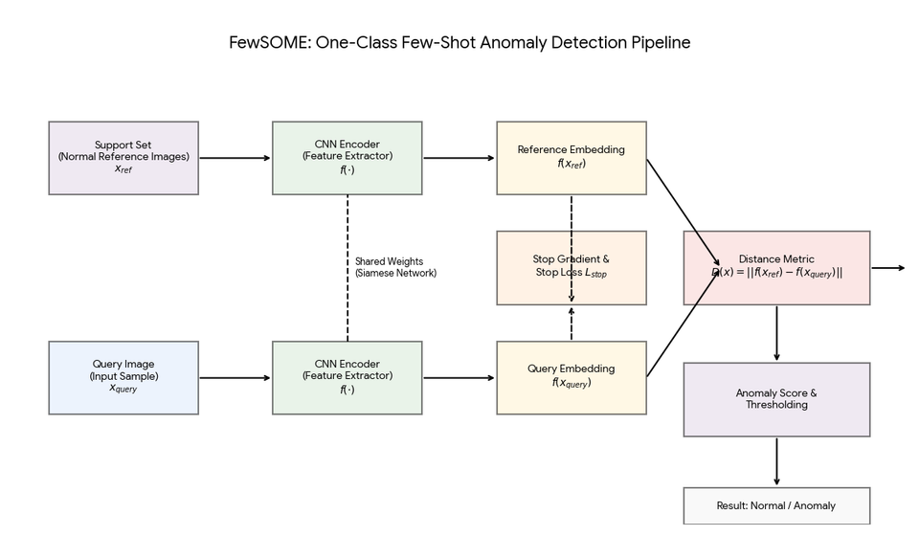
FewSOME: One-Class Few Shot Anomaly Detection With Siamese Networks
FewSOME is a method based on Siamese networks for detecting anomalies with few samples.
The model is trained on only a few normal samples and detects deviations from normality.
It does not require labeled anomalous data, which is beneficial for real-world applications.
The use of a Siamese network allows the model to map normal data into feature embeddings.
FewSOME outperforms traditional methods even with very few samples, providing a state-of-the-art solution.

Slide 6

Technology Behind FewSOME
Siamese networks use two identical sub-networks that share weights to compare data samples.
The network learns to minimize the distance between normal data points in the feature space.
Stop Loss is introduced to prevent representational collapse, ensuring stable learning.
This technique allows the model to generalize well even when limited data is available.
The use of a shared feature space and the Stop Loss mechanism improves model robustness.

Slide 7


Dataset and Evaluation Metrics
FewSOME is evaluated on benchmark datasets like MNIST, CIFAR-10, and Fashion-MNIST.
These datasets provide both image-based and real-world data to assess the model’s performance.
Key evaluation metrics include AUC (Area Under the Curve), F1 score, and Balanced Accuracy.
The performance of FewSOME is compared with other anomaly detection methods.
FewSOME demonstrates superior results, especially with a small number of normal samples.

Slide 8
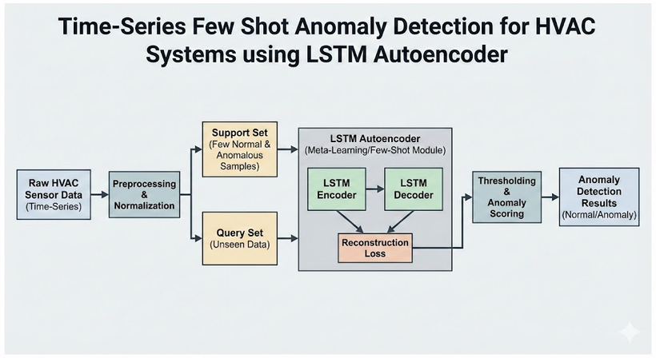
Time-Series Few Shot Anomaly Detection for HVAC Systems
The paper proposes a domain adaptation-based approach using LSTM autoencoders.
This method works by training an anomaly detection classifier on a source domain.
The model is then fine-tuned with a small set of nominal instances from the target domain.
The MZVAV-2 dataset, used for HVAC systems, contains both normal and faulty data.
On

Slide 9
Time-Series Few Shot Anomaly Detection for HVAC Systems
Dataset:
The dataset used in the study is the MZVAV-2 dataset from the ASHRAE 1312 project, released by Lawrence Berkeley National Laboratory (LBNL) in 2019. It contains real and simulated data from a multi-zone air handling unit in an Iowa building, with both normal operation and faults (e.g., leaking heating coil valve, stuck cooling coil valve). The dataset consists of time-series data with 17 features and a ground truth label indicating faults or normal operation.
Evaluation:
The model is evaluated using performance metrics like True Positive Rate (TPR), False Positive Rate (FPR), and the Area Under the Receiver Operating Characteristic Curve (AUC-ROC). Results show that the proposed method outperforms unsupervised methods like LSTM-AE and clustering-based autoencoders. It achieved the highest AUC of 0.873 and the best TPR of 0.809 when using three nominal instances from the target domain for fine-tuning.

Slide 10


TAMA: Time-Series Anomaly Multimodal Analyzer:
TAMA is a framework that uses large multimodal models (LMMs) for anomaly detection.
It transforms time series data into images, making it easier for LMMs to analyze.
The framework incorporates a three-step process: Reference Learning, Analyzing, and Self-reflection.
TAMA outperforms traditional methods, especially on real-world datasets like UCR and NASA-SMAP.
The method improves both the accuracy of anomaly detection and the interpretability of the results.

Slide 11
FastRecon: Few-shot Industrial Anomaly Detection
FastRecon uses a few-shot anomaly detection approach based on feature reconstruction.
The model reconstructs normal data from a small set of reference samples and compares it to the query sample.
This method is evaluated on industrial datasets like MVTec AD and MPDD.
FastRecon performs well even with 2-shot, 4-shot, and 8-shot settings, which are typical in real-world applications.
It outperforms other methods like GANomaly and PatchCore in both image-level and pixel-level anomaly detection.

Slide 12

Open-Set Time-Series Anomaly Detection (MOSAD)
MOSAD is designed for open-set time-series anomaly detection, where only a few labeled anomalies are provided during training.
The model uses a multi-head network consisting of generative, discriminative, and contrastive heads.
It is capable of detecting both seen and unseen anomalies, making it more adaptable.
The method is evaluated on several real-world datasets, including server data and biomedical data.
MOSAD outperforms traditional methods in both unsupervised and supervised settings, providing superior performance.

Slide 13
Conclusion and Future Directions:
Few-shot anomaly detection techniques offer significant advantages when data is scarce.
Methods like FewSOME, FastRecon, and MOSAD provide robust solutions for time-series anomaly detection.
The field is evolving with more advanced methods incorporating multimodal models and domain adaptation.
Future research should focus on improving model scalability and interpretability.
As anomaly detection becomes more critical across industries, these methods will play a vital role in real-world applications.

Slide 14
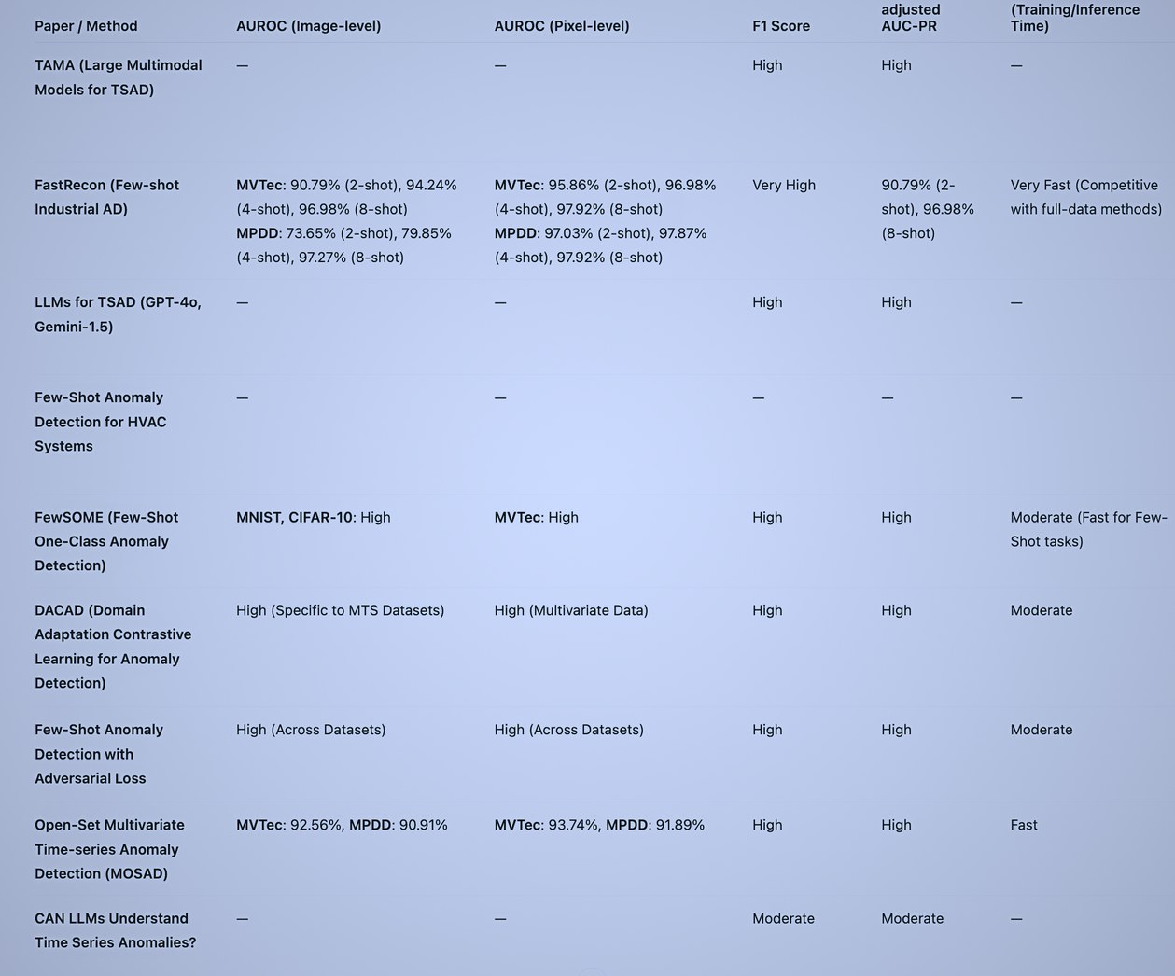

Slide 15
THANK YOU

