Slide 1
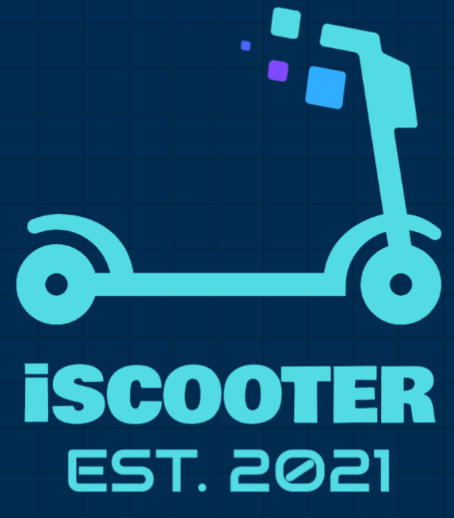
iScooter
By: Abdulrahman Alrifae

Slide 2
The Metropolitan Transportation Authority (MTA)
(MTA) is North America's largest transportation network, serving a population of 15.3
Use MTA to find the best location to start the business.
MTA during Covid-19 lost a lot of money, Finance the MTA through business such as scooter.

Slide 3
Benefit of the Scooter station
“Transportation”
”Finance”

Slide 4
Transportaion
the train leaving in front of the eyes, the missed turn to the doctor - trifles, because of which everything can go according to another scenario.

Slide 5
Calculate the profit
In Europe, renting a bike costs € 2 per hour. If you buy 12 scooters and each of them will ride one hour a day, it turns out that you can earn € 24 a day. If you multiply this by 30 days, you’ll get € 600 in revenue. The costs are as follows: the scooter station, costs about € 1000, the niche shelves for scooters to make - another € 1000, and you can buy the scooters themselves - € 1000. It turns out € 3000. That is, a maximum of five months, and you will recoup the costs.

Slide 6
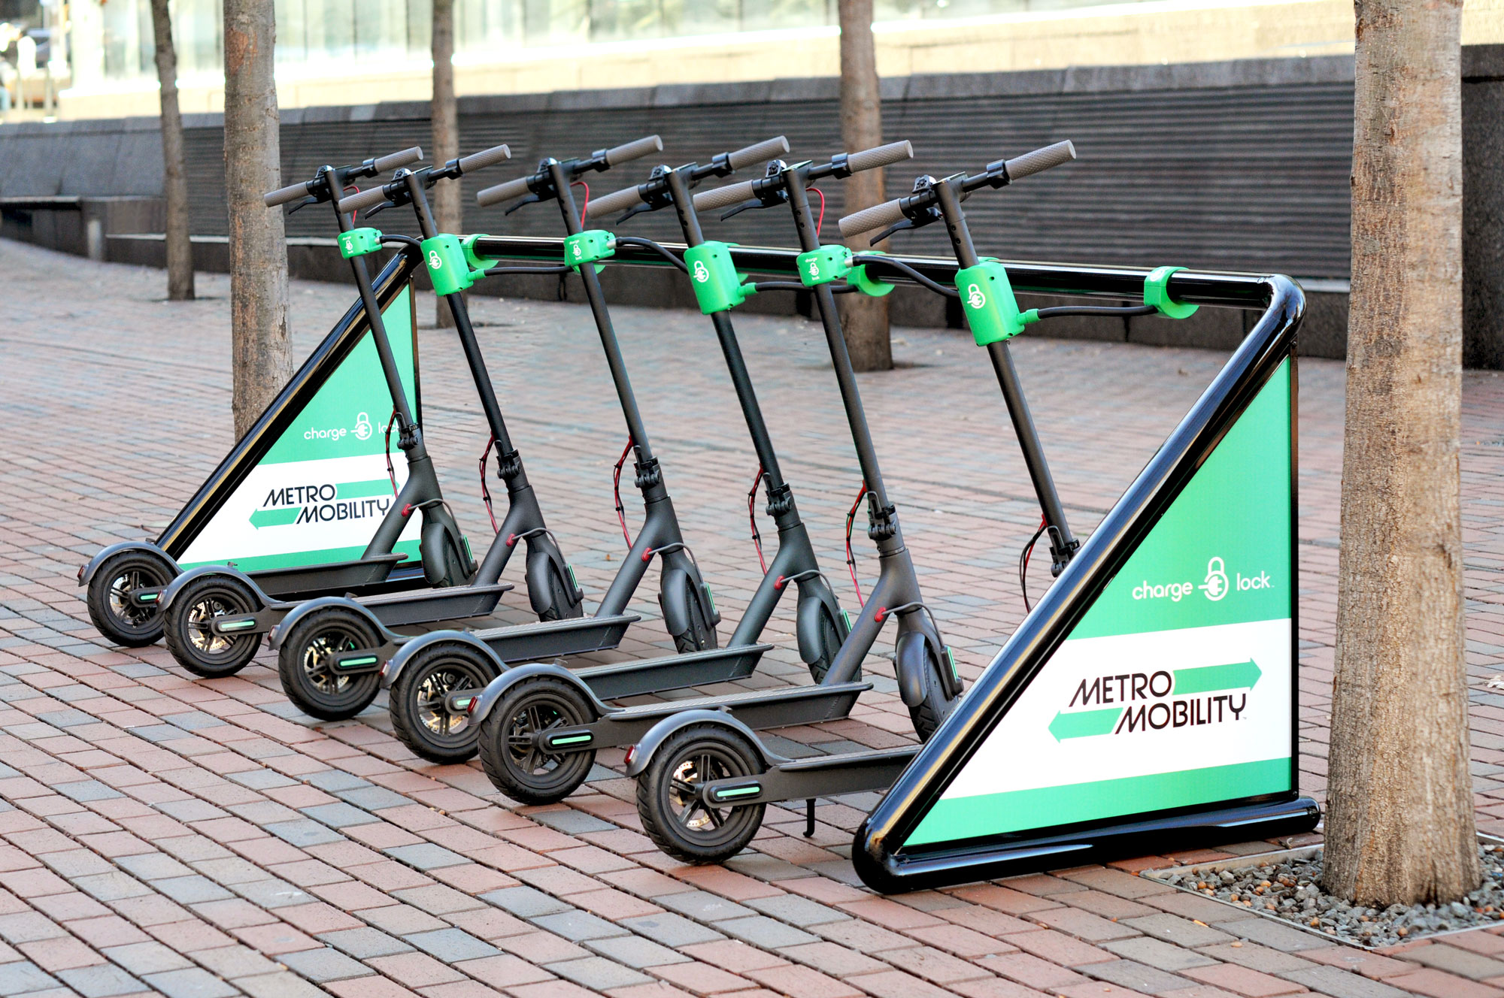
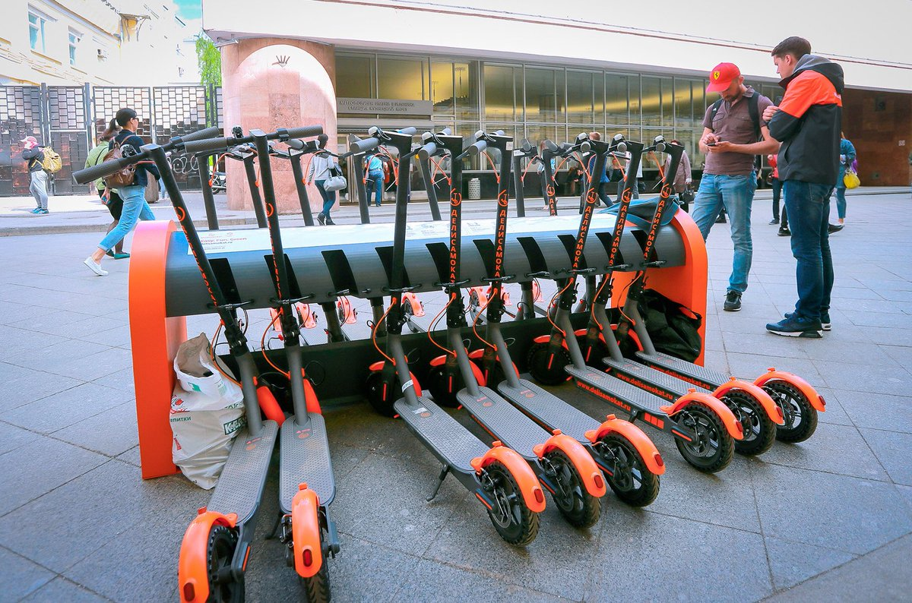
Scooter Station

Slide 7
Tools And Dataset
Numpy and Pandas for data manipulation
Matplotlib and Seaborn for plotting
GeoPandas
SQLAlchemy

Slide 8
Strategy
Read and understand the Data set
Clean data set
Create function
Add columns based on Goals

Slide 9
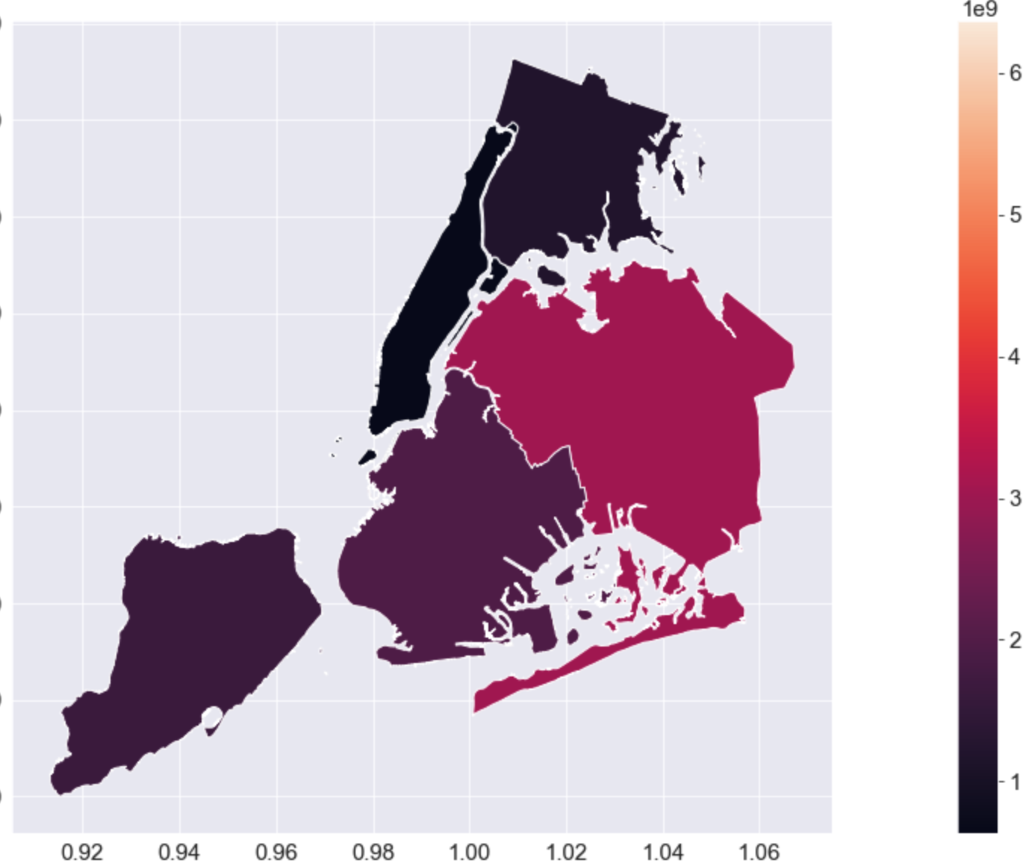
Heat Map of NYC

Slide 10
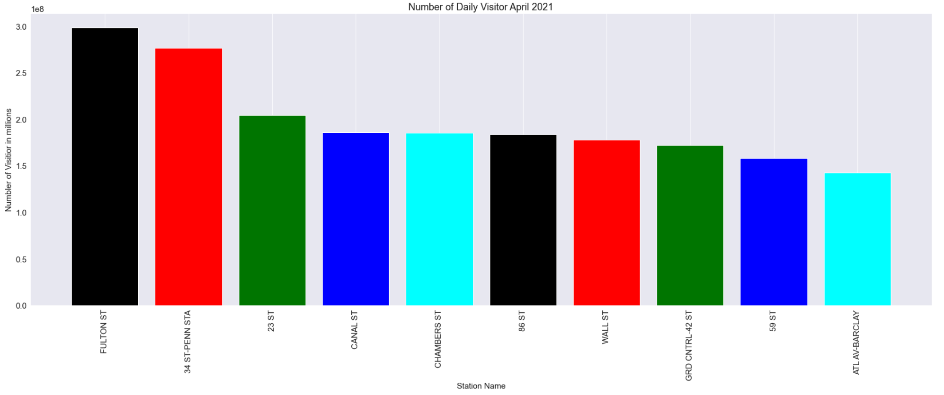
April 2021

Slide 11
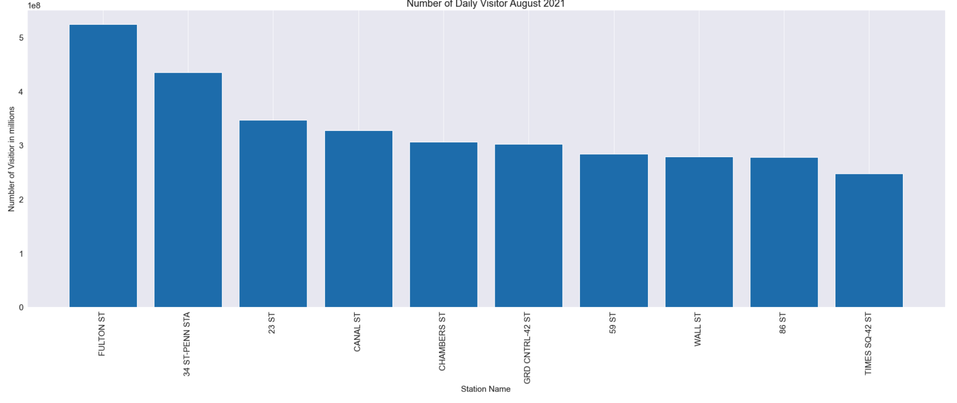
August 2021

Slide 12
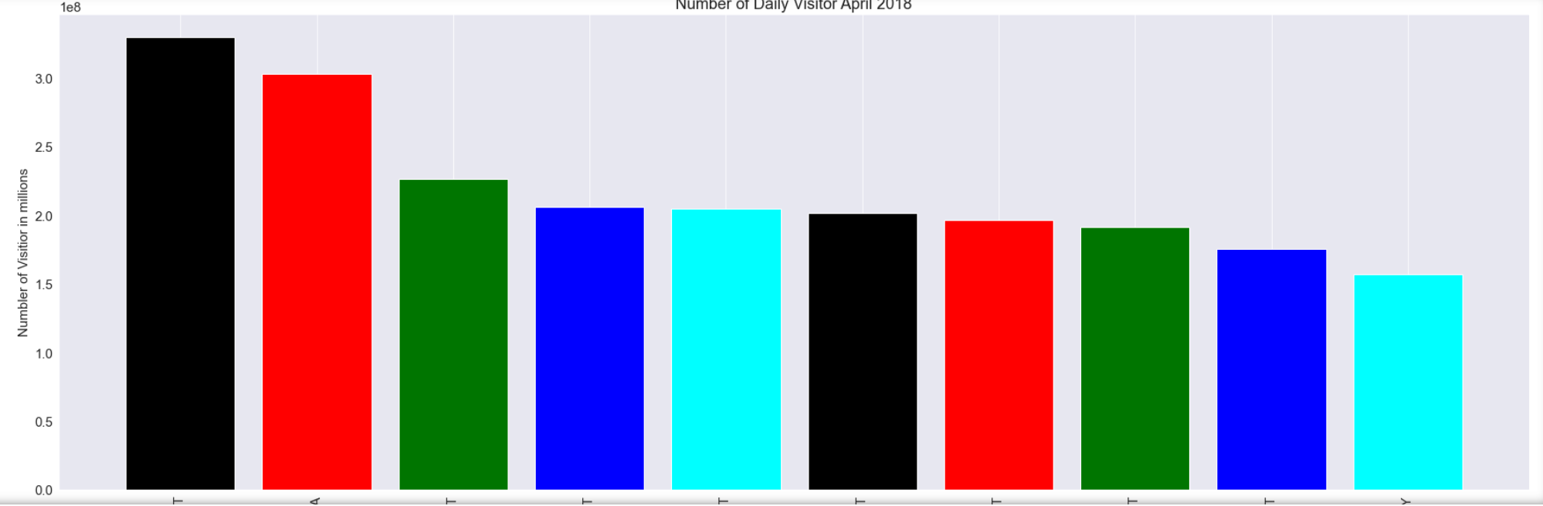
April 2018

Slide 13
August 2018

Slide 14
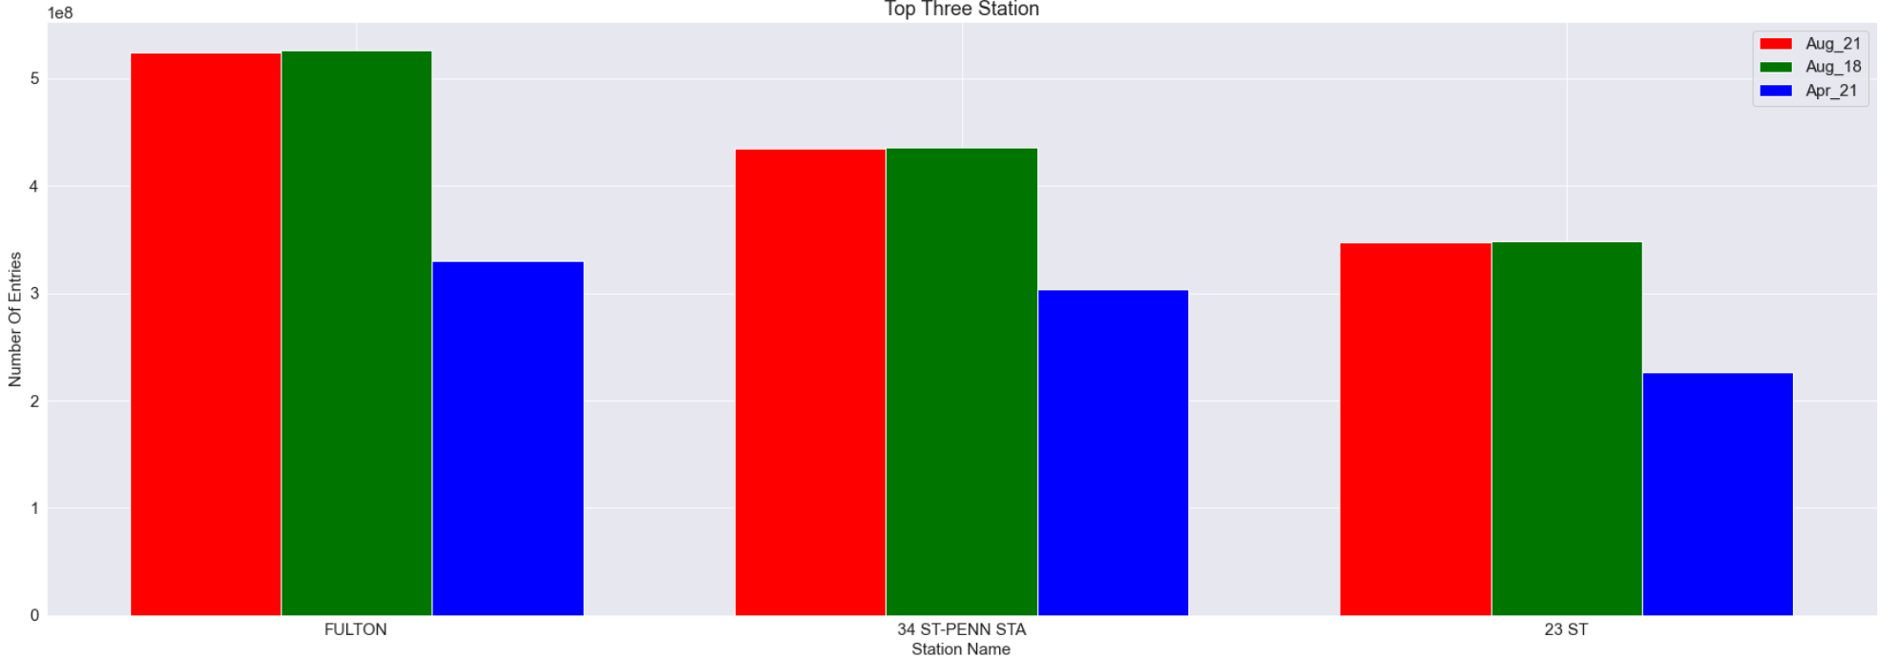
All The Months

Slide 15
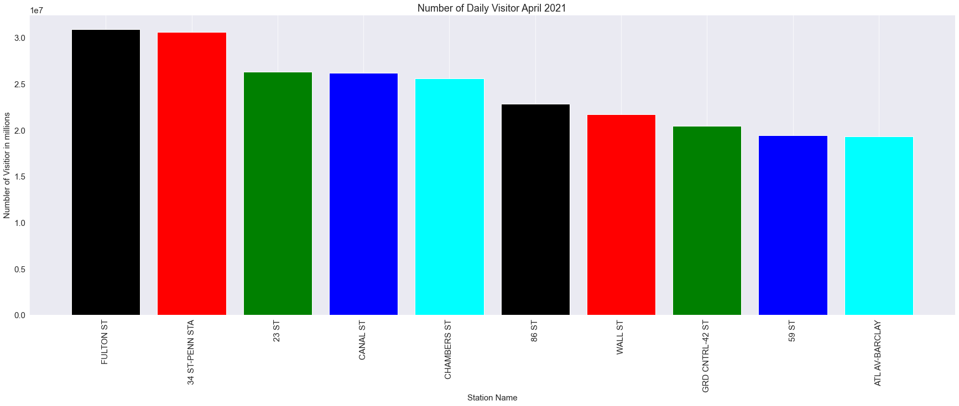
Mean of the daily visitor

Slide 16
Calculate the profit
In Europe, renting a bike costs € 2 per hour. If you buy 12 scooters and each of them will ride one hour a day, it turns out that you can earn € 24 a day. If you multiply this by 30 days, you’ll get € 600 in revenue. The costs are as follows: the scooter station, costs about € 1000, the niche shelves for scooters to make - another € 1000, and you can buy the scooters themselves - € 1000. It turns out € 3000. That is, a maximum of five months, and you will recoup the costs.

Slide 17
Conclusion
Find the busiest location and establish the scooter station
Help people move faster during rush hours
Manhattan is the most used station

