Slide 1
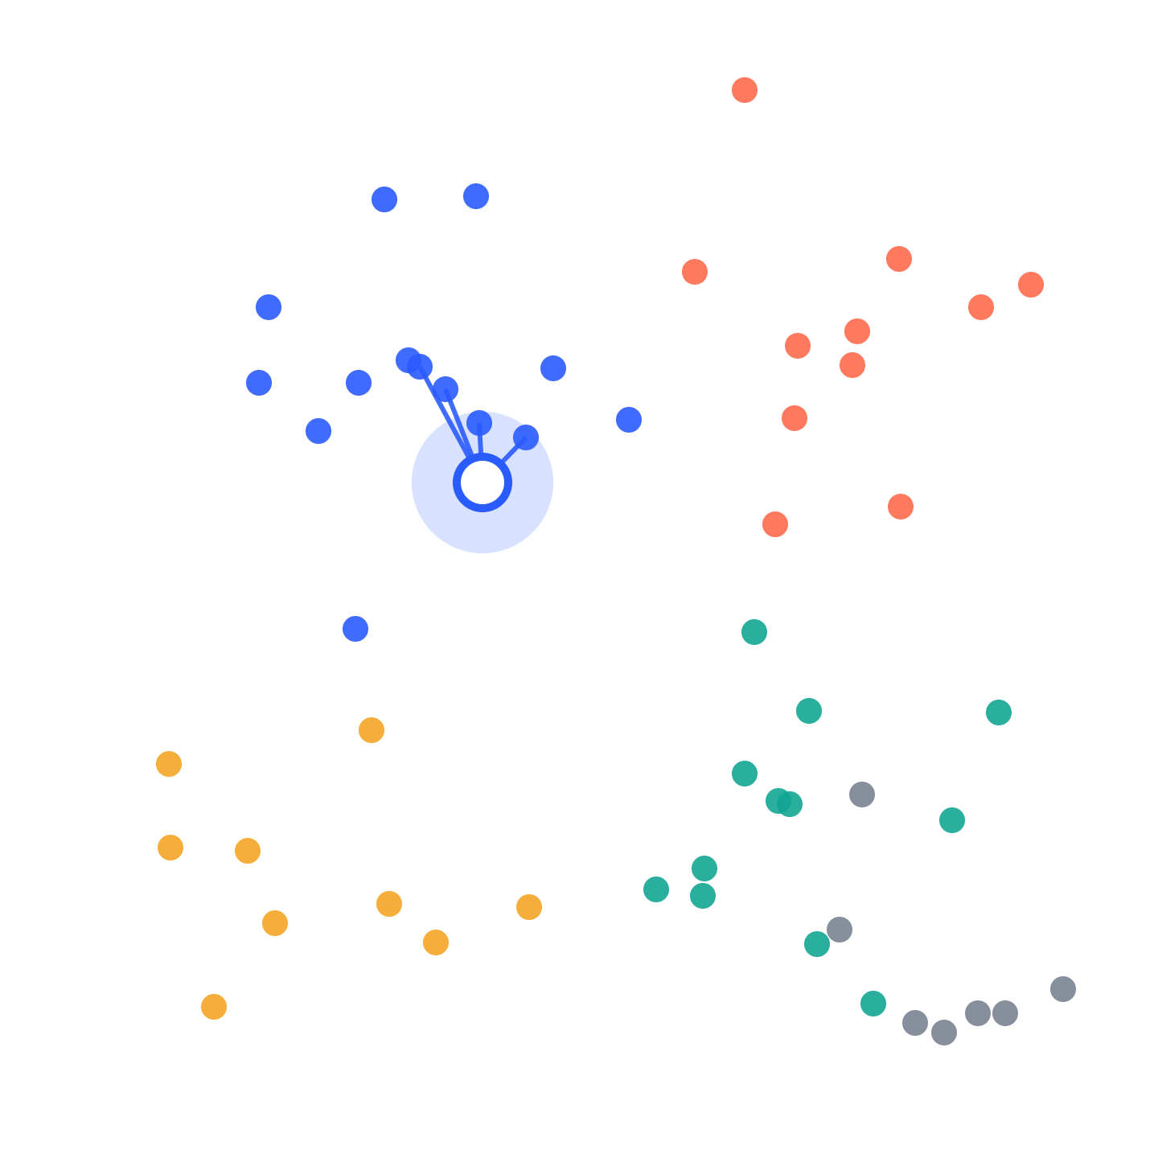
Semantic Search in Rails
Searching the Rails Guides by meaning, with Postgres, pgvector and a model that runs on your laptop
Postgres + pgvector + neighbor + informers
Notes:
About 30 seconds. Set the frame: in the next twenty minutes we build search that understands questions, using only Postgres and a Rails app, and then we break it on purpose and measure it. Everything runs locally: no API keys, no cloud service. The picture on the right is the whole talk in one image: every dot is a passage from the Rails Guides, colored by topic; the white dot is a question, and the lines connect it to its nearest passages. That’s semantic search.

Slide 2
Nobody asks in the Guides’ own words
You type
The Rails Guides say
“do something once a record is saved for good”
Transaction Callbacks
after_commit
0 results
from keyword search, because it needs every word of the question in one passage.
Notes:
About 90 seconds. Read the dark card out loud, the way a developer would type it. Then the white card: that’s how the Rails Guides describe it, under Transaction Callbacks, with after_commit. Same idea, almost no words in common. Postgres full-text search with plainto_tsquery requires every word to match, so it returns zero results. Ask the room how many phrasings they try before giving up on docs search.

Slide 3

An embedding is a point on a map
$ bin/rails console
semantic_search(dev)> Embedder.call("do something once a record is saved for good")
=> [0.0213, -0.1131, 0.0874, … 381 more]
# 64 of them as colors: blue is positive, coral is negative
Mailers
Your question
Caching
Migrations
Callbacks
Notes:
About 90 seconds. Top: this is the real call in the Rails console. Embedder.call runs a small model, all-MiniLM-L6-v2, on the laptop and returns 384 numbers; the strip shows 64 of them as colors. The numbers on screen are illustrative; in rehearsal, run it and paste your real output. Those numbers are a position. Bottom: a two-dimensional cartoon of that 384-dimension space. Every passage from the Guides is a dot, colored by topic, and dots about the same topic sit together. Our question gets a dot too, the dark one, and it lands inside the callbacks group even though it shares almost no words with those passages. Search becomes “find the nearest dots”.

Slide 4
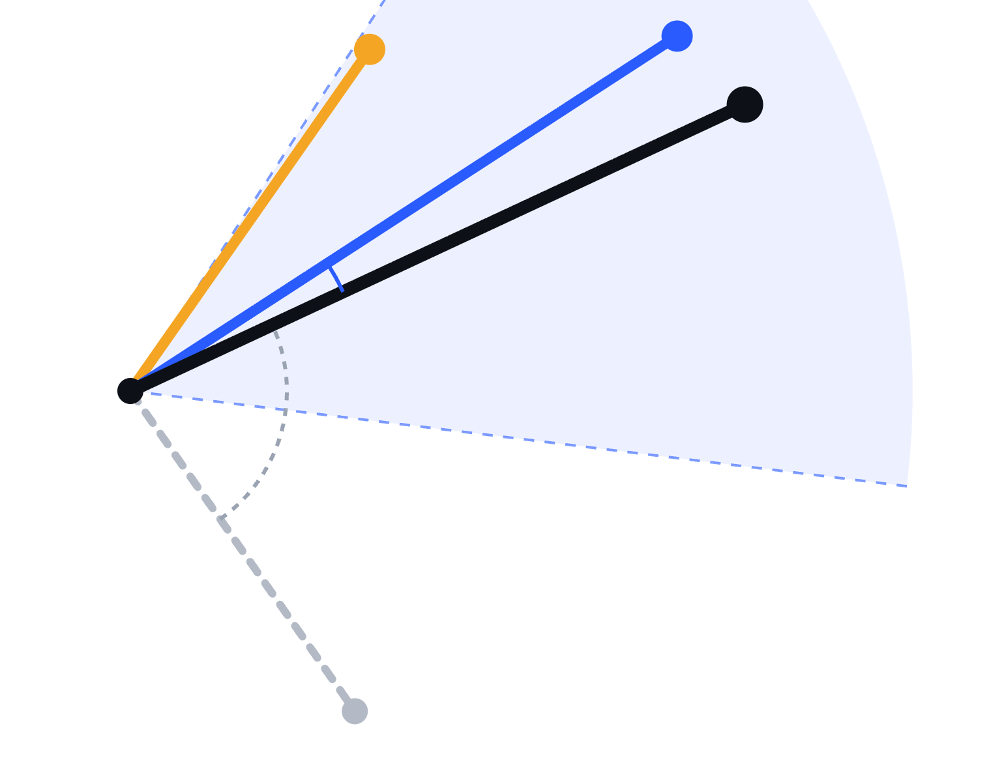
Close in meaning, high score
Top 5 for “how do I email a user?” Bars that don’t reach the dashed cutoff are rejected.
Action Mailer Basics
0.82
Active Job, deliver_later
0.61
Action Mailbox Basics
0.55
Active Record Callbacks, after_create
0.38
Active Record Migrations
0.12
similarity = cos(angle) distance = 1 − similarity
Notes:
About 90 seconds. Left: every embedding is an arrow from the same origin. The dark arrow is the question, “how do I email a user?”. Action Mailer Basics, in blue, points almost the same way; deliver_later, in amber, a bit further; Active Record Migrations, dashed grey, points far away. Right: the same idea as numbers. Similarity is the cosine of the angle: 1 means same direction, 0 means unrelated, and distance is one minus that. These are the top five results for the question, ranked. The dashed line is the cutoff: bars that don’t reach it are rejected, so the callbacks and migrations passages are filtered out even though they were in the top five. The scores are illustrative; in rehearsal, swap in the real ones from the demo app, and the cutoff comes from calibration.

Slide 5
The vector is just a column
guide
heading
embedding: 384 numbers
active_record_callbacks
Transaction Callbacks
[0.021, -0.113, 0.087, … 381 more]
caching_with_rails
Fragment Caching
[-0.054, 0.032, 0.141, … 381 more]
active_record_migrations
Changing Columns
[0.118, -0.007, -0.062, … 381 more]
t.vector :embedding, limit: 384
Chunk.nearest_neighbors(:embedding, Embedder.call(question), distance: "cosine")
pgvector stores it, the neighbor gem queries it, informers computes it on your laptop.
Notes:
About 75 seconds. This is a normal Postgres table: guide, heading, and one more column holding each passage’s 384 numbers. The table shows the first three of each; the values are illustrative. That’s the whole storage story. pgvector is a Postgres extension that adds the vector type and distance operators. The neighbor gem gives Active Record has_neighbors and nearest_neighbors. informers runs the embedding model locally through ONNX Runtime, downloaded once and offline after that. No new database, no new service. The search is one line: embed the question with the same model, then order by cosine distance.

Slide 6
Four steps from markdown to search
1
2
3
4
Chunk
Embed
Store
Search
Split each guide at its headings, at most 150 words
A job turns each chunk into 384 numbers
One row per chunk, text and vector side by side
Embed the question, order by distance
embed_chunk_job.rb
create_chunks.rb
chunk_search.rb
guide_chunker.rb
Each step is plain Rails: a service, a job, a migration and a few class methods.
Notes:
About 60 seconds. The whole system on one slide, in order, with the file that does each step. Chunk: a plain Ruby service splits each guide by heading. Embed: an Active Job turns each chunk into a vector. Store: a normal table with a vector column. Search, the dark card because it’s what users touch: embed the question with the same model and order by distance. The data is a shallow git clone of the Rails repo, reading guides/source.

Slide 7
How you cut the text matters
Question: “do something once a record is saved for good”. Same Guides text, cut three ways:
Too long
Too short
Just right
Callbacks › Overview, 400 words
Transaction Callbacks, 8 words
Transaction Callbacks, 120 words
Callbacks are hooks into the life cycle of an Active Record object: validation, creation, updating…
“It runs once the transaction is committed.”
after_commit runs once the database transaction is committed, so the record is saved for good. Use it to send emails or enqueue jobs.
What is “it”? The sentence naming after_commit landed in another chunk.
…after_commit runs once the transaction is committed.
Weak: the chunk lost its subject
Match: one whole idea, with its heading
Missed: the answer sits past token 256, which the model never reads
GuideChunker.new(max_words: 150)
splits at headings, then packs paragraphs up to 150 words
Notes:
About 90 seconds. One question, one piece of the Guides, three ways to cut it. Too long: the chunk starts with the callbacks overview and the after_commit sentence only shows up near the end; the model reads the first 256 tokens and silently ignores the rest, so the answer never makes it into the vector. Too short: the chunk is just “it runs once the transaction is committed”, and the sentence that named after_commit ended up in a different chunk, so this one has no subject. Just right: one section, one whole idea, with its heading, and it matches the question. That’s why the chunker splits at headings first and then packs paragraphs up to 150 words. The texts on screen paraphrase the Guides to keep them short.

Slide 8
Three ways to search the same table
Keyword
Hybrid
Chunk.keyword_search(q)
Every word must match. Wins on exact names like after_commit.
Chunk.hybrid_search(q)
Vector
Runs both and keeps what ranks well in either. It’s what production search usually does, because real users type both.
Chunk.vector_search(q)
Closest meaning. Wins when people ask in their own words.
Notes:
About 45 seconds. Each card is one class method on Chunk, against the same rows. Keyword is plain Postgres full-text search and wins when people type exact names like after_commit. Vector finds meaning and wins on questions in their own words. Real users do both, so production search usually runs both and merges the two rankings; that’s why hybrid gets the big card. If someone asks how the merge works: reciprocal rank fusion, where each result scores by its rank in each list and the scores add up. The demo page shows these three columns side by side.

Slide 9
The three searches in code
Keyword
Postgres full-text search: every word must match
Chunk.where("to_tsvector('english', body) @@ plainto_tsquery('english', ?)", q)
.limit(5)
Vector
embed the question, order by cosine distance
Chunk.nearest_neighbors(:embedding, Embedder.call(q), distance: "cosine")
.limit(5)
Hybrid
run both, add up a score from each ranking (reciprocal rank fusion)
lists = [keyword_search(q).to_a, vector_search(q).to_a]
scores = Hash.new(0.0)
lists.each do |list|
list.each_with_index { |chunk, i| scores[chunk.id] += 1.0 / (60 + i + 1) }
end
scores.sort_by { |_id, score| -score }.first(5)
Notes:
About 60 seconds. The same three strategies from the previous slide, as the code in app/models/concerns/chunk_search.rb, slightly trimmed for the screen (the real keyword query also searches the guide name and heading, and orders by rank). Keyword is one where clause with Postgres full-text search. Vector is one nearest_neighbors call: embed the question with the same model, order by cosine distance. Hybrid runs both and adds up a score per chunk: one over sixty plus its rank in each list. A chunk that ranks well in either list, or decently in both, ends up on top. That’s reciprocal rank fusion, and it’s six lines of plain Ruby.

Slide 10
Ask the Rails Guides
bin/rails server → localhost:3000
1
2
3
4
5
Meaning beats keywords
Exact names: hybrid keeps them on top
Same question, 30-word chunks
A question the Guides can’t answer
The eval passes, then fails
Notes:
About 5 minutes, following docs/DEMO.md. One: ask the hook question; keyword is empty, vector finds the callbacks guide. Two: search an exact term like after_commit and point at hybrid keeping it on top. Three: click 30 words with the same question and show the results lose context; click back. Four: ask how to configure Phoenix LiveView in Rails; the verdict says not covered, and the dot sits past the cutoff, while the vector column still returns five passages. Five: in the terminal, run the eval for 150-word chunks, then 30. If anything fails, play the recording and narrate over it.

Slide 11
Vector search always answers. A cutoff lets it say “not in the Guides.”
Ask “how do I configure Phoenix LiveView in Rails?” and you still get five passages, probably Action Cable, the closest idea it has.
distance <= MAX_DISTANCE
Notes:
About 45 seconds, as a recap of demo step four. This is the moment most RAG demos never show. Nearest-neighbor search has no notion of “nothing relevant”; it returns the closest rows, however far. A distance cutoff, the one comparison in the white box, turns that into a decision the app can act on. The value is calibrated: run the golden in-scope and out-of-scope questions, look at the real distances, and put the line between the two groups. Too strict and real questions get rejected; the eval checks both sides.

Slide 12
Test retrieval like any other code
test/evals/golden_set.yml
terminal
- question: "run work in the
background"
expected: [active_job_basics]
- question: "send an email
to a user"
expected: [action_mailer_basics]
$ bin/rails test test/evals
Hit rate@5 over 13 questions (w150)
keyword [__]%
vector [__]%
hybrid [__]%
0 failures
$ CHUNK_VARIANT=w30 bin/rails test test/evals
1 failure: vector hit rate@5 was [__]%
13 questions with answers, 3 that must get none
Notes:
About 90 seconds, with demo step five live in the terminal: run bin/rails test test/evals, then CHUNK_VARIANT=w30 bin/rails test test/evals. The golden set is thirteen real Rails questions, each with the guides that would be an acceptable source, plus three out-of-scope questions that must get no answer. It measures retrieval only, not a generated answer. Floors sit just below the baseline, so a real regression fails CI and noise doesn’t. The output here is abbreviated; fill in the percentages from your rehearsal run before the talk.

Slide 13
From search to RAG: add one step
built today
next step
next step
built today
Prompt
Question
Retrieve
Answer
Top 5 chunks that pass the cutoff
Question + chunks + “answer only from these, cite them”
Written by an LLM, with links to the guides it used
“how do I email a user?”
the generation step, e.g. with RubyLLM
chunks = Chunk.semantic_search(question, limit: 5)
context = chunks.map { |c| "[#{c.citation}] #{c.body}" }.join("\n\n")
RubyLLM.chat.ask("Answer using only these passages and cite them.\n\n#{context}\n\nQuestion: #{question}")
The LLM can only be as good as what you retrieve.
Notes:
About 60 seconds. Everything we built today is the first half of RAG, retrieval-augmented generation: take the question, retrieve the best chunks, apply the cutoff. RAG adds one step: paste those chunks into a prompt with the question, and ask an LLM to answer using only them, citing the guide and heading. In Rails that’s three lines, for example with RubyLLM (check its docs for the exact API). Two things carry over directly from this talk. Chunk quality: each chunk must read well on its own, because the LLM sees it out of context. And the cutoff: without it, the LLM gets five irrelevant passages and writes a confident wrong answer; with it, zero chunks means it can say “not in the Guides”. That’s why retrieval comes first.

Slide 14
What to take home
It’s just Postgres: a vector column, the neighbor gem and a local model.
Settings are product decisions
Retrieval gets a test
Chunk size and the cutoff change which answers people get.
A golden set turns “feels better” into a pass or a fail.
Notes:
About 60 seconds. Lead with the big line: you can add semantic search to an existing Rails app this week without adopting a new database. The two smaller points are what separate a demo from something you can ship: treat chunking and the cutoff as decisions with consequences, and put a test around them before you tune anything.

Slide 15
Questions
Repo link: https://github.com/AAlvAAro/semantic_search
Notes:
Open floor. Likely questions and short answers. Which model? all-MiniLM-L6-v2, small and local; swap the Embedder class for a hosted model and re-run ingestion, the content hash re-embeds everything. Cost? Zero here; it runs on a laptop. Multi-tenant? Filter by account in the same query, and test filtered queries once you add an index. Where’s the LLM? Out of scope today; generation is only as good as retrieval, so retrieval comes first.

