Slide 1
BULB GAME

Slide 2
Game Description
The game is based on assignment 3 and assignment 4 such that you have all the physics-based effects and the keyframing animations.
And for extension, we add 4 points for the whole game:
Animation
GUI
Shadow
Sound

Slide 3
Outline
Game Description
Development Tool
Character Animation
Extension
Future Work

Slide 4
Development tool
Blender 2.79
jMonkeyEngine 3
MacBook Pro

Slide 5
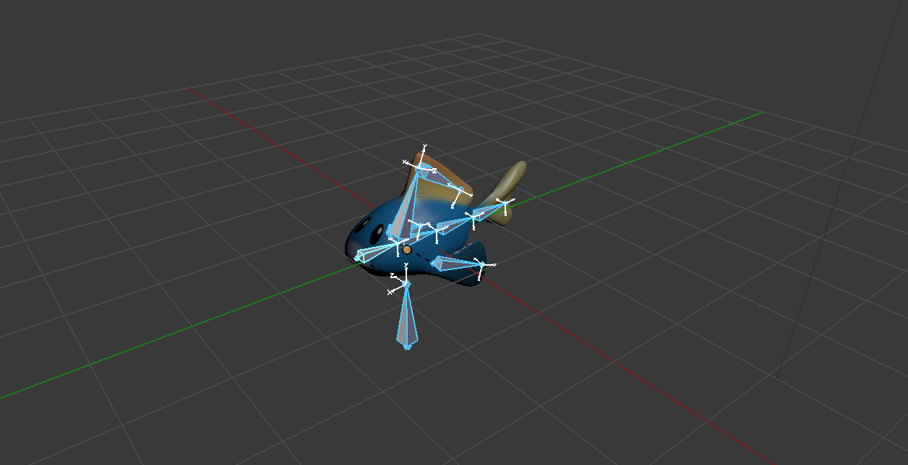
Character Animation
Rigging
Skinning
Keyframing

Slide 6
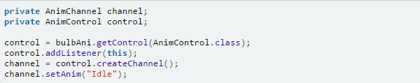
Extension -Animation
Bulb Swing
Set up a animation channel to add swing animation created in Blender to the bulb

Slide 7
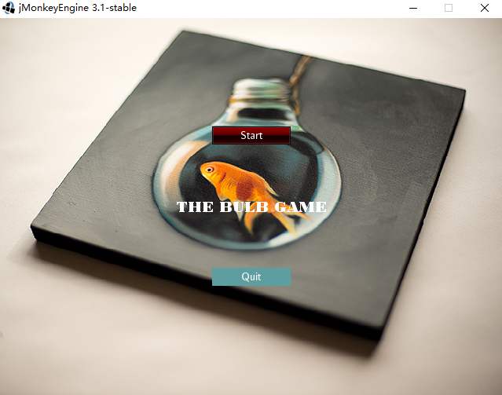
Extension -GUI
Adding a start page for the game
Use nifty GUI to give the game a start GUI including start and quit button.
Lay out GUI on XML.
Overlay the user interface over the screen.
Interact with the GUI from myStartSceen.java

Slide 8
Extension - Shadow
Add DirectionalLight to the scene
Add shadow by DirectionalLight shadow renderer and shadow caculatation( cast and receive )

Slide 9
Extension - Sound
Creating new balls with a sound effect
Trigger sound in iniKey().
Set setLooping (false) since audio plays once when it is triggered.
Creating a sound effect when the collision is detected
Use physics collision listener to detect the collision.
Add sound effects.

Slide 10
Future Work
As a game, our work still need to be improved in many ways.
We can improve it in the following ways:
1.Adding more interactions with the player.
2.Posting it in Android.
3.Setting different levels.

Slide 11
Thank you!

