Slide 1
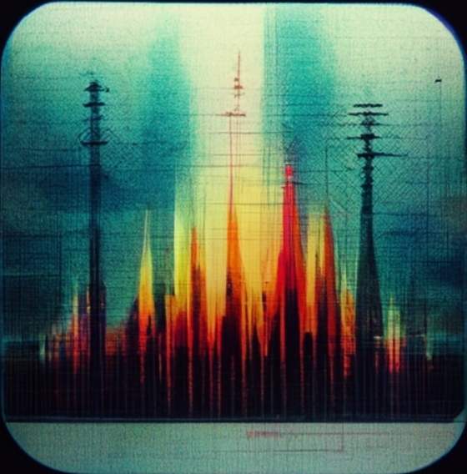
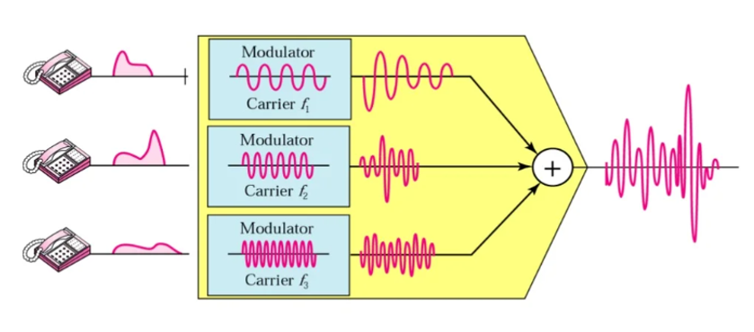
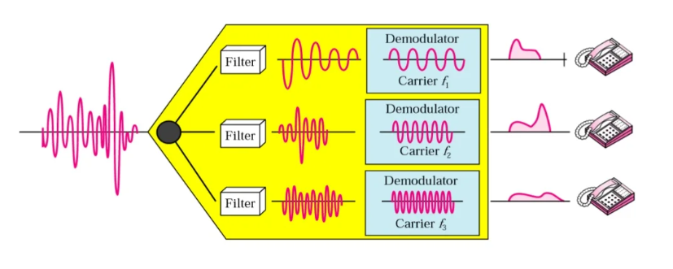
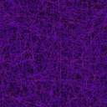
Project Title:
Frequency Division Multiplexing
(FDM)
Course Teacher:
Dr. Md. Shafiqul Islam
Shafin Bin Hamid
Department of Electrical & Electronics Engineering, BUET
Group 8
ID:1906048
ID:1906049

Slide 2
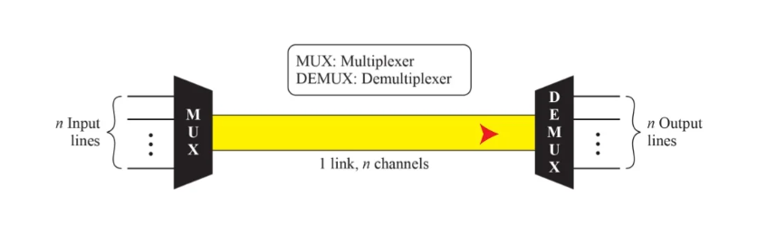
What is Frequency division multiplexing:
In telecommunications, frequency-division multiplexing (FDM) is a technique by which the total bandwidth available in a communication medium is divided into a series of non-overlapping frequency bands, each of which is used to carry a separate signal.

Slide 3

Project Overview
FDM simulation model (with pspice simulation software
Modulation
Adding the modulated signals
Transmission
Passing the transmitted signal through the bandpass filter
Demodulation
Passing through the LPF to get back the baseband signal

Slide 4
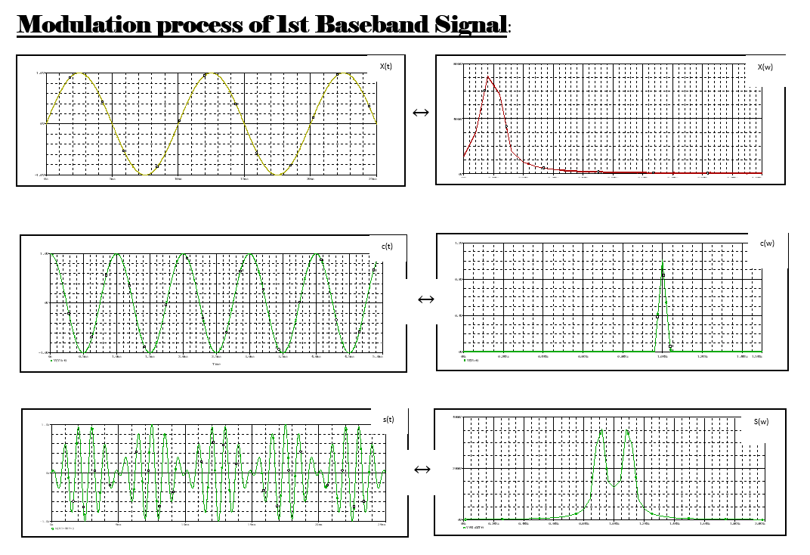
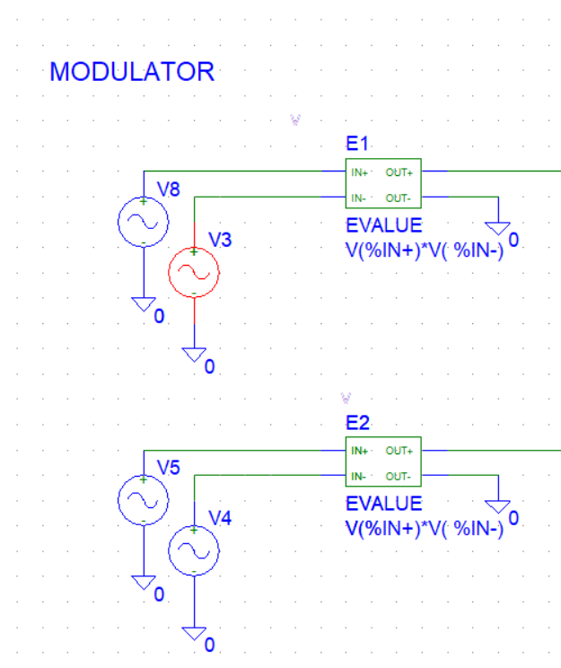
Modulation
Modulator Circuit

Slide 5
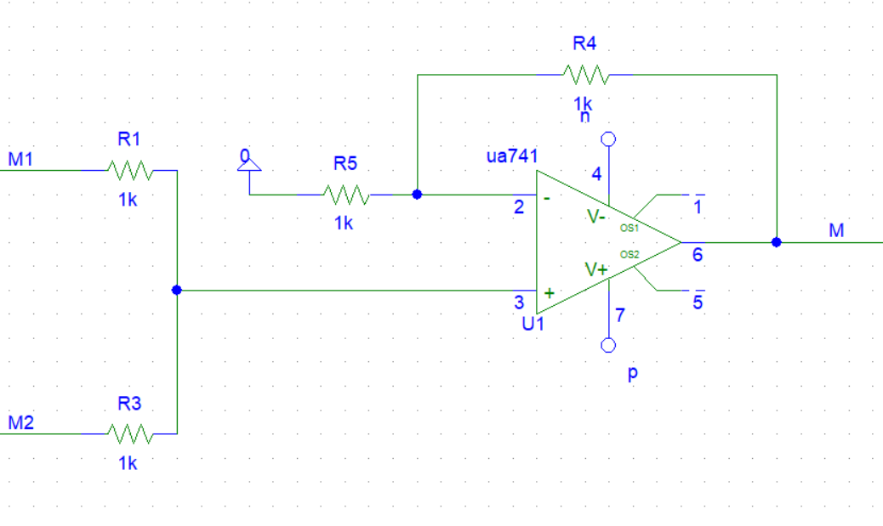
Transmission

Slide 6
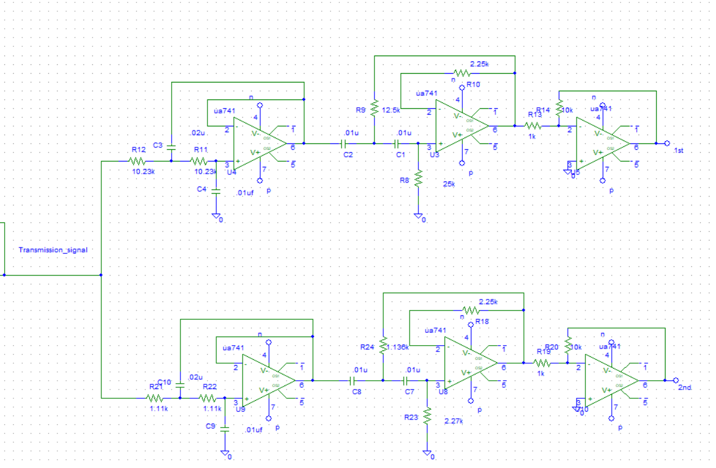
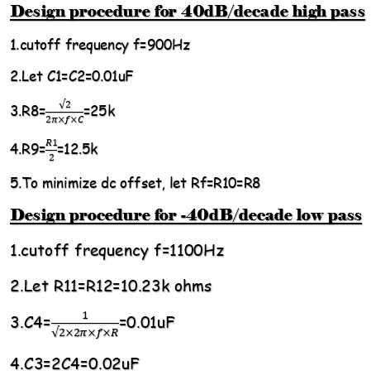
Designing Bandpass filters
we have selected the roll of is 40dB/decade.

Slide 7
Filtered signal output:
1st
2nd

Slide 8
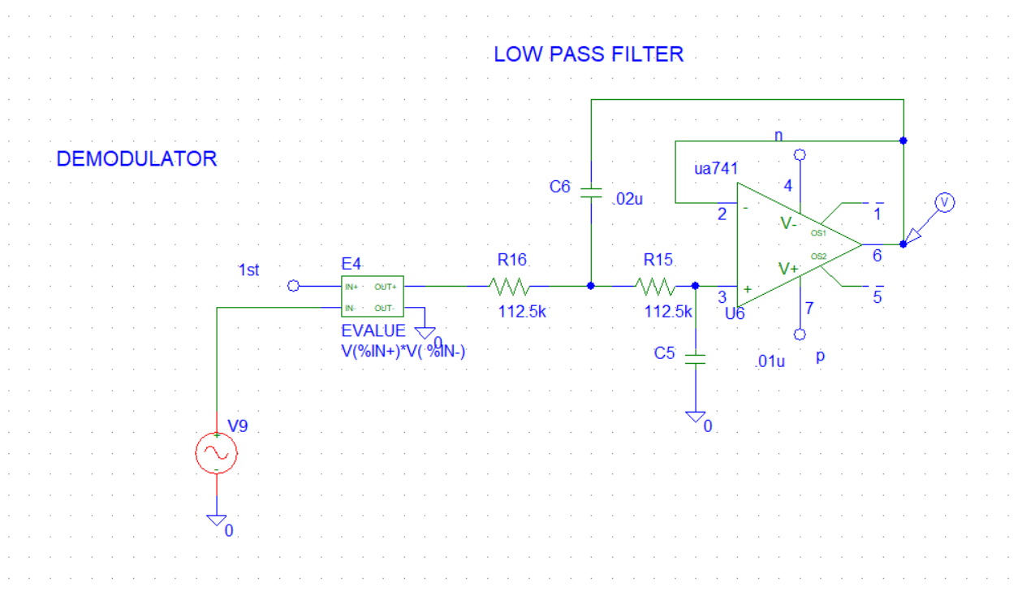
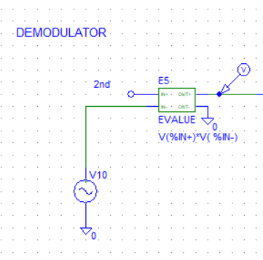
Demodulation
Demodulator Circuit

Slide 9
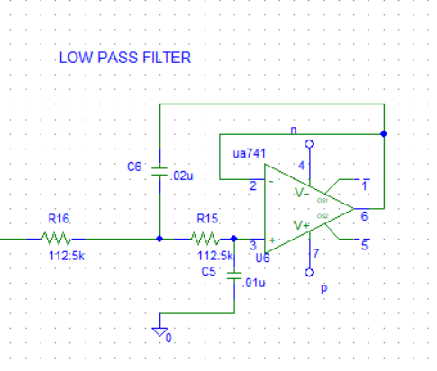
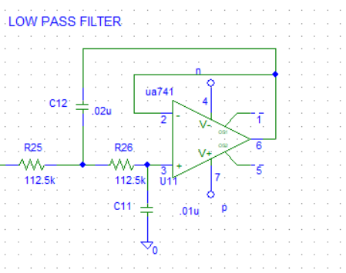
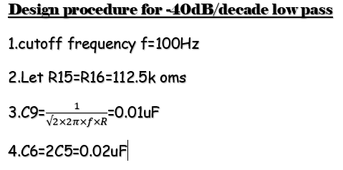
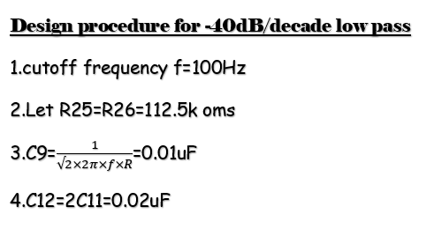
1st
2nd
Designing Lowpass filters
Output of this low pass filter gives back the baseband signal in the receiver end

Slide 10
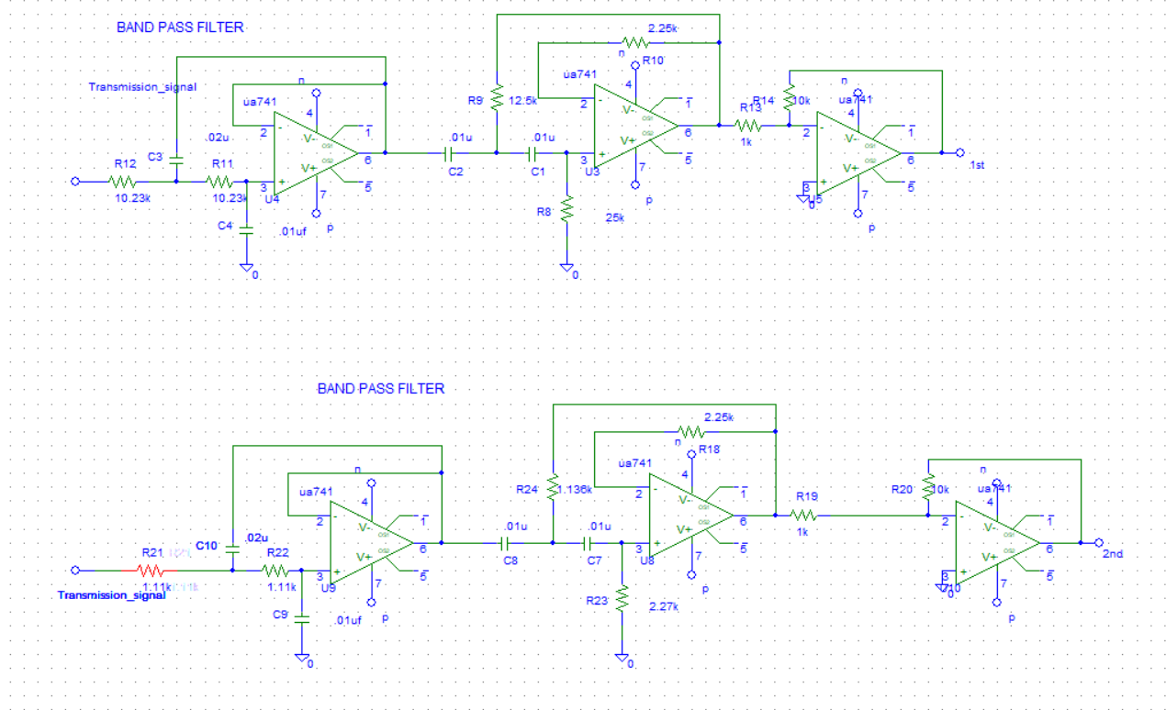
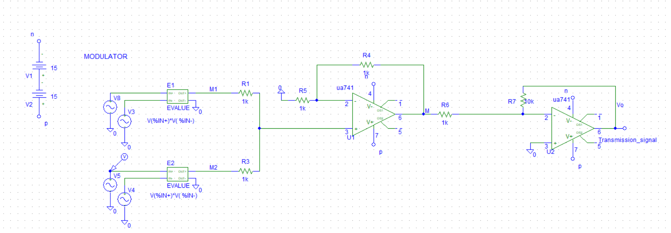
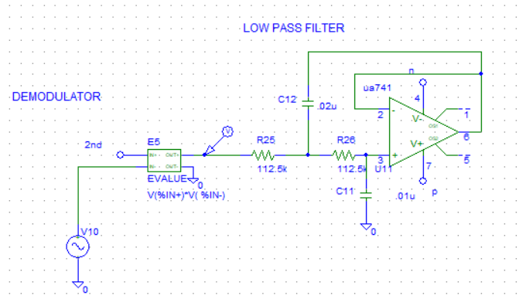
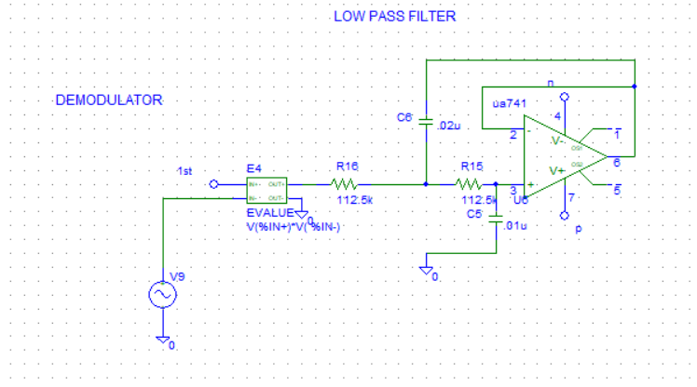
The Full circuit model(FDM)

Slide 11
Signal 1 (Source end vs Receiver end)

Slide 12
Signal 2 (Source end vs Receiver end)

