Slide 1
Work and Travel application
Department of Electronics, Telecommunications and Informatics
Course : Introduction to Software Engineering
Students: Aurimas Arlauskas,106590
Tanja Miloshoska, 105625
Aleksandra Zdravkova, 105635
Ana Atanasova, 105648
26/1/2022

Slide 2
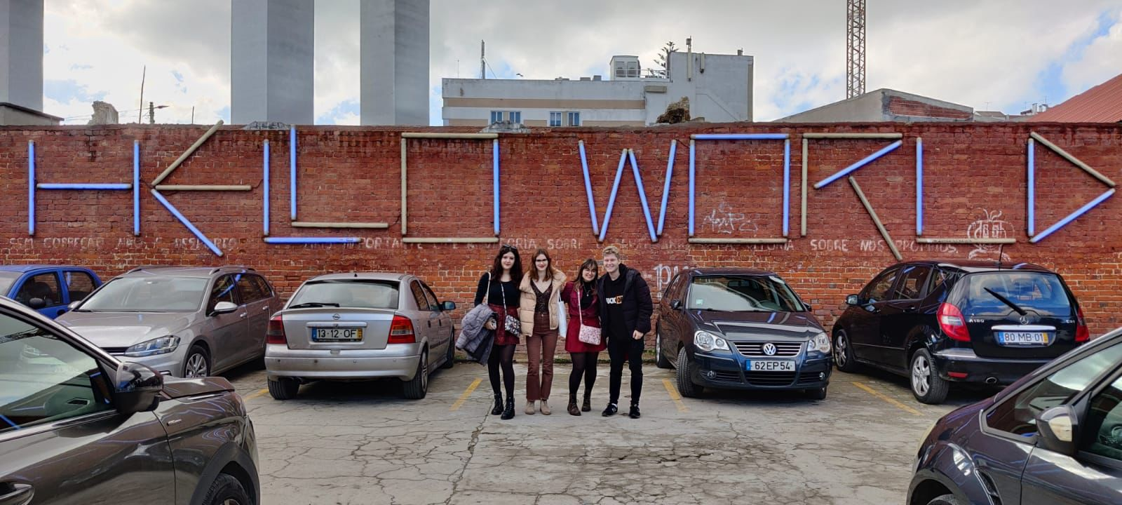
Project team: IT-ish Team
Developers:
Team Manager: Ana Atanasova
DevOps master: Aleksandra Zdravkova
Architect: Tanja Miloshoska
Product Owner: Aurimas Arlauskas

Slide 3
Introduction
Work and Travel program is common amongst students
We created a web page to help students to find job easily and in the most efficient way and not to waste to much time writing and sending mails
Create a profile
Get information about the job you want to do
Send email to selected companies at once

Slide 4
Personas
Regarding the personas that will use the application, first we have one student whose name is Stefan. He is 22 years old and he is studying Computer Engineering. He is from Macedonia. He was thinking about applying for job in USA during the summer, in order for him to get some money and go to masters in Portugal, but he was not sure how can he do that and he didn’t want to spend many of his time just writing emails. One of his friends recommended our application to him.
Here is also Ivana. She is 48 years old. She lives in USA in Boston and she has her own restaurant. She likes working with young people, especially with people that come from other countries because in that way she can get in contact with different cultures and learn new things. She knows about Work-And-Travel and she always put information about her restaurant in order for students to get contact with her. Usually during the summer, she is offering job to 3 students in different working positions. Until now everyone is satisfied. She is glad that the application is helping young people to contact her even more.

Slide 5
User Stories
As a user, I would like to be able to sign in with my personal email and password
As a user, I would like to check first if the application is worth for using by sending email to yourself to test it and to sign up as a basic user
As a pro user, I would like to get a list of companies with the type of job that they are providing and the state, where are they located
As an admin, I would like to be able to see the logs
As a company owner, I would like to be able to register my company.

Slide 6
Product Concept
Database with details about the companies that provide jobs in the Work and Travel program
When you are logging in, you have an option to test our application and send one email to yourself to see if it works
Log in, and decide if you want to be basic or pro user
If you are pro user you will have to pay and you will have access to all the info and to all the companies
Sending emails for basic user is limited to 30 companies and for pro user is 500
The goal is to make the way of applying to the program easier, by providing this type of service

Slide 7
Types of users
The personas that can use the application are Basic User, Pro User and Admin
Basic User – can only send the amount of emails that are allowed in the free trial
Pro User – user that can send emails up to 1500 emails per day, to a company of his choice
Admin – have access to everything, can put tasks on the application and can register companies

Slide 8




Architectural Notebook
The technologies used for the project are:
ReactJS
Java Spring Boot
MySQL database
Python/JS script for data generation

Slide 9
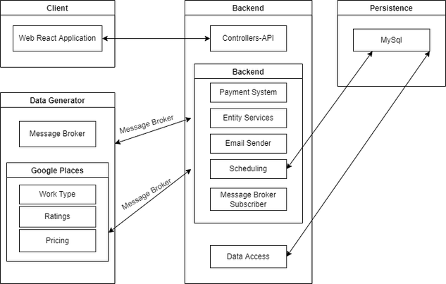
Diagram of Architecture View

Slide 10
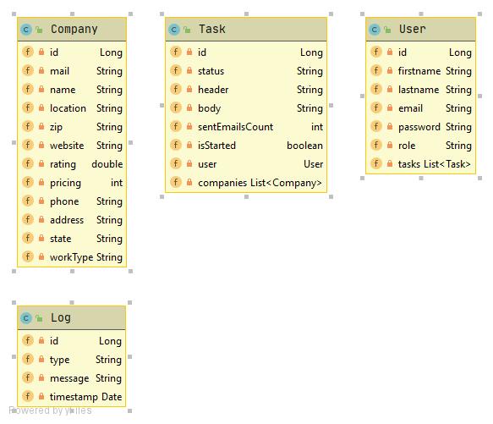
Information perspective

