Slide 1

Presentation Project
CSC 4350: Software Engineering
Team 1 members:
Cesar Spaniol
Ma Juarez
Raktim Biswas
Ravier Konan
Taylor Duncan

Slide 2

Table of content
What is Ignition?
Sprint Cycle 2 Progress
Difficulties
Moving Forward

Slide 3
Ignition
Name | Email | Role
Ravier Konan | rkonan1@student.gsu.edu | Solution Architect
Cesar Spaniol | cspaniolramos1@student.gsu.edu | Front End Developer
Ma Juarez | Mjuarezgaytan1@student.gsu.edu | Back End Developer
Raktim Biswas | rbiswas1@student.gsu.edu | Technical Writer
Taylor Duncan | Tduncan15@student.gsu.edu | Back End Developer
A job board application designed to match recent graduates with local employers with direct connections, avoiding "middle-men" that funnel applications through ATS
Allows graduates to filter their job search by company, position, location, etc.
Allows employers to group desired candidates for a best match

Slide 4
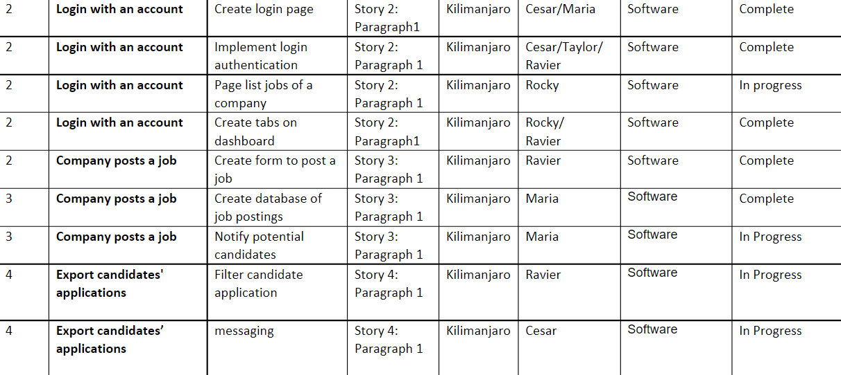
Sprint Cycle 2 Tasks

Slide 5
Difficulties
Having the necessary package for the project was a bit challenging. Some package required some complex modification on our system before working.
Learning multiple tools to merge front end and backend development with HTML, PHP, and SQL
Differing functionalities of Firebase and Flask

Slide 6
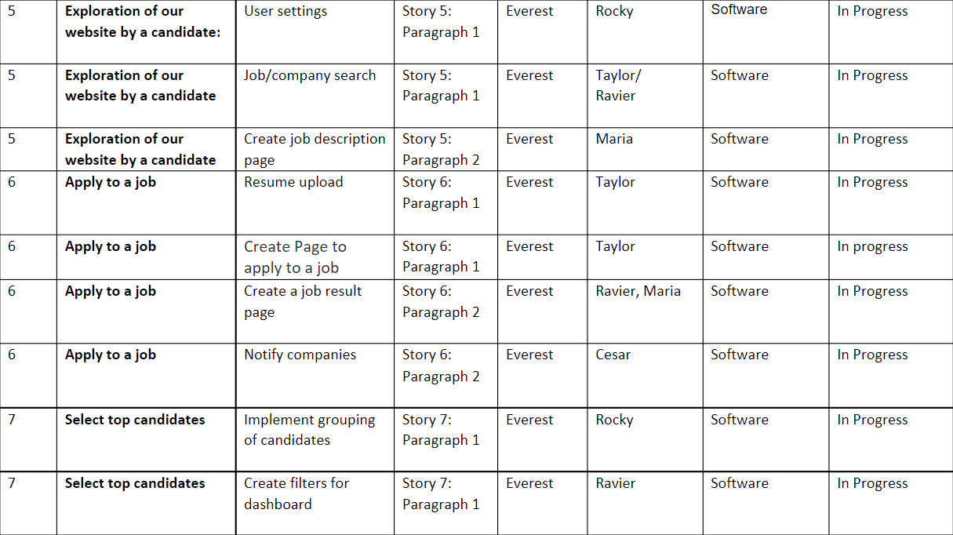
Sprint Cycle 3 Tasks

