Slide 1

Project Presentation on: Title of Project : Skin Disease Detection using Image Data Name of the Supervisor: Dr. Khushboo Jain
INDIAN INSTITUTE OF INFORMATION TECHNOLOGY, NAGPUR
Department of Computer Science and Engineering
ENrollMENT NO. and Name of STUDENT
BT21CSE170 - Ankit Doye
BT21CSE179 – Aayush patil
BT21CSE200 – Vaibhav Taywade

Slide 2
AGENDA
Topic Outline / Problem statement
Literature Survey
Model Implementation
Results
Future Work
Sequence Flow
Novelty

Slide 3
Problem Statement
Skin disease can range from normal to life threatening like skin cancer.
Objective
Develop a deep learning model to classify and detect skin disease from image data .
Manual examination can be time consuming , subjected to human error and require expert knowledge .
Diagnostic method are limited in accuracy and accessibility especially in rural and underserved areas .
Use of ViT for feature extraction .
Comparing performances of CNN models and ViT.

Slide 4
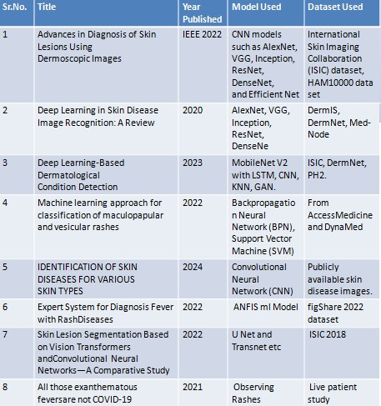
Literature Survey Summary

Slide 5
Dataset and Preprocessing
Dataset:35,000 images of 14 skin disease classes.
Images categorized into training, validation, and test sets.
Preprocessing: Resizing images to 224x224 pixels.
Normalization using ViT’s pre-trained mean and standard deviation.
Class balancing using WeightedRandomSampler.

Slide 6
Model Implementation (ResNet)
ResNet Architecture: CNN with Residual Blocks for better training of deep networks.
Input: 224x224x3 images.
Convolutional Layers: Detect basic patterns in images.
Residual Connections: Skip connections to improve gradient flow.
Fully Connected Layer: For final classification.
Training: Trained for 50 epochs.
Achieved 77.7% accuracy on test data.

Slide 7
Transition to Vision Transformer (ViT)
Why ViT?
ViT captures global relationships between image patches. Better suited for complex image classification tasks like skin disease detection.
ViT Architecture: Image divided into patches (16x16).
Positional Encoding added to capture spatial relationships.
Self-attention mechanism for learning long-range dependencies.
Internal Feature Extraction: Asymmetry, Compactness, Borders.

Slide 8
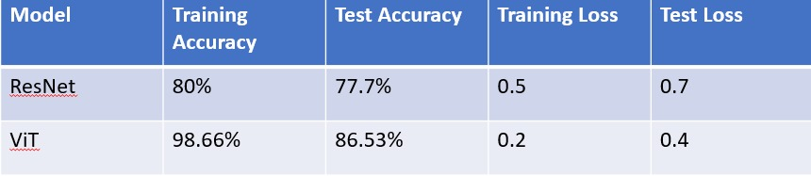
Comparison between CNN and ViT

Slide 9
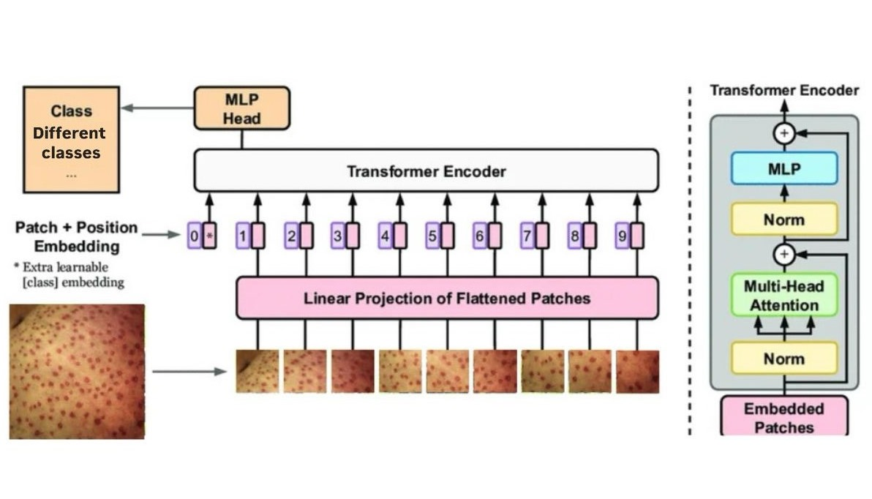
Architecture for ViT patch (3*3)

Slide 10
Training the Vision Transformer (ViT)
Training Configuration:
Fine-tuned pre-trained ViT for 10 epochs.
Optimizer: AdamW, learning rate: 5e-5.
Cross-Entropy Loss for multi-class classification.
Results:Training Accuracy: 98.66%.Test Accuracy: 86.53%.

Slide 11
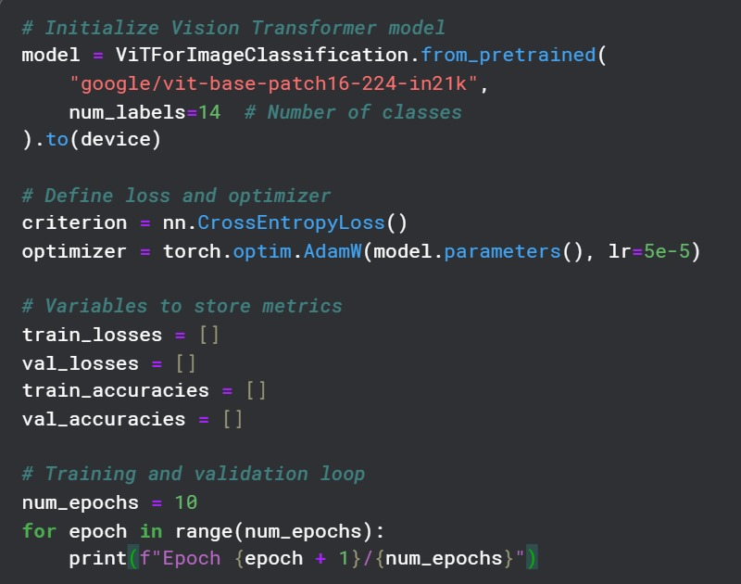
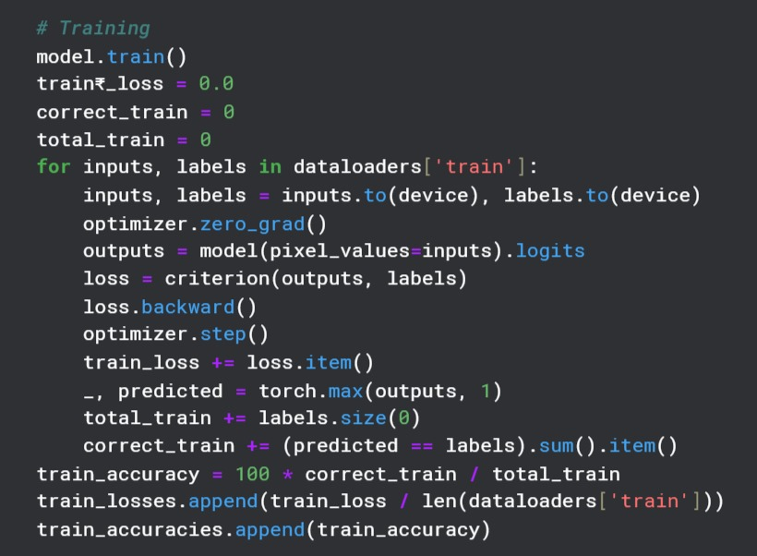
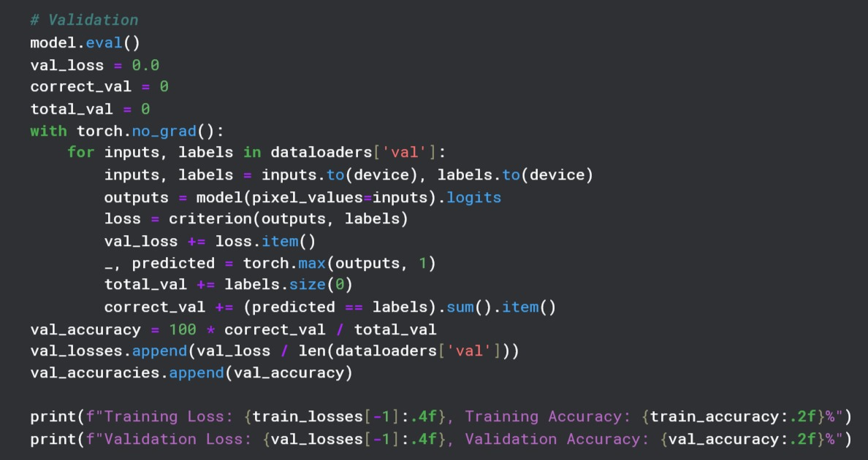
Initialize ViT
Training Model
Validate Model

Slide 12
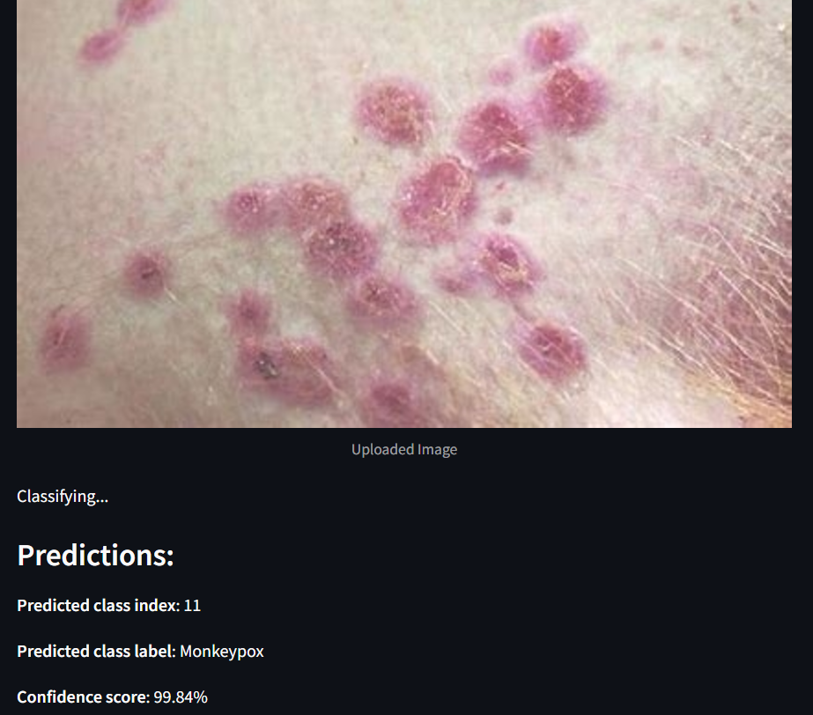
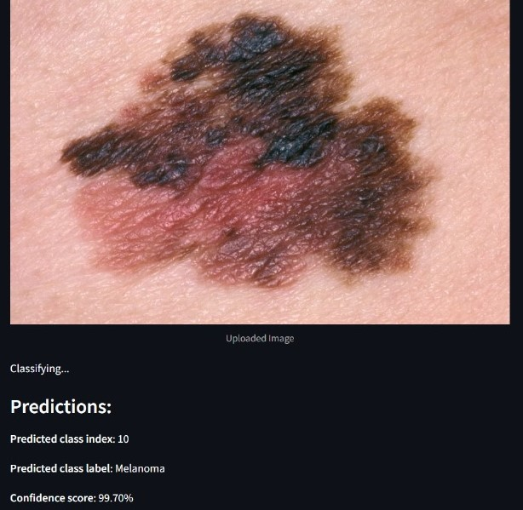
Result Visualization
Monkeypox Prediction
Melanoma Prediction

Slide 13
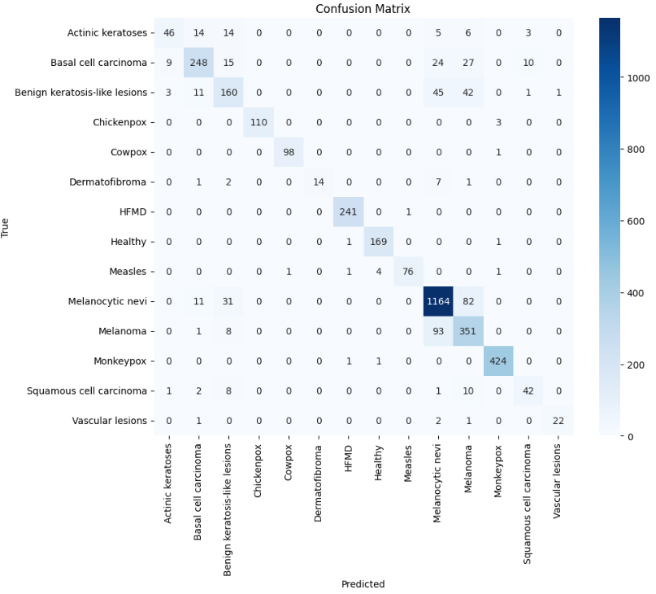
Confusion Matrix

Slide 14
Future Work
Future Directions:
Explore further fine-tuning of ViT with additional data.
Investigate hybrid models combining CNN and ViT for better accuracy and efficiency.
Real-time application for teledermatology and mobile-based diagnosis systems.

Slide 15
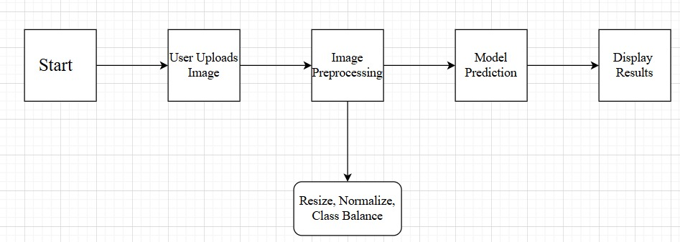
Sequence Flow

Slide 16
Novelty
Leveraged Vision Transformer (ViT), a cutting-edge deep learning architecture,
for the medical imaging domain.
Application in Dermatology
Demonstrated robust classification across diverse skin disease classes..
Potential for real-time deployment in telemedicine and integration with mobile-based
diagnostic systems.
Demonstrating how transformers can outperform traditional CNNs, especially in complex
image classification tasks like skin disease detection.

Slide 17
Thank You

