Slide 1
The battle of the Neighbourhoods

Slide 2
Introduction
Home to a large number of financial institutions and banking companies
Low tax rates attract overseas companies to set up their headquarters there
Great tourist destination and is home to a few UNESCO world heritage sites.
Determine the optimal location to open a restaurant in the Zurich district, determine the most popular type(s) of restaurants in Zurich
Target stakeholders interested in opening a restaurant in Zurich, valuable information for them

Slide 3
Data Description
3 data sets
1. Data Set containing Names of municipality, district, CoA and date of merger, scrapped from Wikipedia
Latter 2 dropped
2. Data set containing geo coordinates, creating using Wikipedia
Data from FourSquare API showing venues

Slide 4
Methodology
Utilized one hot encoding to replace categorical variables w/ 1’s and 0’s
Analyzed frequency of mean occurrence of each category
Clustered Data using K-means clustering
K-Means simple and efficient

Slide 5
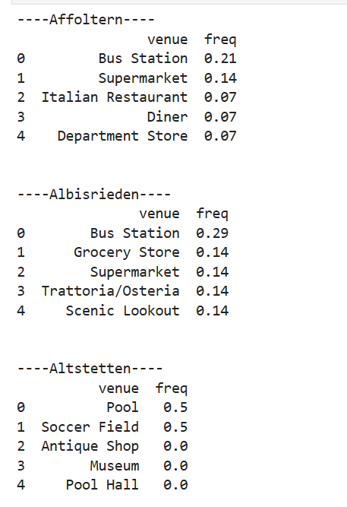
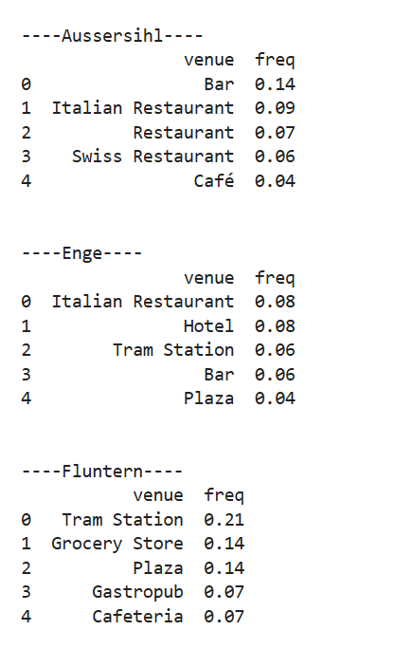
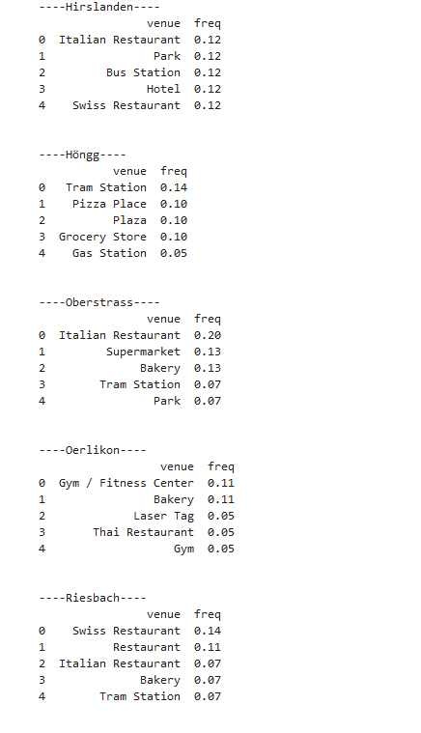
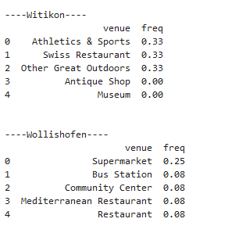
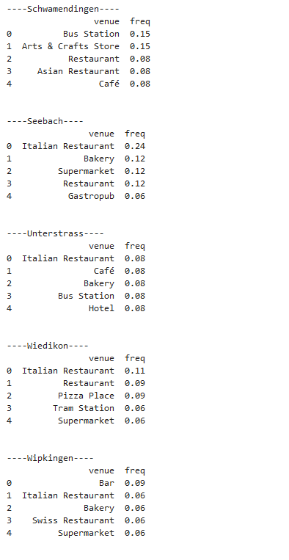
Frequency of each Venue

Slide 6
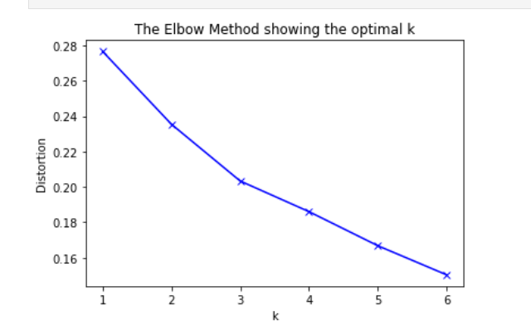
K-Means Clustering: choosing the right K
Utilized ‘elbow’ method
Optimal k: 3

Slide 7
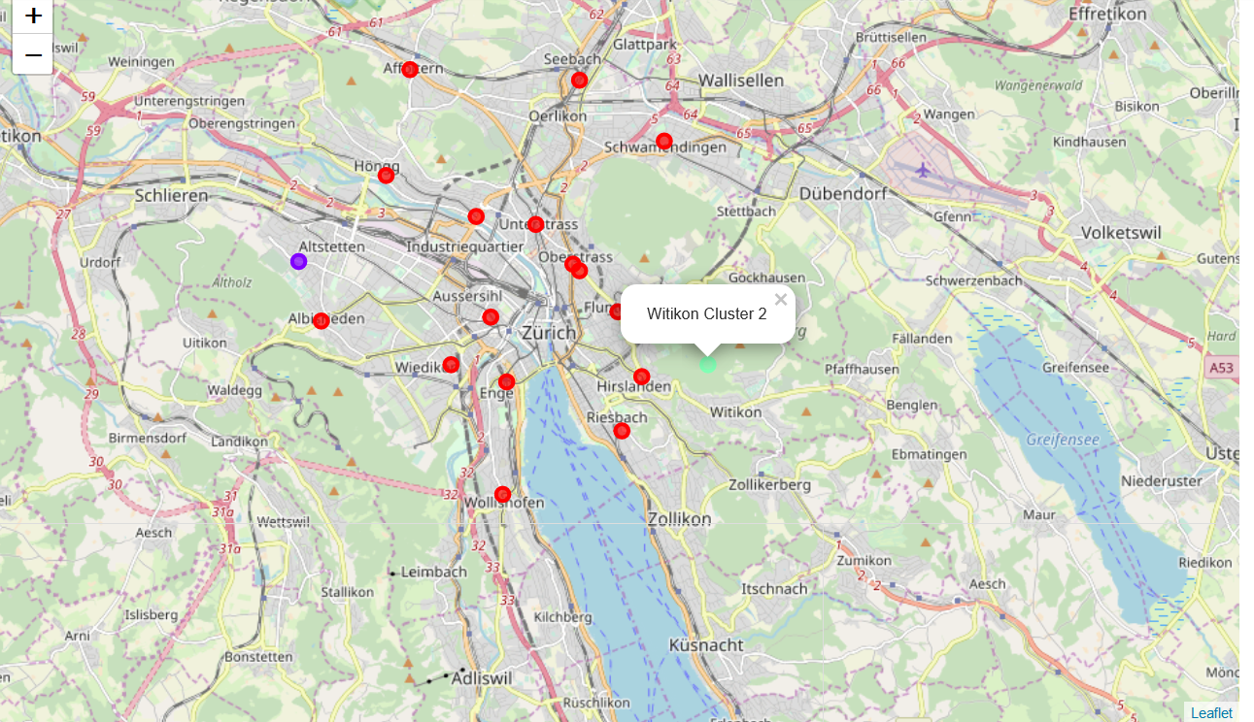
K-Means Visualizing the clusters

Slide 8
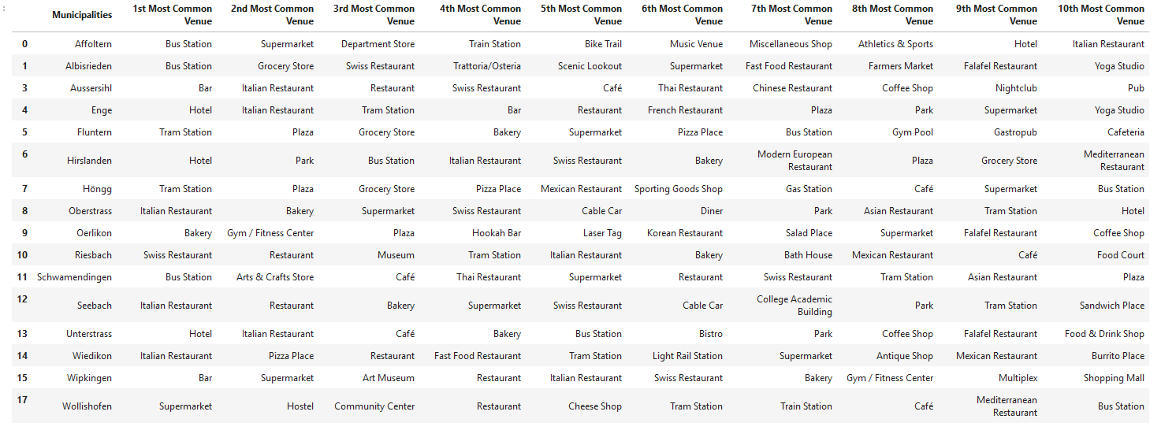
K-Means Cluster 1

Slide 9
K-Means Cluster 2

Slide 10
K-Means Cluster 3

Slide 11
Discussion and Conclusion
Best type of restaurant: Italian
Optimal Location: Any District in cluster 1
Final Decision left to stakeholders
Analyses are not perfect
Should be used with other tools/techniques of decision making

