Slide 1
Sea Ice levels in Northern Canada Machine Learning Models
Andrew Cobb
Arsalan Farooqui
Giuseppe Ragusa

Slide 2
Table of Contents
Idea and Research
Implementation
Analysis
Conclusion

Slide 3
Idea and Research
See if we can predict Sea Ice Levels in Northern Canada
Used open source information from Government of Canada
Datasets include Northern Canadian Sea Ice Levels and various temperatures recorded from weather stations across Northern Canada
Modeled information using linear regression using training and testing information about sea ice levels against year

Slide 4
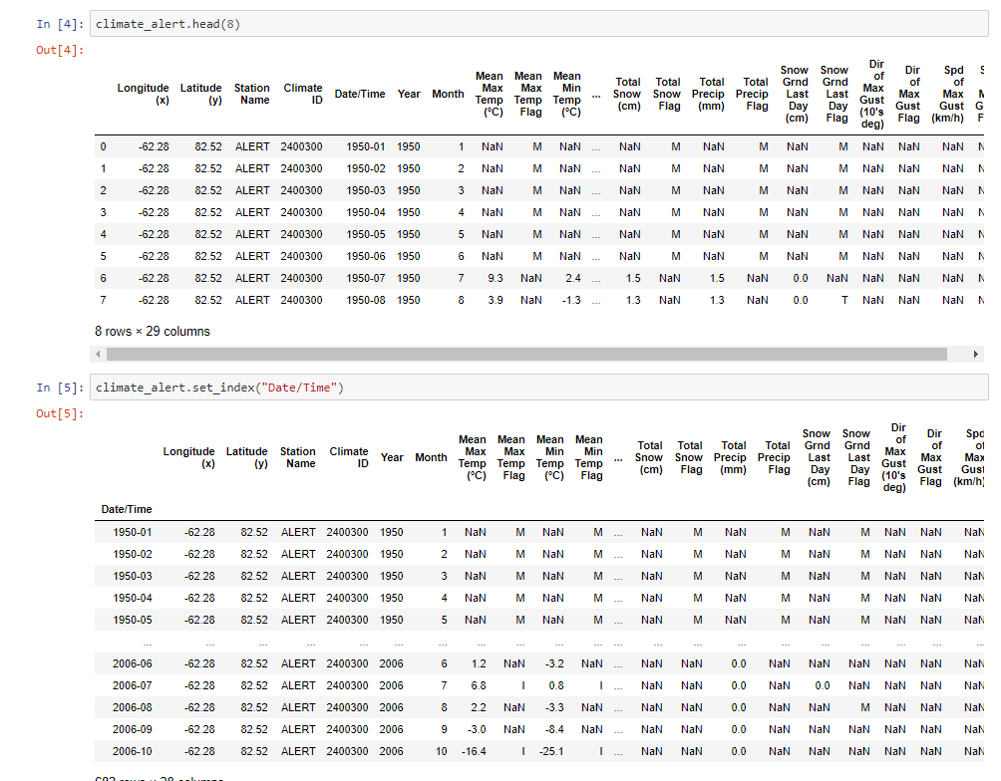
Implementation
Imported numpy and pandas and read information into DF called climate_alert
Set our index to date/time

Slide 5
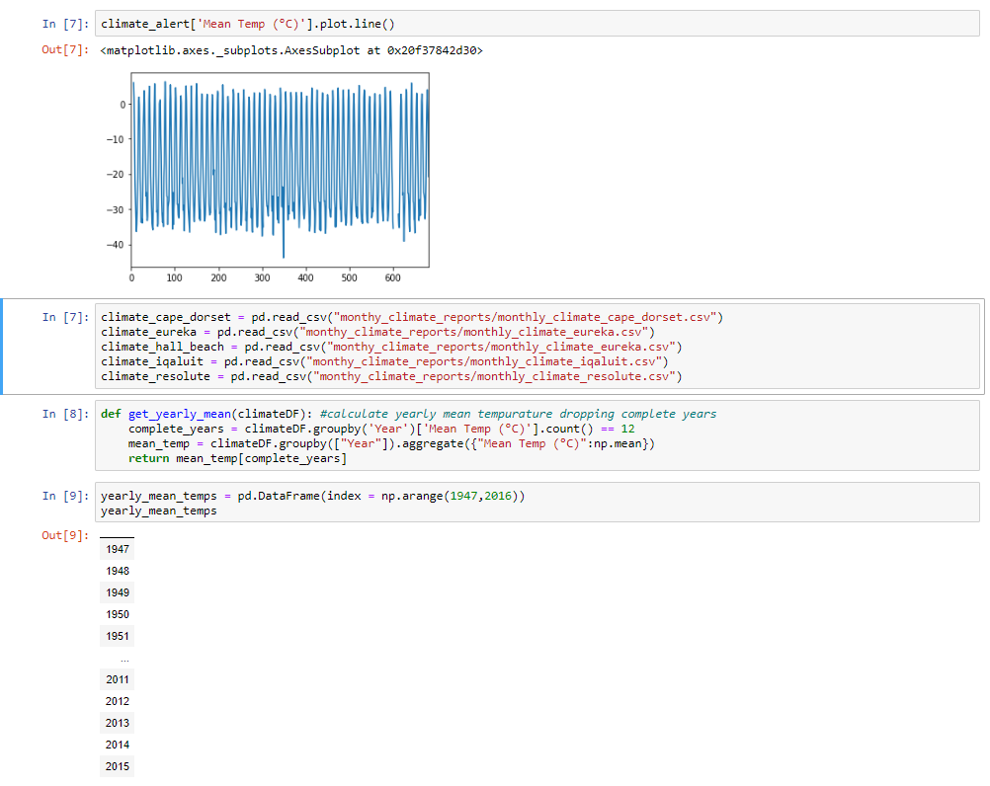
Implementation
Plotted our mean temperature in our main DF
Loaded more information about various weather stations across Northern Canada
Wrote function to extract yearly mean custom to our datasets

Slide 6
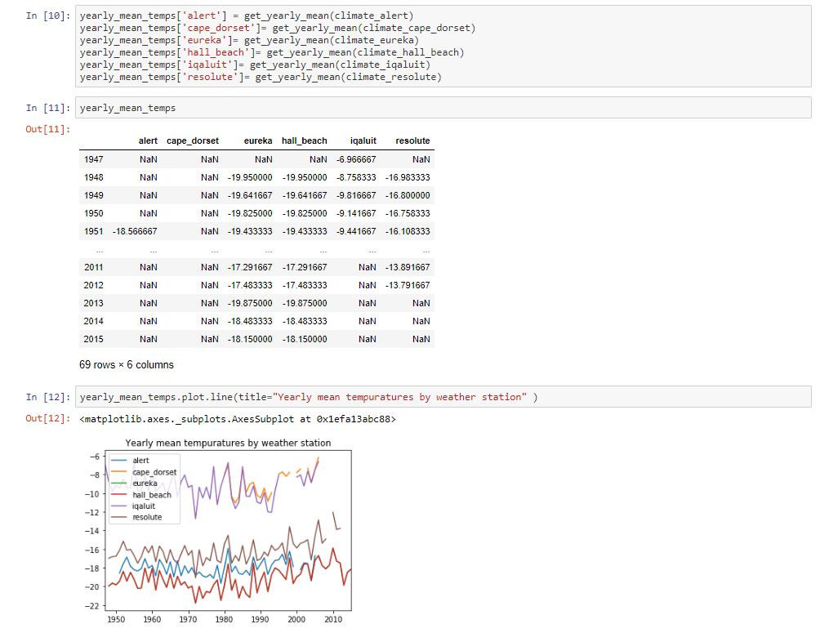
Implementation
Created new DF with the yearly mean temp across several weather stations
Plotted DF

Slide 7
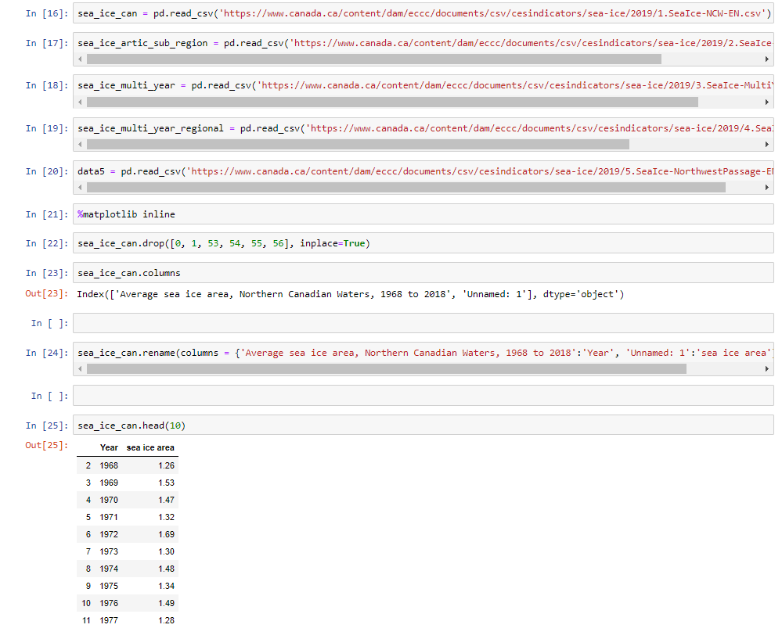
Implementation
Creating DF’s for Sea Ice levels across various regions in Northern Canada
Extracting information for only sea ice area relative to year

Slide 8
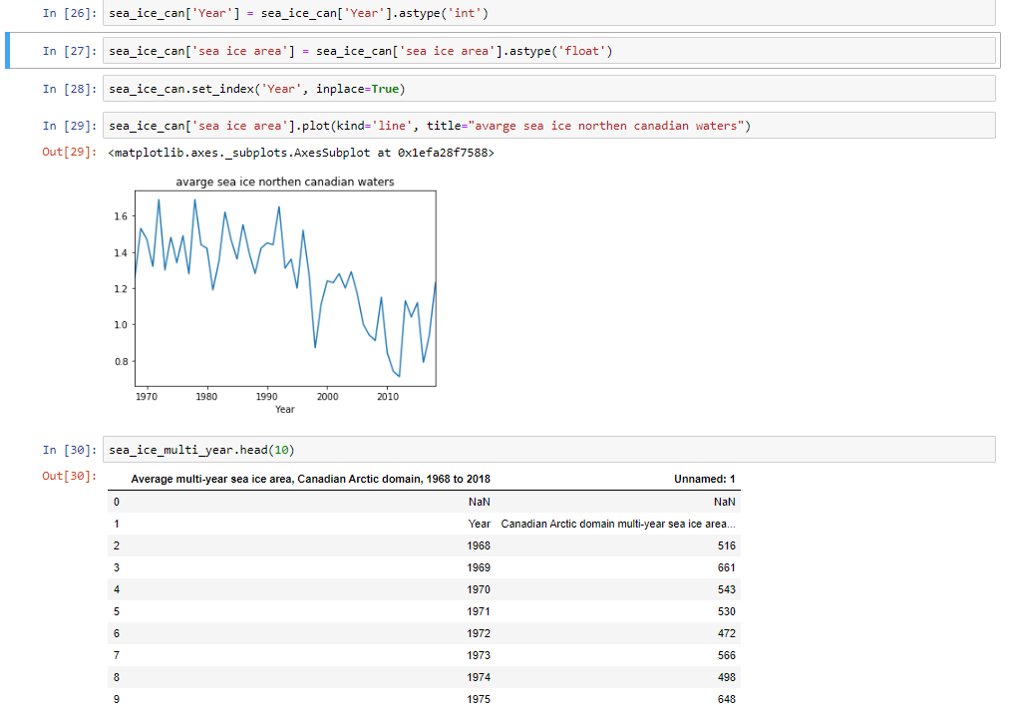
Implementation
Plotting the prior extracted information about sea ice area across Northern Canadian Waters

Slide 9
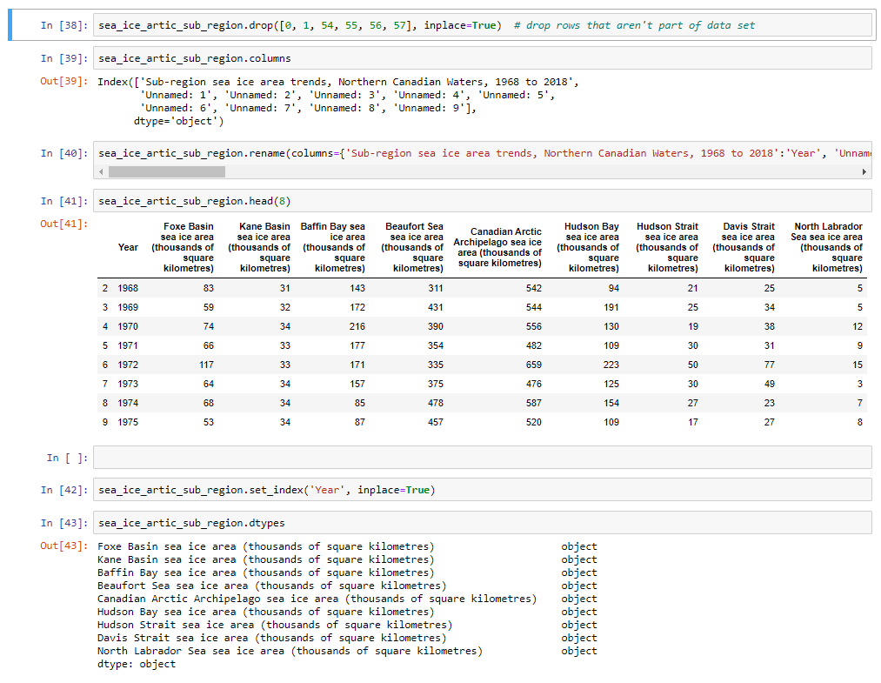
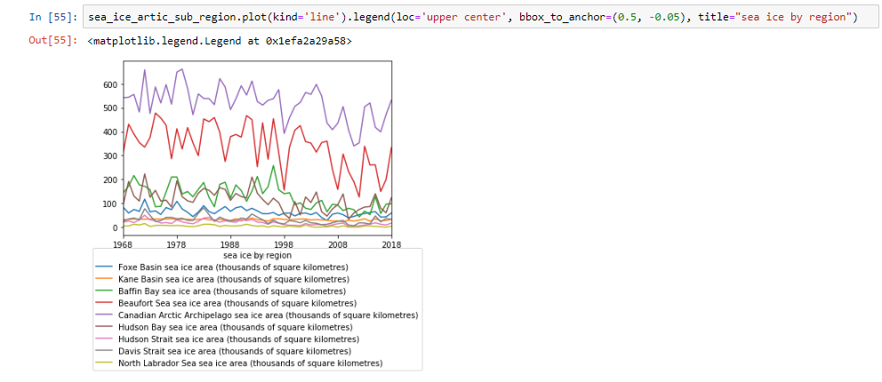
Implementation
Observing our new DF with average annual sea ice levels across various locations in Northern Canada
Observing the data types of all these columns
The years are made the index of the DF
The columns are casted to become integers
Information is plotted

Slide 10
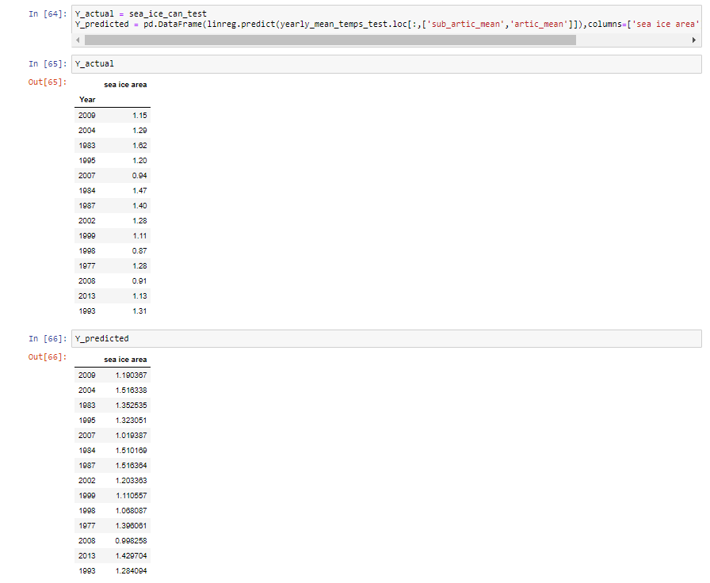
Implementation
Displaying our actual versus our predicted results

Slide 11
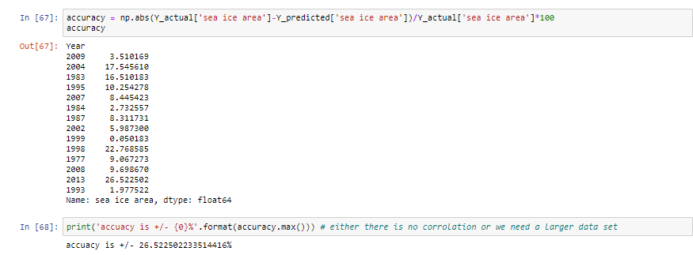
Implementation
We had an accuracy of roughly 26% on our first run

Slide 12
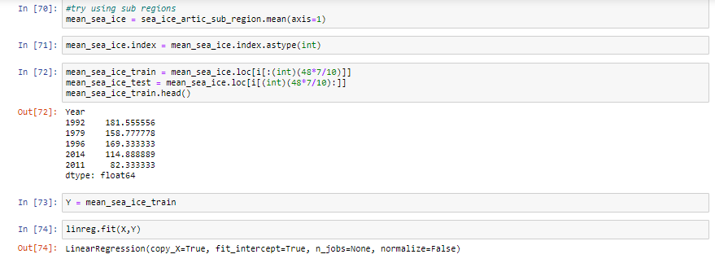
Implementation
We tried running our model again but on the arctic sub region instead

Slide 13
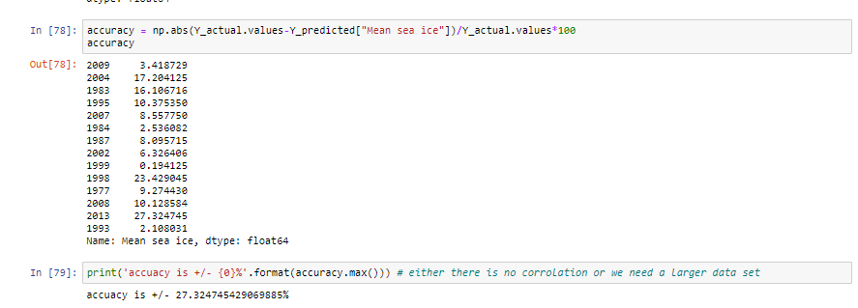
Implementation
Our model with a different set of data gave us roughly a 27% accurate prediction for sea ice levels

Slide 14
Analysis
Our results did not give us an accurate prediction
Upon further research, we discovered that temperature is a minimal factor in predicting sea ice levels
Major factors include; sea water temperatures, wind patterns, and cloud coverage for a given region
Major factor datasets for our model were not able to be found or are not publicly available for Northern Canadian regions
Data could potentially be made more accurate if it covered smaller regions (As opposed to a large arctic or subarctic region)

Slide 15
Conclusion
Temperature alone cannot accurately predict Sea Ice Area Levels in Northern Canadian regions
Future models could be made more accurate upon having access to data regarding water temperature, wind patterns and cloud coverage

