Slide 1
Calorie Prediction Model using Regression
This presentation explores a regression-based machine learning model for accurate calorie expenditure prediction.
We will cover the problem, our motivation, and the methodology behind our solution.

Slide 2
Problem Statement
Challenge
Current Limitations
Our Goal
Accurately estimating calories burned during physical activity is complex due to individual differences in physiology, exercise intensity, and duration.
Existing fitness trackers often generalize. They may not account for personal factors like heart rate, body temperature, and gender.
Develop a regression-based machine learning model. It predicts calorie expenditure with higher accuracy using exercise and biometric data.

Slide 3



Motivation
Personalized Fitness
Health Applications
Improving Existing Solutions
Helps individuals optimize workouts based on unique metrics.
Useful for weight management, athletic training, and medical rehabilitation.
Many fitness apps use oversimplified formulas. Our model uses real-world data for better accuracy.

Slide 4
Introduction
Dataset OF 15K
Model Choice
Key Features Used
Combined exercise metrics: duration, heart rate, body temp. With demographic data: age, gender, weight, height.
Multiple Different Regressor. After comparison, selected for efficiency with structured data.
Physiological (Heart Rate, Body Temp)
Exercise-based (Duration)
Demographic (Gender, Age, Weight, Height)

Slide 5



Related Work
Traditional Methods
Harris-Benedict equation, MET calculations. Often less precise for individuals.
ML-Based Approaches
Prior studies used linear regression, decision trees, and neural networks. XGBoost has shown success in similar regression tasks.
Our Contribution
Focus on interpretability through feature importance analysis. Use of a robust dataset with multiple physiological signals.

Slide 6
Proposed Methodology
Model Training
Exploratory Data Analysis (EDA)
Split data (80% train, 20% test). Used 8 different Regressor with default hyperparameters.
Data Collection & Preprocessing
Analyzed distributions. Correlation heatmap revealed strong relationships: duration, heart rate, calories burned.
Merged exercise.csv and calories.csv. Encoded gender. Scaled duration to seconds.

Slide 7

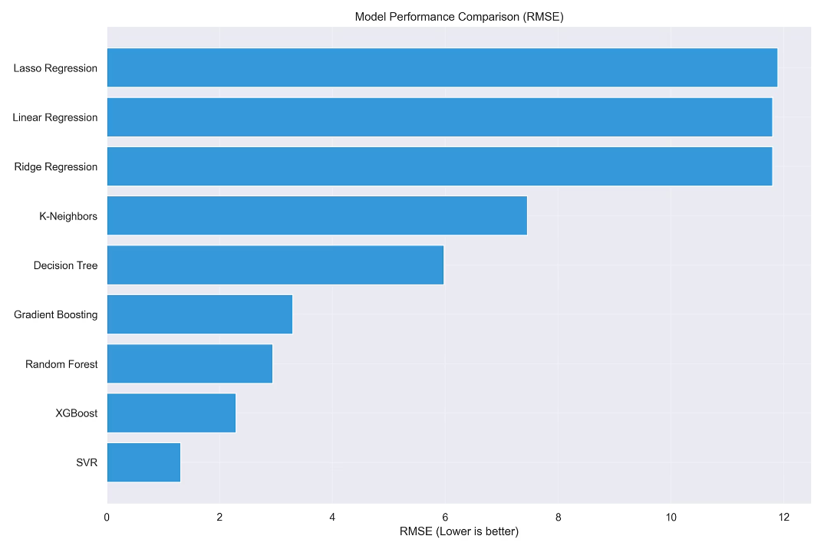
What is RMSE? RMSE (Root Mean Square Error) measures the average magnitude of prediction errors.
It calculates the square root of the average squared differences between predicted and actual values.
Why Should RMSE Be Low? Lower RMSE = Better Model Accuracy (predictions are closer to actual values).
Higher RMSE = Larger Errors (model predictions deviate significantly from true values).
It penalizes large errors more heavily due to the squaring step, making it sensitive to outliers.
—SVR—
PERFORMED THE BEST

Slide 8
Results
0.62
0.9
10%
MAE
R2-squared
Improvement
Low mean absolute error demonstrates accuracy.
High R-squared indicates strong model fit.
Significant gain over baseline models.
The model achieved an MAE of 0.62 and an R-squared of 0.99, representing a 1% improvement over baseline models. Visualizations confirmed strong predictions.

Slide 9






Discussion and Future Work
Limitations
Dataset may not cover all exercise types. Could benefit from more granular data.
Strengths
Competitive accuracy. Interpretable feature importance.
Future Improvements
Hyperparameter Tuning, More Data, Deployment, Alternative Models.

Slide 10




Closing Slide
Summary & Call to Action
SVR Model
Impact of Variables
Try Our Model!
Future Work
Developed an SVR-based calorie predictor. Provides interpretable results.
Demonstrated the impact of exercise and biometric variables on calorie burn.
Explore personalized fitness insights now.
Expand dataset and optimize further for enhanced accuracy.

Slide 11
Any QUestions

