Slide 1
Assembler Directives
Pseudo-operations
do not refer to operations executed by program
used by assembler
look like instruction, but “opcode” starts with dot
Opcode | Operand | Meaning
.ORIG | address | starting address of program
.END |  | end of program
.BLKW | n | allocate n words of storage
.FILL | n | allocate one word, initialize with value n
.STRINGZ | n-character string | allocate n+1 locations, initialize w/characters and null terminator

Slide 2
LC-3 TRAP Routines(service routines)
GETC (TRAP x20)
Read a single character from KBD.
ASCII copied in R0, R0[15:8] cleared.
OUT (TRAP x21)
Write R0[7:0] to screen.
PUTS (TRAP x22)
Write a string to screen. String address in R0.
IN (TRAP x23)
Print a prompt on the screen and read a single character from KBD.
Character is echoed to Display. ASCII copied to R0[7:0] and R0[15:8] cleared.
HALT (TRAP x25)
Prints message on screen & halts execution.
x0000
:
:
x0020
x0400
x0021
x0430
x0022
x0450
x0023
x04A0
x0024
x04E0
x0025
xFD70
:
:
x00FF
The LC-3 System
Control Block

Slide 3
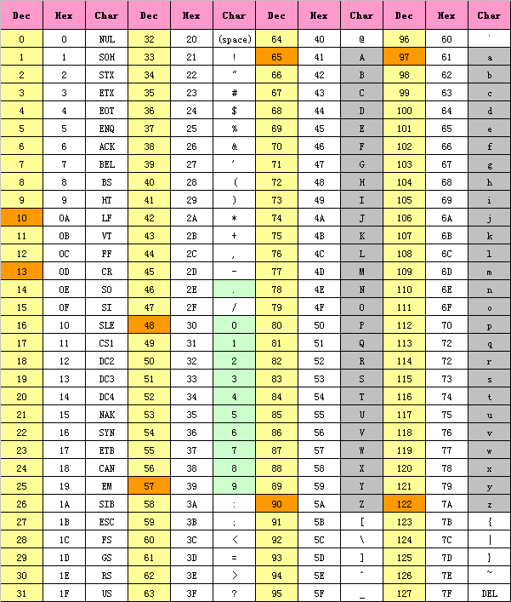
ASCII（American Standard Code for Information Interchange）

Slide 4
1 输出字符串
.orig x3000
lea r0, STRING
puts
halt
STRING .stringz “hello world!”
.end

Slide 5
2 循环读入字符并回显
.orig x3000
LOOP getc
out
jsr LOOP
halt
.end

Slide 6
3 读入字符并保存
.orig x3000
getc
st r0, SAVE
halt
SAVE .blkw 1
.end

Slide 7
4 数字转换为ASCII码并显示
.orig x3000
ld r0, NUMBER
ld r1, ZERO
add r0, r0, r1
out
halt
NUMBER .fill #3
ZERO .fill x30
.end

Slide 8
5 循环与跳转1
.orig x3000
ld r0, COUNTER
LOOP add r0, r0, #-1
brp LOOP
halt
COUNTER .fill #10
.end

Slide 9
6 循环与跳转2（保存一个两位十进制数的十位到r0）
.orig x3000
and r0, r0, 0
ld r1, NUMBER
ld r2, Neg10
LOOP add r1, r2, r1
brn End10
add r0, r0, #1 ; add one to digit
brnzp LOOP
End10 halt
NUMBER .fill #68
Neg10 .fill xFFF6 ; -10
.end

